Slide 1
Most Random Gene Expression Signatures are Significantly Associated with Breast Cancer Outcome
Venet, et al.
PLoS Computational Biology, 2011
Molly Carroll

Slide 2
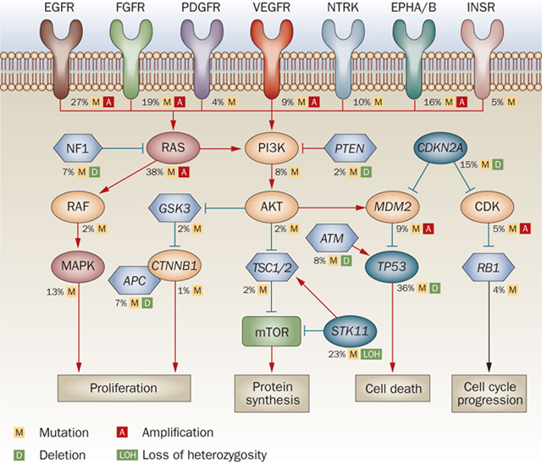
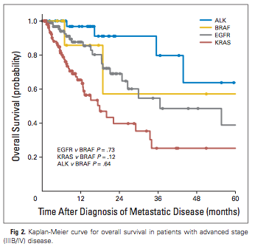
Biomedical Research Methods
Characterize mechanism in the model
Derive a marker that changes when the mechanism is altered
Show correlation of marker with disease outcome
Hazard Ratio:
chances of an event (death) occurring in variable condition
chances of an event (death) occurring in control condition
Ding, L. et al. Nature (2008).
Paik, PK. et al. Journal of Clinical Oncology (2011)

Slide 3
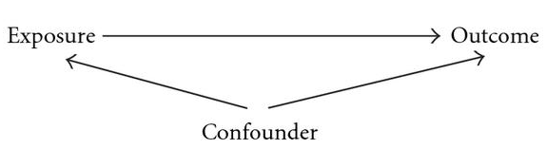
Confounding Variable Problem
Some signatures are markers of mechanisms- ie. Epithelial mesenchymal transition
Several signatures have equivalent prognostic outcome
Are all mechanisms independent drivers or is there a confounding factor?
(Proliferation?)
Notes:
Give example of the exposure being ownership of TV
Outcome is longer life expectancy
Confounder: gross national product per capita

Slide 4
Advances made in Methods
Step 2: Increase in genome-wide expression profiling leading to automated screen for markers and increased signatures
Step 3: Rise of cohorts with genome-wide expression profiles and patient follow-ups
Need to test negative controls to check relation of signature to outcome
Typical: Signature of interest more strongly related to outcome than signature of no oncological rationale
Proposed: Random signature is more likely to be correlated with cancer outcome than not

Slide 5
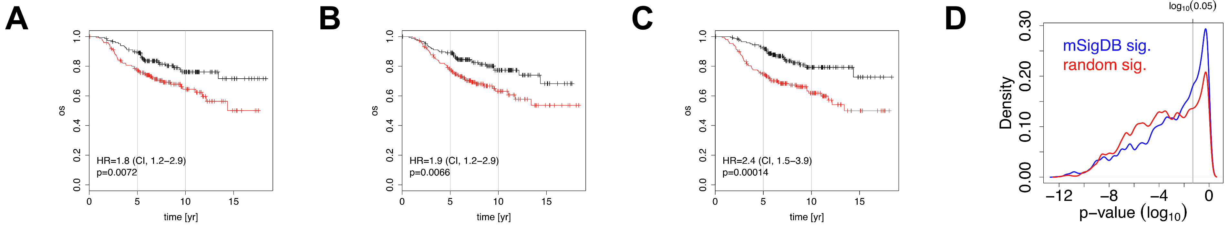
Results- Fig 1
Post-prandial laughter sig.
Localization of skin fibroblasts sig.
Social defeat in mice sig.
Notes:
Figure 1:
Signature significance in correlation with breast cancer outcome tested in the NKI cohort (295 patients)
1. sig on the effect of postprandial laughter on PBMCs
2. Sig of skin fibroblast localization
3. Sig of social defeat obtained from mice brains
All signatures from different sources– rationale does not suggest connection with cancer
Black= group of cohort that does not have sig
Red= group of cohort that does have sig
There is significance between the two conditions in each case in terms of their outcome and whether you do or don’t possess that signature.
Figure 1D: decided to increase the number of signatures tested so they used the MSigDB c2 signatures (1890 sig) that encompass all fields of biomedical sciences
67% of c2 sig. were significantly associated with breast cancer outcome at p<0.05, 23% at p<0.00001
c2 category may be enriched for cancer-related signatures so they compiled corresponding signatures to those in C2 that are of equal # of genes for each signature but contained random genes from the human genome. 77% of these random signatures were significant at p<0.05
Therefore: p value of .05 or .00001 is no more related to outcome than a random set of genes

Slide 6
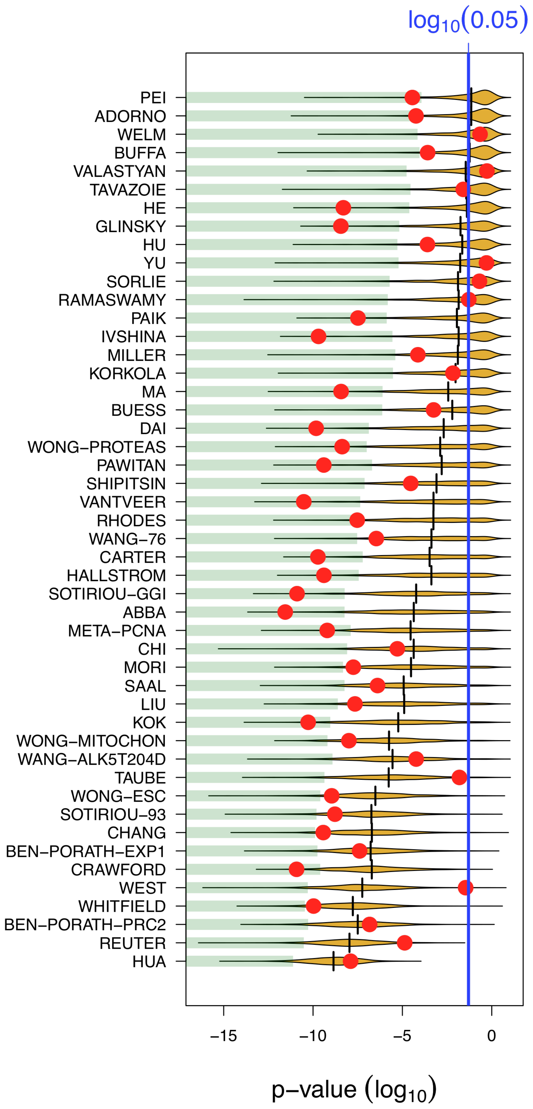
Results- Fig 2
Compared published breast cancer signature p-value of association with random signatures of equal size
Used NKI cohort of patients
Increasing size
Notes:
Red dot= p value of association of the published signature
Yellow= distribution of p-values for 1000 random sig. of equal size
|= median p value of randomized signatures
Some Smaller signatures do not show a significance between signature and outcome; Those that do often have a lower p value than the median of the randomized signatures
Larger published signatures have smaller p values; however, the randomized signatures of equal size tend to have a distribution of smaller p values as well, with median p value of random decreasing with increasing size. (trend of yellow distribution and median lines)
In some cases the median p value of random sig. is smaller than the published cohort

Slide 7
Methods: Meta-PCNA and Data Adjustment
Samples (j)
m-PCNA index
Pearson correlation between PCNA and all genes in by Ge et al. via genome-wide expression profiling of healthy tissues
131 genes were top 1% that correlated with PCNA=> meta-PCNA sig.
m-PCNA index of tissue: median expression of the genes
Used linear regression (R’s ‘lm’ function) to fit a sample’s individual gene expression to m-PCNA gene
g_{i}
g_{ij}
Genes
m-PCNA weight
Residual_ j
g_ij=weight*(mPCNAj) + intercept +error_ij
adj_g_ij = avg(g_i) + error_ij
Notes:
For each gene (g_i), the patient’s individual expression level will vary by some amount from the mean. They decompose this variation into two components: the scaling of the mPCNA signature (weight) and the sample specific residual. The weight or scaling paramater, or the slope found from the regression, is the same across all samples for that specific gene.
When the sample’s individual gene expression is adjusted in the second plot, the dependence of expression of g_ij is on mPCNA is gone

Slide 8
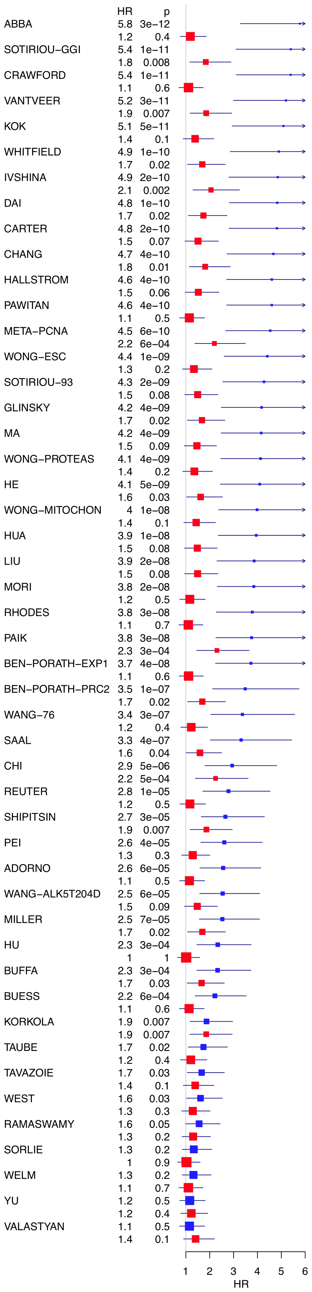
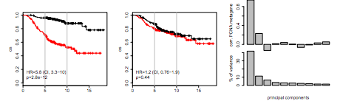
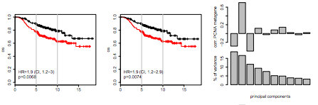
Results: Figure 3 and Supplmental
Abba Signature
Korkola Signature
Notes:
By adjusting the data for meta-PCNA, majority of the published signatures tested in Fig 2 have a decreased hazard ratio.
When they computed the first principle component of the signatures and split the cohort according to media of PC1, those whose first principle component was highly positively or negatively correlated with PCNA metagene had their hazard ratios decreased (Abba signature)
Korkola did not change significantly but its original hazard ratio was low.
Those with low initial hazard ratios were less affected by mPCNA adjustments
In general, hazard ratios were lowered and p values for correlation of outcome increased

Slide 9
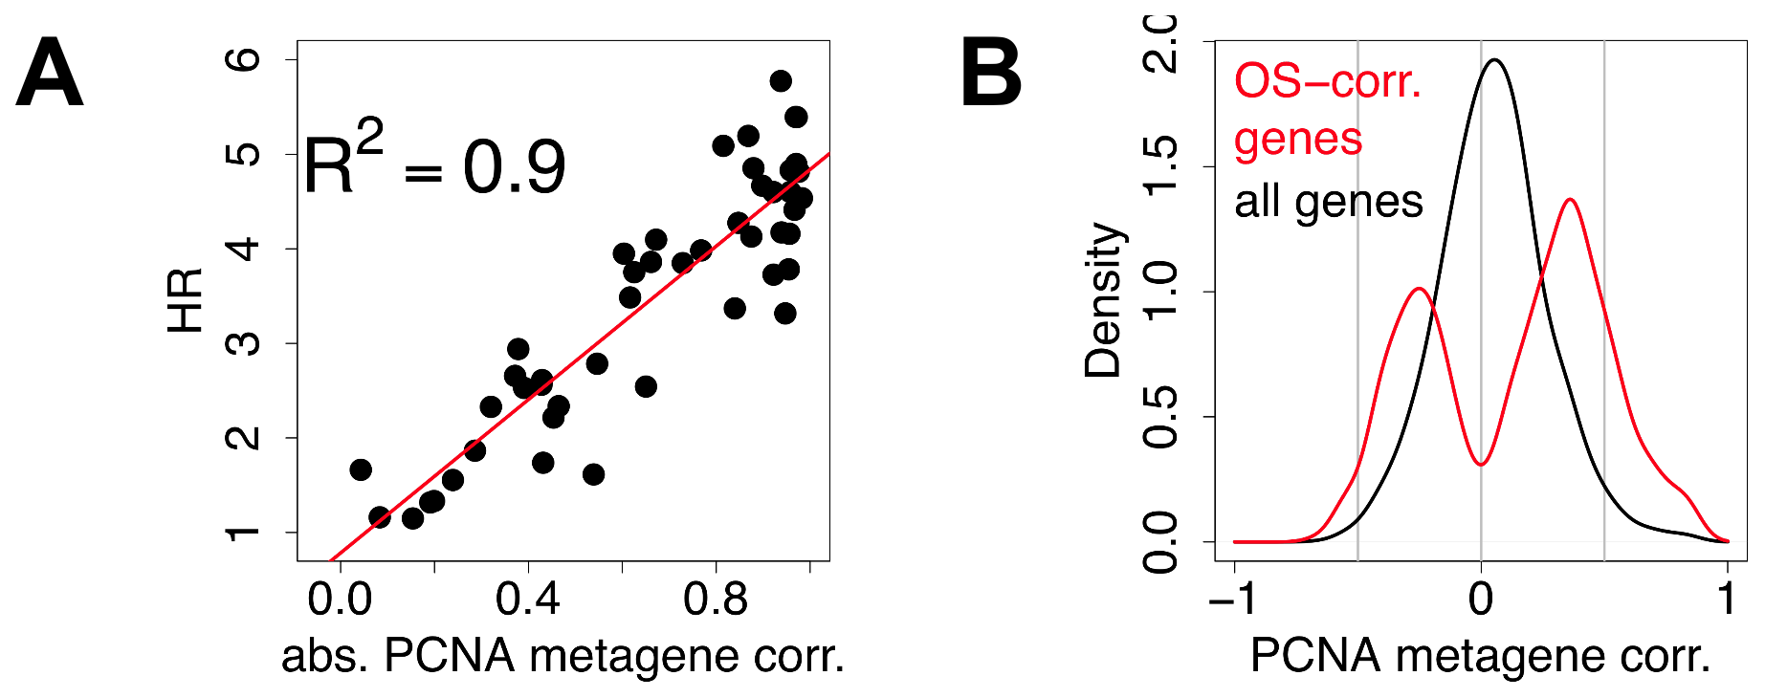
Results: Figure 4
Notes:
These plots are a different way to show dependence on PCNA for survival or hazard ratio
Shows that high hazard ratios are linearly correlated with +/- correlation of the 1st PC of the signature with mPCNA
Shows that genes associated with overall survival are split into two groups– greatly positively correlated or negatively correlated with PCNA metagene
Any predictor resting on a linear combination of genes associated with outcome has a high probability to be confounded by proliferation

Slide 10
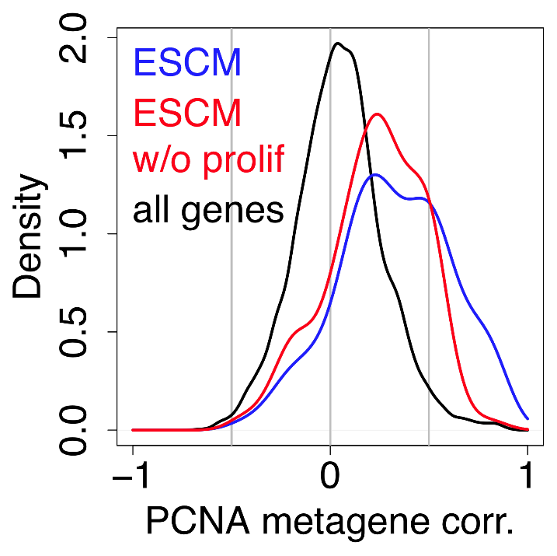
Results: Figure 5
ESCM: signature of gene sets associated with embryonic stem cell identity from Wong et al.
Purging of cell cycle genes did not eliminate high correlation of ESCM with PCNA metagene
Correlations with meta-PCNA extend far beyond cell-cycle genes
Notes:
Removing cell cycle genes fails to rule out the confounding effect of proliferation
A signature does not have to be enriched with cell cycle genes to convey strong cell proliferation signal

Slide 11
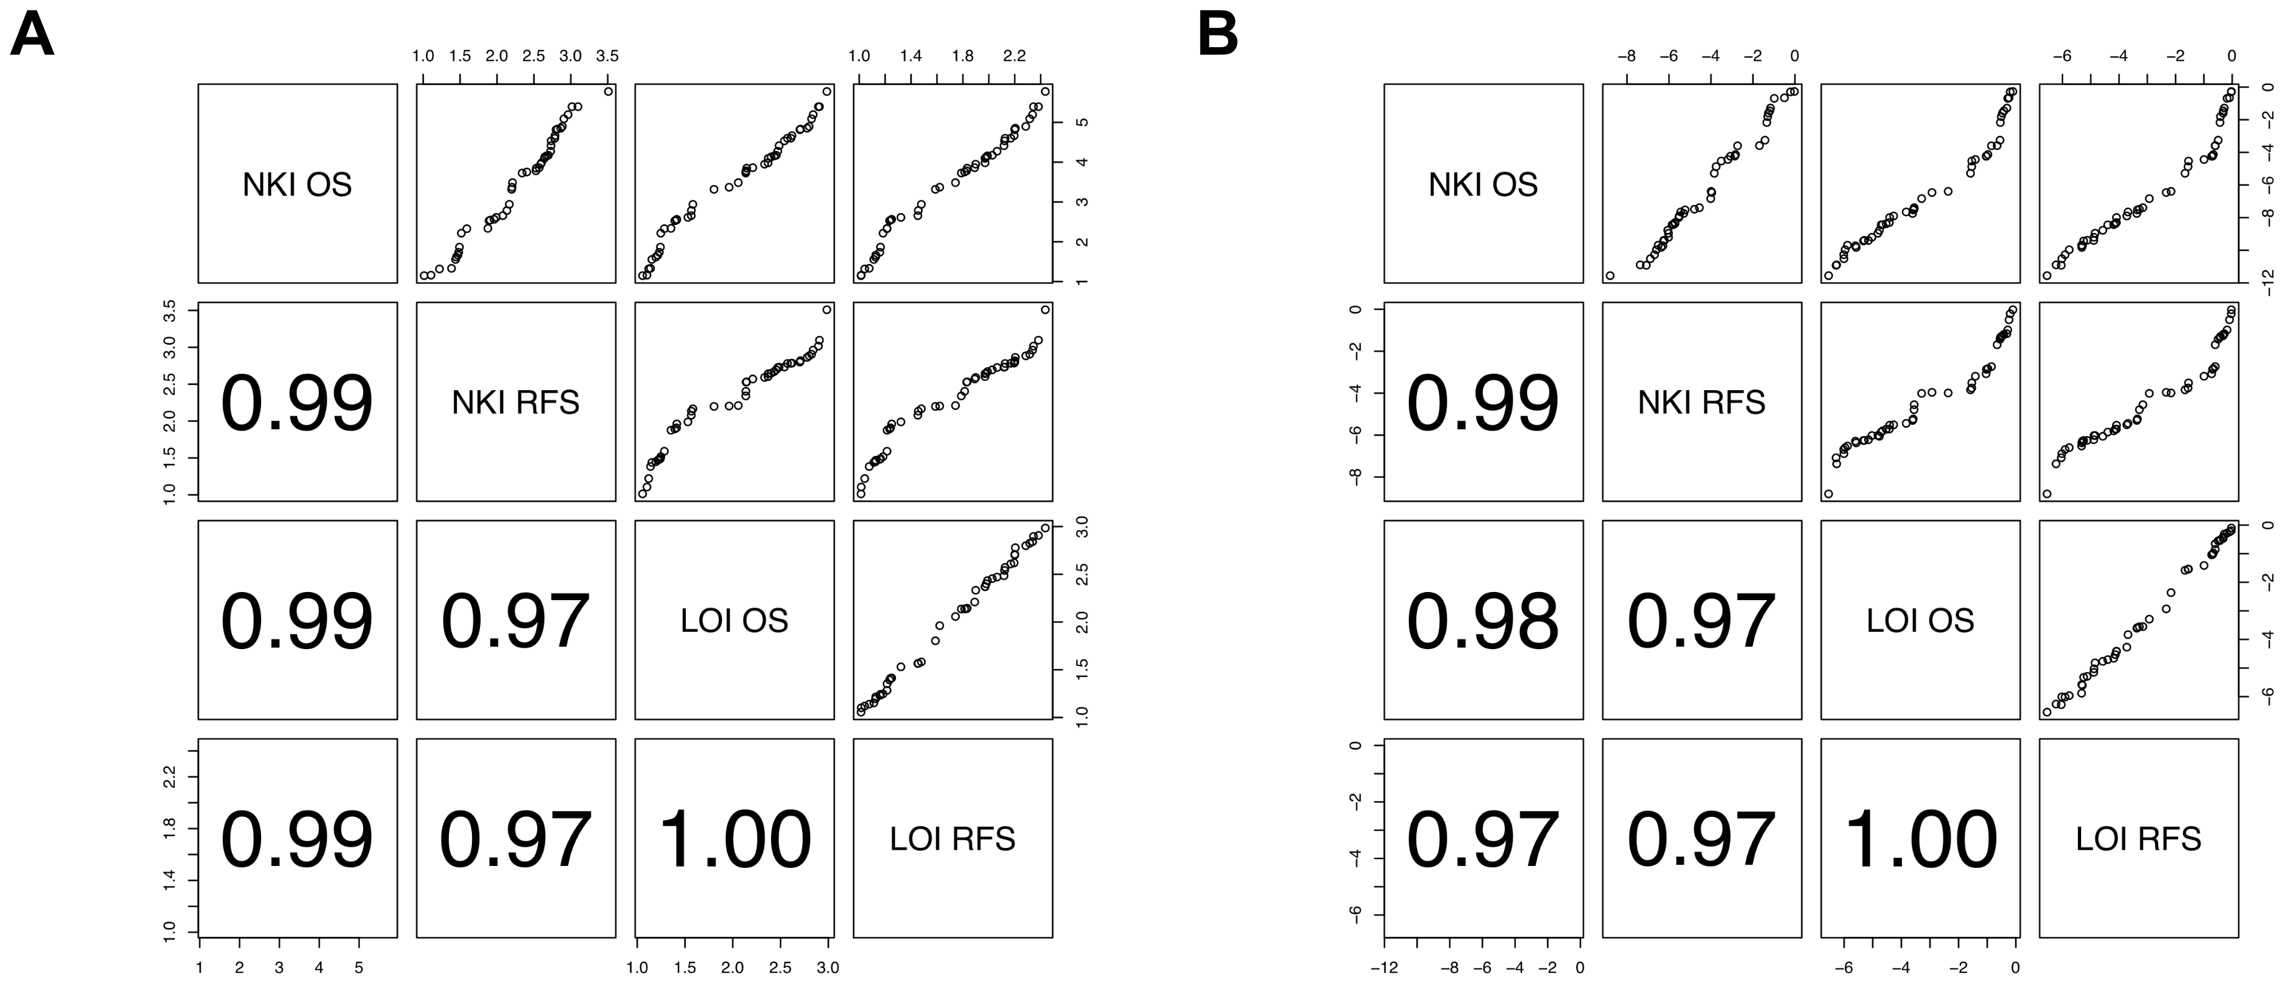
Results: Figure 6
Hazard Ratio
Log rank p-values
Notes:
All results are robust to data (cohort– either NKI or LOI) and now you can calculate odds survival
Re-ran the analyses using recurrence-free survival and using another cohort using both overall survival and relapse-free survival
40% of MSigDBc2 sig. and 5% of all genes are associated with outcome
At most, 40% of the 47 published sig. are better than the 5% best same-size random signatures
Of the 47 studies in the panel, some developed arguments of the signatures independent of outcome association– some used it as a tool to discover driver DNA copy number abberations, which were then investigated in full
Many of the studies extrapolated the results from animal or invitro models to human in vivo cancer

Slide 12
Conclusions and Moving Forward
Random single and multiple genes expression markers have high probability to be associated with BC outcome
Most published signatures are not significantly more associated with outcome than random signatures
Meta-PCNA metagene integrates most of the outcome-related information in BC transcriptome
This information is present in 50% of the transcriptome and can’t be removed by purging cell cycle genes from a signature
Development of larger cohorts with various sub-types of a cancer included may help find better prognostic signatures
  The NKI cohort represented bulk tumors from a wide spectrum of patients
  Couldn’t use NKI cohort to detect transcriptional signatures in specific cells (stromal, epithelial, etc) or patient groups (ER+, HER2 amplification)

