Slide 1
Dissecting cancer heterogeneity with a probabilistic genotype-phenotype model
Anthony Gitter
Cancer Bioinformatics (BMI 826/CS 838)
May 5, 2015
All figures from Cho2013 unless noted otherwise

Slide 2
Class business
Project presentations Thursday
Guidelines on website
Project report due May 11
How to schedule presentation order?

Slide 3
Inspiration from CMapBatch
Chris rank | 1
Jiayue rank | 4
Network stratification project rank | √4 (1)
Anita rank | 7
Vee rank | 6
Survival prediction project rank | √42 (3)
Taylor rank | 3
Haixiang rank | 5
Erkin rank | 2
Clustering pipeline project rank | √15 (2)
Outlier

Slide 4
Subtyping in cancer
Substantial differences across tumors even within one type of cancer
Molecular alterations
Survival outcomes
Response to therapy

Slide 5
Traditional subtyping
Learn gene expression signature to distinguish classes
AML vs ALL
PAM50 for breast cancer
Glioblastoma (GBM) Verhaak2010

Slide 6
GBM subtypes
Learn class centroids with ClaNC (classification to nearest centroids)
t-test statistic to identify genes
210 genes per class in GBM
Neural subtype has been criticized
Verhaak2010

Slide 7
Many analyses depend on subtypes
MutSig or other enrichment tests

Slide 8
Many analyses depend on subtypes
Group lasso in regulator regression
Setty2012

Slide 9
Many analyses depend on subtypes
DIGGIT functional CNV association test
Chen2014

Slide 10
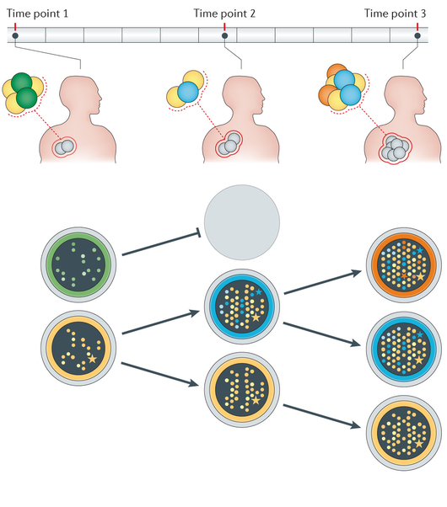
Problem with subtype classifiers
Cancer and individual tumors are heterogeneous
Ding2014

Slide 11
Heterogeneity in expression classification
Single-cell RNA-seq shows a single GBM tumor is composed of cells from multiple subtypes
Patel2014

Slide 12
Prob_GBM: mixtures of subtypes
Patients are mixtures of subtypes
Subtypes are mixtures of genomic factors
Sound familiar?

Slide 13
Relation to Non-negative Matrix Factorization
Network-based stratification
Similar concepts, different strategies
Hoffree2013

Slide 14
Prob_GBM model
Gene expression is a molecular level phenotype
Treated as effect of disease, not cause
Patient-patient similarity based on expression
Genomic factors cause disease
Mutations, CNV, miRNAs
Expression similarities explained by genomic similarities

Slide 15
Build patient-patient similarity network

Slide 16
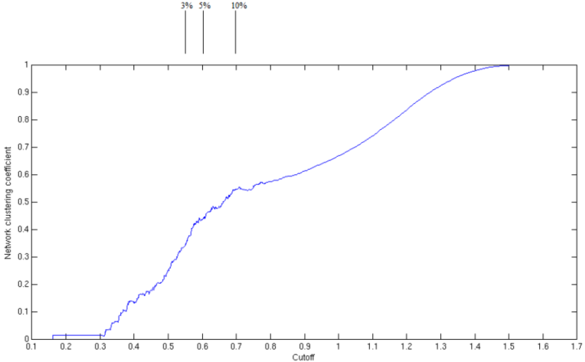
Choose co-expression threshold

Slide 17
Learn subtype distributions

Slide 18
Likelihood of edge between similar patients from subtype assignments

Slide 19
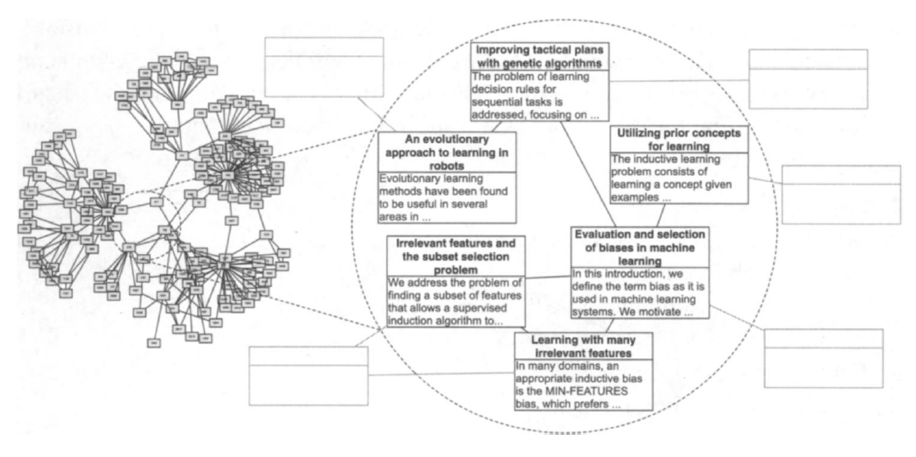
Inspired by relational topic model
Documents are bags of words
Document-document citation network
Chang2010

Slide 20
Mapping to cancer domain
Documents = patients
Bag of words = bag of genomic alterations
Document citation link = patient-patient co-expression above some threshold

Slide 21
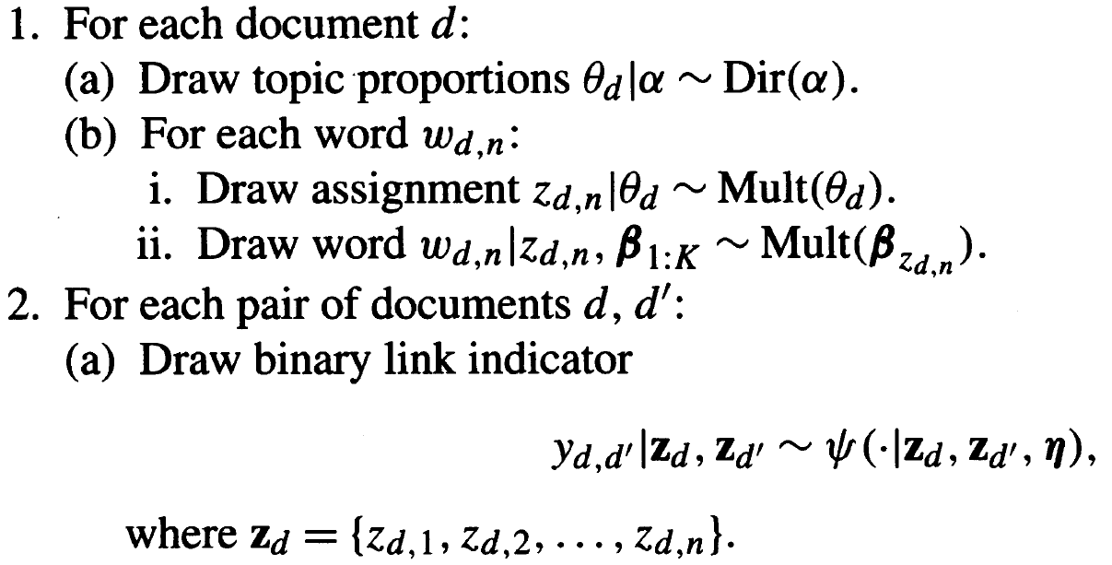
Generative probabilistic model
patient
d -> p
w -> g
subtype
“gene”
“gene”
patients
Chang2010

Slide 22
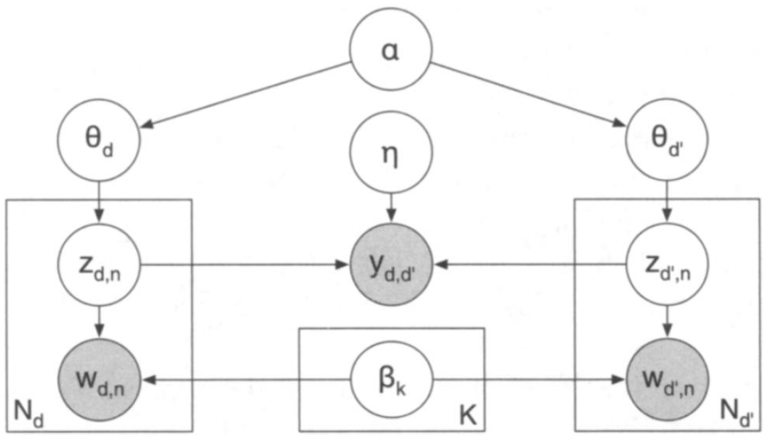
Generative probabilistic model
Chang2010
γ

Slide 23
Prob_GBM distributions
Joint distribution
Posterior distribution of the latent variables

Slide 24
Model estimation
Cannot maximize posterior exactly
Gibbs sampling generates samples from this distribution
Two Gibbs sampling references:
1 page summary
231 slide tutorial

Slide 25
Latent variables of interest
Subtype distributions per patient p
Distributions of genomic alteration n under subtype k

Slide 26
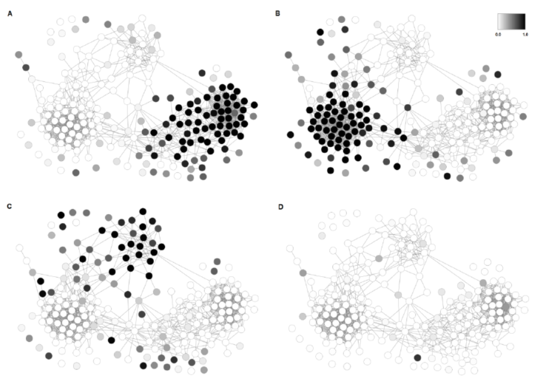
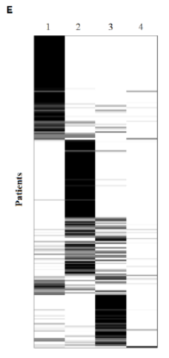
Visualizing patient distributions

Slide 27
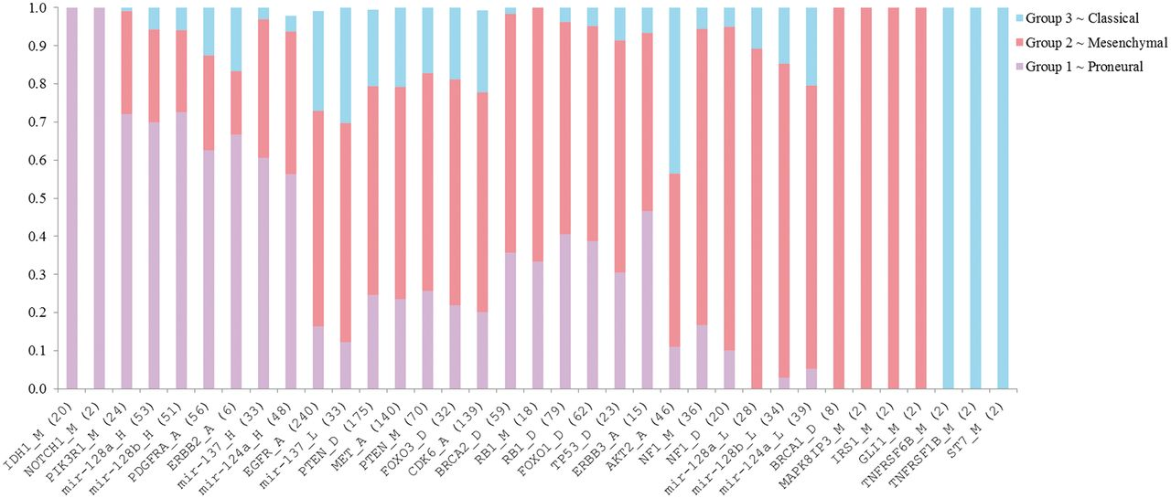
Visualizing genomic alteration distributions

Slide 28
Assigning patients to subtypes

Slide 29
Neural is mixture of subtypes

Slide 30
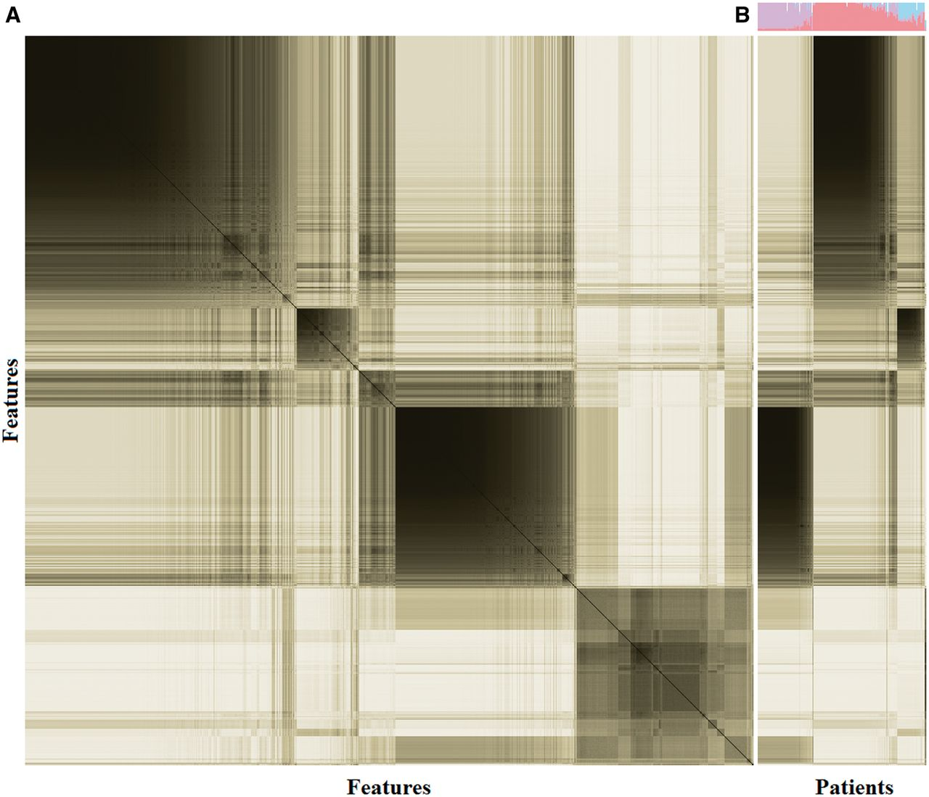
Stability of subtype assignments

Slide 31
Ultimate patient-subtype, alteration-subtype associations

