Slide 1
Simultaneous Identification of Multiple Driver Pathways in Cancer
Mark D. M. Leiserson, et.al

Slide 2
Goal
To distinguish the functional driver mutations responsible for cancer development from the random passenger mutations that have no consequences for cancer.

Slide 4
Multi-Dendrix
Dendrix – De novo Driver Exclusivity
Important Assumption:
1) High Coverage- most patients have at least one mutation in the set, i.e, set of potential mutated genes of a particular pathway
2) High Exclusivity- nearly all patients have no more than one mutation in the set
Notes:
No prior knowledge of pathway or interactions between genes
Dendrix method is different from MeMo method that was discussed last Thursday, which indentify recurrently mutated subnetworks in protein protein interaction
Based on prior biological knowledge, such as known pathways
So why is De novo algorithm important? Because there is no complete knowledge of gene and protein interactions in human and the existing pathway databases and interactions networks do not precisely represent the pathways and interactions that occur in a particular cancer cell. Since the de novo assume no prior knowledge, so it can be used for novel biological discoveries.

Slide 5
Justification by the author
From Vandin, et al, 2012

Slide 6
Notes:
By exclusivity definition: this pathway can be altered by a single gene mutation.

Slide 7
Dendrix - Method
From Vandin, et al, 2012
Notes:
Mutation Definition: A mutation class is a grouping of different mutation types at a specific genomic locus, meaning single nucleotide variants, copy number aberrations in the same locus are considered the same. The goal is to find a set of mutations where the set satisfy two properties, the set has high coverage with many patients having a mutation in the set; the set exhibits a pattern of mutual exclusivity where most patients have exactly one mutation in the set.

Slide 8
Dendrix Method
Maximum Coverage Exclusive Submatrix Problem: Given an m*n mutation matrix A and an integer k>0, find a mutually exclusive m*k submatrix of M of k columns (genes) of A with the largest number of nonzero rows (patients).
Coverage Overlap
Denote the set of patients in which g is mutated


Denote the set of patients in which at least one of the genes in M is mutated
Weight
From Vandin, et al, 2012
Notes:
Due to the trade off between requiring mutual exclusivity in the set and obtaining large coverage, they made a formula to quantify the trade off between coverage and exclusivity. The weight is the difference between the coverage and coverage overlap of M.

Slide 9
Dendrix Method
Maximum Weight Submatrix Problem: Given an m * n mutation matrix A and an integer k >0, find the m * k column submatrix M of A that maximizes W (M).
Problem
Computationally Difficult to Solve
Size k = 6 of 20,000 genes
10^ 23 subsets
Solution
A greedy Algorithm for independent genes
Markov Chain Monte Carlo (MCMC)
From Vandin, et al, 2012
Notes:
Start with the best pair M of genes and then to iteratively build the set M of genes by adding the best gene.
The basic idea of the MCMC is to build a Marko chain whose states are the collections of k columns of the mutation matrix A and to define transitions between the states that differ by one gene.

Slide 10
Limitation of Dendrix
Mutations in different pathways may not be mutually exclusive.
Mutations in different pathways may exhibit significant patterns of co-occurrence across patients.
Solution -> Multi-Dendrix Algorithm

Slide 11
Multi-Dendrix Algorithm
1) Find sets of genes with high coverage as an integer linear program (ILP)
2) Generalize the ILP to simultaneously find multiple driver pathways
3) Additional Analysis: Subtype-specific mutations, stability measures, permutation test, compute enrichment states

Slide 12
The Multi-Dendrix Pipeline
Notes:
Process single nucleotide variant data, and copy number variant data. Combine both
Consider a reasonable range of values for these parameters and summarize the results over these parameters into modules.
Build a graph, each node is individual gene. Weight each edge with the fraction of parameter values for which the pair of genes appear in the same gene set. The resulting edge-weighted graphs provide a measure of the stability of the resulting gene sets over different parameter values. More..
For subtype-specific mutation: Examine possible correlations between the mutually exclusive sets reported by Mutil-Dendrix and particular subsets of samples. a number of cancers are divided into subtypes according to pathology, cytogenetics, gene expression.
Assessing stability of results across different number and size of pathways.
For statistical significance:
1) Compare weight collection output to an randomly permuted data to evaluate the statistical significance of results.
2) evaluate whether the collection output by Multidendrix contains more protein protein interctions than expected by chance using direct interaction test. (details on paper)

Slide 13
Multi-Dendrix Method - the same as the first step of Dendrix
Maximum Coverage Exclusive Submatrix Problem: Given an m*n mutation matrix A and an integer k>0, find a mutually exclusive m*k submatrix of M of k columns (genes) of A with the largest number of nonzero rows (patients).
Coverage Overlap
Denote the set of patients in which g is mutated


Denote the set of patients in which at least one of the genes in M is mutated
Weight
Notes:
Coverage overlap = 0 when mutually exclusive

Slide 14
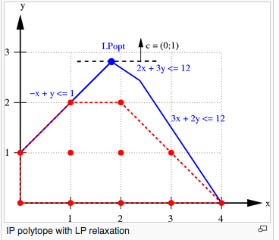
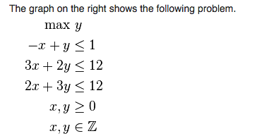
ILP- Integer Linear Programming
Mathematical optimization or feasibility program where variables are restricted to be integers
From Wikipedia

Slide 15
ILP for the Maximum Weight Submatrix Problem
Mutation matrix:
For each gene j, a gene set M is determined by
For each patient I, the coverage is determined by

Slide 16
⬅
Denote the set of patients in which g is mutated


Denote the set of patients in which at least one of the genes in M is mutated
Notes:
Coverage overlap = 0 when mutually exclusive
m = number of patients
k = number of genes in the set M

Slide 17
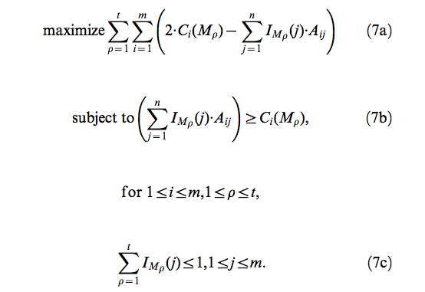
Multiple Maximum Weight Submatrices Problem
Multiple Maximum Weight Submatrices Problem: Given an m*n mutation matrix A and an integer t>0, find a collection M = { M1, M2, …., Mt} of m*k column submatrices that maximizes

Slide 18
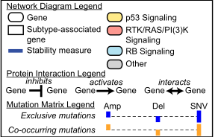
Multi-Dendrix Results on the GBM Dataset
Notes:
RB G1/S progression
Member of

Slide 20
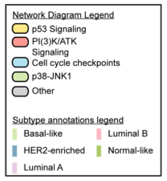
Multi-Dendrix Results on the BRCA Dataset

Slide 22
Thank you for your attention!

