Slide 1
The role of the SDAC in DMC meetings
Matt Downs

Slide 2
SDAC?
Statistics and Data Analysis Center
Also known as:
  Independent Statistical Reporting Group (ISRG)
  Independent Data Coordinating Center (IDCC)
  Data Reporting Group (DRG)
  Reporting Statistician
Group that prepares and presents the safety and efficacy reports reviewed by the DMC at is meetings

Slide 3
SDAC Statistician
AKA “reporting statistician” or “independent statistician”
Not part of sponsor/study management team
Collaborates with trial statistician on design of DMC reports
Produces Open and Closed Reports
Presents Closed Report, including formal interim analyses
Provides additional analyses as needed
Unblinded to by-treatment results
Does NOT make recommendations; is NOT a voting member of the DMC

Slide 4
Outline
Confidentiality & communication channels
DMC reporting process
Report structure and organization
At the meeting

Slide 5
Communication channels

Slide 6
Confidentiality
Interim data & DMC discussions must remain confidential
Leaks can affect trial integrity
  Recruitment
  Adherence
  Outcome assessment
Therefore, communication channels should be clear & simple

Slide 7
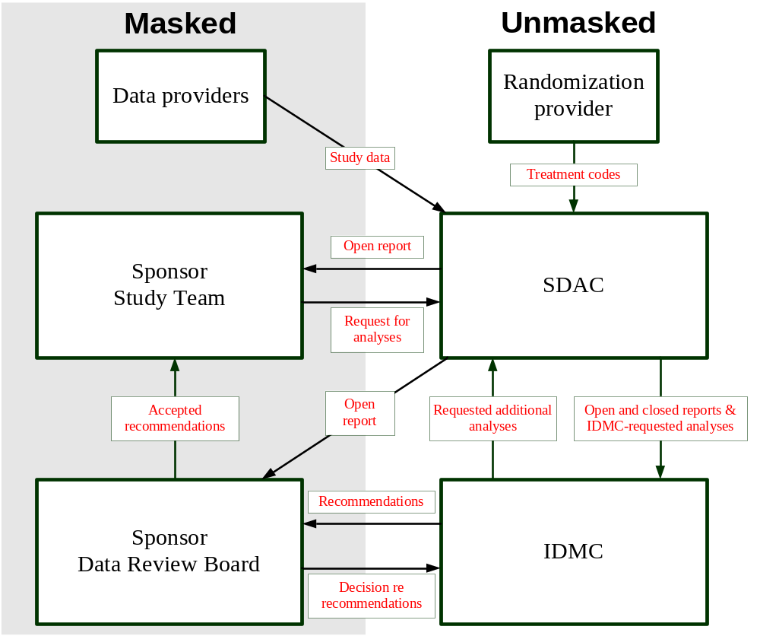
Typical communication flow

Slide 8
Meeting structure
(Introductory closed session)
Open session
Closed session
(Executive session without SDAC)
(Debriefing session)
() = denotes less common elements

Slide 9
Meeting structure
Open session
  Sponsor, Steering Committee, DMC, SDAC
  Study team provides update on:
    Trial status & recruitment
    Adjudication metrics
    Blinded observations on important safety findings
      However, experienced DMCs may be impatient with an extensive open-session data presentation; prefer to spend time on closed-session data
  No discussion by treatment arm
Closed session
  Unblinded review of DMC report with DMC and SDAC
  Draft of recommendation on future trial conduct

Slide 10
Meeting structure
A closed session may precede the open session
  Opportunity for DMC to form questions to pose to Sponsor in open session
Sometimes a “debriefing” session concludes the meeting where DMC:
  Asks questions of sponsors; OR
  Shares its recommendations; OR
  Both

Slide 11
Caution…
People can slip, especially on the phone during open session
Less experienced DMC members forget that they cannot disclose information
DMC members may open and refer to closed report during open session
SDAC staff should
  Remind attendees at start of open session of ground rules
  Remain vigilant during open session
Sponsors should not ask probing questions of DMC (e.g., when would you like to meet next?)
Some sponsors have SOPs that allow them to attend open sessions only by phone

Slide 12
Conveying DMC recommendations
Who receives recommendation?
  Sponsor executive or data review board
  Steering Committee Chair
Generally not a member of the study team
  Why not?
  Recipient serves as a firewall in case sponsor does not accept DMC recommendation outright
This means that ‘debriefing’ or open session following DMC deliberations may be ill-advised
  At the very least, discussions in debriefing sessions need to be particularly guarded
  Must be clear in advance if recommendations are to be shared during ‘debriefing’ session

Slide 13
Conveying DMC recommendations
Timing of recommendations
  Varies greatly between DMC charters
  SDAC often facilitates process
  Good model: conveyed verbally following meeting, with formal written recs following within 5 days
  Recommendations may take extended time to reach study team
Sometimes two versions prepared
  Abbreviated set for distribution to IRBs by sponsor
  More complete set that may contain guidance or requests from the DMC

Slide 14
Conveying DMC recommendations
All meetings generally have corresponding recommendations
  Possible exception are unscheduled (i.e., unplanned) DMC reviews
Recommendations generally do not include unblinded data
  Can be provided upon request following review of the recommendations
Sponsor should communicate acceptance of recs to DMC via SDAC

Slide 15
DMC reporting process

Slide 16
Open reports
Open (a.k.a. sponsor) report = report that presents only total counts and statistics pooled over treatment group
Purpose
  To inform study team about recruitment etc.
  To provide a common document for discussing issues during meeting’s open session
  To check accuracy of SDAC’s reporting
Dangers
  Potential to unmask recipients
  Compete with more important activities leading up to meeting
  May no longer reflect what DMC is seeing in closed report
    Requires two versions of programs – one for sponsor and one for IDMC

Slide 17
Open reports
Important to preserve the blind
  analyses should be presented by aggregating information across treatment groups and, usually, avoiding subject-level data (e.g., listings, etc.)
  Often send open report to Sponsor one day later than closed report
Different Sponsors request different amounts of data
  Only accrual, status and baseline data
  Plus limited follow-up data (e.g. AEs)
  Or, include all or most of the closed session analysis, in aggregate form
  Good to make clear to DMC what degree of access Sponsor will have at organizational meeting
If DMC requests specific analyses based on concern raised in closed session,
don’t include in Open Report

Slide 18
Materials for each DMC safety review
Protocol summary
Closed report
Copies of past meeting minutes
Charter
Informed consent form
Supplemental materials (electronic only)
Open report (electronic only)
Protocol, SAP, IB (electronic only)

Slide 19
Common closed report content
Executive overview
Data sources and currentness
Screening & randomization rates
Baseline comparability
Subject disposition
Major protocol violations
Treatment exposure

Slide 20
Common closed report content
Safety
  AEs
  Laboratory parameters
  Vital signs
  ECGs/echocardiograms
  Antidrug antibodies
Efficacy
Supplemental listings & presentations

Slide 21
Closed reports often aren’t static
Reports evolve over time
  Entire battery of tables & figures may not make sense for early reports if accrual is slow
Report template presented at org meeting
Changes because of DMC requests
  Now that tables are populated, changes requested
  Safety signal requires further exploration
  Results from related compounds prompt exploration
  DMC is contemplating recommendation to stop trial
    Subgroup analyses
    Sensitivity analyses on primary endpoint
    Conditional power calculations
  Intellectual curiosity of DMC members (not a good reason for changes)
Because not all changes can be anticipated, best to get all available data as part of transfers

Slide 22
Silent access to data
Needed to support ad hoc DMC meetings between normally scheduled meetings
  Monthly transfers of data
  On demand access
What data are sent?
  SDTM or CRF data?
  ADaM datasets?
    Often not ready in time for SDAC to use
    SDAC may have less understanding of the data since they did not program it
  Hybrid approach
    SDTM/CRF for most domains
    ADaM for complicated efficacy analysis (e.g., PFS where you want to ensure alignment between conventions for IA and final analysis)

Slide 23
Typical report timeline
3-4 weeks before meeting
  Transfer of IxRS and CRF/SDTM data
  Sponsor approaches
    Include only data through a data cut-off date 4-8 weeks before transfer
      Often done for interim analyses to allow greater time to clean data
      Potentially “dirty” data after data cut-off not sent
    Take a snapshot of the current database, warts and all
      This is often preferred by DMCs
  Other non-CRF data also transferred
    Central laboratory
    Adjudicated events
    Protocol violations
    Supplemental pharmacovigilance data
1 week before meeting
  Distribute closed report to DMC members
  Distribute open report to sponsor/Steering Committee Chair one day later

Slide 24
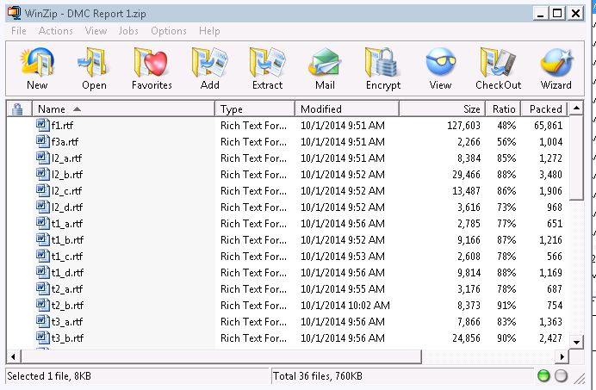
The report’s delivery
= No!

Slide 25
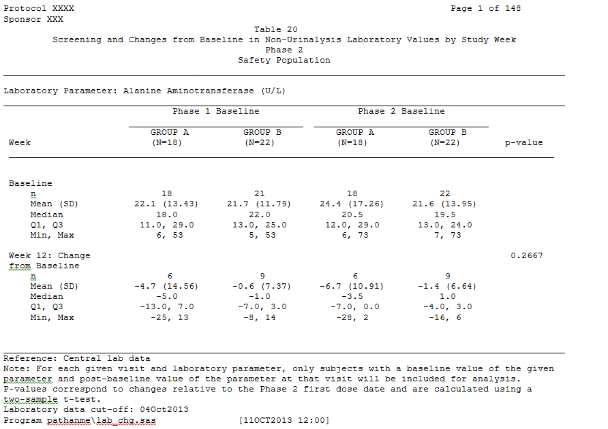
The report’s delivery
= Also not great
(entire report was 1,800 pages)

Slide 26
The report’s delivery
Electronic delivery is (more and more) common
  DMC member retrieves from access-restricted file sharing site
  Shortens time between report preparation and DMC availability
Hardcopy also an option
  Requires better “report hygiene” than electronic report
    Organization of content
    Having to print 1,800 pages makes you think how you can shorten the report while still having it be comprehensive
    Encourages consideration of more efficient presentations
      Graphics instead of 200-page tables in Courier
      “Traffic lighting” output
      Subdividing content between main report and appendix
  Review during the meeting itself is also more efficient

Slide 27
Closed Report Content:
Tips for a more readable report

Slide 28
Treatment group labels
SDAC and DMC should be aware of the identity of treatment group labels
  i.e., Group A = control; Group B = experimental
  Maintained across report cycles
Nonetheless, report uses semi-masked labels
  Preserves masking if report seen outside of DMC

Slide 29
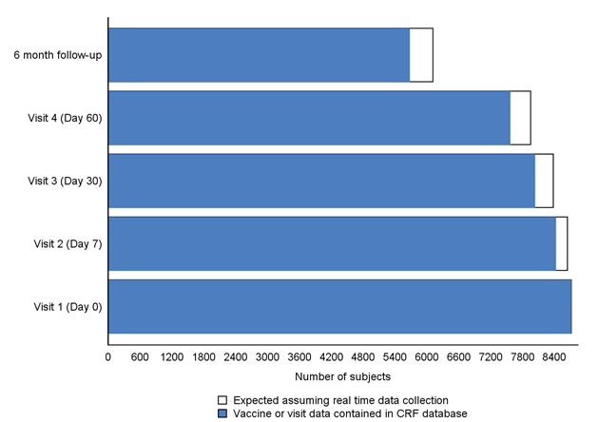
Data currentness
Tension in IDMC reporting between accuracy and timeliness
Blank portion of bar represents data that are in the field but not in IDMC’s report

Slide 30
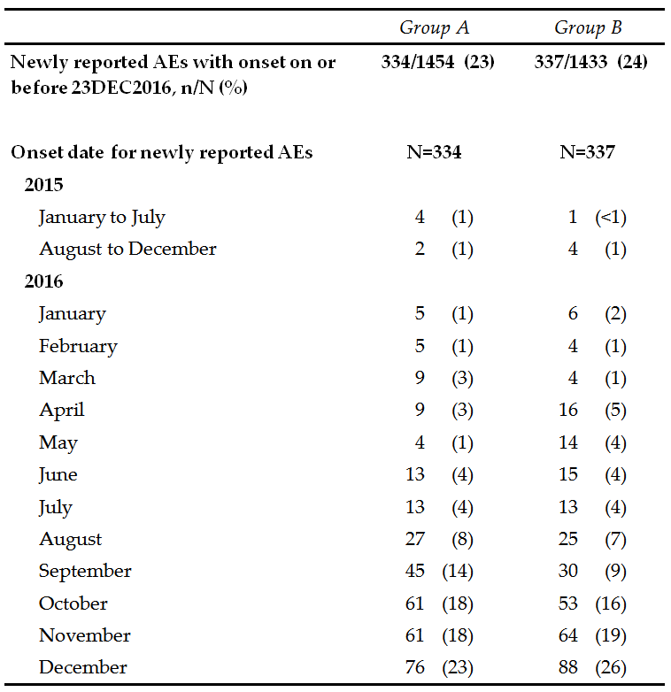
Data currentness
AEs that occurred before last report’s data extraction date, but had not yet been reported in the last report’s database
For events that had not yet been reported, when had they occurred

Slide 31
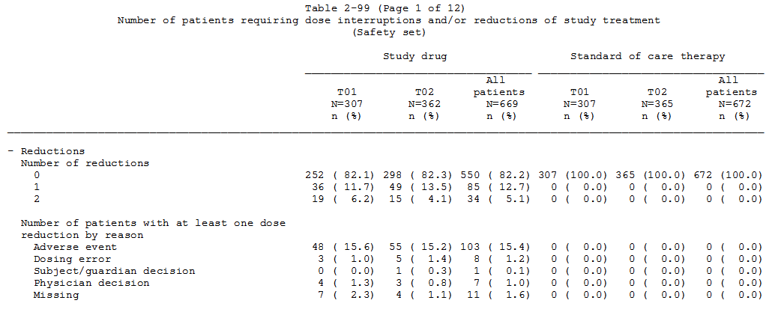
False precision adds noise
Death by a thousand decimal points
Group A
Group B
Group A
Group B

Slide 32
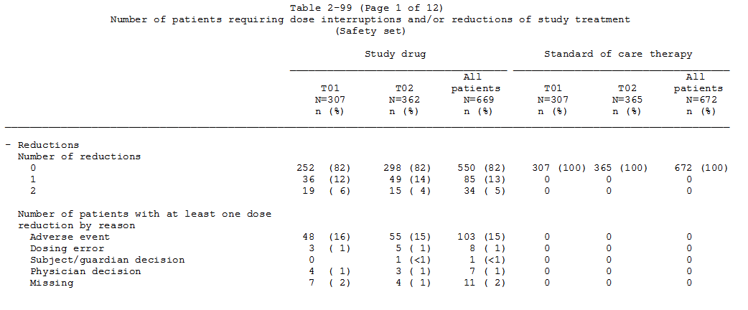
Better
Group A
Group B
Group A
Group B

Slide 33
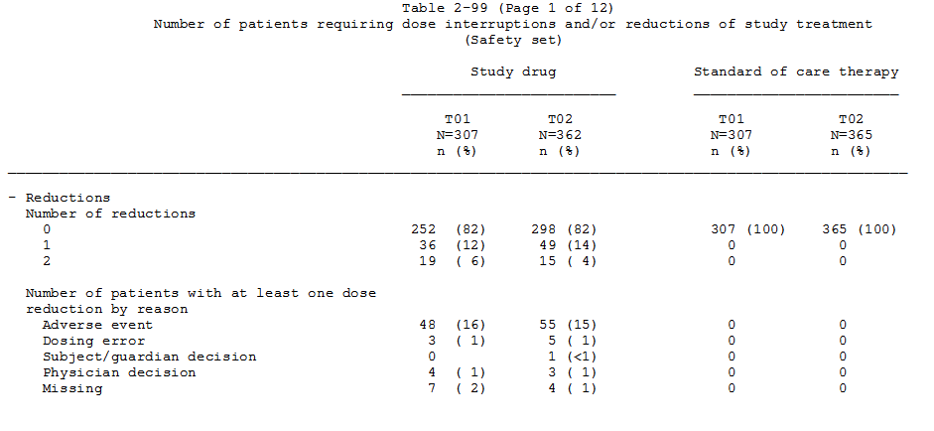
Even better
Group A
Group B
Group A
Group B

Slide 34
Recap the last report
IDMC doesn’t need to take time rehashing points that it has already noted and discussed and that haven’t changed
Executive summaries can be helpful here
As can copies of previous meeting minutes

Slide 35
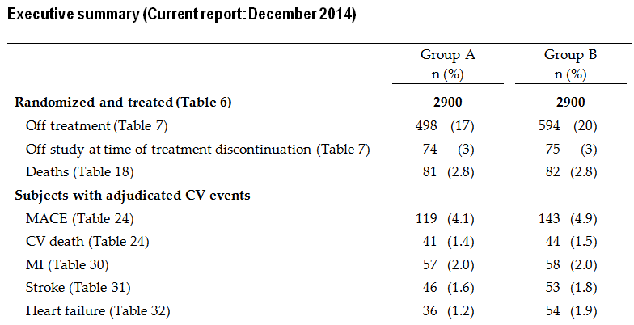
Exec summary

Slide 36
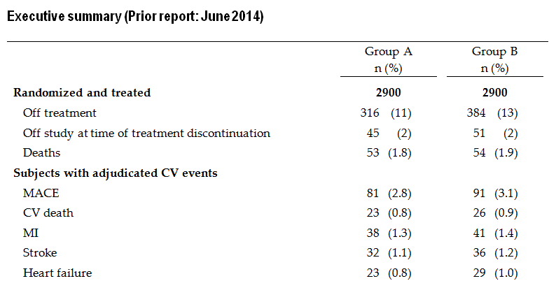
Include prior exec summary

Slide 37
Forest, to tree, to leaf
(and maybe to chlorophyll)
For especially dense sections (i.e., AEs), begin with overview of data and then drill to details
Helps navigate multi-page tables and figures that follow

Slide 38
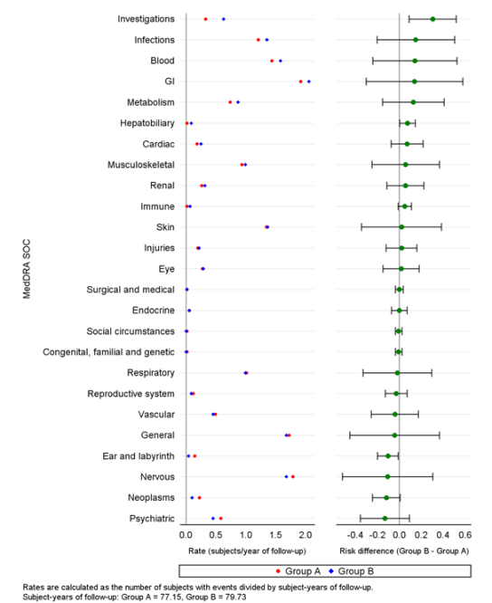
Dotplot
B worse

Slide 39
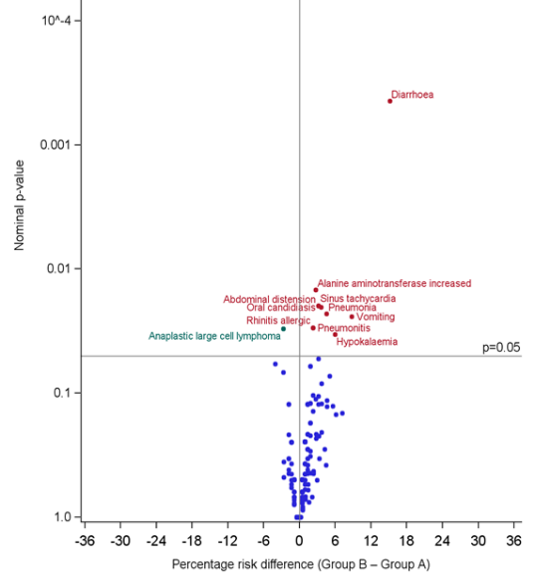
Volcano plot
Diarrhea
45 (20%) in Group A and
78 (35%) in Group B
Fisher’s exact p = 0.0004
Group B better
Group B worse

Slide 40
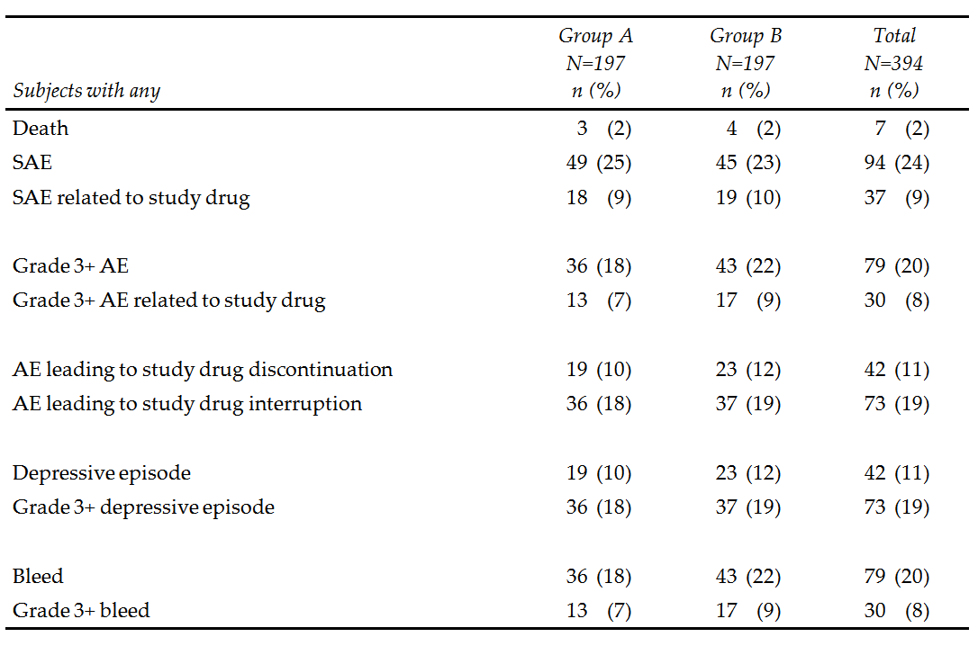
Overview AE table

Slide 41



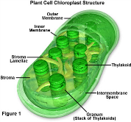
Volcano plot
Dotplot
AE overview table
Table of SAEs
Table of Grade 3+ AEs
Table of AEs leading to tx discontinuation
Etc.
By-subject listing
SAE narratives

Slide 42
Be a lumper, not a splitter
MedDRA preferred terms can split related events
In next slide, how many participants had a UTI?

Slide 43
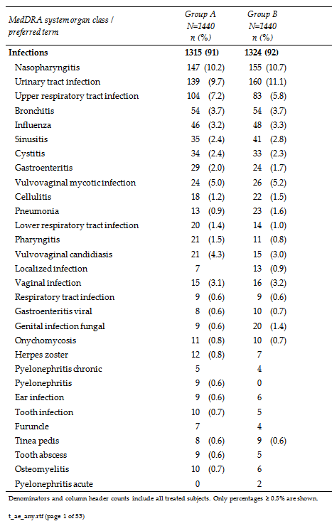

Slide 44
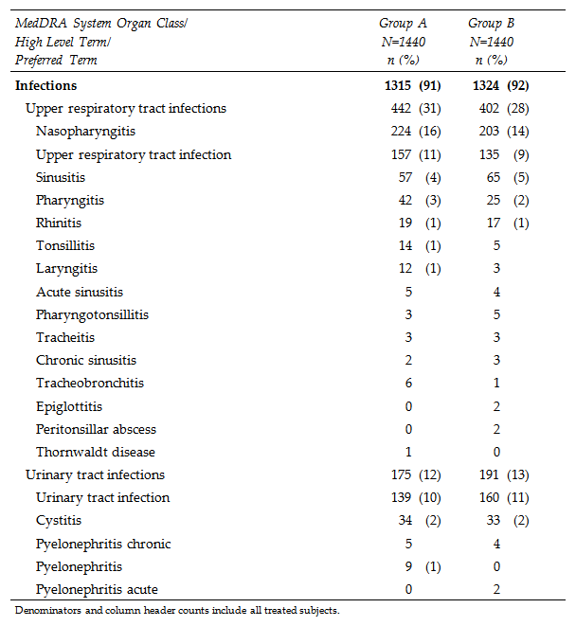

Slide 45
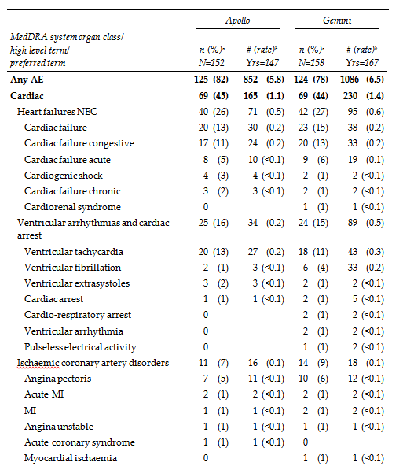
Traffic light output

Slide 46
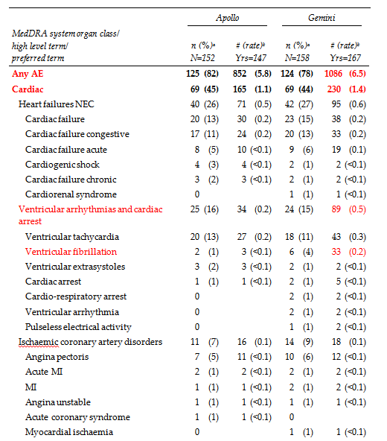
Traffic light output

Slide 47
Code defensively
By definition, “dirty” interim data will have more data quality issues than a clean and locked final database
Limiting IDMC safety reporting only to clean data causes unacceptable lag in reporting
IDMC programming needs to account for dirty data, warts & all
  Measurements incompatible with life (e.g., height of 150 inches)
  Nonsensical measurements (e.g., post-tx dosing dates before randomization)

Slide 48
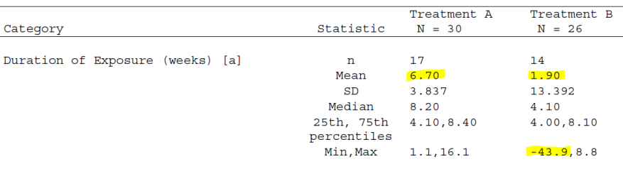
Code defensively
Not coded defensively
Recommend setting obvious errors
to missing in presentation

Slide 49
Harmonize data sources
Frustrated IDMC member: “Table 5 shows 10 subjects discontinued from the treatment due to death, but the AE table shows only 9 events with fatal outcomes. Now you tell me 11 subjects have died; you need to get your story straight.”
Possible explanation:
  2 deaths were not reported as AEs because they were beyond safety reporting period (therefore, 9 fatal AEs and not 11)
  One subject who died had already discontinued from treatment for other reasons (e.g., investigator decision), which accounts for why 10 and not 11 d/c treatment due to death
Alternative explanation – interim data are dirty and various sources of information are not yet fully reconciled

Slide 50
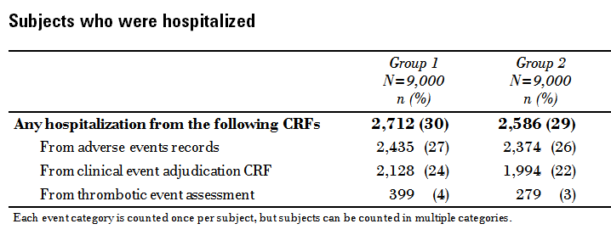
Harmonize data sources

Slide 51
Get graphic
Lab and vital sign summaries can go on… and on… and on.
Suggestion
  Identify laboratory thresholds of interest
    e.g., doublings in serum creatinine
    e.g., LFTs increasing to > 5×ULN
  Boxplots or scatterplots of post-baseline shifts to identify potential changes of interest
  Appendix tables can provide univariate statistics and frequencies for any signals identified in the plots

Slide 52
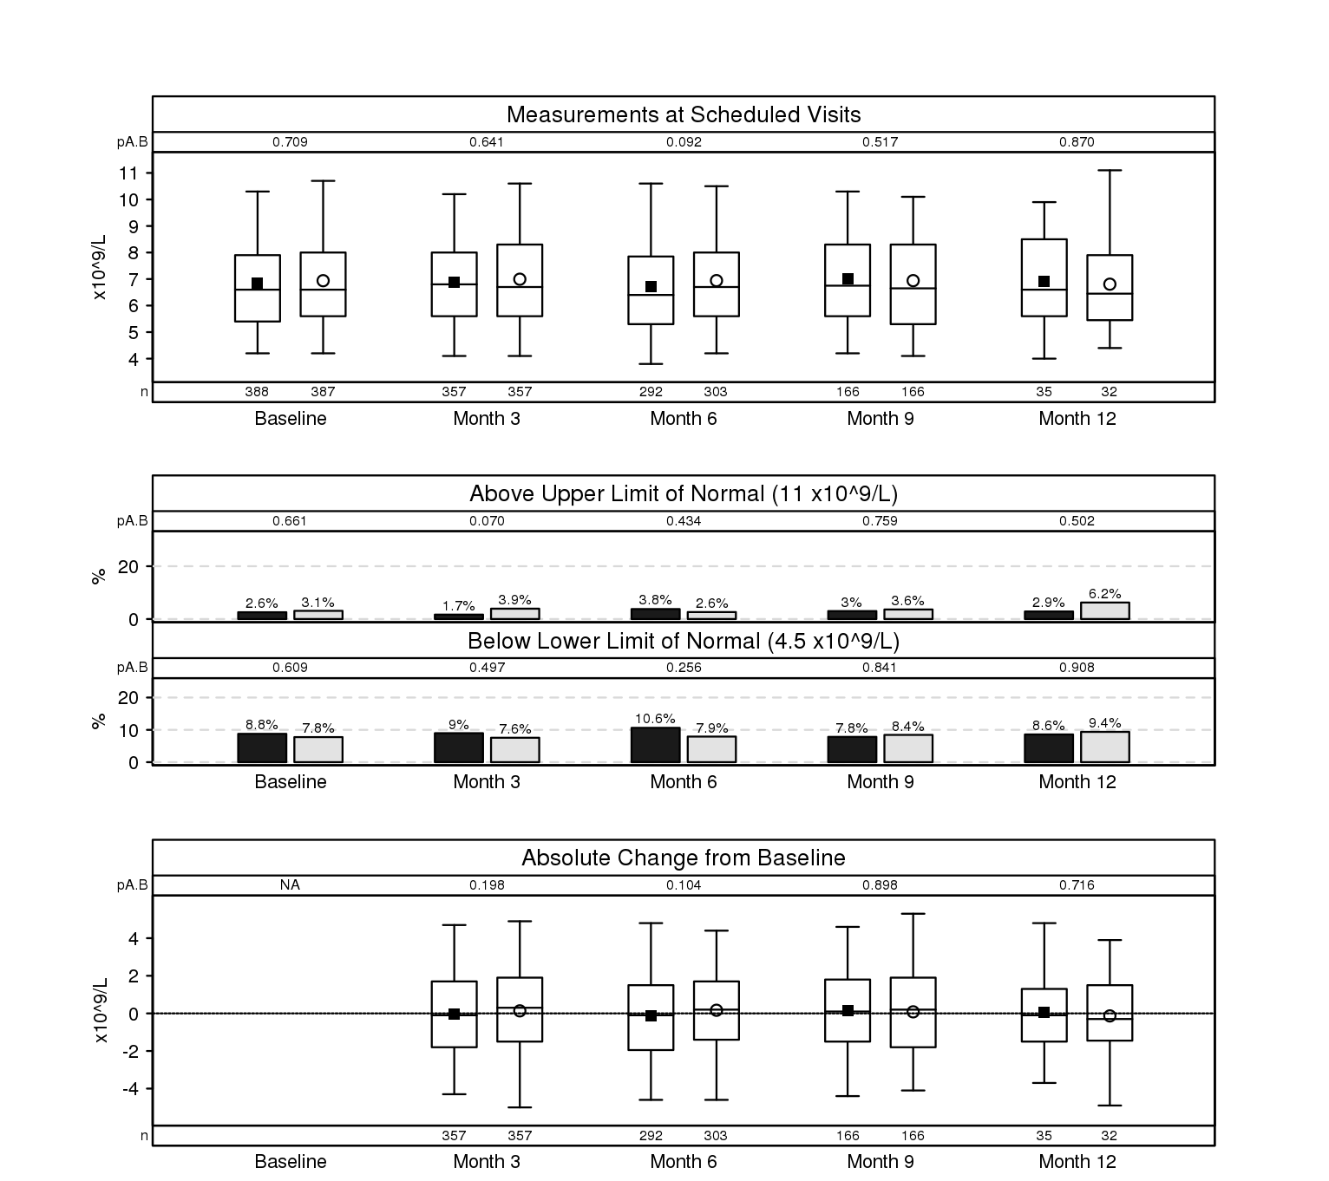
Per-Analyte Summary Page
From UW Madison SDAC sample DMC report:
https://biostat.wiscweb.wisc.edu/wp-content/uploads/sites/1008/2019/05/Sample_Report_Closed_20160920.pdf

Slide 53
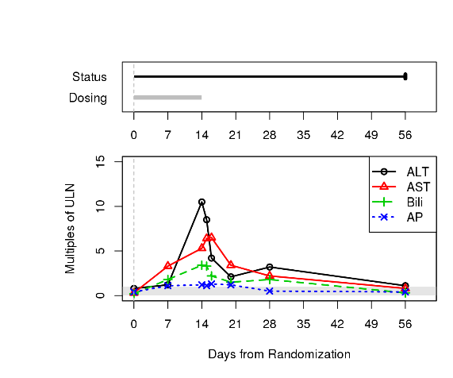
LFT Per-Patient Plot
From UW Madison SDAC sample DMC report:
https://biostat.wiscweb.wisc.edu/wp-content/uploads/sites/1008/2019/05/Sample_Report_Closed_20160920.pdf

Slide 54
At the meeting

Slide 55
Multiple roles of the SDAC
Flexibility based on personalities of DMC members & sponsors
Scheduler: Getting all to the table can be the biggest challenge
Agenda setter: Proposes meeting agenda w/sponsor & DMC Chair
Meeting “emcee”
Tech support guru
Expert on specifics of DMC charter
Expert on protocol & analysis plan
Note taker: Chair often delegates SDAC to draft meeting minutes

Slide 56
Multiple roles of the SDAC
Forecaster of DMC’s needs
  Is the DMC likely to need additional analyses?
  If so, have them at the ready for the meeting.
  Walk-through of the report within the SDAC can be helpful to identify these before the report is sent to the DMC
Expert on data
Report interpreter – see next slide
Recommendation facilitator

Slide 57
Multiple roles of the SDAC
Given the multifaceted role of SDAC, more than just one SDAC statistician is involved in DMC support
  Often at least 2 from SDAC at meetings
    Present report
    Take notes
    Field simple ad hoc requests
  Validation of analyses
    Double programming of results
    Team review of report before sending

Slide 58
Closed report review – 2 styles
Chair: “Walk us through the report, Matt”
  Not a literal page-by-page review
  Come prepared with high points that need to be covered
  Pace of review can be difficult to judge
    Newbies tend to go too slow
    Nature of DMC questions can inform you if you are going too fast
Chair: “I’ll take the lead” or “I’ve assigned each DMC member a section of the report”
  SDAC statistician on call to field questions or to jump in if member has misinterpreted what a presentation is showing

Slide 59
Ad hoc requests during meeting
Fine if they are simple requests
  “Can you give me more information for the AE coded as ‘device malfunction’”?
  “It would be interesting to see the number of MIs in the primary prevention subgroup.”
If more complicated, don’t do on-the-spot. Consequences of a mistake are too high
  Include with minutes if timeliness is not critical
  Schedule a follow-up call if timeliness matters
Underscores importance of trying to predict these needs before meeting
Agreements with sponsors need to allow flexibility for ad hoc requests

Slide 60
Tips for meeting minutes
Focus on areas with the greatest conversation among the DMC (or with the sponsor, for open meeting minutes)
Need not be 100% faithful to the actual chronology of meeting
Avoid attributing statements to individual DMC members
These aren’t the SDAC’s minutes; they’re the DMC’s
  Defer to committee on content

Slide 61
Thank you!
Matt Downs
matdowns@gmail.com

