Slide 1
Interpreting noncoding variants
BMI/CS 776
www.biostat.wisc.edu/bmi776/
Spring 2021
Daifeng Wang
daifeng.wang@wisc.edu
These slides, excluding third-party material, are licensed under CC BY-NC 4.0 by Anthony Gitter, Mark Craven, Colin Dewey and Daifeng Wang

Slide 2
Goals for lecture
Key concepts
Mechanisms disrupted by noncoding variants
Deep learning to predict epigenetic impact of noncoding variants

Slide 3
GWAS output
GWAS provides list of SNPs associated with phenotype
SNP in coding region
  Link between the protein and the disease?
SNP in noncoding region
  What genes are affected?

Slide 4
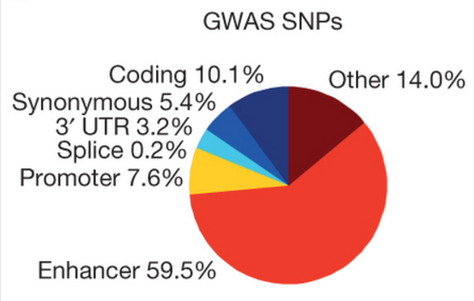
Noncoding variants common in GWAS
Meta-analysis of GWAS for 21 autoimmune diseases
  Rheumatoid arthritis, lupus, multiple sclerosis, etc.
Method to prioritize candidate causal SNPS
90% of causal variants are noncoding
Farh Nature 2015

Slide 5
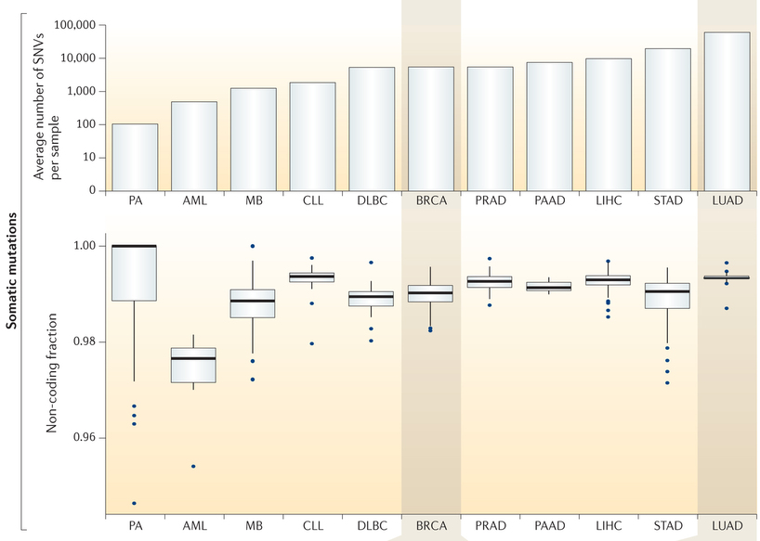
Almost all single nucleotide variants in cancer are noncoding
Khurana Nature Reviews Genetics 2016
However, very few of these are driver mutations

Slide 6
Ways a noncoding variant can be functional
Disrupt DNA sequence motifs
  Promoters, enhancers
Disrupt miRNA binding
Mutations in introns affect splicing
Indirect effects from the above changes
Examples in Ward and Kellis Nature Biotechnology 2012

Slide 7
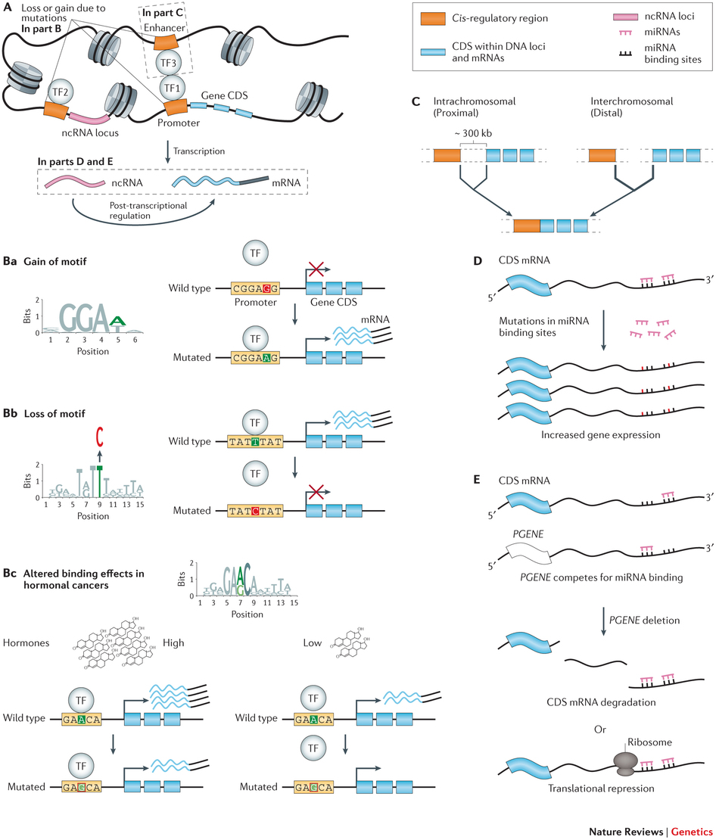
Variants altering motifs
Khurana Nature Reviews Genetics 2016

Slide 8
Variants affect proximal and distal regulators
Khurana Nature Reviews Genetics 2016

Slide 9
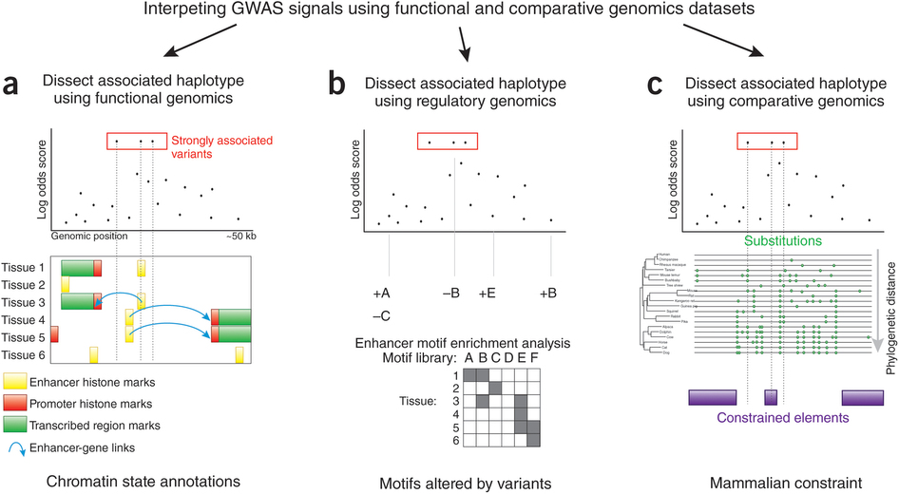
Evidence used to prioritize noncoding variants
Ward and Kellis Nature Biotechnology 2012

Slide 10

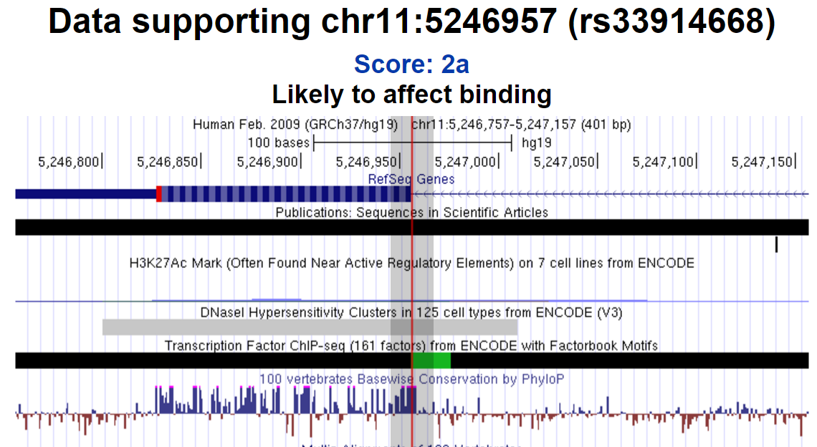
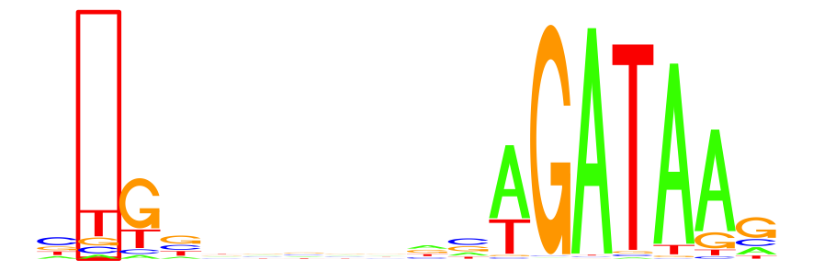
Visualizing evidence
Summary of evidence
Genes
Epigenetic annotations
Conservation
Boyle Genome Research 2012
Affected motifs

Slide 11
Combined Annotation–Dependent Depletion (CADD)
Example of an algorithm that integrates multiple types of evidence into a single score
  Conservation
  Epigenetic information
  Protein function scores for coding variants
Train support vector machine on simulated and observed variants
Variants present in simulation but not observed are likely deleterious
Kircher Nature Genetics 2014

Slide 12
Prioritizing variants with epigenetics summary
+ Disrupted regulatory elements one of the best
understood effects of noncoding SNPs
+ Make use of extensive epigenetic datasets
+ Similar strategies have actually worked
  rs1421085 in FTO region and obesity
  Claussnitzer New England Journal of Medicine 2015
Epigenetic data at a genomic position is often in
the presence of the reference allele
  Don’t have measurements for the SNP allele

Slide 13
DeepSEA
Given:
  A sequence variant and surrounding sequence context
Do:
  Predict TF binding, DNase hypersensitivity, and histone modifications in multiple cell and tissue types
  Predict variant functionality
Zhou and Troyanskaya Nature Methods 2015

Slide 14
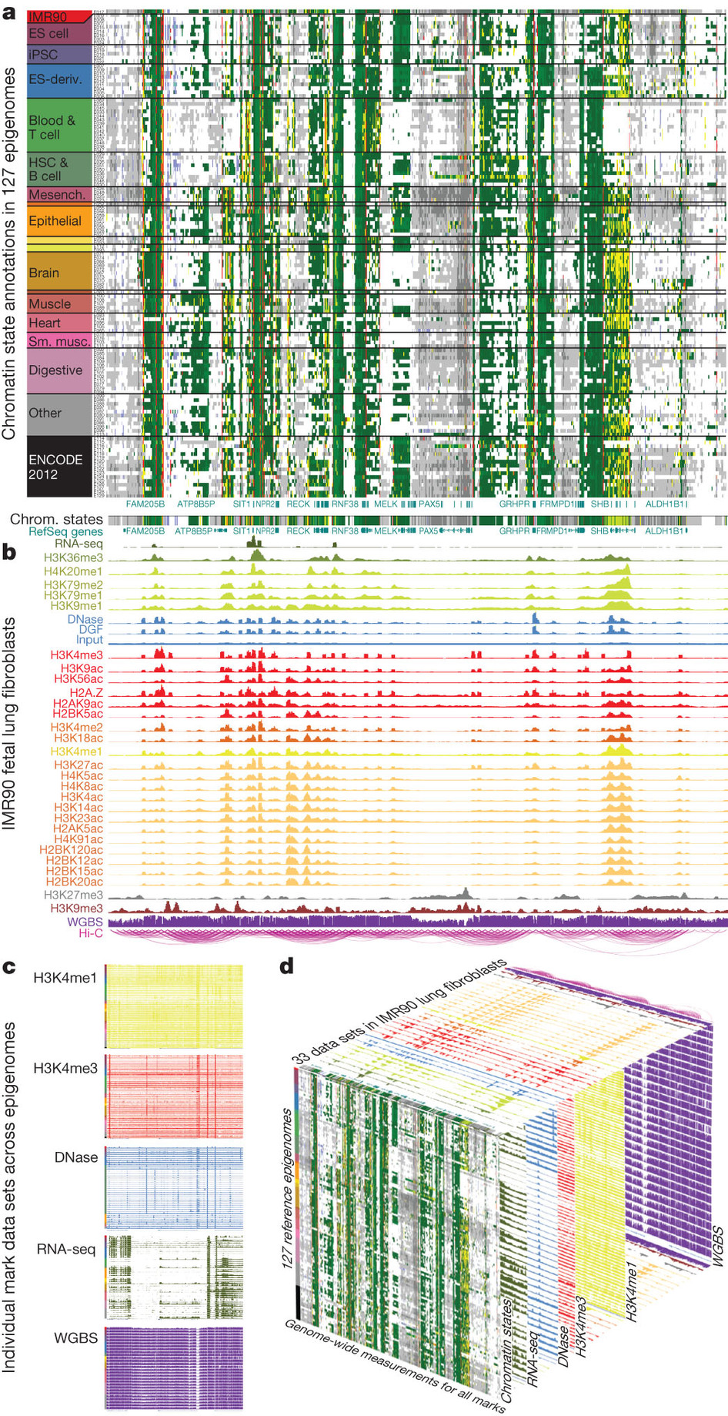
Classifier input and output
N genomic windows
Output
  200 bp windows of genome
  Label 1 if window contains peak
  Label for each epigenetic data type
    Multiple types of epigenetic features
    Multiple types of cells and tissues
Input: 1000 bp DNA sequence centered at window
919 classes
200 bp
Roadmap Epigenomics Consortium Nature 2015
index 1 … 401 402 403 … 1000
A 0 1 0 0 0
C 0 0 0 0 1
G 1 0 1 1 0
T 0 0 0 0 0

Slide 15
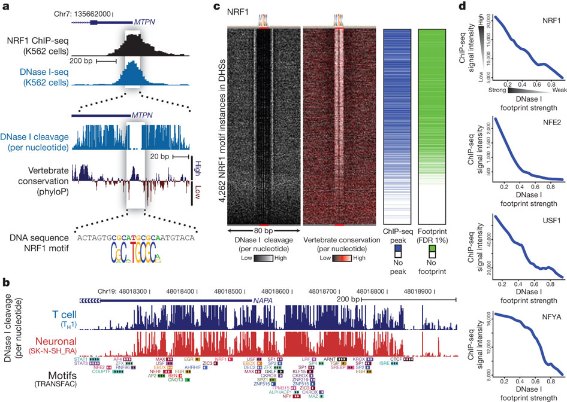
Desired properties for epigenomic classifier
Learn preferences of DNA-binding proteins
  Locally: “motifs” and other simple sequence patterns
  Sequence context: “cis-regulatory modules”
Support nonlinear decision
boundaries
Multiple, related prediction tasks
Neph Nature 2012
Roadmap Epigenomics Consortium Nature 2015
Notes:
Use image as example. Motifs like features in image

Slide 16
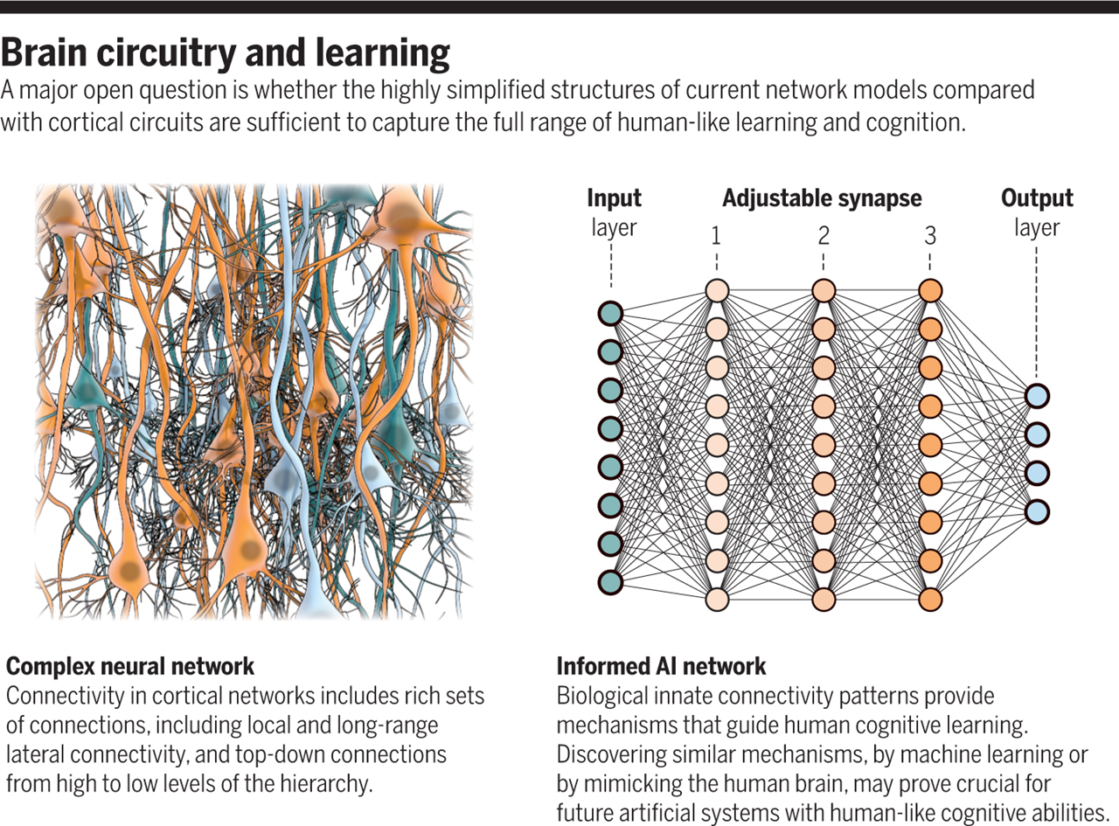
Neuroscience to artificial intelligence
Shimon Ullman, Science 15 Feb 2019:
Vol. 363, Issue 6428, pp. 692-693

Slide 17
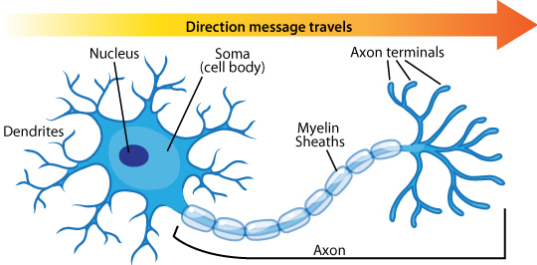
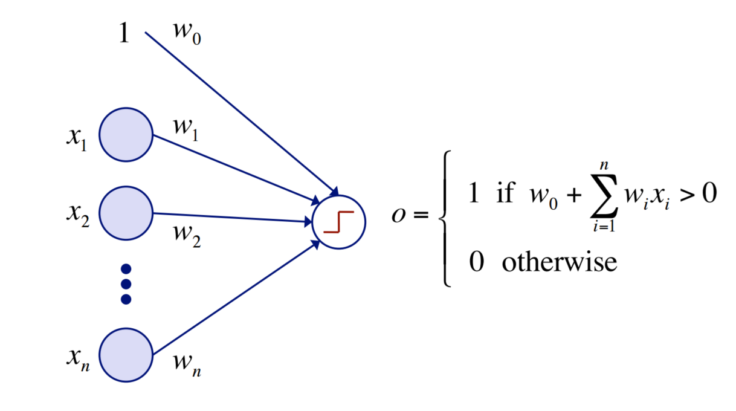
Perceptron
Inspired by neuron
Simple binary classifier
  Linear decision boundary
Ask a biologist
Bias
Mark Craven CS 760 slides
Notes:
Mention PWM

Slide 18
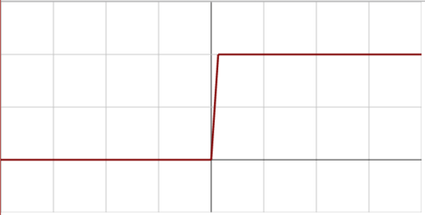
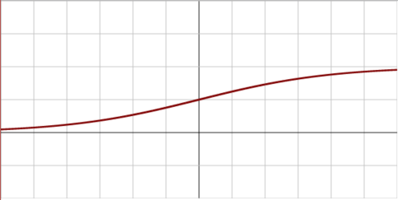
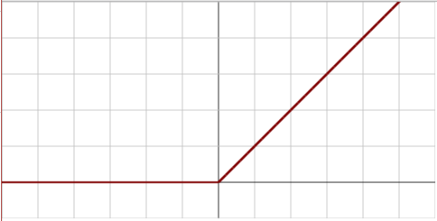
Activation function
What makes the neuron “fire”?
  Step function
  Sigmoid function
  Rectified linear unit (ReLU)
Images from Wikipedia: Activation function

Slide 19
Neural networks
Single perceptron not useful in practice
Neural network combines layers of perceptrons
Learn “hidden” features
Complex decision boundary
Tune weights to reduce error
Train with backpropagation
  Stanford’s CS231n materials
  Andrej Karpathy’s gentle introduction
  CS 760 slides
Output
Perceptron
Input
Output
Hidden layer 2
Hidden layer 1
Input

Slide 20
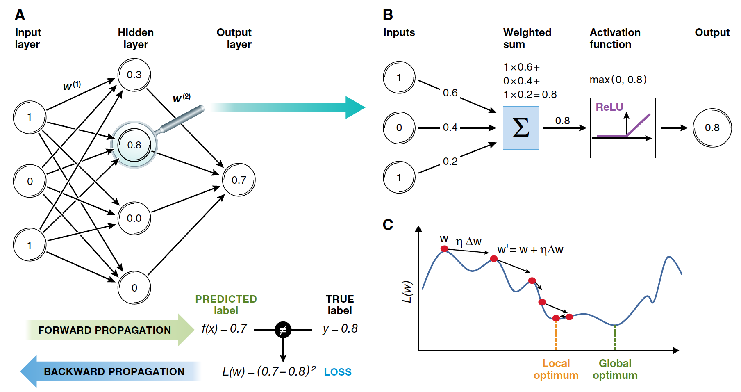
Train NN with backpropagation
Christof Angermueller et al. Mol Syst Biol 2016;12:878

Slide 21
Neural network examples
Simple linear decision boundary
Linear decision boundary fails for XOR
XOR with one hidden layer
Complex, non-linear patterns
Try varying weights, hidden units, and layers
  What patterns can you learn with 0 hidden layers?
  1 hidden layer?
  More?

Slide 22
First hidden layer
First hidden layer scans input sequence
Activation function fires if “motif” is recognized
Hidden node to recognize motif 1 in position 1 of the input sequence
…
1
1 0 0 0 1 0 0 0 0 1 0 0 0 1 1 0 0 1 0 0 0 0 0 0
Bias
A 1 0 0 0 1 0 0 0 0 0
C 0 0 0 1 0 0 0 0 1 0
G 0 1 1 0 0 1 0 1 0 1
T 0 0 0 0 0 0 1 0 0 0
Motif width (window size) s = 6
Sequence length L
A G G C A G T G C G

Slide 23
First hidden layer example
Forward pass at the first hidden layer, input 1
Hidden node to recognize motif 1 in position 1 of the input sequence
Current weight vector for h_{1,1}
e.g., from PWM of a motif
1
1 0 0 0 0 1 0 0
Bias
A 1 0 0 0 1 0 0 0 0 0
C 0 0 0 1 0 0 0 0 1 0
G 0 1 1 0 0 1 0 1 0 1
T 0 0 0 0 0 0 1 0 0 0
Weights times input
For simplicity,
s = 2
Apply ReLU activation function
Input sequence 1
A G G C A G T G C G

Slide 24
First hidden layer example
Forward pass at the first hidden layer, input 2
Hidden node to recognize motif 1 in position 1 of the input sequence
Current weight vector for h_{1,1}
1
0 0 0 0 1 1 0 0
Bias
A 0 0 0 1 0 1 1 0 0 0
C 0 0 0 0 1 0 0 1 0 0
G 1 1 1 0 0 0 0 0 0 1
T 0 0 0 0 0 0 0 0 1 0
Weights times input
Apply ReLU activation function
Input sequence 2
G G G A C A A C T G

Slide 25
First hidden layer
Multiple hidden nodes to recognize different motifs at a particular position
Check for motif at each position in sequence
A hidden node with its own weight vector
W = L – s + 1 starting positions
…
D motifs or “filters”
(hidden layer depth)
…
…
…
…
A 1 0 0 0 1 0 0 0 0 0
C 0 0 0 1 0 0 0 0 1 0
G 0 1 1 0 0 1 0 1 0 1
T 0 0 0 0 0 0 1 0 0 0
A 1 0 0 0 1 0 0 0 0 0
C 0 0 0 1 0 0 0 0 1 0
G 0 1 1 0 0 1 0 1 0 1
T 0 0 0 0 0 0 1 0 0 0

Slide 26
First hidden layer example
Next filter applied to input 1
Hidden node to recognize motif 2 in position 1 of the input sequence
Current weight vector for h_{2,1}
1
1 0 0 0 0 1 0 0
Bias
A 1 0 0 0 1 0 0 0 0 0
C 0 0 0 1 0 0 0 0 1 0
G 0 1 1 0 0 1 0 1 0 1
T 0 0 0 0 0 0 1 0 0 0
Weights times input
Apply ReLU activation function
Input sequence 1
A G G C A G T G C G

Slide 27
First layer problems
We already have a lot of parameters
  Each hidden node has its own weight vector
We’re attempting to learn different motifs (filters) at each starting position
  D*W hidden nodes

Slide 28
Convolutional layers
Input sequence and hidden layer as matrices
Share parameters for all hidden nodes in a row
  Search for same motif at different starting positions
…
D X W
Shared weight vector for all nodes in a row
…
…
…
…
…
4 X L
A 1 0 0 0 1 0 0 0 0 0
C 0 0 0 1 0 0 0 0 1 0
G 0 1 1 0 0 1 0 1 0 1
T 0 0 0 0 0 0 1 0 0 0
…
…
…

Slide 29
Pooling layers
Account for sequence context
Multiple motif matches in a cis-regulatory module
Search for patterns at a higher spatial scale
  Fire if motif detected anywhere within a window

Slide 30
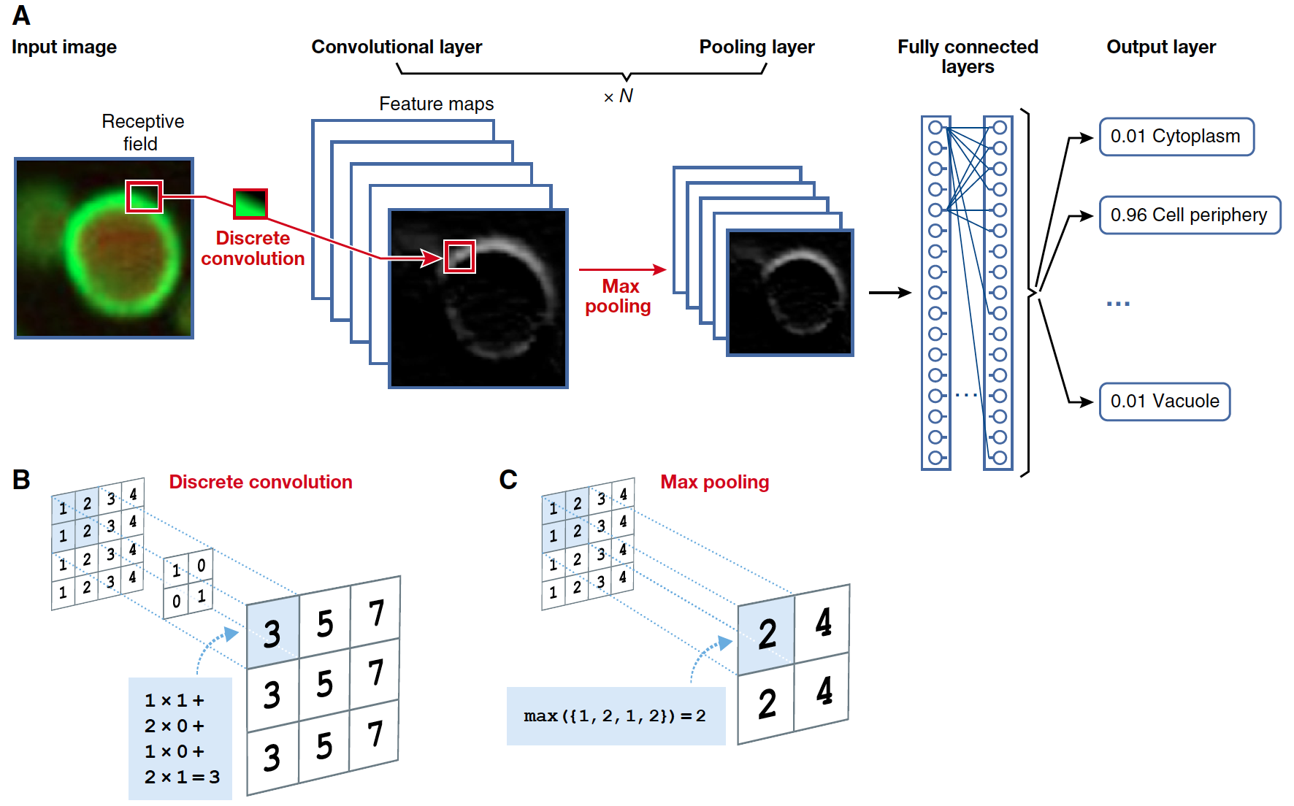
Convolution and Pooling
Christof Angermueller et al. Mol Syst Biol 2016;12:878

Slide 31
Pooling layers
Take max over window of 4 hidden nodes
D X (W / 4)
…
…
D X W
…
…

Slide 32
Subsequent hidden layers
Next convolutional hidden layer on top of pooling layer
D' is new number of patterns
s' is new window size
W ' = (W / 4) – s'+ 1
D' X W '
…
…
D X (W / 4)
Once again, shared weight vector for all nodes in a row
…
…

Slide 33
Full DeepSEA neural network
Multitask output makes simultaneous prediction for each type of epigenetic data
ReLU activations
919 classes
Fully connected layer
Pooling layer
Convolutional layer
Pooling layer
Convolutional layer
Pooling layer
Convolutional layer
Input sequence

Slide 34
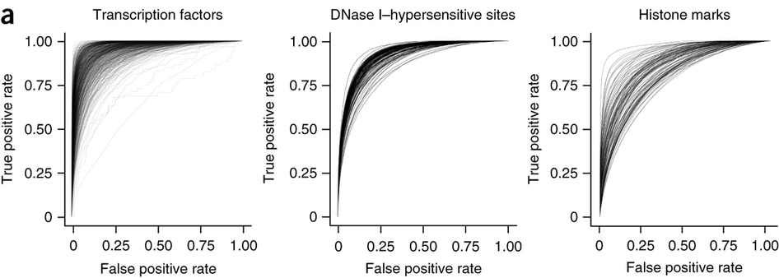
Predicting epigenetic annotations
Compute median AUROC for three types of classes
0.958
0.923
0.856
Zhou and Troyanskaya Nature Methods 2015

Slide 35
Predicting functional variants
Can predict epigenetic signal for any novel variant (SNP, insertion, deletion)
Define novel features to classify variant functionality
  Difference in probability of signal for reference and alternative allele
Train on SNPs annotated as regulatory variants in GWAS and eQTL databases

Slide 36
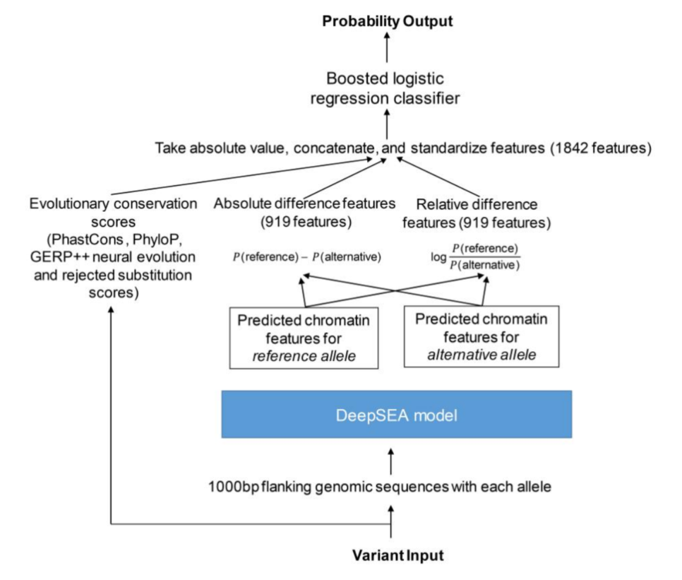
Predicting functional variants
Boosted logistic regression
Conservation and predicted epigenetic impact of variant as features
Zhou and Troyanskaya Nature Methods 2015

Slide 37
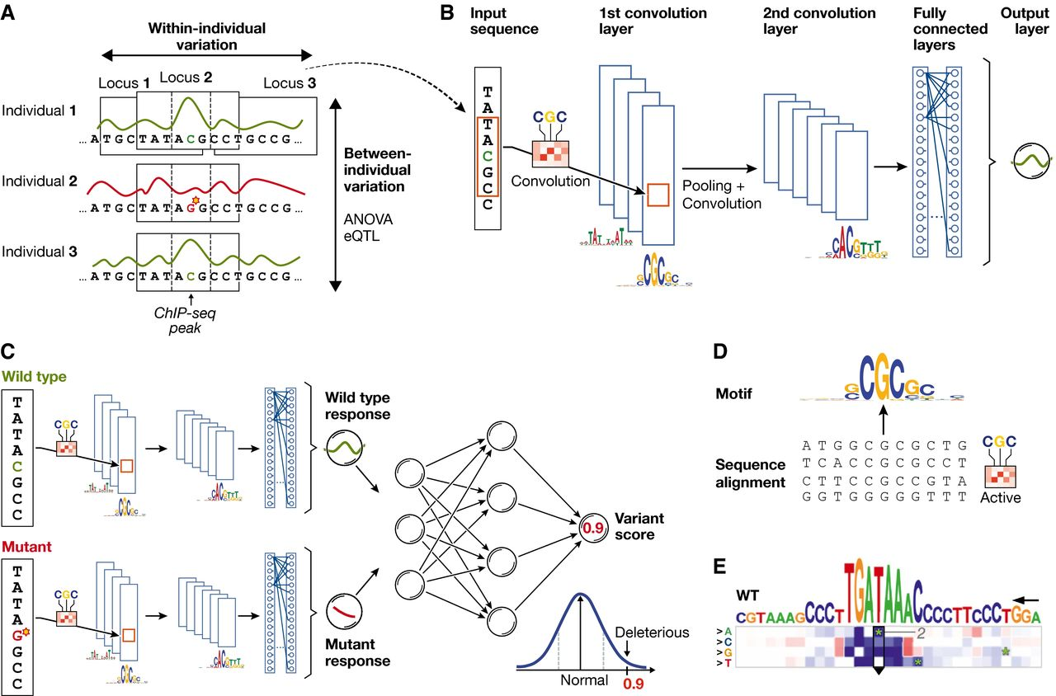

Principles of using neural networks for predicting molecular traits from DNA sequence
© as stated in the article, figure or figure legend
Christof Angermueller et al. Mol Syst Biol 2016;12:878
Notes:
Principles of using neural networks for predicting molecular traits from DNA sequence (A) DNA sequence and the molecular response variable along the genome for three individuals. Conventional approaches in regulatory genomics consider variations between individuals, whereas deep learning allows exploiting intra‐individual variations by tiling the genome into sequence DNA windows centred on individual traits, resulting in large training data sets from a single sample. (B) One‐dimensional convolutional neural network for predicting a molecular trait from the raw DNA sequence in a window. Filters of the first convolutional layer (example shown on the edge) scan for motifs in the input sequence. Subsequent pooling reduces the input dimension, and additional convolutional layers can model interactions between motifs in the previous layer. (C) Response variable predicted by the neural network shown in (B) for a wild‐type and mutant sequence is used as input to an additional neural network that predicts a variant score and allows to discriminate normal from deleterious variants. (D) Visualization of a convolutional filter by aligning genetic sequences that maximally activate the filter and creating a sequence motif. (E) Mutation map of a sequence window. Rows correspond to the four possible base pair substitutions, columns to sequence positions. The predicted impact of any sequence change is colour‐coded. Letters on top denote the wild‐type sequence with the height of each nucleotide denoting the maximum effect across mutations (figure panel adapted from Alipanahi et al, 2015).

Slide 38
DeepSEA summary
Ability to predict how unseen variants affect regulatory elements
Accounts for sequence context of motif
Parameter sharing with convolutional layers
Multitask learning to improve hidden layer representations
Does not extend to new types of cells and tissues
AUROC is misleading for evaluating genome-wide epigenetic predictions

Slide 39
Predicting new TF-cell type pairs
Training data
DeepSEA cannot predict pairs not present in training data
  Can predict TF A in cell type 1
  Not TF A in cell type 4
New methods can
  TFImpute
  FactorNet
  Virtual ChIP-seq
TF | Cell type
A | 1
A | 2
A | 3
B | 3
B | 4
C | 1
C | 4

Slide 40
Deep learning is rampant in biology and medicine
Network interpretation: DeepLIFT
Protein structure prediction
Cell lineage prediction
Variant calling
Model zoo: Kipoi
Comprehensive review: deep-review

