Slide 1
Advanced Topics in Bioinformatics
BMI/CS 776
www.biostat.wisc.edu/bmi776/
Spring 2021
Daifeng Wang
daifeng.wang@wisc.edu
These slides, excluding third-party material, are licensed under CC BY-NC 4.0 by Mark Craven, Colin Dewey, Anthony Gitter and Daifeng Wang

Slide 2
Outline
More machine learning applications
Machine learning challenges in bioinformatics
Spatial transcriptomics
Imaging genetics/genomics
Artificial intelligence in drug discovery

Slide 3
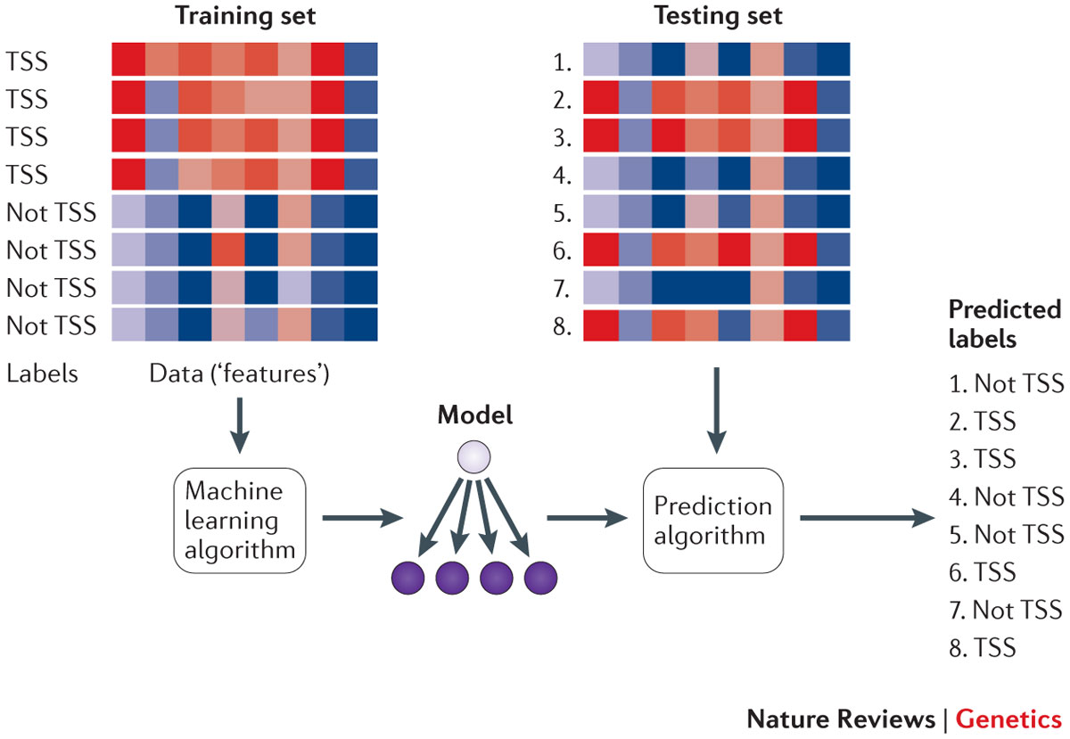
Training and Testing
Libbrecht, M., Noble, W. Machine learning applications in genetics and genomics. Nat Rev Genet 16, 321–332 (2015). https://doi.org/10.1038/nrg3920

Slide 4
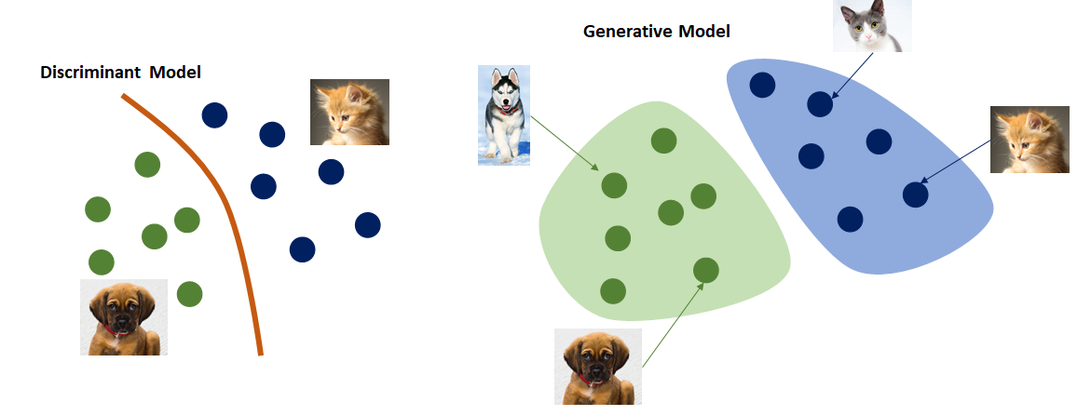
Generative vs. Discriminative models
Generative approaches model the joint probability p(x,y) for generating data
Discriminative approaches directly model p(y|x) for classification
https://medium.com/@jordi299/about-generative-and-discriminative-models-d8958b67ad32

Slide 5
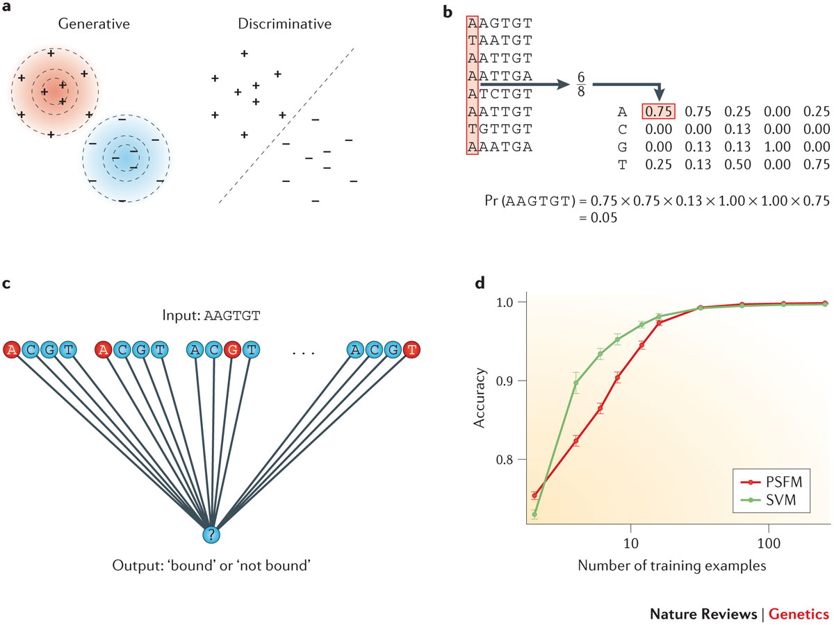
Predicting TF binding via
Generative vs. Discriminative models
Libbrecht, M., Noble, W. Machine learning applications in genetics and genomics. Nat Rev Genet 16, 321–332 (2015). https://doi.org/10.1038/nrg3920

Slide 6
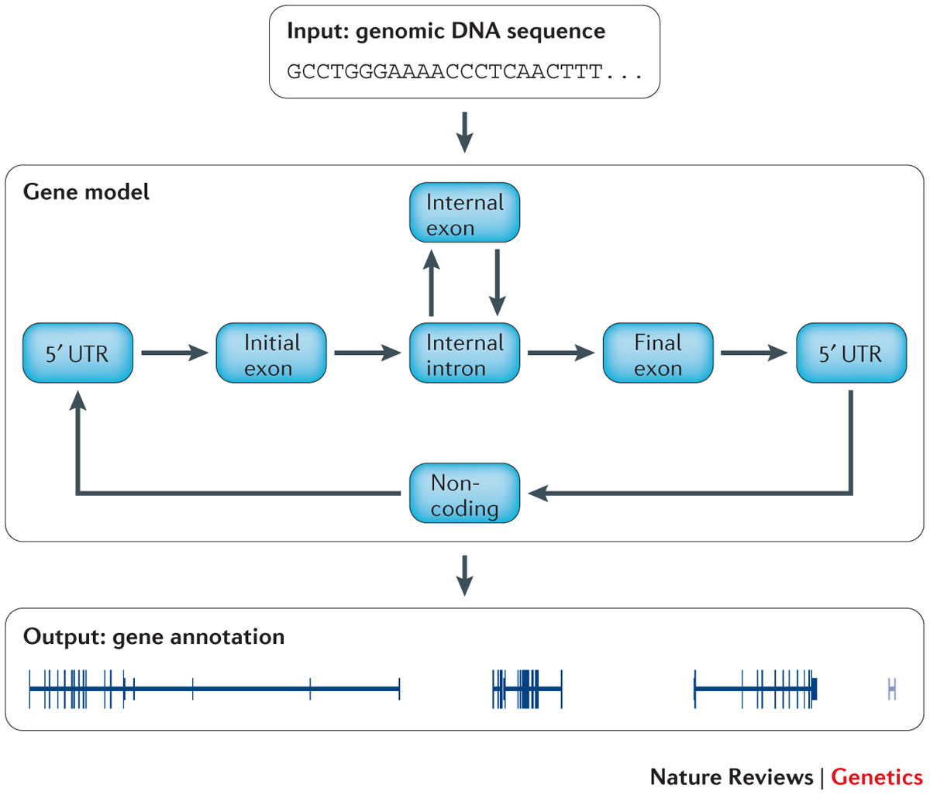
Semi-supervised learning (e.g., gene finding)
Train a model with known gene sequences
Predict labels for many unknown sequences
Refine the model with known and predicted sequences
Libbrecht, M., Noble, W. Machine learning applications in genetics and genomics. Nat Rev Genet 16, 321–332 (2015). https://doi.org/10.1038/nrg3920

Slide 7
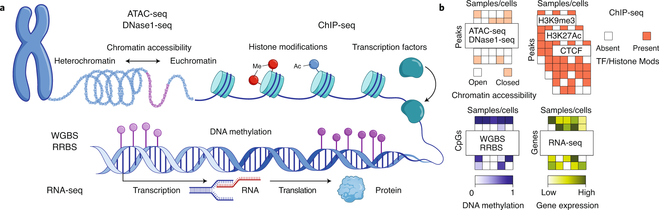
Data heterogeneity
Scherer, M., Schmidt, F., Lazareva, O. et al. Machine learning for deciphering cell heterogeneity and gene regulation. Nat Comput Sci 1, 183–191 (2021). https://doi.org/10.1038/s43588-021-00038-7

Slide 8
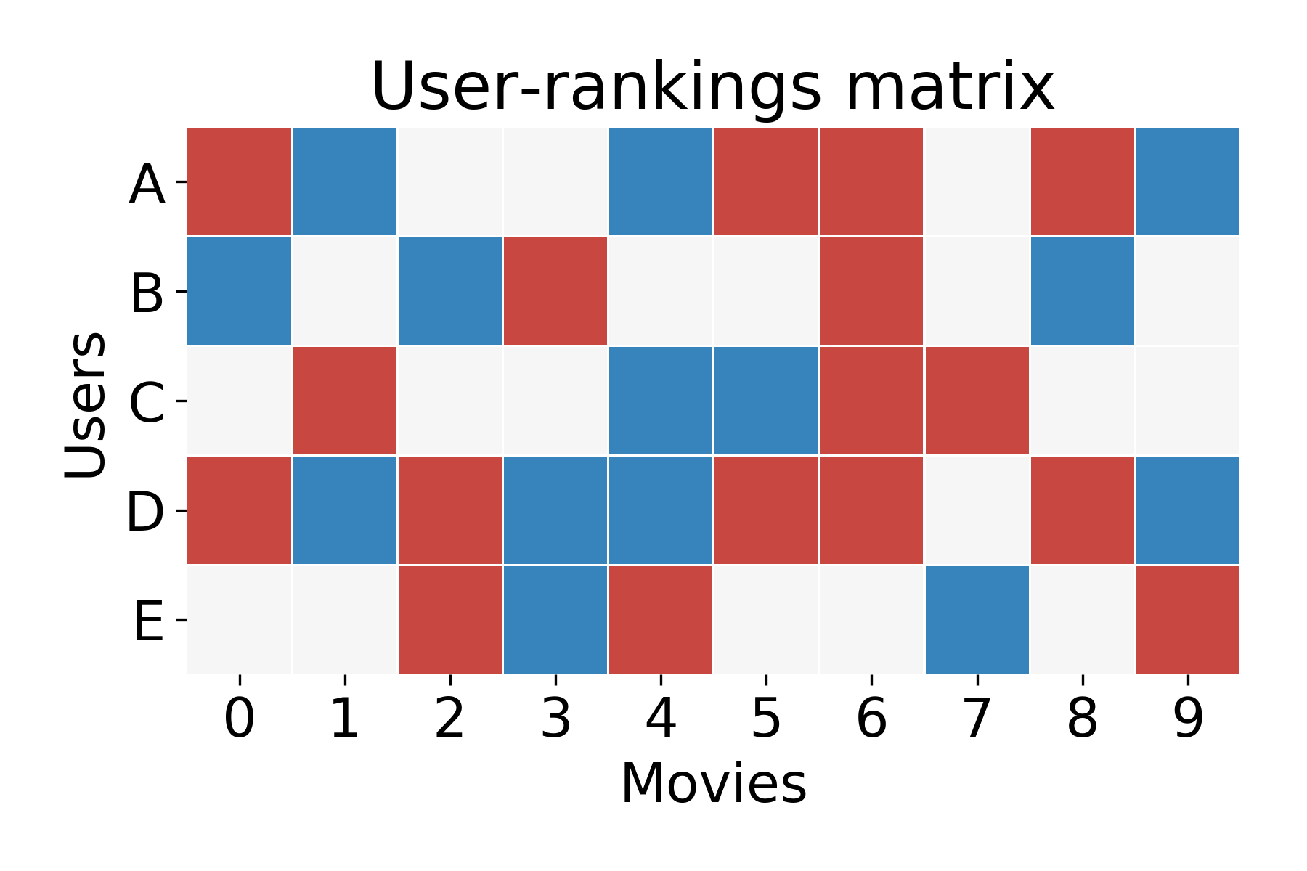
Missing data and imputation
Remember Netflix Problem?
Biological data has many missing values
  e.g., single cell dropouts
https://krishnaswamylab.github.io/tutorial/imputation_and_netflix/

Slide 9
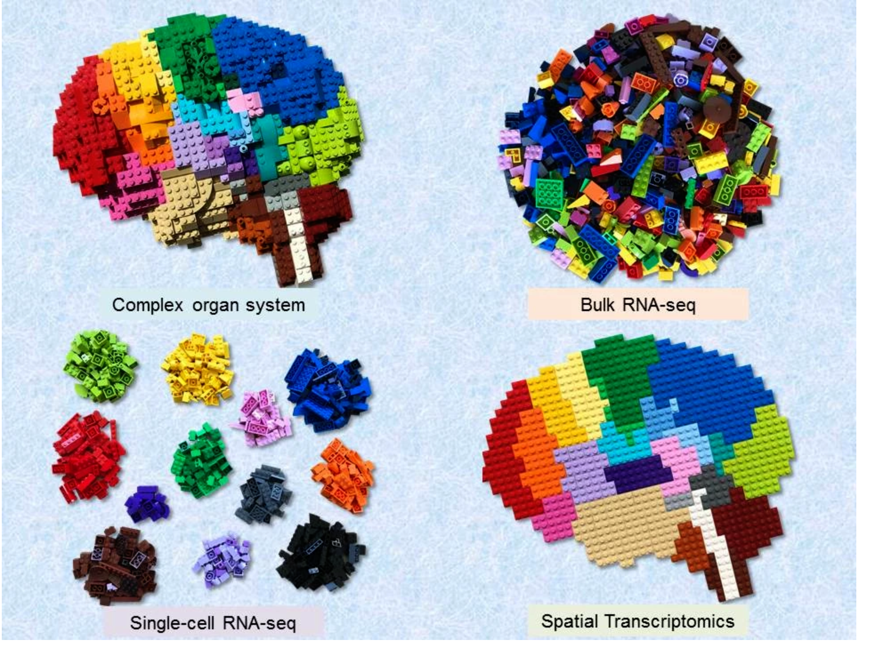
Spatial Transcriptomics
Assessment of gene expression profiles and spatial organization for interrogation of complex, heterogeneous tissues
Bulk RNA-seq
Single cell RNA-seq
Spatial Transcriptomics
Functional tissue
Average gene expression level, lacks cellular or spatial resolution
Identify distinct cell types and their gene expression profiles
Visualize gene expression profiles with tissue context
Spatial organization of distinct cell types and their gene expression profiles
https://boxia2018.wixsite.com/boxia/momemts
https://www.youtube.com/watch?v=20-qNM4Ax3s

Slide 10
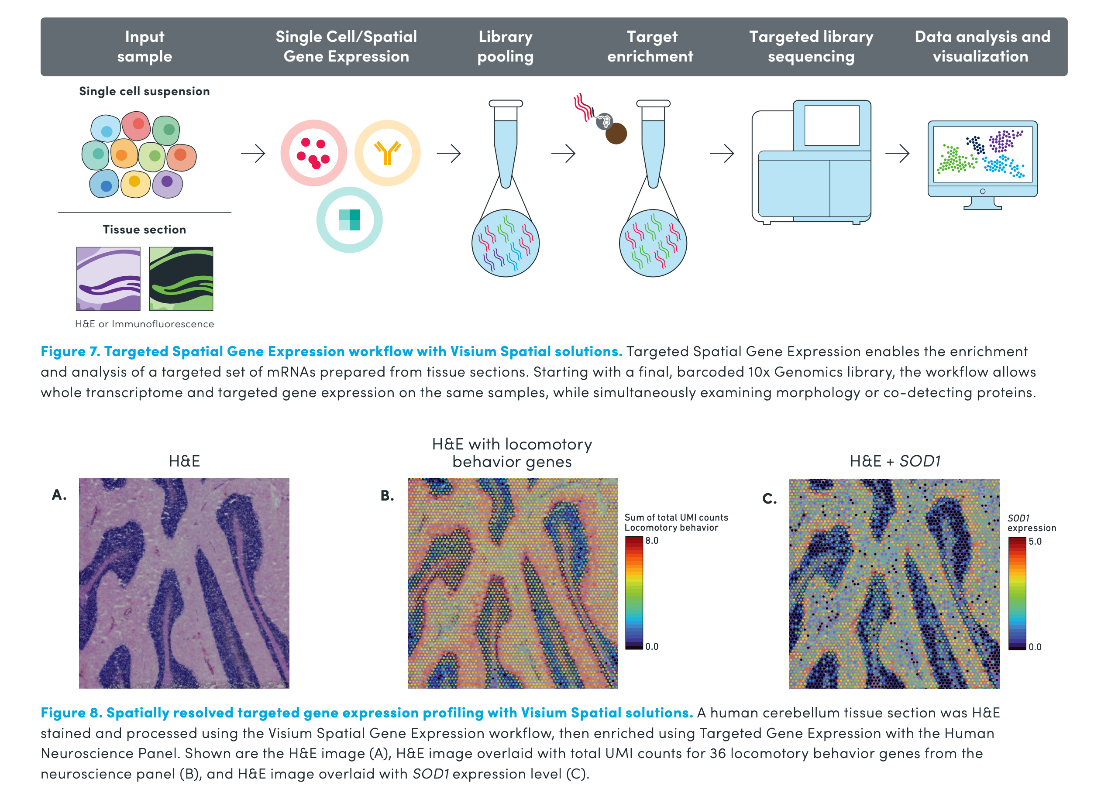
Genomics Visium platform
Visium Targeted Gene Expression combines crucial spatial insights with the ease and breadth of targeted panels
Accelerate the understanding of human health and disease with a more refined picture of the biology captured on a tissue slide
https://pages.10xgenomics.com/rs/446-PBO-704/images/10x_BR060_Inside_Visium_Spatial_Technology.pdf

Slide 11
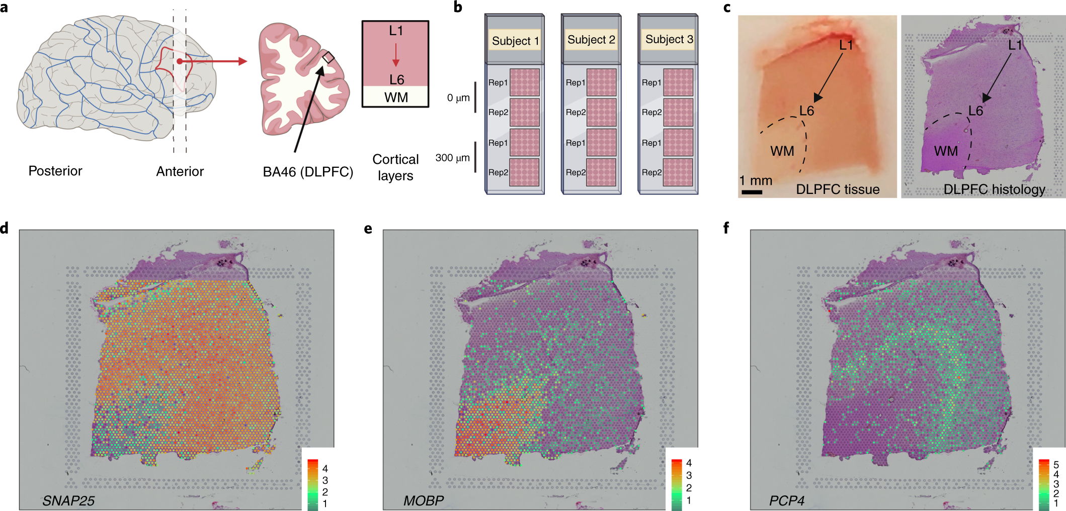
Transcriptome-scale spatial gene expression in the human dorsolateral prefrontal cortex (DLPFC)
Localize spatial gene expression in the human brain at cellular resolution will be critical to gain further insight into disease mechanisms
Spatial transcriptomics in DLPFC using Visium
Maynard, K.R., Collado-Torres, L., Weber, L.M. et al. Transcriptome-scale spatial gene expression in the human dorsolateral prefrontal cortex.
Nat Neurosci 24, 425–436 (2021). https://doi.org/10.1038/s41593-020-00787-0

Slide 12
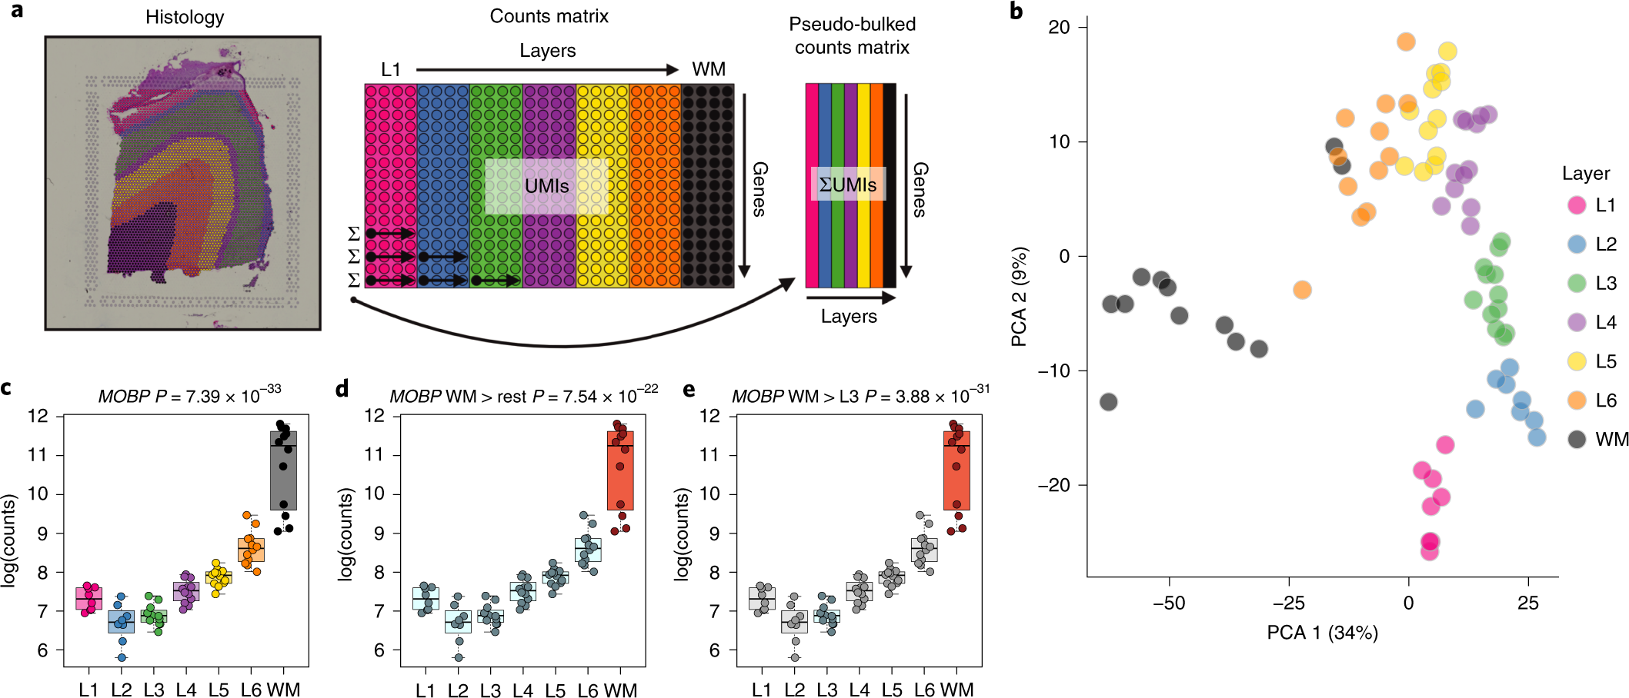
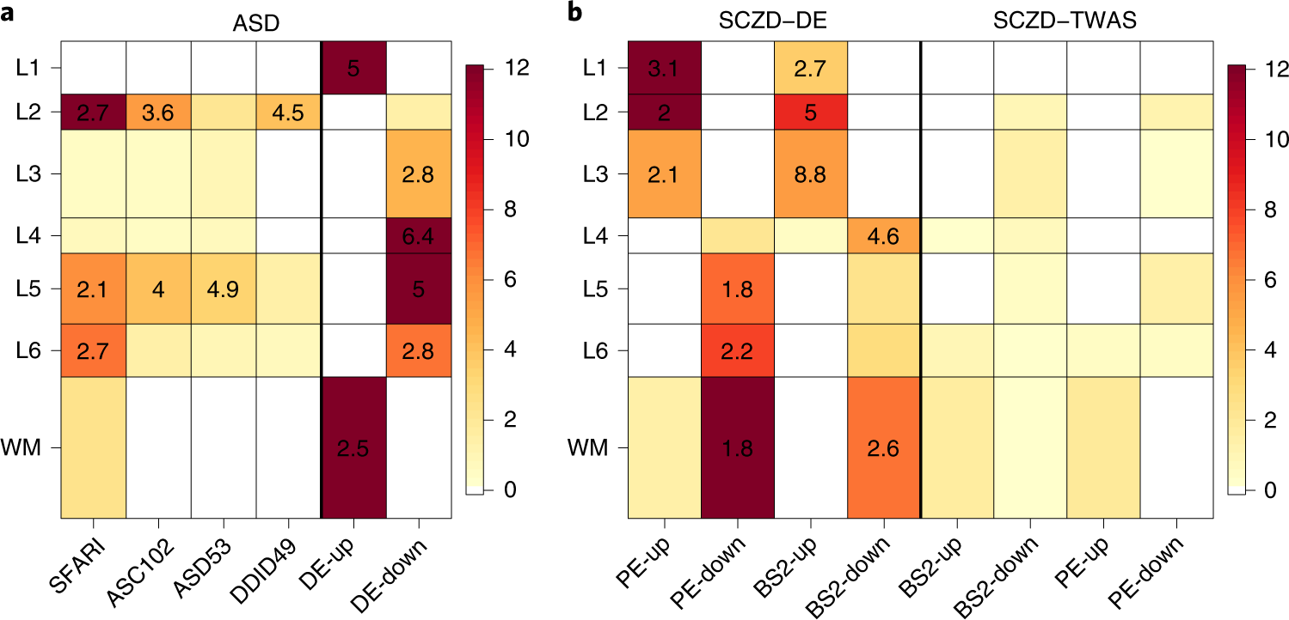
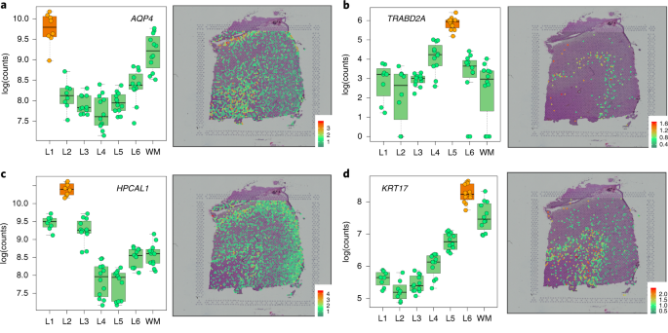
Further applications of
spatial gene expression
Differential layer-enriched expression of genes associated with schizophrenia disorder (SCZD) and autism spectrum disorder (ASD), highlighting the clinical relevance of spatially defined expression
Extensive layer-enriched expression signatures and refined associations to previous laminar markers
Novel cortical layer-enriched genes
Maynard, K.R., Collado-Torres, L., Weber, L.M. et al. Transcriptome-scale spatial gene expression in the human dorsolateral prefrontal cortex. Nat Neurosci 24, 425–436 (2021). https://doi.org/10.1038/s41593-020-00787-0

Slide 13
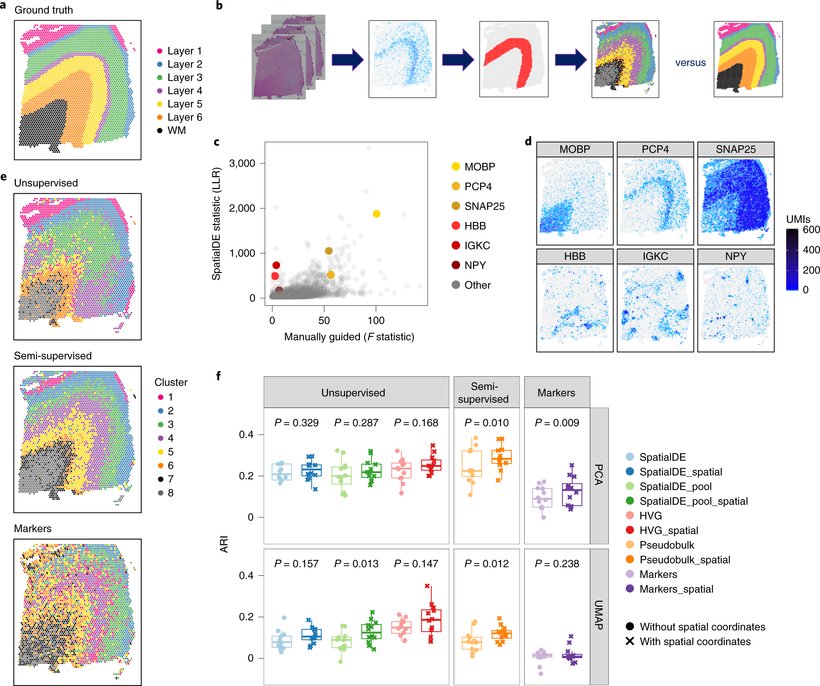
Further applications of spatial gene expression in DLPFC
A data-driven framework to define unsupervised clusters in spatial transcriptomics data, which can be applied to other tissues or brain regions in which morphological architecture is not as well defined as cortical laminae
Supervised annotation
of DLPFC layers
Schematic illustrating the data-driven clustering pipeline
Comparison of gene-wise test statistics
Evaluation of clustering performance
Expression patterns for selected laminar and nonlaminar genes
Maynard, K.R., Collado-Torres, L., Weber, L.M. et al. Transcriptome-scale spatial gene expression in the human dorsolateral prefrontal cortex.
Nat Neurosci 24, 425–436 (2021). https://doi.org/10.1038/s41593-020-00787-0

Slide 14
Imaging genetics
GWAS for imaging phenotypes
  Subcortical region volumes
Genomics, Circuits, and Pathways in Clinical Neuropsychiatry. http://dx.doi.org/10.1016/B978-0-12-800105-9.00007-X

Slide 15
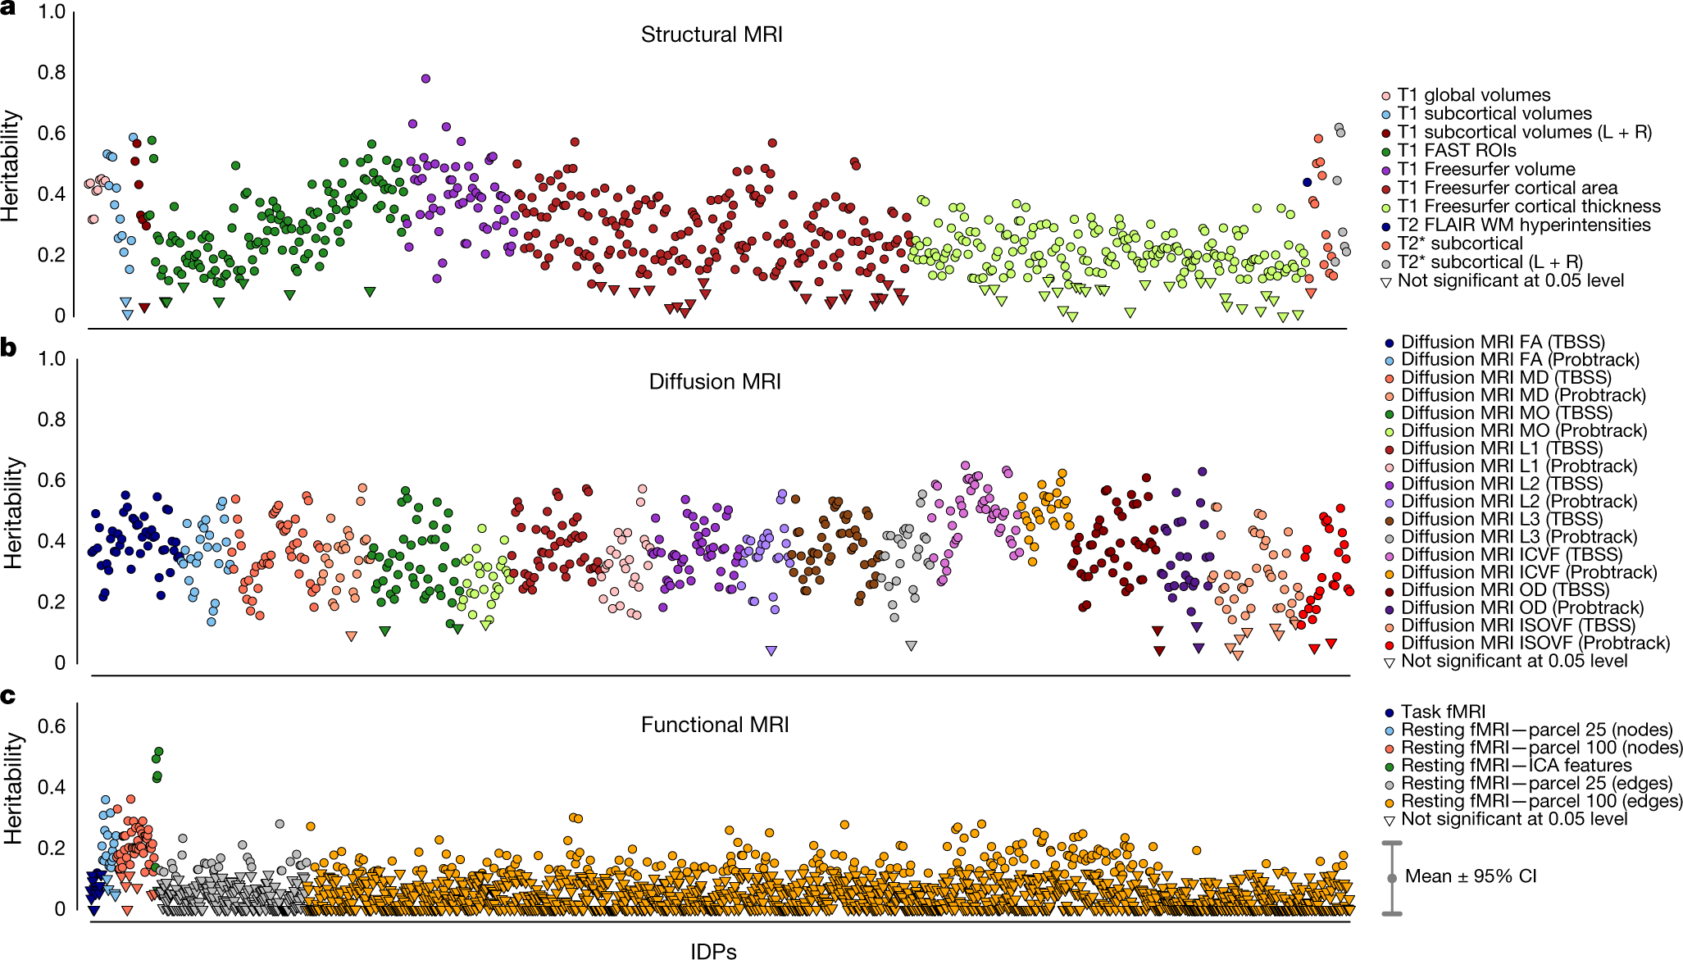
UK BioBank
n = 8,428 subjects for 3,144 functional and structural brain imaging phenotypes
Elliott, L.T., Sharp, K., Alfaro-Almagro, F. et al. Genome-wide association studies of brain imaging phenotypes in UK Biobank. Nature 562, 210–216 (2018). https://doi.org/10.1038/s41586-018-0571-7

Slide 16
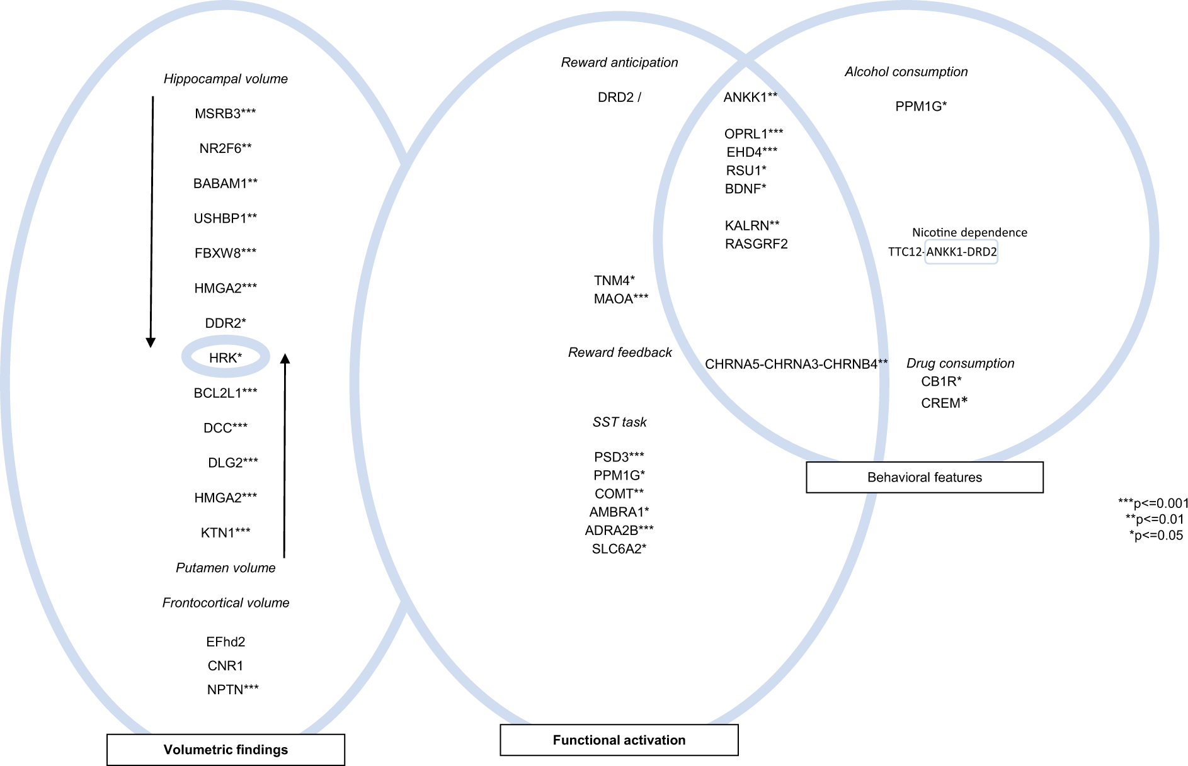
Linking genes to brain phenotypes
IMAGEN cohort
Mascarell Maričić, L., Walter, H., Rosenthal, A. et al. The IMAGEN study: a decade of imaging genetics in adolescents. Mol Psychiatry 25, 2648–2671 (2020).

Slide 17
Artificial Intelligence vs. Machine learning
Artificial Intelligence (AI)
  Broad concept using machines to do human-intelligence tasks
  Visual perception, speech recognition, etc.
Machine learning (ML)
  An AI subarea making machines (e.g., computers) automatically learn how to finish tasks
https://commonfund.nih.gov/bridge2ai/faqs

Slide 18
AI/ML in drug discovery
Previously computer-aided drug design (CADD)
  Molecular structures
  Low successful rate (6.2%)
Increasing data enables AI/ML application
  Omics
  Imaging
  Diagnosis
  Behaviors

Slide 19
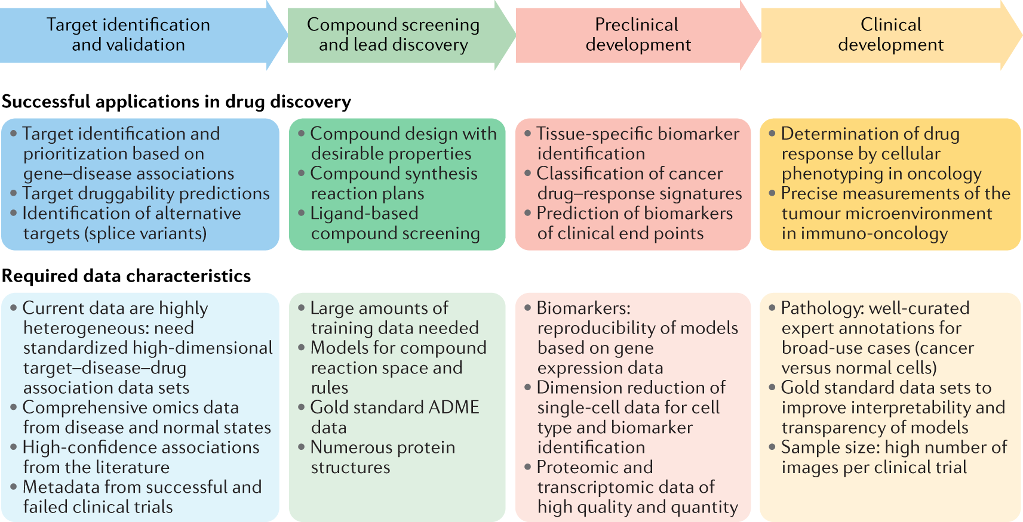
Drug discovery pipeline
Vamathevan, J., Clark, D., Czodrowski, P. et al. Applications of machine learning in drug discovery and development. Nat Rev Drug Discov 18, 463–477 (2019).

Slide 20
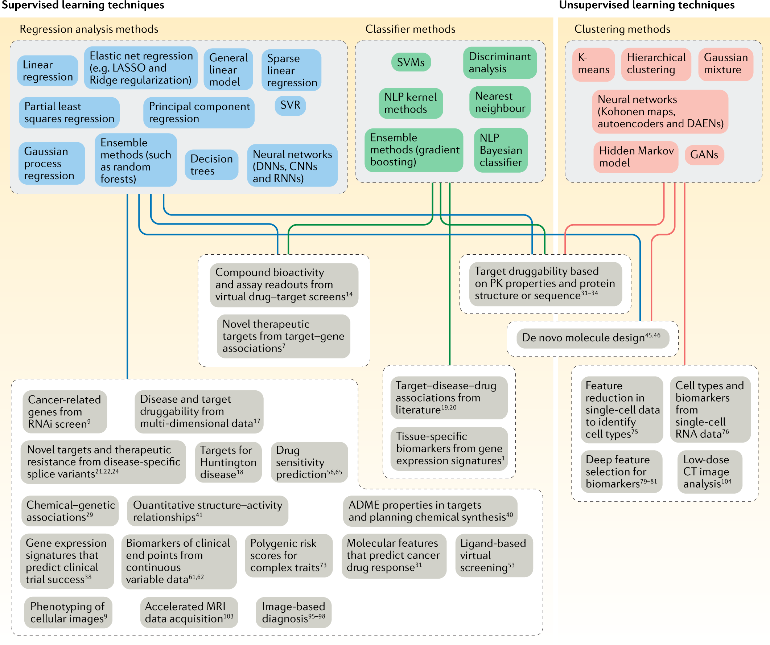
ML approaches for drug discovery
Vamathevan, J., Clark, D., Czodrowski, P. et al. Applications of machine learning in drug discovery and development. Nat Rev Drug Discov 18, 463–477 (2019).

Slide 21
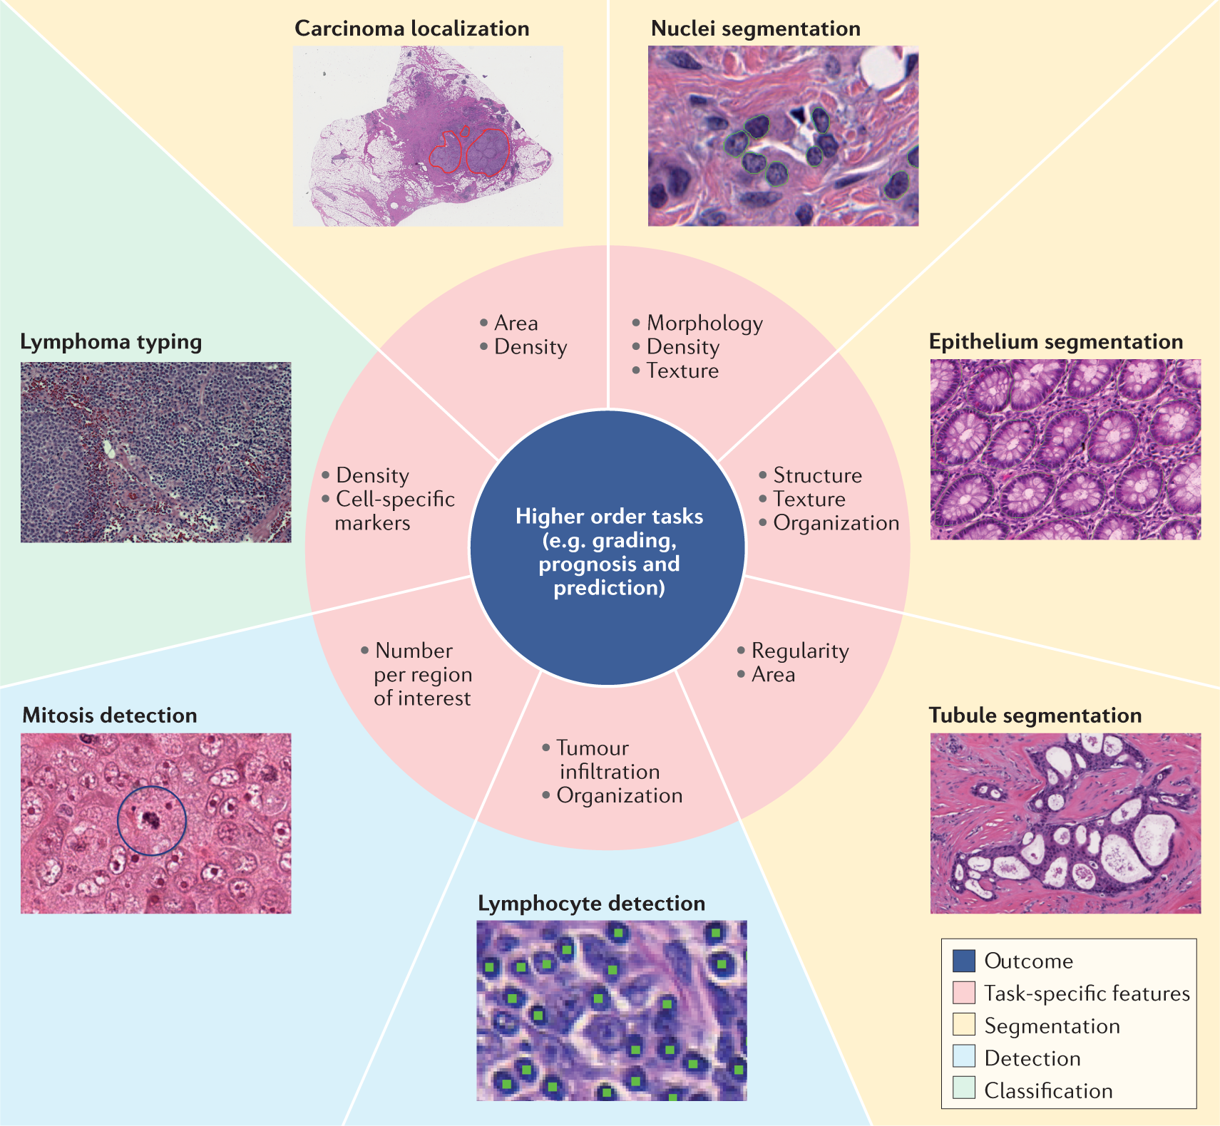
Deep learning applications in pathology
Vamathevan, J., Clark, D., Czodrowski, P. et al. Applications of machine learning in drug discovery and development. Nat Rev Drug Discov 18, 463–477 (2019).

Slide 22
Final exam review
Network biology
Applied machine learning
RNA-seq analysis
Gene discovery

