Slide 1
Single cell omics
BMI/CS 776
www.biostat.wisc.edu/bmi776/
Spring 2021
Daifeng Wang
daifeng.wang@wisc.edu
Thanks to Ting Jin for slides!
These slides, excluding third-party material, are licensed under CC BY-NC 4.0 by Mark Craven, Colin Dewey, Anthony Gitter and Daifeng Wang

Slide 2
Outline
Introduction on single cell sequencing
Single-cell RNA sequencing data processing & analysis
Cell-type gene regulatory networks
scATAC-seq data & analysis plus integration with scRNA-seq
Single cell deconvolution
Dropout

Slide 3
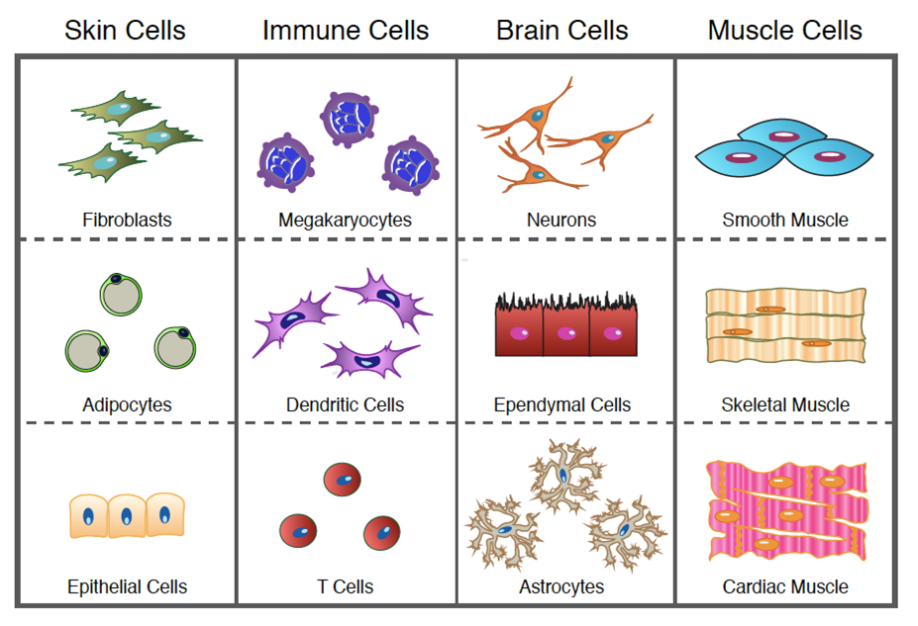

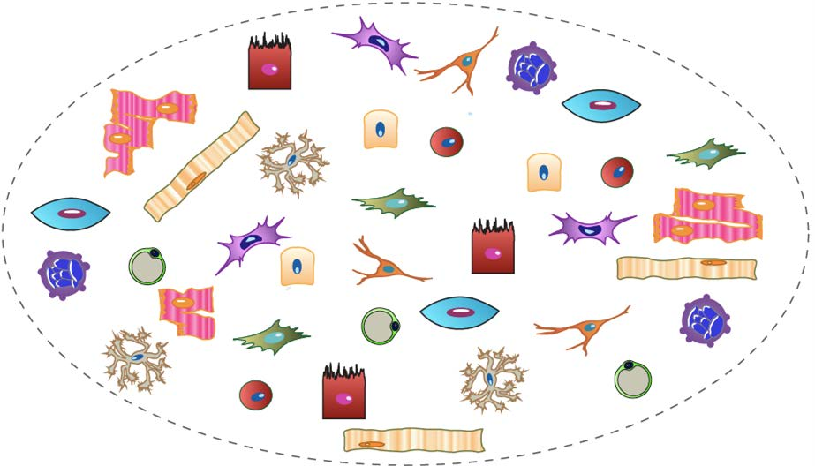
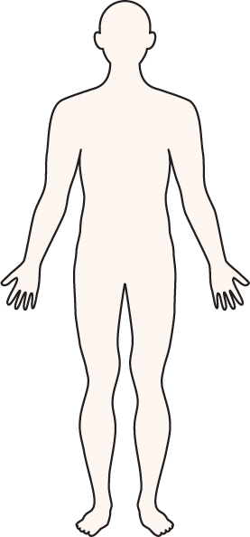
Why study single cells?
Cells are our core constituents, are classified by characteristic molecules, structures, and functions
https://www.youtube.com/watch?v=PRjX3-m16cw

Slide 4
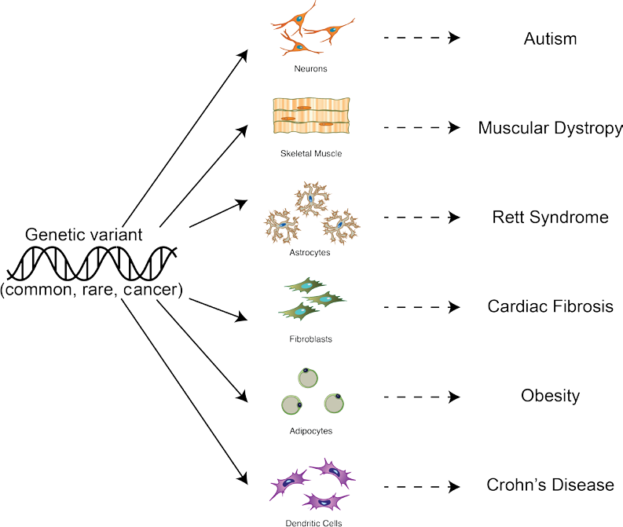

Why study single cells?
Genotype Cell Phenotype
Cells are key intermediate from genotype to phenotype, also are essential for functional dissection of genetic variants
https://bioinformatics-core-shared-training.github.io/cruk-summer-school-2018/SingleCell/slides/2018-07-25_CRUK_CI_summer_school-scRNAseq.pdf
https://www.youtube.com/watch?v=PRjX3-m16cw

Slide 5
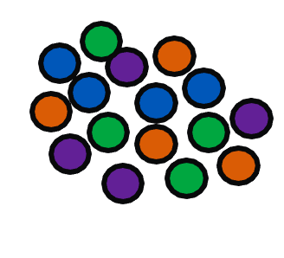
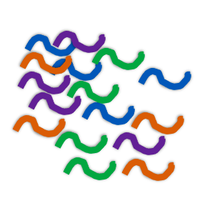






























Bulk vs scRNA-seq
average
expression
level
Bulk RNA-seq
comparative transcriptomics
quantifying expression signatures from ensembles
insufficient for studying heterogeneous system
Population 1
Population 2
Population 3
Population 4
distribution of expression levels
scRNA-seq
inference of gene regulatory networks across the cells
heterogeneity of cell responses
cell type identification

Slide 6



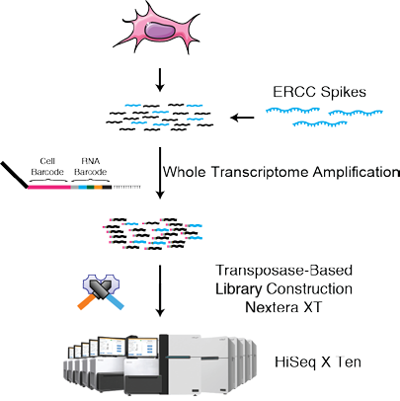
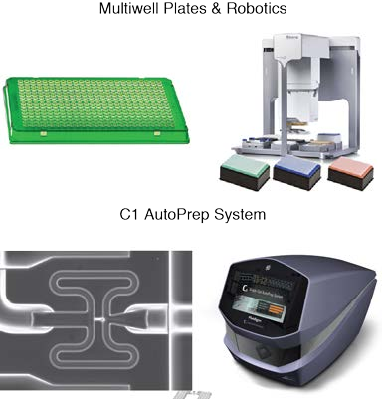
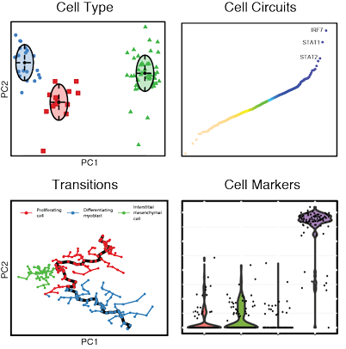
How can we study single cell?
Core technology
Sample prep
Computation
2012: 18 cells
2020: ~100,000 cells
https://www.youtube.com/watch?v=PRjX3-m16cw

Slide 7
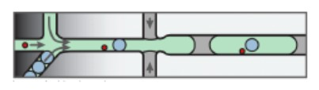
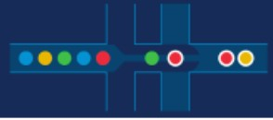
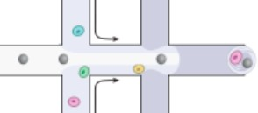
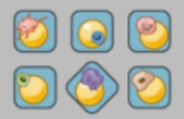
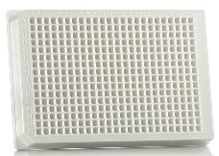
Single cell technology
 | inDrops | 10x Genomics | Drop-seq | Seq-well (Honeycomb) | SMART-seq
Cell capture efficiency | ~70-80% | ~50-70% | ~10% | ~80% | ~80%
Time to capture 10k cells | ~30min | 10min | 1-2 hours | 5-10min | --
Encapsulation type | Droplet | Droplet | Droplet | Nanolitre well | Plate-based
Library prep | CEL-seq Linear amplification by IVT | SMART-seq Exponential PCR based amplification | SMART-seq Exponential PCR based amplification | SMART-seq Exponential PCR based amplification | SMART-seq Exponential PCR based amplification
Commercial | Yes | Yes | -- | Yes (Summer 2020) | Yes
Cost (~$ per cell) | ~0.06 | ~0.2 | ~0.06 | ~0.15 | 1
Strengths | Good cell capture Cost-effective Real-time monitoring Customizable | Good cell capture Fast and easy to run Parallel sample collection High gene / cell counts | Cost-effective Customizable | Good cell capture Cost-effective Real-time monitoring Customizable | Good cell capture Good mRNA capture Full-length transcript No UMI
Weaknesses | Difficult to run | Expensive | Difficult to run & low cell capture efficiency | Available Soon | Expensive
https://github.com/hbctraining/scRNA-seq/blob/master/slides/Single_Cell_2_27_20.pdf

Slide 8
10x Genomics
Single Cell 3’
V3.1 Gel Bead
Step1 : GEM Generation & Barcoding
GEM: Gel Beads-in-emulsion partition that encapsulates each tiny micro-reaction within the Chromium system
Step2 : Post GEM-RT Cleanup & cDNA Amplification
Step3: 3ʹ Gene Expression Library Construction
Chromium Single Cell 3' Reagent Kits User Guide (v3.1 Chemistry).User Guide, v3.1 Next GEM Chemistry, Last Modified on November 22, 2019, Permalink
https://support.10xgenomics.com/single-cell-gene-expression/index/doc/user-guide-chromium-single-cell-3-reagent-kits-user-guide-v31-chemistry

Slide 9
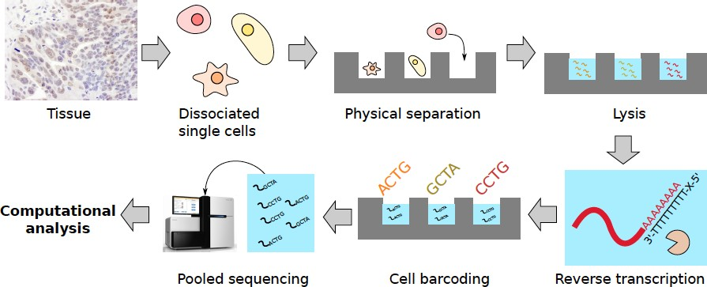
Workflow for typical scRNA-seq experiment
https://bioinformatics-core-shared-training.github.io/cruk-summer-school-2018/SingleCell/slides/2018-07-25_CRUK_CI_summer_school-scRNAseq.pdf

Slide 10
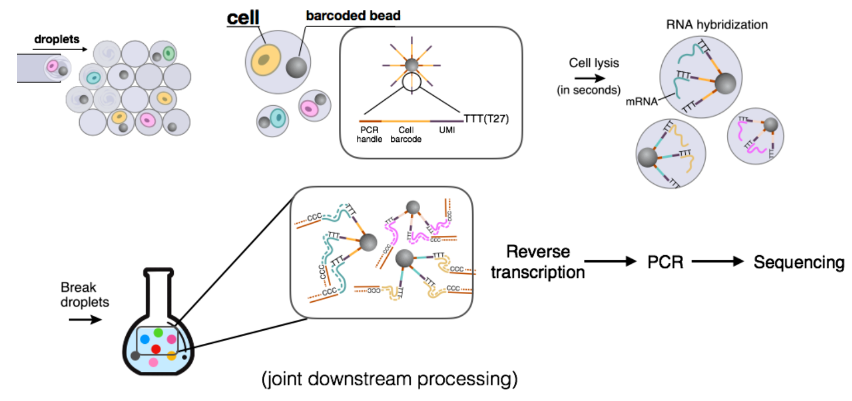
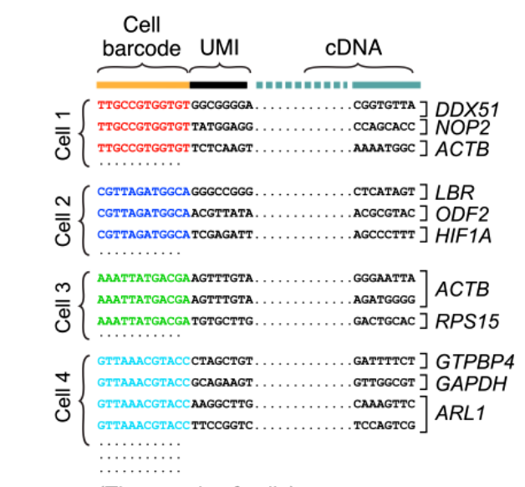
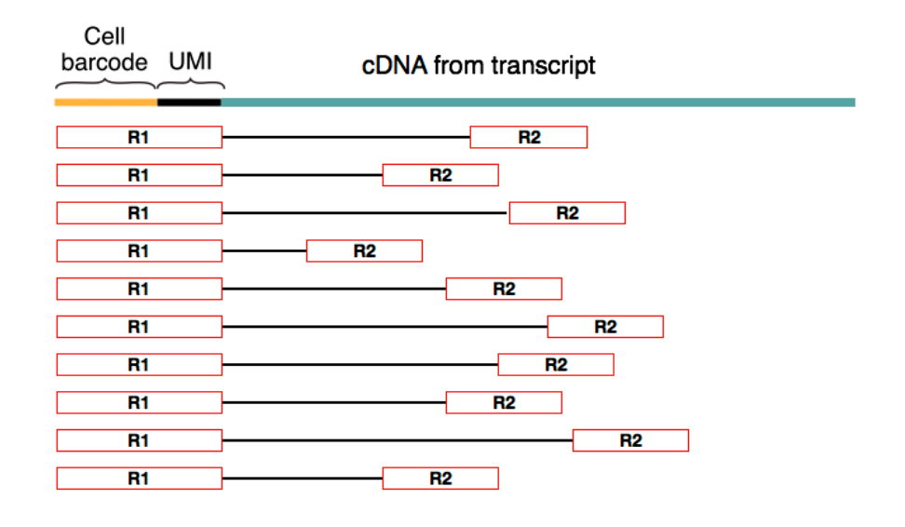
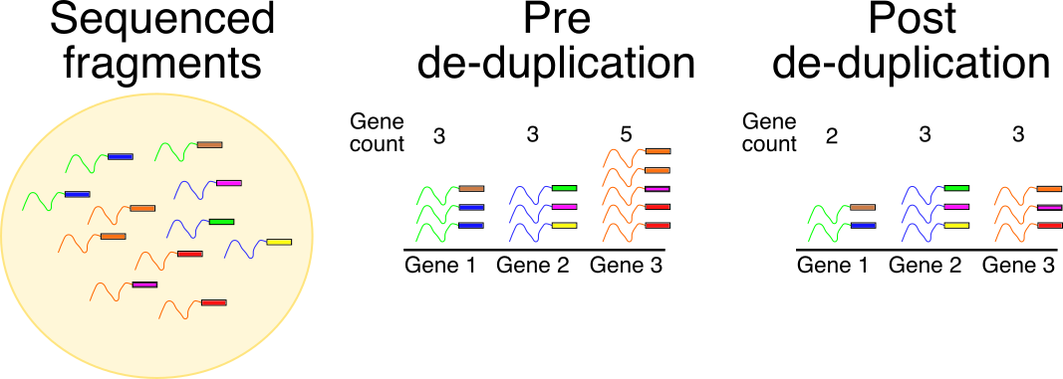
UMI
Unique molecular identifier
UMIs are short (4-10bp) random barcodes added to transcripts during reverse-transcription. They enable sequencing reads to be assigned to individual transcript molecules and thus the removal of amplification noise and biases from scRNA-Seq data
Drop-Seq workflow
Grouping barcodes
to assign reads to cells
Biased paired-end reads
They reduce the amplification noise by allowing (almost) complete de-duplication of sequenced fragments
https://bioinformatics-core-shared-training.github.io/cruk-summer-school-2018/SingleCell/slides/2018-07-25_CRUK_CI_summer_school-scRNAseq.pdf
http://data-science-sequencing.github.io/Win2018/lectures/lecture16/

Slide 11
Single-cell RNA sequencing data processing & analysis
Dimensional reduction
  Non-linear: t-SNE, UMAP
  Linear: PCA
Cell clustering
  K-means
  hierarchical clustering
  graph-based clustering
Cell type annotation
  SingleR
Cell type markers
  Differential expression analysis
Pseudo timing

Slide 12
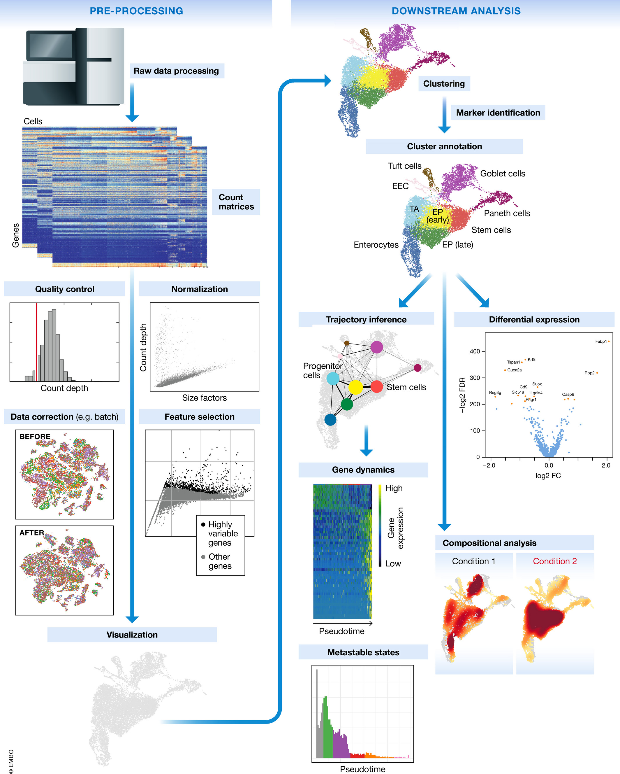
Single-cell RNA-seq workflow
Generation of the count matrix
Quality control of the raw counts
Marker gene identification
  Single-cell differential expression analysis
Luecken, MD and Theis, FJ. Current best practices in single‐cell RNA‐seq analysis: a tutorial, Mol Syst Biol 2019 (doi: https://doi.org/10.15252/msb.20188746)

Slide 13
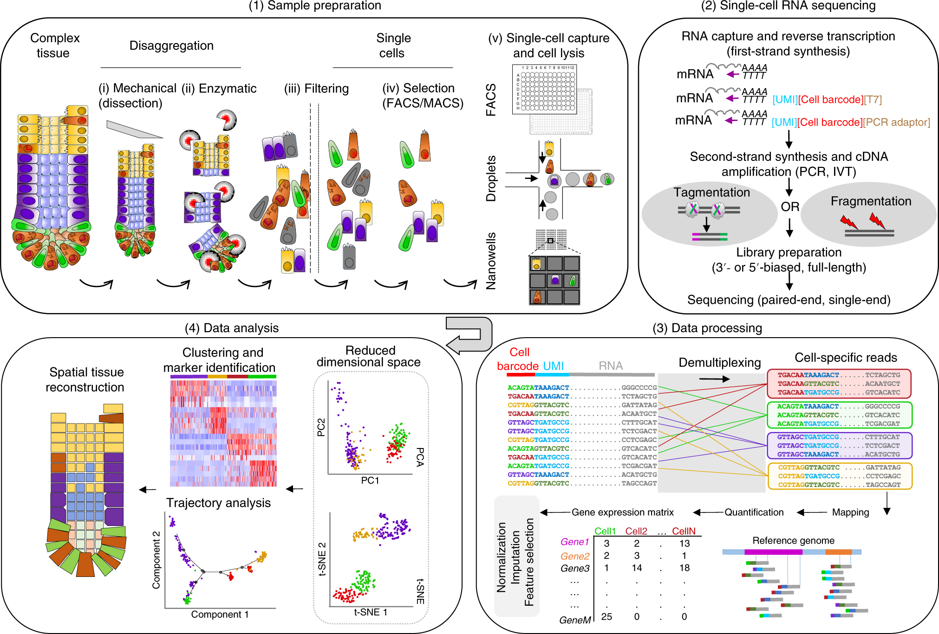
Single-cell RNA-seq process
Lafzi et al. Tutorial: guidelines for the experimental design of single-cell RNA sequencing studies, Nature Protocols 2018 (https://doi.org/10.1038/s41596-018-0073-y)

Slide 14
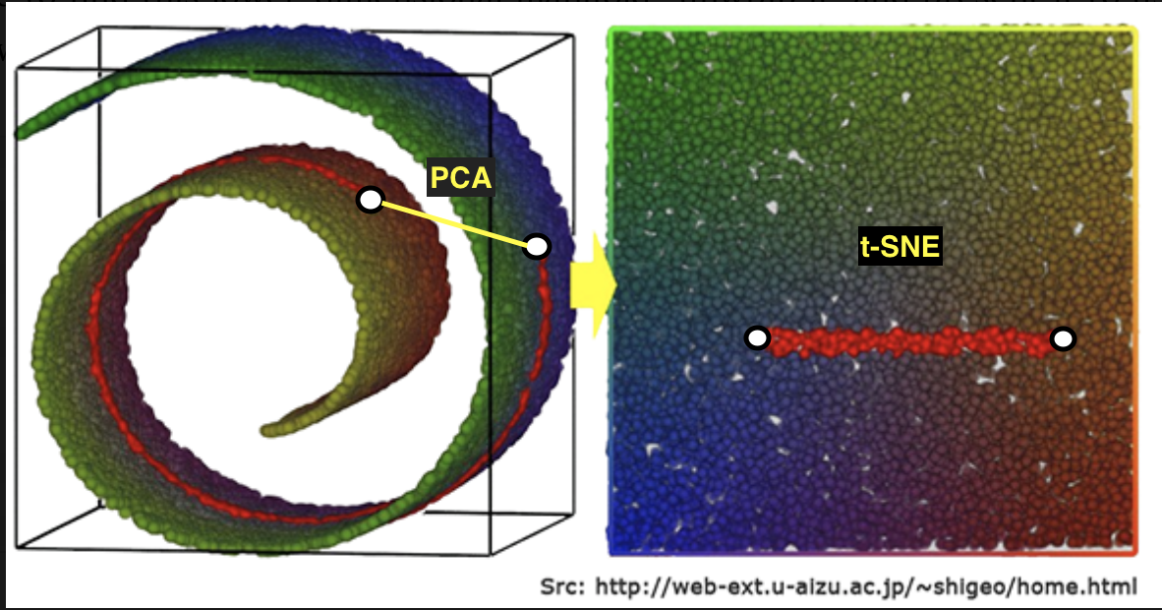
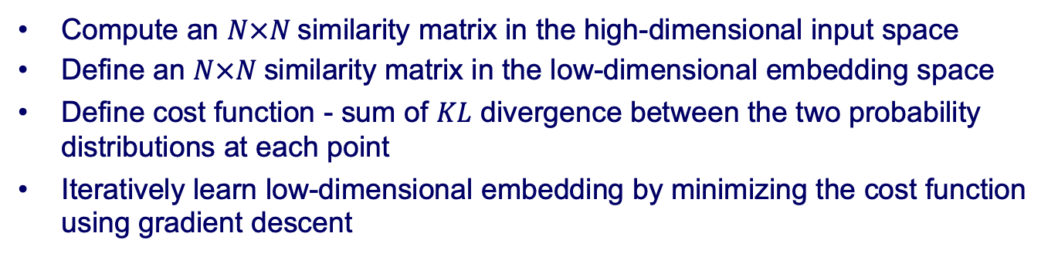
tSNE t-Stochastic Neighborhood Embedding
Compute an $N×N$similarity matrix in the high-dimensional input space
Define an $N×N$similarity matrix in the low-dimensional embedding space
Define cost function - sum of $KL$ divergence between the two probability distributions at each point
Iteratively learn low-dimensional embedding by minimizing the cost function using gradient descent
L.J.P. van der Maaten and G.E. Hinton. Visualizing High-Dimensional Data Using t-SNE. JMLR2008

Slide 15
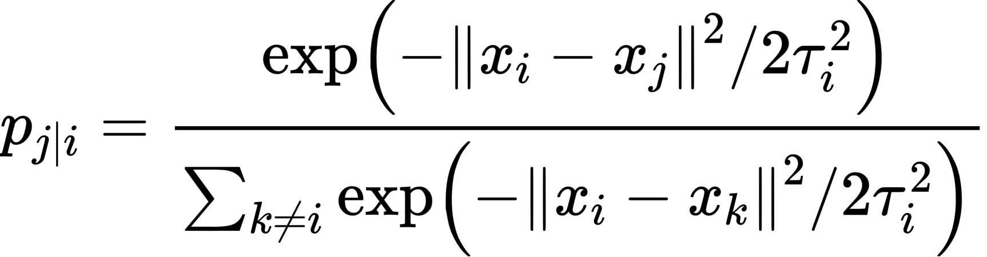
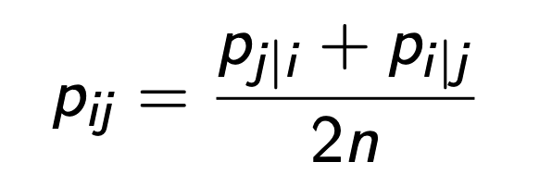



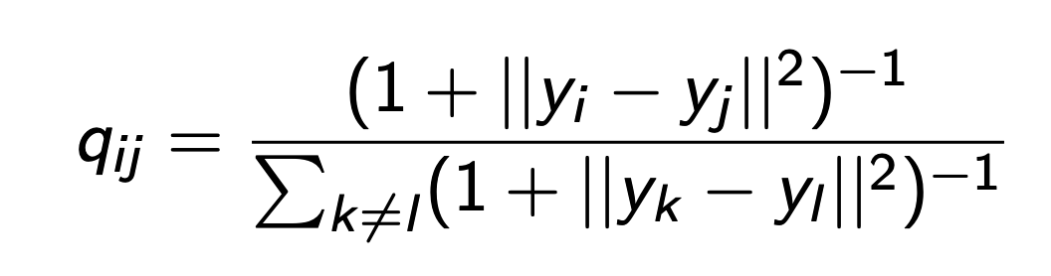
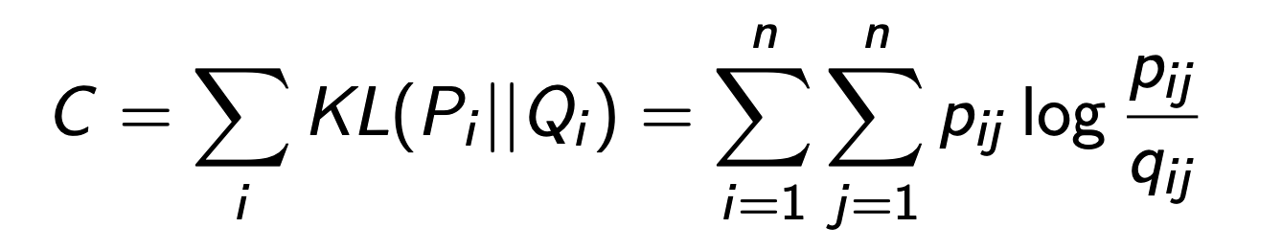

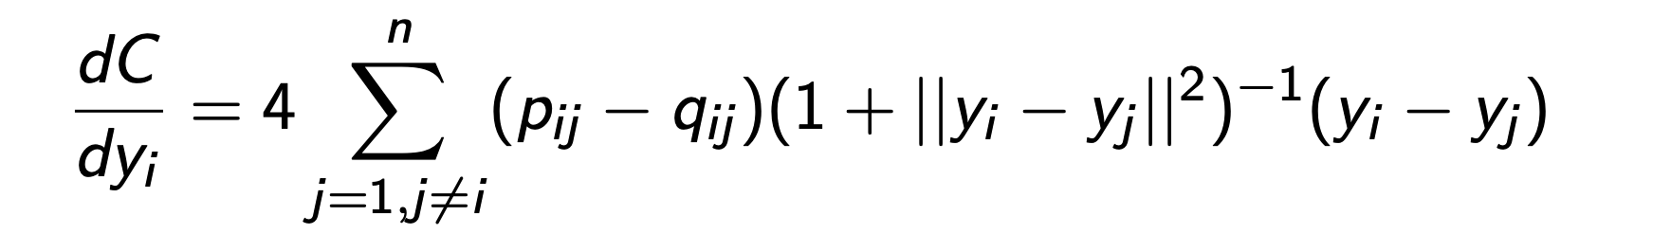
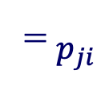
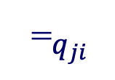
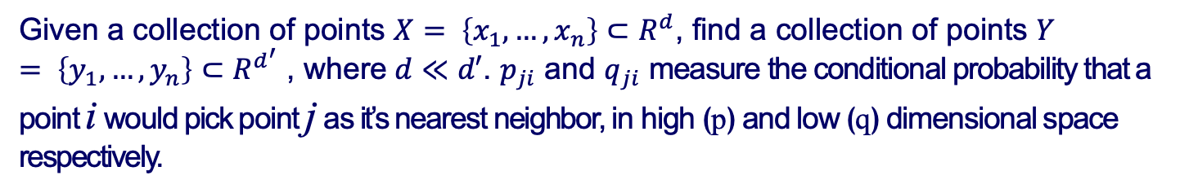
Modulization
Given a collection of points $X= \left\{x_{1},…,x_{n}\right\}⊂R^{d}$, find a collection of points $Y= \left\{y_{1},…,y_{n}\right\}⊂R^{d^{′}}$ , where$d≪d′$. $p_{ji}$ and $q_{ji}$ measure the conditional probability that a point i would pick point j as it’s nearest neighbor, in high (p) and low (q) dimensional space respectively.
Similarity matrix at high dimension:
High dimension
where τ _{i}² is the variance for the Gaussian distribution centered around x_{i}
j
⁼ $p_{ji}$
i
Similarity matrix at low dimension:
Low dimension
Cost Function (Kullback-Leibler divergence):
j
⁼ $q_{ji}$
Derivatives:
i
L.J.P. van der Maaten and G.E. Hinton. Visualizing High-Dimensional Data Using t-SNE. JMLR2008

Slide 16
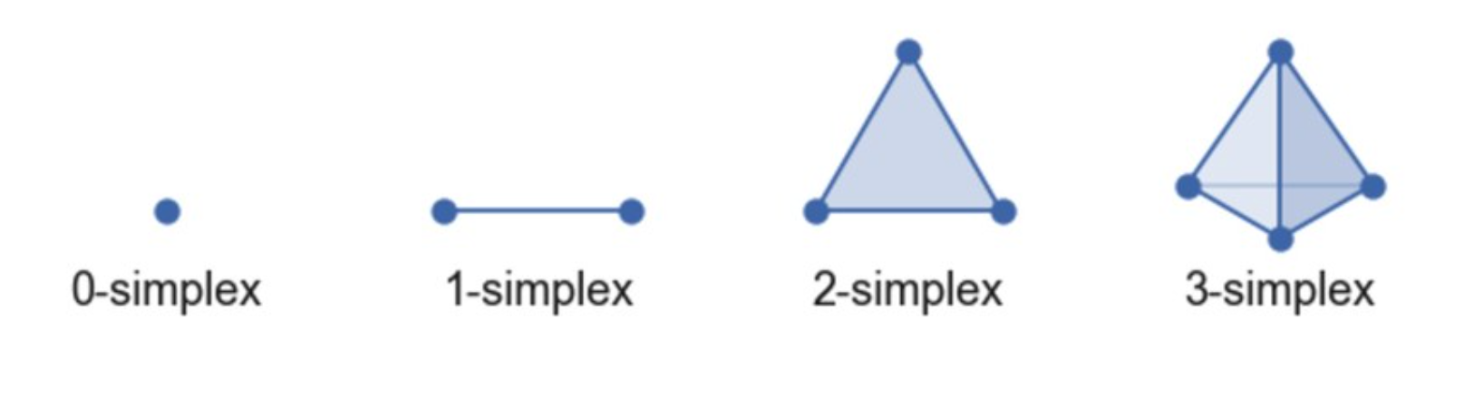
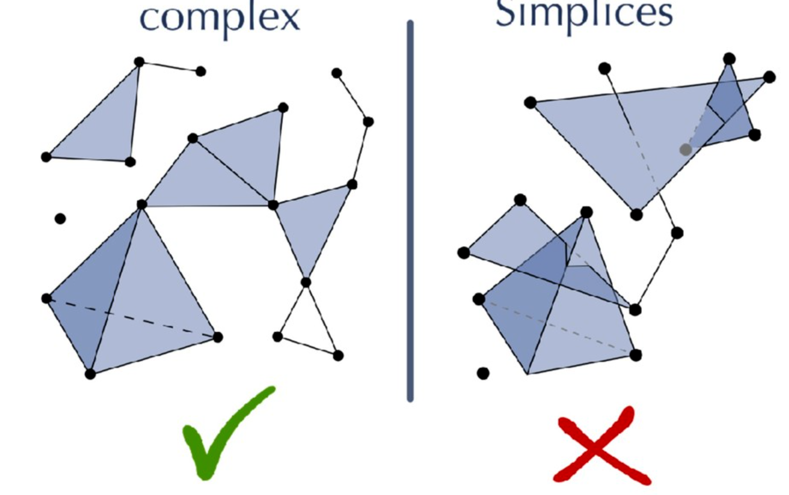










UMAP
Uniform Manifold Approximation and Projection
UMAP is based on topological structures in the multidimensional space (simplices)
Simplicial complexes are a means to construct topological spaces out of simple combinatorial components, and calculate the relative point distances in the low dimension
$$x_{3}$$
$$x_{3}$$
$$x_{1}$$
$$x_{1}$$
$$x_{2}$$
$$x_{1}$$
$$x_{4}$$
$$x_{1}$$
$$x_{2}$$
$$x_{2}$$
Vertex Edge Triangle Tetrahedron k-simplex
$[x_{1}]$ $[x_{1, }x_{2 }]$ $[x_{1, }x_{2 }{,x}_{3}]$ $[x_{1, }x_{2 }{,x}_{3}{,x}_{4}]$ $[x_{1, }x_{2 }{,…, x}_{k+1}]$
Simplicial complex
Collection of simplices
https://www.youtube.com/watch?v=nq6iPZVUxZU
https://nbisweden.github.io/excelerate-scRNAseq/session-dim-reduction/lecture_dimensionality_reduction.pdf
https://umap-learn.readthedocs.io/en/latest/how_umap_works.html

Slide 17
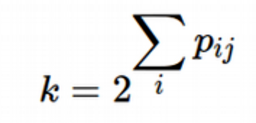
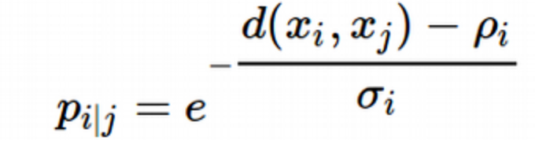
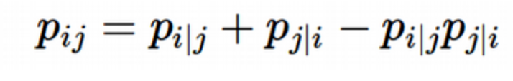
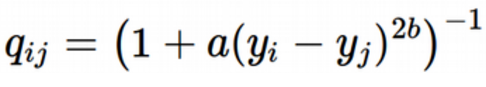
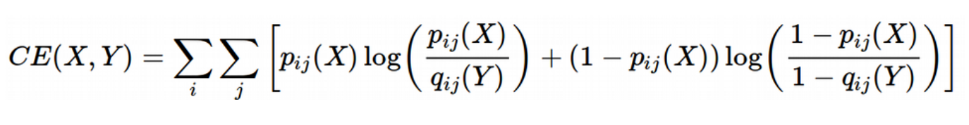
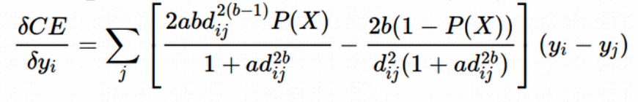

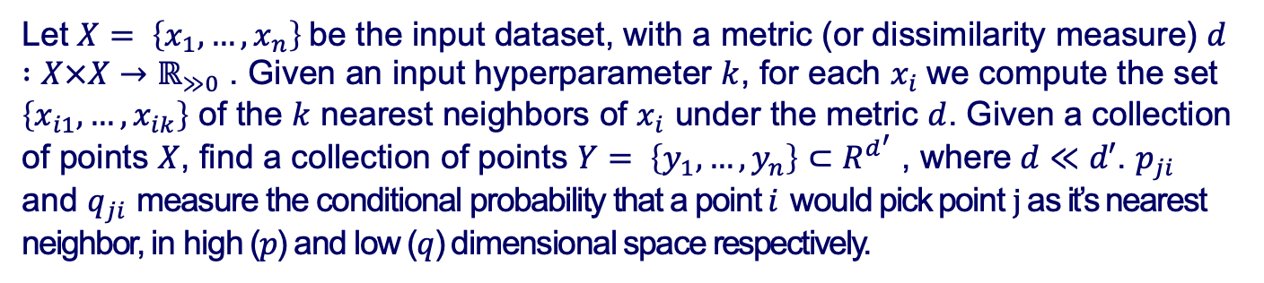
Modulization
Let $X= \left\{x_{1},…,x_{n}\right\}$be the input dataset, with a metric (or dissimilarity measure) $d :X×X→ℝ_{≫0}$ . Given an input hyperparameter $k$, for each $x_{i}$we compute the set $\left\{x_{i1},…,x_{ik}\right\}$ of the $k$ nearest neighbors of $x_{i}$ under the metric $d$. Given a collection of points $X$, find a collection of points $Y= \left\{y_{1},…,y_{n}\right\}⊂R^{d^{′}}$ , where$d≪d′$. $p_{ji}$ and $q_{ji}$ measure the conditional probability that a point $i$ would pick point $j$ as it’s nearest neighbor, in high ($p$) and low ($q$) dimensional space respectively.
Similarity matrix at high dimension:
Similarity matrix at low dimension:
UMAP uses the family of curves $1/a×y^{2b}$ for modelling distance probabilities in low dimensions, $a$ and $b$ are hyperparameters
Cost Function ( binary cross-entropy (CE)):
Derivatives:
https://towardsdatascience.com/how-exactly-umap-works-13e3040e1668
arXiv:1802.03426

Slide 18
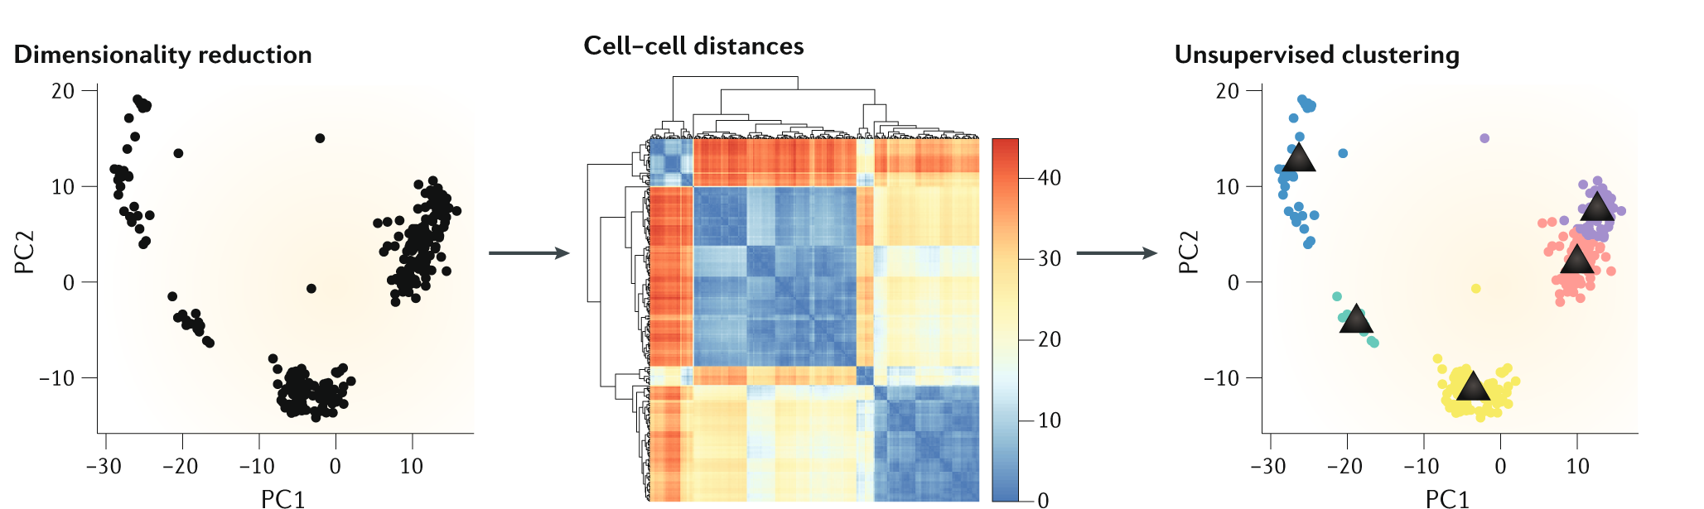
Unsupervised clustering of scRNA-seq
Feature selection and dimensionality reduction extracts the most informative genes and strongest signals from background noise, respectively
Cell–cell distances are then calculated in the lower dimensional space and used to either construct a cell–cell distance graph or used directly by clustering algorithms to assign cells to clusters
Kiselev, V.Y., Andrews, T.S. & Hemberg, M. Challenges in unsupervised clustering of single-cell RNA-seq data. Nat Rev Genet 20, 273–282 (2019). https://doi.org/10.1038/s41576-018-0088-9

Slide 19
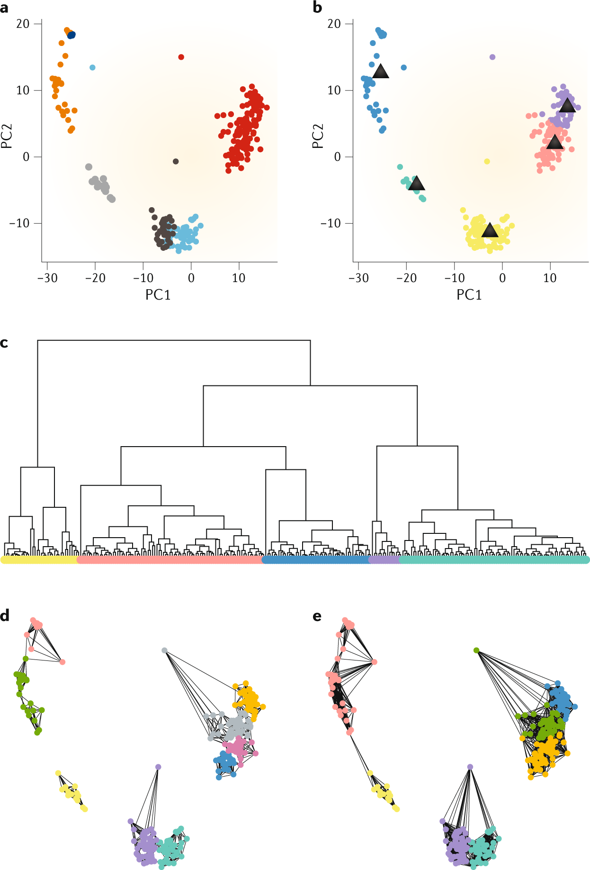

Clustering methods for scRNA-seq
Unsupervised clustering methods:
K-means
hierarchical clustering
graph-based clustering
Tools for graph-based clustering:
Seurat: Louvain, Leiden, SLM
igraph:fast greedy, Louvain, optimal, walktrap, spinglass, infomap
Kiselev, V.Y., Andrews, T.S. & Hemberg, M. Challenges in unsupervised clustering of single-cell RNA-seq data. Nat Rev Genet 20, 273–282 (2019). https://doi.org/10.1038/s41576-018-0088-9

Slide 20
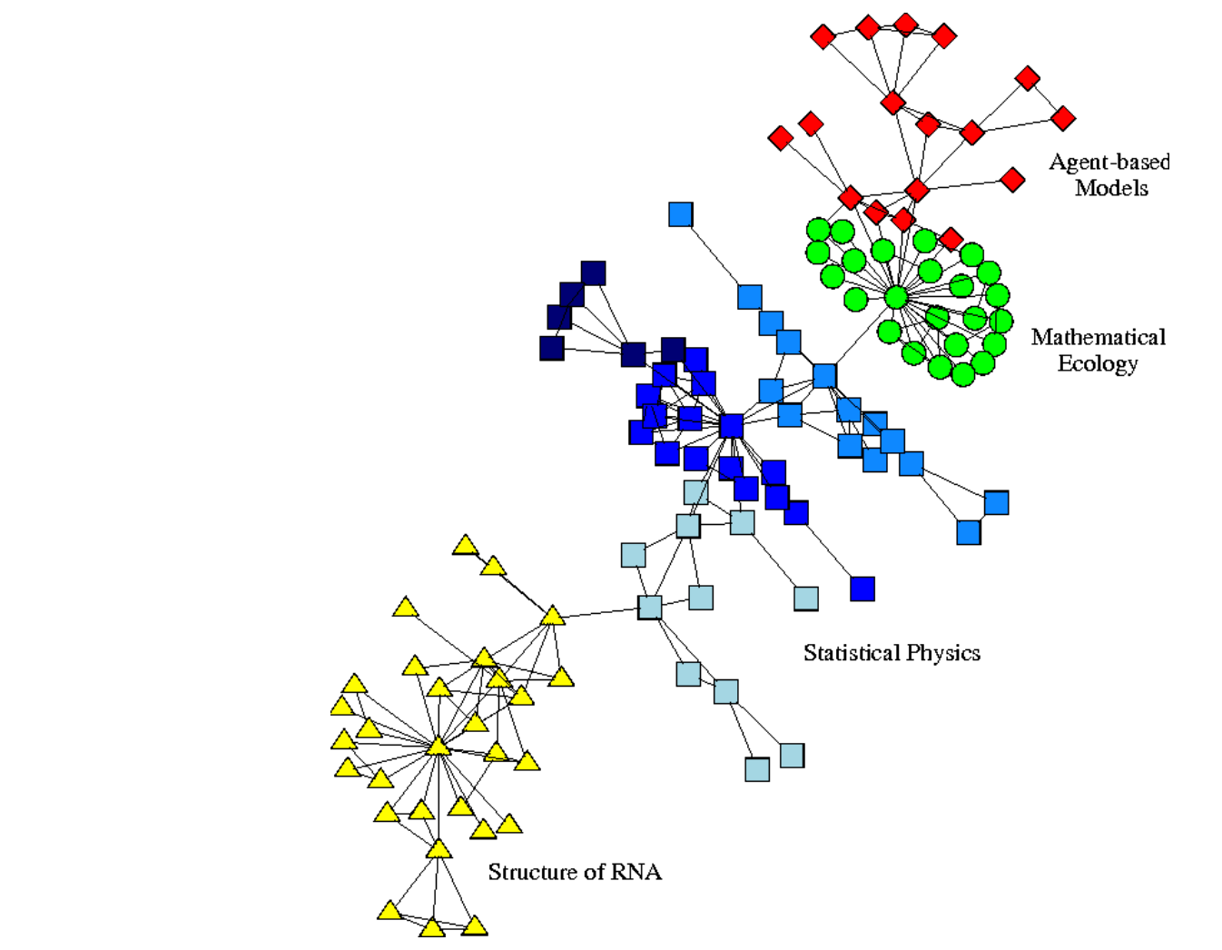
Graph-based clustering
“A community is subset of actors among whom there are relatively strong, direct, intense, frequent or positive ties”
Some of community detection methods can be applied to scRNA-seq data by building a graph where each vertice represents a cell and (weight of) the edge measures similarity between two cells
Graph-based clustering is the most popular clustering algorithm in scRNA-seq data analysis, and has been reported to have outperformed other clustering methods in many situations (Freytag et al. 2018)
Freytag, Saskia, Luyi Tian, Ingrid Lönnstedt, Milica Ng, and Melanie Bahlo. 2018. “Comparison of Clustering Tools in R for Medium-Sized 10x Genomics Single-Cell Rna-Sequencing Data.” F1000Research 7. Faculty of 1000 Ltd.
Wasserman, S. & Faust, K. (1994) Social Network Analysis (Cambridge Univ. Press, Cambridge, U.K.).
https://biocellgen-public.svi.edu.au/mig_2019_scrnaseq-workshop/public/clustering-and-cell-annotation.html#ref-freytag2018comparison

Slide 21
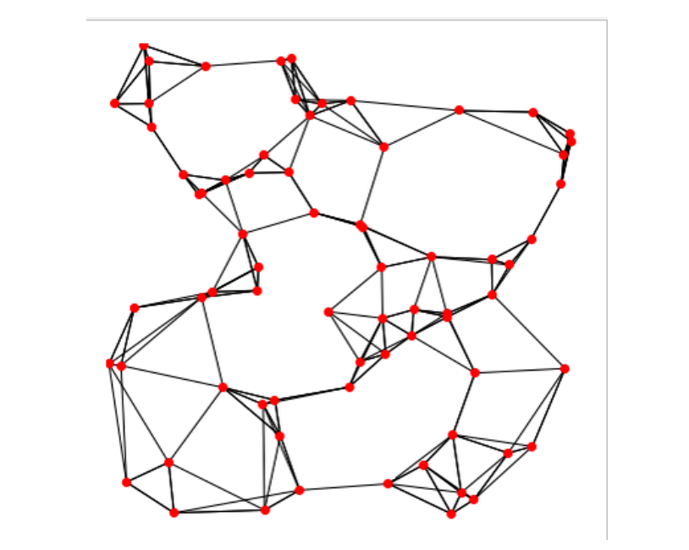
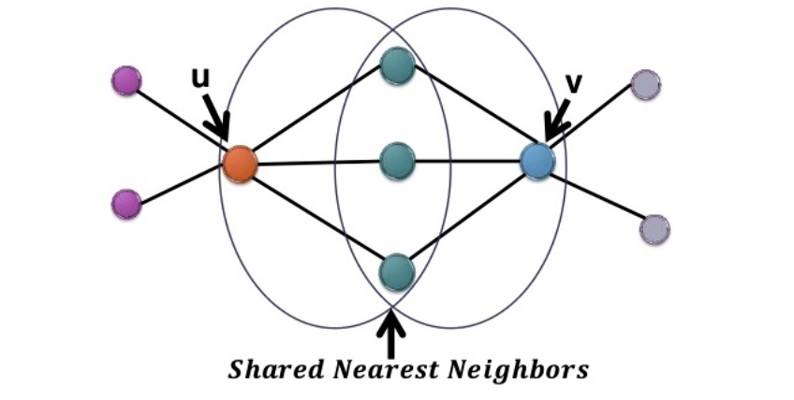
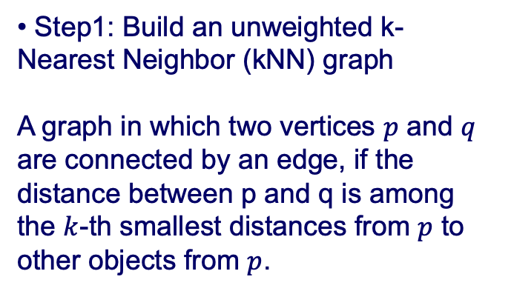
Graph-based clustering
Building a graph
• Step1: Build an unweighted k-Nearest Neighbor (kNN) graph
A graph in which two vertices $p$ and $q$ are connected by an edge, if the distance between p and q is among the $k$-th smallest distances from $p$ to other objects from $p$.
• Step2: Add weights, and obtain a Shared Nearest Neighbor (SNN) graph
A graph in which weights define proximity, or similarity between two nodes in terms of the number of neighbors (i.e., directly connected nodes) they have in common.
https://biocellgen-public.svi.edu.au/mig_2019_scrnaseq-workshop/public/clustering-and-cell-annotation.html#ref-freytag2018comparison

Slide 22
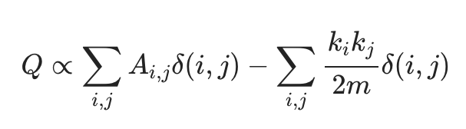
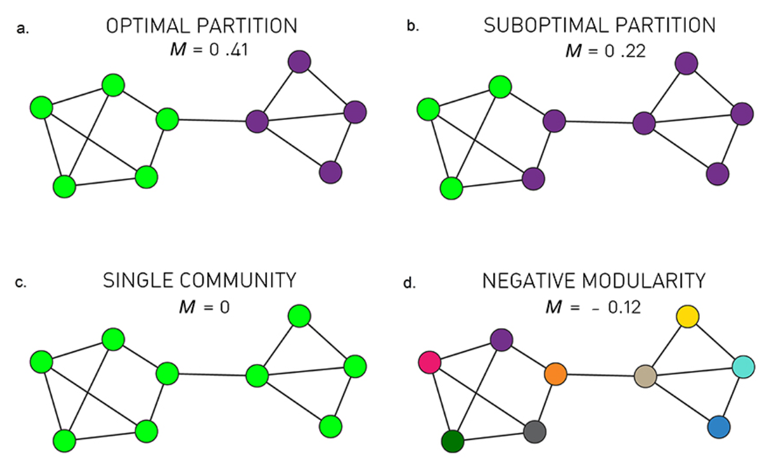
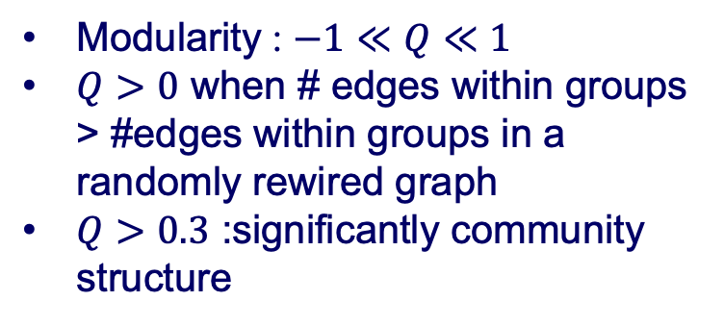
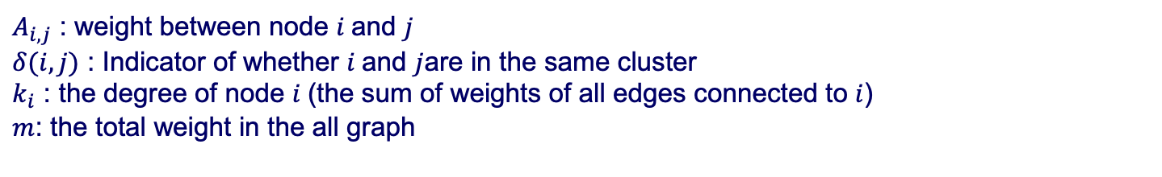
Modularity
Modularity (Newman and Girvan 2004) is not the only quality function for graph-based clustering, but it is one of the first attempts to embed in a compact form many questions including the definition of quality function and null model etc.
$A_{i,j}$ : weight between node $i$and $j$
$δ(i,j)$ : Indicator of whether $i$and $j$are in the same cluster
$k_{i}$ : the degree of node $i$(the sum of weights of all edges connected to $i$)
$m$: the total weight in the all graph
Higher modularity implies better partition
Modularity : $−1≪Q≪1$
$Q>0$ when # edges within groups > #edges within groups in a randomly rewired graph
$Q>0.3$ :significantly community structure
Newman, Mark EJ, and Michelle Girvan. 2004. “Finding and Evaluating Community Structure in Networks.” Physical Review E 69 (2). APS: 026113.
https://biocellgen-public.svi.edu.au/mig_2019_scrnaseq-workshop/public/clustering-and-cell-annotation.html#ref-freytag2018comparison

Slide 23


Louvain community detection
Start with every node in its own community
Step1: Modularity optimization
  Order the nodes and for each node $i$, move $i$ to the community of neighbor $j$ that leads to maximum $∆Q$
  If all $∆Q<0$ the $i$ remains in its current community
  Repeatedly cycle through all nodes until $∆Q=0$
Step2 : Community aggregation
  Create a weighted network of communities from Step1
  Nodes : communities in Step1
  Edge weights : sum of weights of edges between communities
  Edges within a community become two self-loops
Repeat: Apply Step1/ Step2 to resulting network, and so on until $∆Q=0$
https://biocellgen-public.svi.edu.au/mig_2019_scrnaseq-workshop/public/clustering-and-cell-annotation.html#ref-freytag2018comparison
https://www.youtube.com/watch?v=QNv7rKWCgM8

Slide 24



Cell type annotation
The most challenging task in scRNA-seq data analysis is arguably the interpretation of the results. Obtaining clusters of cells is fairly straightforward, but it is more difficult to determine what biological state is represented by each of those clusters
Various computational approaches could exploit prior biological knowledge to assign meaning to an uncharacterized scRNA-seq dataset could be used
Types of cell type annotation tools
  Supervised methods: require a training dataset labeled with the corresponding cell populations in order to train the classifier
    SingleR, ACTINN, CaSTle
  Prior-knowledge based methods: either a marker gene file is required as an input or a pretrained classifier for specific cell populations is provided
    DigitalCelllSorter, Moana
Annotation
https://btep.ccr.cancer.gov/wp-content/uploads/Celltype_Annotation_final.pdf
https://biocellgen-public.svi.edu.au/mig_2019_scrnaseq-workshop/public/clustering-and-cell-annotation.html
https://bioconductor.org/books/release/OSCA/cell-type-annotation.html

Slide 25







Cell type annotation
SingleR : Reference-based annotation of scRNA-seq
Step1: Find variable gene
  For every gene, obtain median grouped by label
  Select genes that makes at least one label different: If we are looking for the genes that makes label “green” different from label “red”, we substract the second column by the first, and pick the top $N$ highest and positive values
Step2: Spearman’s correlation
  Spearman’s correlation $∈[−1,1]$ is a measure of the strength of a linear or monotonic relationship between paired data.
  compute the Spearman’s correlation for all pairs of cells in the test and reference dataset, and obtain an $n_{test}×n_{ref}$correlation matrix, where $n$ is the number of cells (see the first matrix in Step3).
Step3 : Scoring
  We want to know how each cell in the test data is correlated to the labels in the reference data, instead of each reference cell. So we take the correlations of a cell in the test data with all the cells with a certain label in the reference data, and summarize them into one number or a score, in SingleR, the default is to take the $80\%$ quantile.
Step4 : Fine tuning
https://biocellgen-public.svi.edu.au/mig_2019_scrnaseq-workshop/public/clustering-and-cell-annotation.html
Notes:
Step3 : Scoring

Slide 26

Cell type annotation
SingleR : Reference-based annotation of scRNA-seq
correlated single-cell transcriptomes with reference transcriptomic data sets and improved its inferences iteratively
Aran, D., Looney, A.P., Liu, L. et al. Reference-based analysis of lung single-cell sequencing reveals a transitional profibrotic macrophage. Nat Immunol 20, 163–172 (2019). https://doi.org/10.1038/s41590-018-0276-y

Slide 27


Cell type markers identification
Differential expression analysis
Non-parametric tests
  Wilcoxon rank sum test
  Student’s t-test
Methods specific for scRNA-seq
  MAST : GLM-framework that treats cellular detection rate as a covariate (Finak et al, Genome Biology, 2015)
Methods for bulk RNA-seq
  DESeq2 : DE based on a model using the negative binomial distribution (Love et al, Genome Biology 2014)
Finak, G., McDavid, A., Yajima, M. et al. MAST: a flexible statistical framework for assessing transcriptional changes and characterizing heterogeneity in single-cell RNA sequencing data. Genome Biol 16, 278 (2015). https://doi.org/10.1186/s13059-015-0844-5
Love MI, Huber W, Anders S (2014). “Moderated estimation of fold change and dispersion for RNA-seq data with DESeq2.” Genome Biology, 15, 550. doi: 10.1186/s13059-014-0550-8.
https://satijalab.org/seurat/archive/v3.1/immune_alignment.html

Slide 28

Pseudo timing
Many differentiation processes taking place during development: following a stimulus, cells will change from one cell-type to another. We must sample at multiple time-points and obtain snapshots of the gene expression profiles.
Since some of the cells will proceed faster along the differentiation than others, each snapshot may contain cells at varying points along the developmental progression.
We use statistical methods to order the cells along one or more trajectories which represent the underlying developmental trajectories, this ordering is referred to as “pseudotime”
Using single-cell -omics data, many trajectory inference (TI) methods could computationally order cells along trajectories, allowing the unbiased study of cellular dynamic processes
http://cole-trapnell-lab.github.io/monocle-release/docs/#constructing-single-cell-trajectories
https://scrnaseq-course.cog.sanger.ac.uk/website/biological-analysis.html#pseudotime-analysis
Saelens, W., Cannoodt, R., Todorov, H. et al. A comparison of single-cell trajectory inference methods. Nat Biotechnol 37, 547–554 (2019). https://doi.org/10.1038/s41587-019-0071-9

Slide 29

Pseudo timing
Practical guideline for method users
The performance of a method mostly depends on the topology of the trajectory, the choice of TI method will be primarily influenced by the user’s existing knowledge about the expected topology in the data. Methods to the right are ranked according to their performance on a particular (set of) trajectory type. Further to the right are shown the accuracy (+: scaled performance ≥ 0.9, ±: >0.6), usability scores (+:≥0.9, ± ≥0.6), estimated running times and required prior information. k, thousands; m, millions.
Saelens, W., Cannoodt, R., Todorov, H. et al. A comparison of single-cell trajectory inference methods. Nat Biotechnol 37, 547–554 (2019). https://doi.org/10.1038/s41587-019-0071-9

Slide 30

Gene regulation
Gene regulation is the process of controlling which genes in a cell's DNA are expressed (used to make a functional product such as a protein).
https://www.cs.purdue.edu/homes/ayg/TALKS/STC_CHICAGO10/Introductory_material/regulatory_networks.ppt
Notes:
Sources: http://www.ornl.gov/sci/techresources/Human_Genome/graphics/slides/images/REGNET.jpg

Slide 31




Gene regulatory network
Gene regulatory networks (GRNs) are the on-off switches of a cell operating at the gene level
two genes are connected if the expression of one gene modulates expression of another one by either activation or inhibition
can be inferred from correlations in gene expression data, time-series gene expression data, and/or gene knock-out experiments
Observation
Inference
https://www.cs.purdue.edu/homes/ayg/TALKS/STC_CHICAGO10/Introductory_material/regulatory_networks.ppt

Slide 32

Cell-type gene regulatory networks
(NI)
cell-type-specific GRNs would be key tools for the study of cellular heterogeneity
cell-type-specific GRNs will reveal key regulatory factors and circuits for specific cell types, facilitating mapping between disease-associated variants and affected cell types
Todorov H., Cannoodt R., Saelens W., Saeys Y. (2019) Network Inference from Single-Cell Transcriptomic Data. In: Sanguinetti G., Huynh-Thu V. (eds) Gene Regulatory Networks. Methods in Molecular Biology, vol 1883. Humana Press, New York, NY. https://doi.org/10.1007/978-1-4939-8882-2_10

Slide 33

Network inference algorithms
Todorov H., Cannoodt R., Saelens W., Saeys Y. (2019) Network Inference from Single-Cell Transcriptomic Data. In: Sanguinetti G., Huynh-Thu V. (eds) Gene Regulatory Networks. Methods in Molecular Biology, vol 1883. Humana Press, New York, NY. https://doi.org/10.1007/978-1-4939-8882-2_10

Slide 34

SCENIC single-cell regulatory network inference and clustering
SCENIC is a tool to simultaneously reconstruct gene regulatory networks and identify stable cell states from single-cell RNA-seq data. The gene regulatory network is inferred based on co-expression and DNA motif analysis, and then the network activity is analyzed in each cell to identify the recurrent cellular states.
Aibar et al. (2017) SCENIC: single-cell regulatory network inference and clustering. Nature Methods. doi: 10.1038/nmeth.4463.

Slide 35



Step1.TF-based co-expression network
SCENIC
GENIE3
or
GRNBoost
Aibar et al. (2017) SCENIC: single-cell regulatory network inference and clustering. Nature Methods. doi: 10.1038/nmeth.4463.

Slide 36
Step2.Gene regulatory network
SCENIC
RcisTarget
cis-regulatory sequence analysis
Aibar et al. (2017) SCENIC: single-cell regulatory network inference and clustering. Nature Methods. doi: 10.1038/nmeth.4463.

Slide 37

Step3.Activity of the network in each cell
SCENIC
AUCell
Identifying cells with active gene-sets
Aibar et al. (2017) SCENIC: single-cell regulatory network inference and clustering. Nature Methods. doi: 10.1038/nmeth.4463.

Slide 38



GRN-based cell states
Microglia
Aibar et al. (2017) SCENIC: single-cell regulatory network inference and clustering. Nature Methods. doi: 10.1038/nmeth.4463.

Slide 39




Cell-type specific master regulators
Biologically-driven dimensionality reduction
Further applications
Patient
Cancer subtype
TF recovery
# of TF identified
Cross-species GRN comparisons
Dynamic states
Aibar et al. (2017) SCENIC: single-cell regulatory network inference and clustering. Nature Methods. doi: 10.1038/nmeth.4463.

Slide 40


Tools for GRN inference from scRNA-seq
Ground truth of GRNs is usually unknown.
How do we evaluate the performance of existing GRN inference methods from scRNA-seq data?
BEELINE
Mark W E J Fiers, Liesbeth Minnoye, Sara Aibar, Carmen Bravo González-Blas, Zeynep Kalender Atak, Stein Aerts, Mapping gene regulatory networks from single-cell omics data, Briefings in Functional Genomics, Volume 17, Issue 4, July 2018, Pages 246–254, https://doi.org/10.1093/bfgp/elx046

Slide 41

BEELINE
Benchmarking gene regulatory network inference from single-cell transcriptomic data
BEELINE is an evaluation framework incorporating 12 diverse GRN inference algorithms to assess the accuracy, robustness, and efficiency of GRN inference techniques for single-cell gene expression data based on well-defined benchmark datasets.
BoolODE is developed for accurate simulations of Boolean models with predictable trajectories.
Pratapa A, Jalihal AP, Law JN, Bharadwaj A, Murali TM. Benchmarking algorithms for gene regulatory network inference from single-cell transcriptomic data. Nat Methods. 2020;17(2):147-154. doi:10.1038/s41592-019-0690-6

Slide 42


Input type 1:
Simulated datasets from synthetic networks
GRN
BoolODE
Genes
Cells
Linear
Linear long
Cycle
Bifurcating
Bifurcating
Converging
Trifurcating
BoolODE
Saelens, W., Cannoodt, R., Todorov, H. et al. A comparison of single-cell trajectory inference methods. Nat Biotechnol 37, 547–554 (2019). https://doi.org/10.1038/s41587-019-0071-9

Slide 43





Input type 2:
Simulated datasets from curated models (Boolean)
Mammalian Cortical Area Development (mCAD)¹
Ventral Spinal Cord Development (VSC)²
Hematopoietic Stem Cell Differentiation (HSC)³
Gonadal Sex Determination (GSD)⁴
mCAD
mCAD
BoolODE
GSD
HSC
VSC
Giacomantonio CE & Goodhill GJ A boolean model of the gene regulatory network underlying mammalian cortical area development. PLoS Comput. Biol. 6, e1000936 (2010).
Lovrics A et al. Boolean Modelling reveals new regulatory connections between transcription factors orchestrating the development of the ventral spinal cord. PLoS One 9, e111430 (2014).
Krumsiek J, Marr C, Schroeder T & Theis FJ Hierarchical Differentiation of Myeloid Progenitors Is Encoded in the Transcription Tactor Network. PLoS One 6, e22649 (2011).
Ríos O et al. A Boolean network model of human gonadal sex determination. Theor. Biol. Med. Model. 12, 26 (2015).

Slide 44





Input type 3:
Experimental scRNA-seq datasets
Mouse
Human
hepatocytes
Embryonic stem cells
dendritic cells
Embryonic stem cells
hematopoietic
stem cells
Nestorowa, S. et al. A single-cell resolution map of mouse hematopoietic stem and progenitor cell differentiation. Blood 128, 20–31 (2016).
Hayashi, T. et al. Single-cell full-length total RNA sequencing uncovers dynamics of recursive splicing and enhancer RNAs. Nat. Commun. 9, 619 (2018).
Shalek, A. K. et al. Single-cell RNA-seq reveals dynamic paracrine control of cellular variation. Nature 510, 363–369 (2014).
Camp, J. G. et al. Multilineage communication regulates human liver bud development from pluripotency. Nature 546, 533–538 (2017).
Chu, L. F. et al. Single-cell RNA-seq reveals novel regulators of human embryonic stem cell differentiation to definitive endoderm. Genome Biol. 17, 173 (2016).

Slide 45

BEELINE summary
Pratapa A, Jalihal AP, Law JN, Bharadwaj A, Murali TM. Benchmarking algorithms for gene regulatory network inference from single-cell transcriptomic data. Nat Methods. 2020;17(2):147-154. doi:10.1038/s41592-019-0690-6

Slide 46
ATAC-seq
Assay for Transposase-Accessible Chromatin using sequencing
In ATAC-Seq, genomic DNA is exposed to Tn5, a highly active transposase
Tn5 simultaneously fragments DNA, preferentially inserts into open chromatin sites, and adds sequencing primers (a process known as tagmentation)
The sequenced DNA identifies the open chromatin and data analysis can provide insight into gene regulation
https://www.illumina.com/techniques/popular-applications/epigenetics/atac-seq-chromatin-accessibility.html

Slide 47

Single-Cell ATAC-seq
scATAC-Seq utilizes Tn5 transposase and barcoding of individual cells to profile chromatin accessibility at single cell resolution
Single cells could be captured by combinatorial cell indexing strategies or with use of a microfluidic device
https://www.illumina.com/techniques/popular-applications/epigenetics/atac-seq-chromatin-accessibility.html

Slide 48



scATAC-seq using 10x Genomics technology
Single nucleus GEMs undergo barcoding
Each Gel Bead contains oligos with a unique 10x Genomics barcode
All accessible DNA fragments from a individual nucleus share a common 10x Genomics barcode
Satpathy, A.T., Granja, J.M., Yost, K.E. et al. Massively parallel single-cell chromatin landscapes of human immune cell development
and intratumoral T cell exhaustion. Nat Biotechnol 37, 925–936 (2019). https://doi.org/10.1038/s41587-019-0206-z
https://www.10xgenomics.com/videos/ef93x01cw0?autoplay=true

Slide 49

scATAC-seq
Workflow for measuring single epigenomes using scATAC-seq on a microfluidic device
Develop technology for single cell epigenomic
Single-cell ATAC-seq provides an accurate measure of chromatin accessibility genome-wide
Buenrostro, J., Wu, B., Litzenburger, U. et al. Single-cell chromatin accessibility reveals principles of regulatory variation. Nature 523, 486–490 (2015). https://doi.org/10.1038/nature14590

Slide 50

scATAC-seq + scRNA-seq
linking single-cell epigenomics and single-cell transcriptomics
https://malone.bioquant.uni-heidelberg.de/methods/SingleCellSeq/

Slide 51


Seurat
Integrating scATAC-seq with scRNA-seq to annotate cell types
a strategy to “anchor” diverse datasets together, enabling integrate single-cell measurements not only across scRNA-seq technologies, but also across different modalities
Integrated PBMC scATAC-seq and scRNA-seq
Annotated PBMC scATAC-seq and scRNA-seq
Stuart T, Butler A, Hoffman P, Hafemeister C, Papalexi E, Mauck WM 3rd, Hao Y, Stoeckius M, Smibert P, Satija R. Comprehensive Integration of Single-Cell Data. Cell. 2019 Jun 13;177(7):1888-1902.e21.
doi: 10.1016/j.cell.2019.05.031. Epub 2019 Jun 6. PMID: 31178118; PMCID: PMC6687398.

Slide 52

scAI single-cell aggregation and integration
scAI is an unsupervised approach for integrative analysis of gene expression and chromatin accessibility or DNA methylation profiles measured in the same individual cells
Jin, S., Zhang, L. & Nie, Q. scAI: an unsupervised approach for the integrative analysis of parallel single-cell transcriptomic and epigenomic profiles. Genome Biol 21, 25 (2020). https://doi.org/10.1186/s13059-020-1932-8

Slide 53
scAI method
‘To deconvolute heterogeneous single cells from both transcriptomic and epigenomic profiles, scAI aggregates the sparse/binary epigenomic profile in an unsupervised manner to allow coherent fusion with transcriptomic profile while projecting cells into the same representation space using both the transcriptomic and epigenomic data’
low-dimensional representations via the matrix factorization model:
X₁ (p genes in n cells)： normalized scRNA-seq data matrix
X₂ (q loci in n cells) : single-cell chromatin accessibility or DNA methylation data matrix
W₁，W₂ ： the gene loading and locus loading matrices with sizes p × K and q × K (K is the rank)
H : the cell loading matrix with size K × n
Z ： cell-cell similarity matrix
R ： a binary matrix generated by a binomial distribution with a probability
s. α, λ, γ ： regularization parameters
∘ ： dot multiplication
Jin, S., Zhang, L. & Nie, Q. scAI: an unsupervised approach for the integrative analysis of parallel single-cell transcriptomic and epigenomic profiles. Genome Biol 21, 25 (2020). https://doi.org/10.1186/s13059-020-1932-8

Slide 54

MAESTRO
Model-based Analyses of single-cell transcriptome and regulome
a comprehensive computational workflow for integrative analysis of scRNA-seq and scATAC-seq data from multiple platforms.
Wang, C., Sun, D., Huang, X. et al. Integrative analyses of single-cell transcriptome and regulome using MAESTRO. Genome Biol 21, 198 (2020). https://doi.org/10.1186/s13059-020-02116-x

Slide 55

MATCHER
an approach for integrating multiple types of single cell measurements
MATCHER uses manifold alignment to infer single cell multi-omic profiles from transcriptomic and epigenetic measurements performed on different cells of the same type
Welch, J.D., Hartemink, A.J. & Prins, J.F. MATCHER: manifold alignment reveals correspondence between single cell transcriptome and epigenome dynamics. Genome Biol 18, 138 (2017). https://doi.org/10.1186/s13059-017-1269-0

Slide 56

Single cell deconvolution
Pros for Bulk-seq
Can assay entire sample at once
Can help identify transcription changes in individual cell types
Huge amount of data out there already
Cheap
Cons
Lose single cell information
Bulk
$200/sample (Novogene)
Single cell
$4000 ~ 10000/sample
How to computationally figure out what went into the mixture?
Bulk transcriptomic analyses lose single cell information
https://projects.iq.harvard.edu/files/chanbioinformatics/files/cell_type_deconvolution.pdf
ASHG 2019 scRNAseq HiPlex oral presentation https://www.youtube.com/watch?v=YlRemO_TE3Y
Single cell transcriptomic analyses retain single cell
Notes:
waht

Slide 57

Single cell deconvolution
‘a system of equations that describe the expression of each gene in a heterogeneous sample as a linear combination of the expression levels of that gene across the different cell subsets present in the sample, weighted by their relative cell fractions’
Finotello, F. & Trajanoski, Z. Quantifying tumorinfiltrating immune cells from transcriptomics data. Cancer Immunol. Immunother. 67, 1031–1040 (2018).

Slide 58

CIBERSORTx cell-type identification by estimating relative subsets of RNA transcripts
a machine learning method to infer cell-type-specific gene expression profiles without physical cell isolation
Newman, A.M., Steen, C.B., Liu, C.L. et al. Determining cell type abundance and expression from bulk tissues with digital cytometry. Nat Biotechnol 37, 773–782 (2019). https://doi.org/10.1038/s41587-019-0114-2

Slide 59

MuSiC
Multi-Subject Single Cell deconvolution
a method that utilizes cell-type specific gene expression from single-cell RNA sequencing (RNA-seq) data to characterize cell type compositions from bulk RNA-seq data in complex tissues
Wang, X., Park, J., Susztak, K. et al. Bulk tissue cell type deconvolution with multi-subject single-cell expression reference. Nat Commun 10, 380 (2019). https://doi.org/10.1038/s41467-018-08023-x

Slide 60

BSEQ-sc
Deconvolution of Bulk Sequencing Experiments using Single Cell Data
a bioinformatics analysis pipeline that leverages single-cell sequencing data to estimate cell type proportion and cell type-specific gene expression differences from RNA-seq data from bulk tissue samples
A single-cell transcriptomic map of the human and mouse pancreas reveals inter- and intra-cell population structure M. Baron, A. Veres, S.L. Wolock, A. L. Faust, R. Gaujoux, A. Vetere, J. Hyoje Ryu, B. K. Wagner, S. Shen-Orr, A. M. Klein, D. A. Melton, I. Yanai Cell Systems. 2016 Oct 26 10.1016/j.cels.2016.08.011

Slide 61

Comprehensive benchmarking of computational deconvolution of transcriptomics data
Cobos, F. A., Alquicira-Hernandez, J., Powell, J., Mestdagh, P. & De Preter, K. 627 Comprehensive benchmarking of computational deconvolution of transcriptomics 628 data. (2020). doi:10.1101/2020.01.10.897116
Notes:
https://www.ncbi.nlm.nih.gov/pmc/articles/PMC7648640/pdf/41467_2020_Article_19015.pdf

Slide 62
Single cell transcriptome data resource for human brain
8 excitatory and 8 inhibitory adult neuronal subtypes (i.e., cell expression clusters)
Major adult non-neuronal types: astrocytes, endothelial, microglia, oligodendrocytes, and oligodendrocyte progenitor (OPC), pericyte
Developmental neuronal and non-neuronal types
Read-count based; e.g., Transcripts Per Kilobase Million (TPM)
Molecular-count based; e.g., Unique molecular identifiers (UMI)
~3000 cells (Lake et al., Science, 2016)
~10319 cells (Lake et al., Nature Biotech, 2018)
~400 cells (Darmanis et al., PNAS, 2015)
~ 900 cells (PsychENCODE)
~ 17,093 cells (PsychENCODE)
Wang, et al., Science, 2018

Slide 63
Single cell deconvolution
Step 1: unsupervised learning to see brain cell types
1866 individuals
25 top components
Non-negative matrix factorization (NMF)
1866 individuals
Unsupervised
decomposition
(NMF)
Bulk
expression
(B)
NMF
comp
(V)
NMF comp fractions
(H)
All genes (∼20K)
≈
All genes
25 top components
×
Single cell signatures
~14,000 cells (Lake et al., Science, 2016&2018)
~400 cells (Darmanis et al., PNAS, 2015)
~18,000 cells (PsychENCODE)
Wang, et al., Science, 2018

Slide 64
Single cell deconvolution
Step 2: supervised learning to estimate cell fractions
single cell expression for a gene
a cell type
a cell type fraction
Non-negative least square
Wang, et al., Science, 2018

Slide 65


Cell fractions explain cross-population variation in human brain
Individual and cross-population reconstruction accuracy via deconvolution
Comparison with existing methods
Experimental validation
Wang, et al., Science, 2018

Slide 66


Neuronal and glial cell fraction changes in gender and disorders
Excitatory to Inhibitory imbalance at neuronal subtype level for ASD*
Astrocyte and Microglia increase in ASD**
* Rubenstein et al., Model of autism: increased ratio of excitation/inhibition in key neural systems, Genes Brain Behav. 2003
** Gandal et al., Shared molecular neuropathology across major psychiatric disorders parallels polygenic overlap, Science 2018
Wang, et al., Science, 2018

Slide 67

Cell fraction changes in Age
Somatostatin (SST)
Astrocyte
Oligodendrocyte
Microglia
Wang, et al., Science, 2018

Slide 68

Cell fraction changes in human brain development
Li, …, Wang, ..., Sestan, Science, 2018

Slide 69

Drop-outs in single cell UMI
a gene is observed at a moderate or high expression level in one cell but is not detected in another cell
Why do dropouts occur in single cell?
technical artifacts
cell type differences
statistical sampling
biological factors
Methods
MAGIC
Droplet
DrImpute
scDoc
What should we do about dropouts?
Impute before learning
ignore zero inflation
preprocess/reduce dimensions
Kharchenko, P., Silberstein, L. & Scadden, D. Bayesian approach to single-cell differential expression analysis. Nat Methods 11, 740–742 (2014).

Slide 70

MAGIC
Markov affinity-based graph imputation of cells
an algorithm for denoising high-dimensional data most commonly applied to single-cell RNA sequencing data. MAGIC learns the manifold data, using the resultant graph to smooth the features and restore the structure of the data.
van Dijk D, Sharma R, Nainys J, Yim K, Kathail P, Carr AJ, Burdziak C, Moon KR, Chaffer CL, Pattabiraman D, Bierie B, Mazutis L, Wolf G, Krishnaswamy S, Pe'er D. Recovering Gene Interactions from Single-Cell Data Using Data Diffusion. Cell. 2018 Jul 26;174(3):716-729.e27. doi: 10.1016/j.cell.2018.05.061. Epub 2018 Jun 28. PMID: 29961576; PMCID: PMC6771278.

Slide 71
Resources
Tutorial
https://github.com/hbctraining/scRNA-seq
https://bioconductor.org/books/release/OSCA/
http://data-science-sequencing.github.io/
https://broadinstitute.github.io/2019_scWorkshop/
https://biocellgen-public.svi.edu.au/mig_2019_scrnaseq-workshop/public/index.html
Tools
https://github.com/seandavi/awesome-single-cell

