Slide 1
Applied Machine Learning Part II
BMI/CS 776
www.biostat.wisc.edu/bmi776/
Spring 2021
Daifeng Wang
daifeng.wang@wisc.edu
These slides, excluding third-party material, are licensed under CC BY-NC 4.0 by Anthony Gitter, Mark Craven, Colin Dewey and Daifeng Wang

Slide 2
Goals for lecture
Multi-omics data
Machine learning modeling
  Empirical risk minimization (ERM)
Multi-layer network clustering
Dimensionality reduction & Spectral methods
Decision tree
Neural network

Slide 3
Goals for lecture
Multi-omics data
Machine learning modeling
  Empirical risk minimization (ERM)
Multi-layer network clustering
Dimensionality reduction & Spectral methods
Decision tree
Neural network

Slide 4
Multi-omics
https://genomebiology.biomedcentral.com/articles/10.1186/s13059-017-1215-1

Slide 5
Metabolites and Metabolomics
Metabolites are small molecules or chemicals involved in metabolism

Slide 6
Multi-scale mechanisms

Slide 7
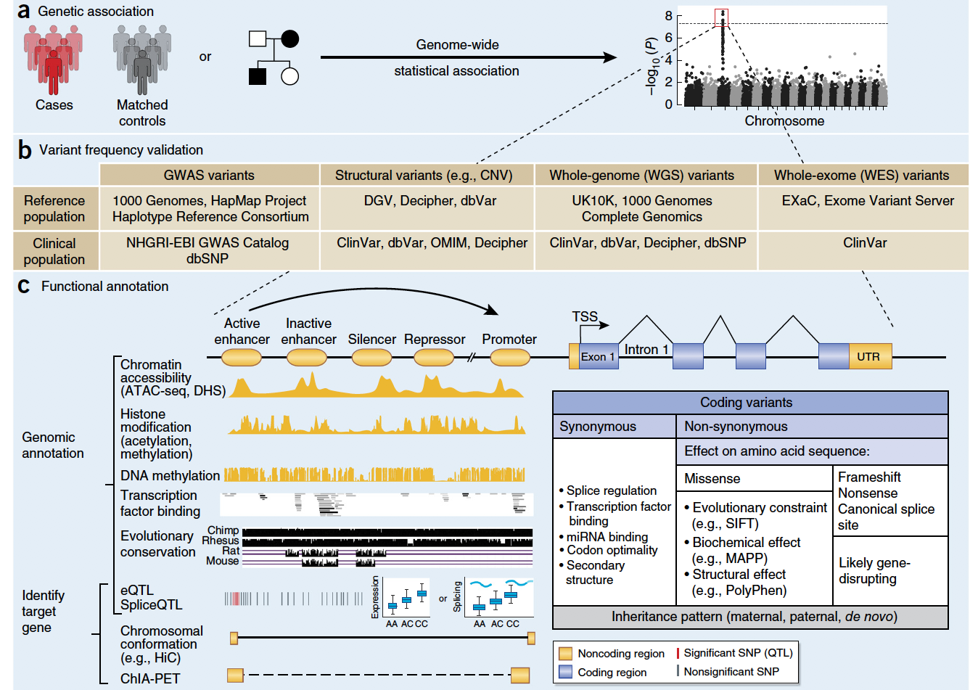
Functional genomics to understand mechanisms
Disease-associated genomic variants
How do variants function?
Gandal et al., Nature Neuroscience, 2016

Slide 8
Example
N Engl J Med 2015; 373:895-907
DOI: 10.1056/NEJMoa1502214

Slide 9
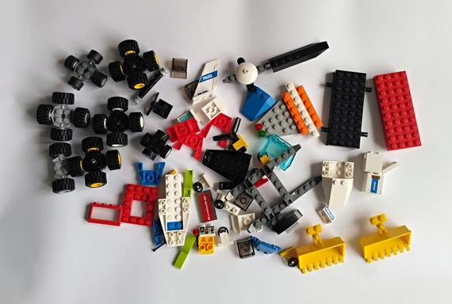


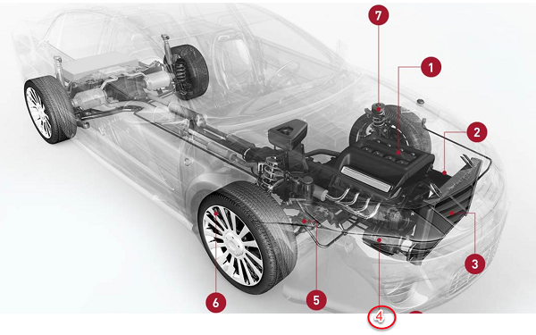
Hierarchical understanding from genotype to phenotype
Elements
variants
Interactions
gene regulation
Mechanisms
pathways
genes
chromatin interaction
TF binding
Prediction & Prioritization
circuits
disease variants & genes
networks
cell types
functions
regulatory regions

Slide 10
Multi-omics for understanding functional genomics and gene regulation

Slide 11





Some multi-omics datasets
Human | 20,000 genes (2% genome) | Other genomic elements: non-coding RNAs, gene regulatory regions, repeats, and so on… (98% genome)
Cell lines
Tissues
Cancers
Development
Psychiatric disorders
Neurodegenerative diseases
ENCODE (Encyclopedia of DNA Elements) Consortium
(> 300 cell types)
Genotype-Tissue Expression (GTEx)
(> 40 tissues)
The Cancer Genome Atlas (TCGA)
(> 40 cancer types)
(13 developmental stages,
16 brain regions)
PsychENCODE Consortium
(~2,000 tissues incl. health, Schizophrenia, Autism, Bipolar)
Religious Orders Study and Memory and Aging Project (ROSMAP)
International Parkinson's Disease Genomics Consortium (IPDGC)
Notes:
tons of public available genomic data from large scientific consortia make us develop independent research programs
https://followthedata.wordpress.com/2014/06/24/data-size-estimates/
Integration is eseential

Slide 12
Goals for lecture
Multi-omics data
Machine learning modeling
  Empirical risk minimization (ERM)
Multi-layer network clustering
Dimensionality reduction & Spectral methods
Decision tree
Neural network

Slide 13
Multi-omics data integration
http://www.nature.com/nrg/journal/v16/n2/full/nrg3868.html

Slide 14
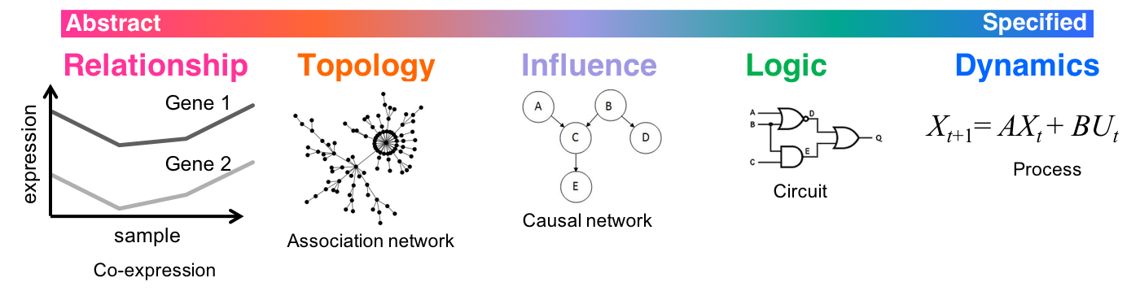
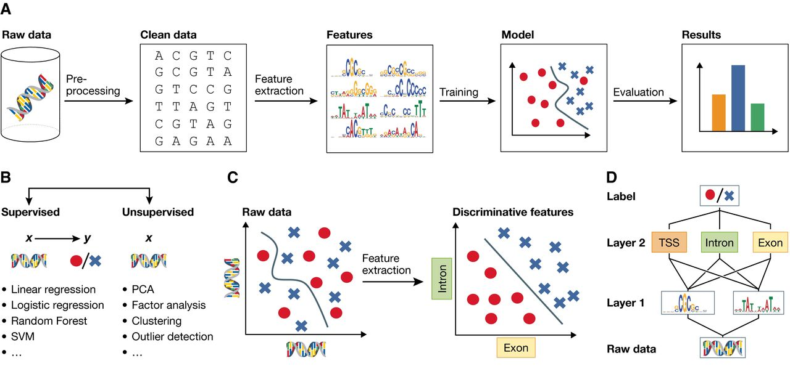
Multi-omics data modeling
Phenotype
BPD
AGE
…
Higher-order groupings
(e.g., pathways, circuits)
Biological Interpretation
Interactions between elements (e.g., co-expression, regulation)
Cell types
Modules
Integrative & Predictive model (e.g., deep neural network)
Regulatory elements
Genes
Genomic elements (e.g., GWAS, differentially expressed genes)
Genotype
* Spectrum inspired from Ideker & Lauffenburger, Trends in Biotechnology, 2003
* Christof Angermueller et al. Mol Syst Biol 2016;12:878
Notes:
Gene regulatory mechanisms to be robust biomarkers, rather than individual genomic variants
synthetic biology
genome engineering
circuit design
control theory
epigenetic drugs

Slide 15
Multiview learning for understanding functional multi-omics
For example, gene regulation can relate to
  Genomics; e.g., SNPs
  Transcriptomics; e.g., genes
  Proteomics; e.g., transcription factors (TFs)
Cross-omics interactions
Ω_{co}(f⁽¹⁾,f⁽³⁾): SNPs break TF binding sites
Ω_{co}(f⁽²⁾,f⁽³⁾): TFs control gene expression
Ω_{co}(f⁽¹⁾,f⁽²⁾): SNPs associate with gene expression (e.g, eQTLs)
Nguyen, Wang, PLoS Computational Biology, 2020

Slide 16
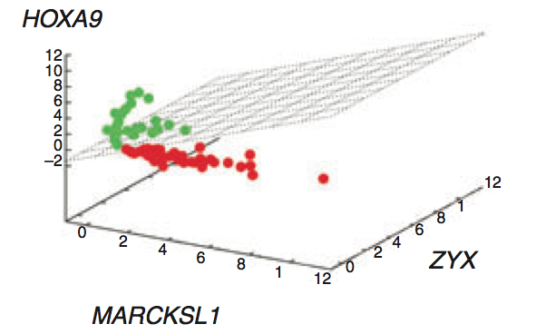
Empirical risk minimization (ERM) for machine learning modeling
e.g., Leukemia patient classification
  y_{i}: Acute lymphoblastic leukemia (ALL) vs. Acute myeloid leukemia (AML)
  x_{i}: gene expression
  f: SVM
Regularize f by biological knowledge Ω
^{Nobel, Nature Biotech, 2006}
Nguyen, Wang, PLoS Computational Biology, 2020

Slide 17
Empirical risk minimization for multi-view learning (MV-ERM)
Regularize f by biological knowledge Ω from single omics
Regularize f by biological knowledge Ω_{co} across multi-omics
Nguyen, Wang, PLoS Computational Biology, 2020

Slide 18
Consensus and complementary principles
Complementary principle
Unique information from each view
Consensus principle
Relationship information across views
Nguyen, Wang, PLoS Computational Biology, 2020

Slide 19


Factorization-based MV-ERM framework
Complementary $G^{(i)}$
Consensus $\tilde{F}$
e.g., solved by Multi-view NMF (Liu et al., SIAM ICDM, 2013)

Slide 20
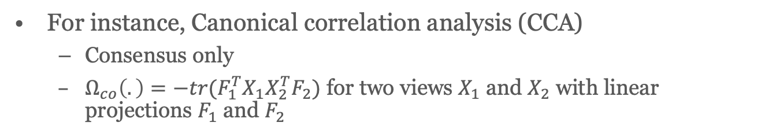
Alignment-based MV-ERM framework
Common latent space
For instance, Canonical correlation analysis (CCA)
  Consensus only
  $Ω_{co}\left(.\right)=−tr(F_{1}^{T}X_{1}X_{2}^{T}F_{2})$ for two views $X_{1}$ and $X_{2}$ with linear projections $F_{1}$ and $F_{2}$
Nguyen, Wang, PLoS Computational Biology, 2020

Slide 21
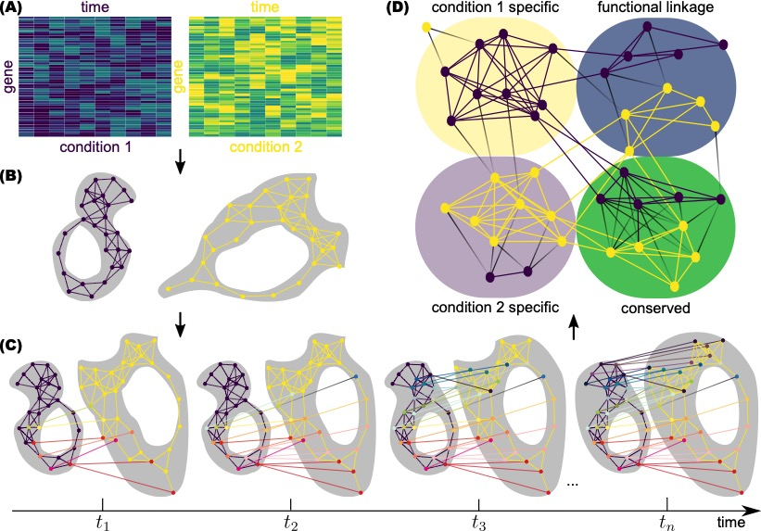
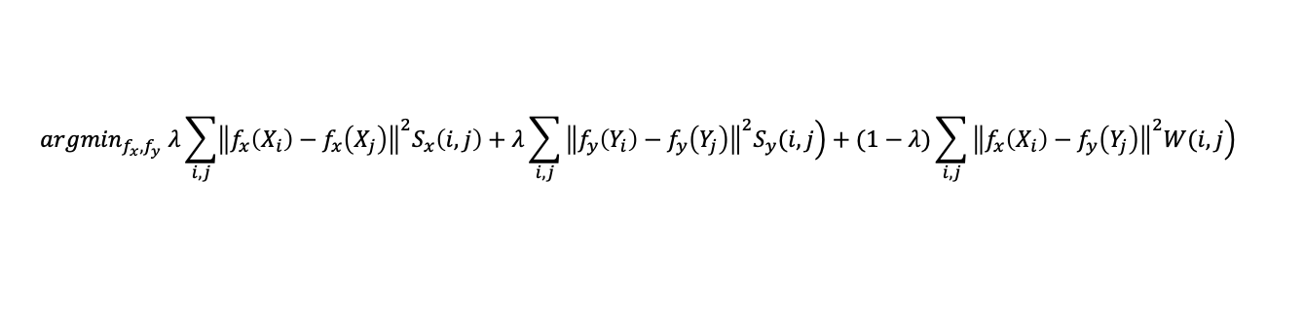
ManiNetCluster: manifold alignment to reveal the functional links between gene networks
Multi-view datasets (e.g., diseases, species, conditions)
Functional linkages across dimensions
$${argmin}_{f_{x}, f_{y}} λ\sum_{i,j}{{\left\|f_{x}\left(X_{i}\right)−f_{x}\left(X_{j}\right)\right\|}^{2}S_{x}\left(i,j\right)+λ\sum_{i,j}{\left.{\left\|f_{y}\left(Y_{i}\right)−f_{y}\left(Y_{j}\right)\right\|}^{2}S_{y}(i,j\right)}}+(1−λ)\sum_{i,j}{\left.{\left\|f_{x}\left(X_{i}\right)−f_{y}\left(Y_{j}\right)\right\|}^{2}W(i,j\right)}$$
Nguyen, Blaby, Wang, BMC Genomics, 2019

Slide 22
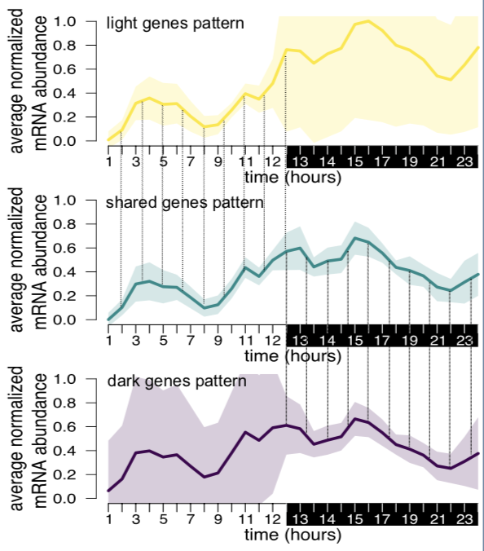
ManiNetCluster: manifold alignment to reveal the functional links between gene networks
Application: genomic functional linkages between light and dark periods of green alga
Nguyen, Blaby, Wang, BMC Genomics, 2019

Slide 23
Goals for lecture
Multi-omics data
Machine learning modeling
  Empirical risk minimization (ERM)
Multi-layer network clustering
Dimensionality reduction & Spectral methods
Decision tree
Neural network

Slide 24
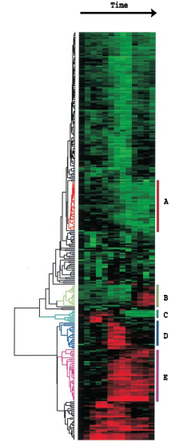
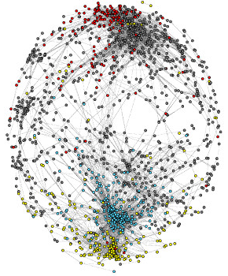
Co-expressed genes have similar functions in single species
Yeast cell cycle
18 time points
A gene co-expression network (relationship) can reveal functional groupings
Hierarchal clustering, K-means, Gaussian mixture model (GMM), Principal component analysis (PCA), …
6000 genes
node: gene
edge: expression correlation
Protein synthesis
Eisen et al., PNAS, 1998.
Carlson et al., BMC Bioinformatics, 2006.
Notes:
When we have gene expression data only, we can see some genes have similar expression profiles across samples. Thus, we can construct a gene co-expression network, where nodes are genes, and edges connect genes with highly correlated expression profiles. We can clustering a gene co-expression network to find gene co-expression modules. Each module includes a group of genes that are clustered together may have similar biological functions.

Slide 25
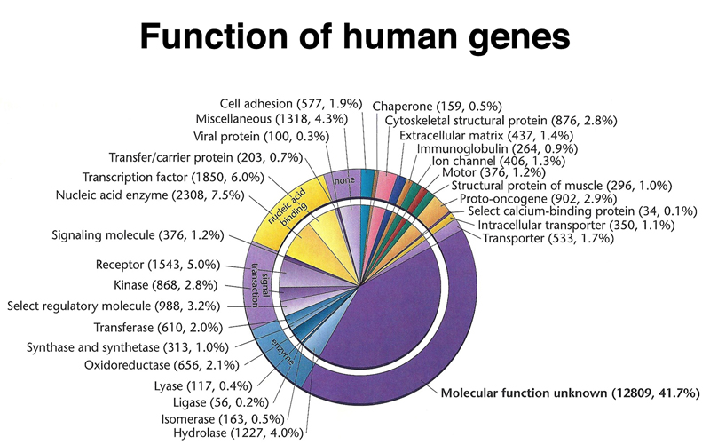

Limited knowledge in single species
~ half human genes, 1% human genome plus other 98% genomic elements (non-coding regions) with unknown functions
How do we know human gene functions during embryonic or brain development?
http://www.discoveryandinnovation.com/BIOL202/notes/lecture24.html
Notes:
but, always clustering a single network is not enough to find new gene functions. first, biologists try to know individual gene functions by experiments to get knowledgebase, but experiments are very small-scale and costly. we don’t have enough knowledgebase. e.g., for both human and plant, around 50% genes have unknown functions. 2nd, some biological knowledge is hard to get directly from experiments. e.g., human genes must function correctly during embyrnoic development, but we cannot experiment on human embryos to know gene functions.
One cannot experiment on human embryos, nor can one selectively breed humans to express a particular mutant phenotype.

Slide 26
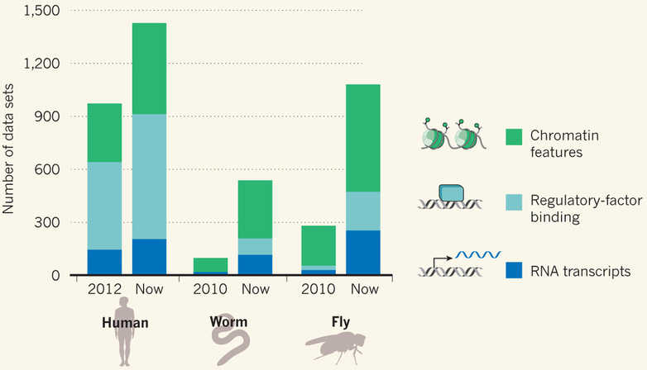
Integration of co-expressed and orthologous genes across species to transfer function information
gene
Cross-species gene co-expression network
co-expressed
worm genes with
developmental functions
orthologs
A human gene with
developmental functions
Notes:
then after our clustering method, species-specific modules have its own module numbers, and conserved modules share same module number.

Slide 27
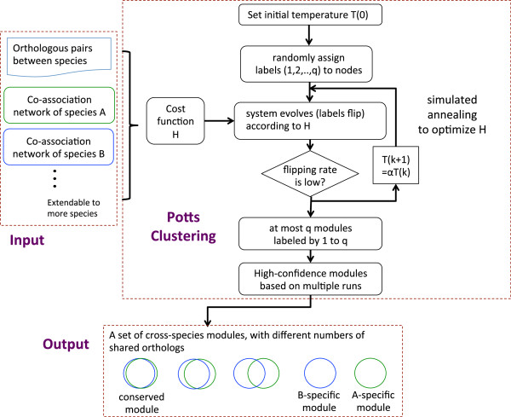
OrthoClust: an orthology-based method for clustering cross-species networks (e.g., co-expression networks)
Yan*, Wang*, et al., Genome Biology, 2014
Notes:
Thus, we developed a novel clustering algorithm to solve this problem: OrthoClust: an orthology-based network framework for clustering data across multiple species, which was published in Genome biology in 2014. Orthoclust inputs a bunch of gene co-expression networks from different species along with orthology genes, and outputs conserved and species-specific gene co-expression modules.

Slide 28
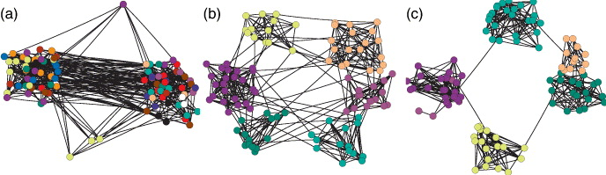
Maximize “modularity” for clustering a single network
low
high
Brede, Europhysics Letters, 2010.
Modularity Q: measurement on strength of network division
sum over nodes within a group (module)
normalization
m: total number of edges
edge weight between nodes i and j
=expected edge weight that would go between i and j
Clustering goal: assign each node a module
to maximize “modularity” as an objective function
(module is a group of highly connected nodes)
Newman, PNAS, 2006.
Notes:
for a single network clustering, we always try to divide nodes into groups / modules such that connections within groups are relatively dense while those between groups are sparse.
then, the modularity has been proposed to measure strength of division using your clustering method. e.g., right clustering is good because modularity is high. Thus, a common clustering strategy is that we can use modularity as objective function, and find the modules that maximize modularity from all possible divisions of a network.
http://www.cs.cmu.edu/~ckingsf/bioinfo-lectures/modularity.pdf

Slide 29
OrthoClust: an orthology-based method for clustering cross-species networks
Every node i is assigned with a module number σ_{i}.
2
species A specific
conserved modules
co-expressed
2
3
2
3
orthologs
2
3
Species A
2
3
species B specific
Species B
3
1
3
1
3
3
1
1
Objective function
reward an orthologous pair
in the same module
"Modularity" in species A + "Modularity" in species B + consistency between A & B
Yan*, Wang*, et al., Genome Biology, 2014
Notes:
then after our clustering method, species-specific modules have its own module numbers, and conserved modules share same module number.

Slide 30
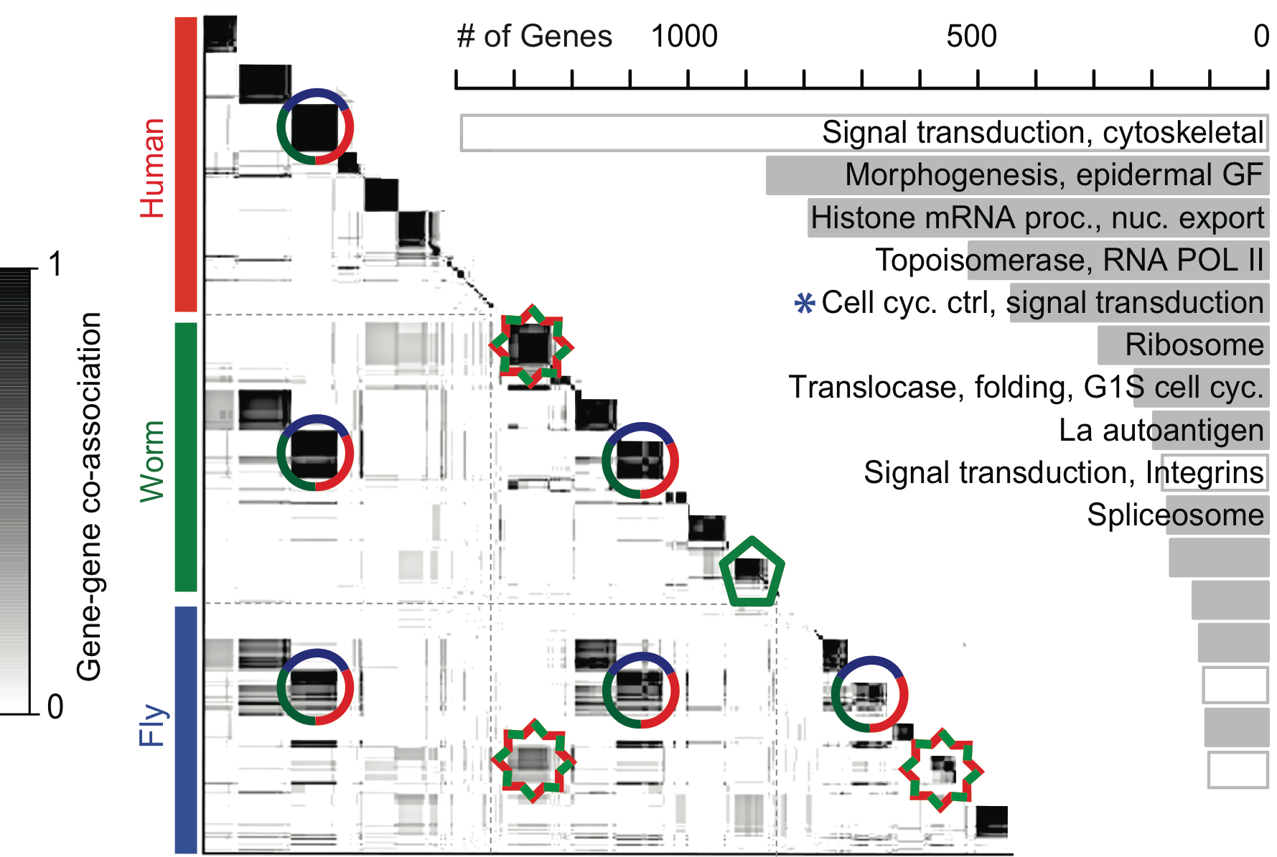
Conserved gene co-expression modules discovered human genes having developmental functions
human-worm-fly conserved
Conservation of module across number of species
16 human-worm-fly conserved modules
worm-fly conserved
…
worm-specific
19,901 20,377 13,623 genes (~55,000)
Gerstein*,…, Wang*, et al., Nature, 2014
Notes:
This symmetric heatmap visualizes the gene co-expression modules across three species. A dark block along the diagonal represents a group of genes within a species. . If this is associated with an off-diagonal block then it is a cross-species module. for example, the circle module includes genes from all three species, so this is a conserved gene co-expression module across three species. The star module associates with a off-diagonal block btw worm and fly, so it is a worm-fly conserved module. Also, we can find specie-specific modules like pentagon module which is worm-specific without any off-diagonal association. In total, we found 16 conserved modules across human, worm and fly. we shows their function enrichments at right hand side.
********************************
Left, human, worm and fly gene–gene co-association matrix; darker colouring reflects the increased likelihood that a pair of genes are assigned to the same module. A dark block along the diagonal represents a group of genes within a species. If this is associated with an off-diagonal block then it is a cross-species module (for example, a three- species conserved module is shown with a circle and a worm–fly module, with a star). However, if a diagonal block has no off-diagonal associations, then it forms a species-specific module (for example, green pentagon). Right, the Gene Ontology functional enrichment of genes within the 16 conserved modules is shown. GF, growth factor; nuc., nuclear; proc., processing.

Slide 31
OrthoClust reveals better genomic functional groups
OrthoClust’s modular genes have similar functions
OrthoClust clusters more orthologs than other clustering methods
Gene ontology (GO) similarity of gene pairs
Enrichment of orthologous genes
Pairs between
OrthoClust modules
Pairs in
OrthoClust modules
Hierarchical clustering
OrthoClust (k=0)
OrthoClust (k=3)
K-means
PAM

Slide 32
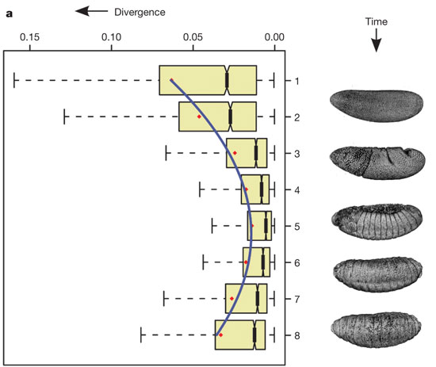
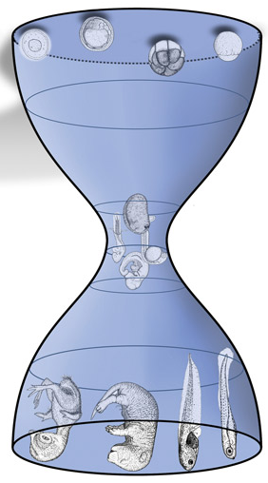
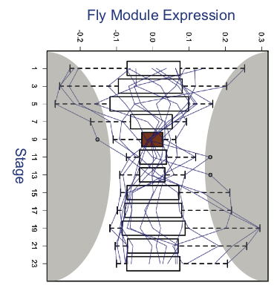
Developmental hourglass behavior across conserved modules in a species
Inter-organism
Temporal differences among ortholog expression levels are
minimized at phylotypic stage across different species.
Expression
Hourglass
Time
Kalinka et al. Nature, 2010
Expression
Intra-organism
Temporal differences among ortholog expression levels are minimized at phylotypic stage across conserved modules in a species (fly).
Time
Gerstein*,…, Wang*, et al., Nature, 2014
Notes:
conceptual analogy
In addition to annotate novel genomic functions, we also discovered the developmental hourglass behaviors from conserved modules. in 2010, ppl found that at phylotyic stage, a particular middle stage during embyronic development, the temporal expression divergenece of ortholog genes across species is minimized. we found that 12 out of 16 conserved modules have across-species hourglass behaviors. moreover, in a single organism like in fly, we found that temporal expression divergence of ortholog genes across these 12 modules is also minimized at phylotypic stage, which implies that at phylotypic stage, the ortholog gene expression is tightly controlled. it is very like that after we power on computer, every computer always have a booting process to initiate basic hardware components, to prepare loading different operating systems. therefore, at phylotypic stage, those ortholog genes may need to work together to do conserved functions. but, can they really work like electronic circuits in a computer? now, let’s go to my 2nd project

Slide 33
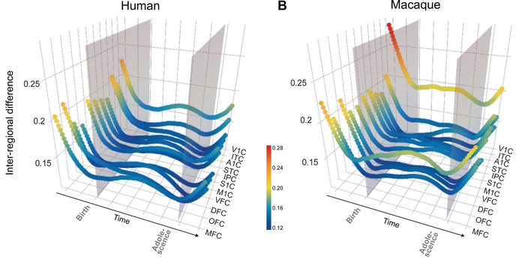
Human and Rhesus brain developmental “hourglass” from spatiotemporal gene co-expression networks
Li, …, Wang, ..., Sestan, Science, 2018
Brain regions
Ying, ..., Sestan, Science, 2018

Slide 34
Goals for lecture
Multi-omics data
Machine learning modeling
  Empirical risk minimization (ERM)
Multi-layer network clustering
Dimensionality reduction & Spectral methods
Decision tree
Neural network

Slide 35
Reading list for spectral methods
O Alter et al. (2000). "Singular value decomposition for genome-wide expression data processing and modeling." PNAS 97: 10101
Langfelder P, Horvath S (2007) Eigengene networks for studying the relationships between co-expression modules. BMC Systems Biology 2007, 1:54
Z Zhang et al. (2007) "Statistical analysis of the genomic distribution and correlation of regulatory elements in the ENCODE regions." Genome Res 17: 787
TA Gianoulis et al. (2009) "Quantifying environmental adaptation of metabolic pathways in metagenomics." PNAS 106: 1374.

Slide 36
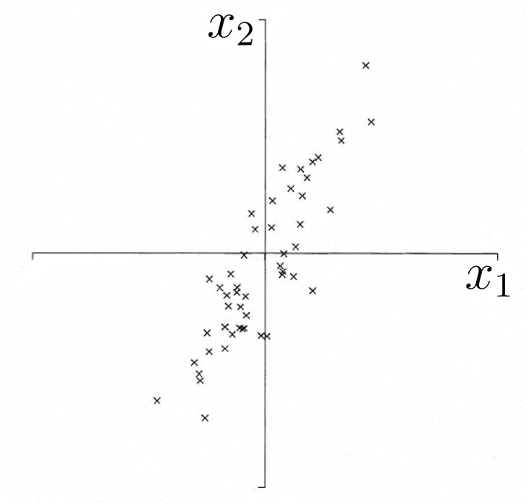
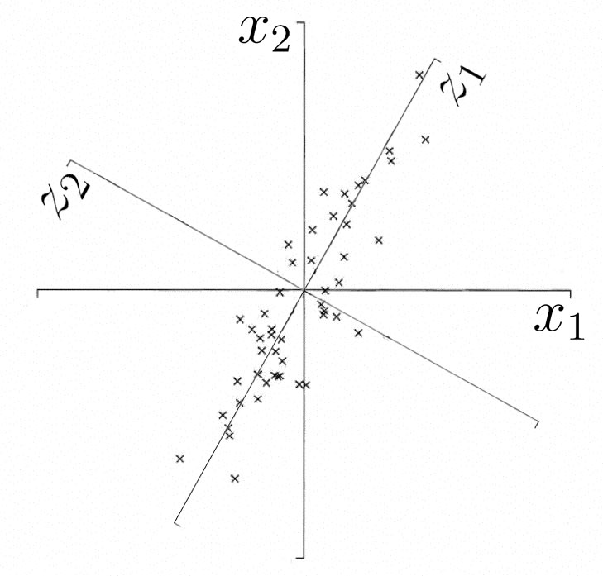
What is Principal component analysis (PCA) ?
A technique used to reduce the dimensionality of a data set by finding directions of maximum variability
Projection (typically a rotation) into new axes
But still retains the dataset’s variation
y₁
y₂
Adapted from http://www.astro.princeton.edu/~gk/A542/PCA.ppt

Slide 37
PCA Matrix
Start with dataset of k variables X = x₁, x₂ ... x_{k} and n observations.
Construct covariance or correlation matrix for variables.
The Eigenvalue Problem or Eigenanalysis: matrix diagonalization and solve for eigenvalues and eigenvectors
E.g. Start with a bunch of coordinates
Observations | X1 | X2
1 | 2 | 5
2 | 5 | 6
3 | 4 | 2
4 | 3 | 7
5 | 9 | -5
…
n | -5 | -8

Slide 38
Interpretation:
Eigenvalues & Eigenvectors
λ₂
λ₁
Adapted from http://myweb.dal.ca/~hwhitehe/BIOL4062/pca.ppt

Slide 39

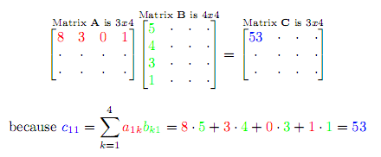
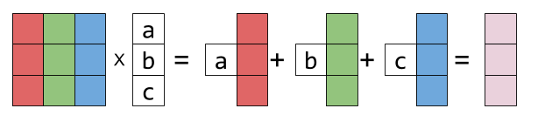
Quick
Refresher on Matrices
http://eli.thegreenplace.net/2015/visualizing-matrix-multiplication-as-a-linear-combination/
http://www.catonmat.net/blog/mit-linear-algebra-part-three/

Slide 40
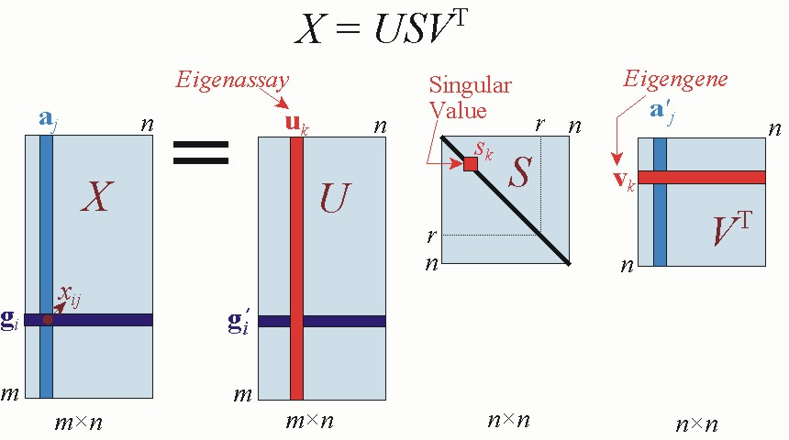
SVD for gene expression data
(Alter et al, PNAS 2000)
http://www.gersteinlab.org/courses/452/

Slide 41
Notation
m=1000 genes
  row-vectors
  10 eigengene (v_{i}) of dimension 10 conditions
n=10 conditions (assays)
  column vectors
  10 eigenconditions (u_{i}) of dimension 1000 genes
http://www.gersteinlab.org/courses/452/

Slide 42
SVD as sum of rank-1 matrices
an outer product (uv^{T} ) giving a matrix rather than the scalar of the inner product
A = USV^{T}
A = s₁u₁v₁^{T} + s₂u₂v₂^{T} +… + s_{n}u_{n}v_{n}^{T}
s₁ ≥ s₂ ≥ … ≥ s_{n} ≥ 0
What is the rank-r matrix A that best approximates A ?
  Minimize
A = s₁u₁v₁^{T} + s₂u₂v₂^{T} +… + s_{r}u_{r}v_{r}^{T}
Very useful for matrix approximation
LSQ approx. If r=1, this amounts to a line fit.
http://www.gersteinlab.org/courses/452/

Slide 43
Potential problems of
SVD/PCA
If the dataset…
Lacks Independence
  NO PROBLEM
Lacks Normality
  Normality desirable but not essential
Lacks Precision
  Precision desirable but not essential
Lacks Linearity
    Problem: Use other non-linear (kernel) methods
Many Zeroes in Data Matrix (Sparse)
  Problem: Use Correspondence Analysis

Slide 44
Conclusion
SVD is the “absolute high point of linear algebra”
SVD is difficult to compute; but once we have it, we have many things
SVD finds the best approximating subspace, using linear transformation
Simple SVD cannot handle translation, non-linear transformation, separation of labeled data, etc.
Good for exploratory analysis; but once we know what we look for, use appropriate tools and model the structure of data explicitly!
http://genomicsclass.github.io/book/pages/pca_svd.html

Slide 45
Goals for lecture
Multi-omics data
Machine learning modeling
  Empirical risk minimization (ERM)
Multi-layer network clustering
Dimensionality reduction & Spectral methods
Decision tree
Neural network

Slide 46
Reading list
What are decision trees?
  Nat Biotechnol. 2008 Sep; 26(9): 1011–1013.
Data mining in the Life Sciences with Random Forest: a walk in the park or lost in the jungle?
  https://academic.oup.com/bib/article/14/3/315/255469

Slide 47
Decision Trees
Classify data by asking questions that divide data in subgroups
Keep asking questions until subgroups become homogenous
Use tree of questions to make predictions
Example: Is a picture taken inside or outside?
Criminisi, Shotton, and Konukoglu Microsoft Technical Report 2011

Slide 48
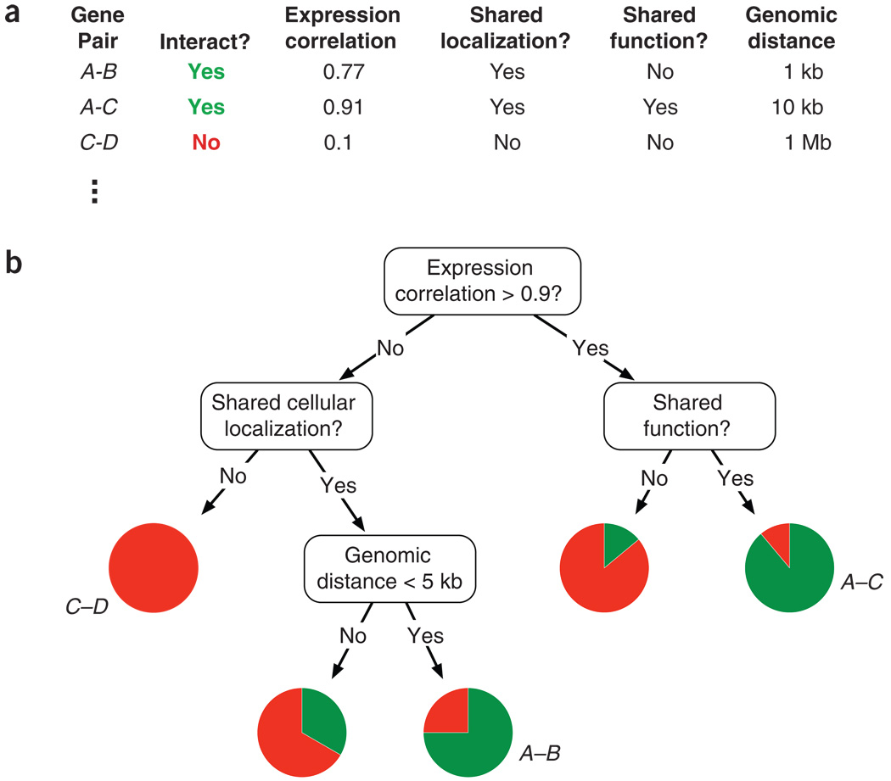
A hypothetical example of how a decision tree might predict protein-protein interactions
Nat Biotechnol. 2008 Sep; 26(9): 1011–1013.

Slide 49
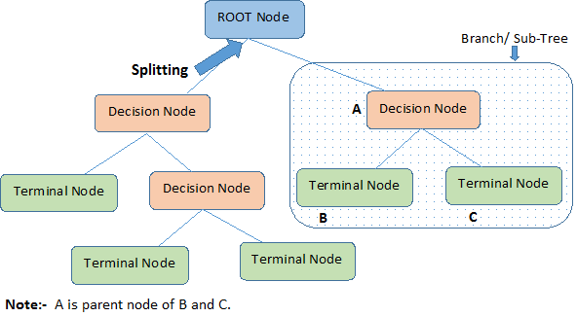
Terminology related to Decision Trees
https://www.analyticsvidhya.com/blog/2016/04/complete-tutorial-tree-based-modeling-scratch-in-python/

Slide 50
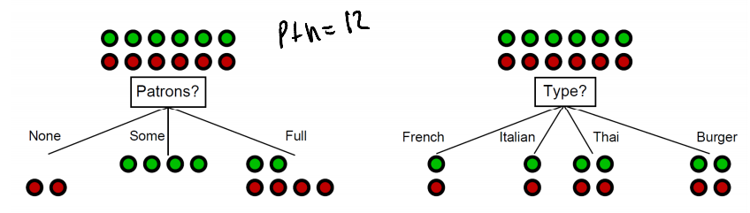
What makes a good rule?
Want resulting groups to be as homogenous as possible
Rule 1
Rule 2
All groups still 50/50
→ Unhelpful rule
2/3 Groups homogenous
→Good rule
Nando de Freitas 2012 University of British Columbia CPSC 340
Notes:
Emphasize that classification is based on underlying characteristics

Slide 51
Quantifying the value of rules
Decrease in inhomogeneity
  Most popular metric: Information theoretic entropy
  Use frequency of classifier characteristic within group as probability
  Minimize entropy to achieve homogenous group
S =

Slide 52
Algorithm
For each characteristic:
  Split into subgroups based on each possible value of characteristic
Choose rule from characteristic that maximizes decrease in inhomogeneity
For each subgroup:
  if (inhomogeneity < threshold):
    Stop
  else:
    Restart rule search (recursion)

Slide 53
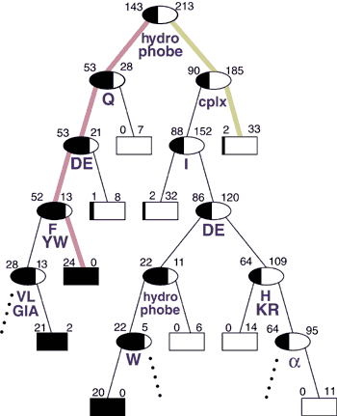
Retrospective Decision Trees
Analysis of the Suitability of 500 M.thermo. proteins
to find optimal sequences purification
[Bertone et al. NAR (‘01)]

Slide 54
Retrospective Decision Trees
Nomenclature
356 total
Not Expressible
Expressible
Has a hydrophobic stretch? (Y/N)
[Bertone et al. NAR (‘01)]

Slide 55
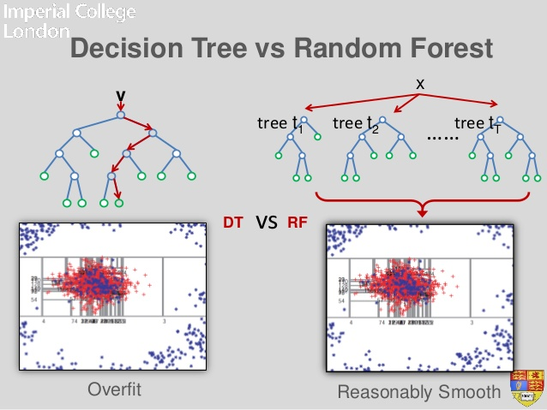
Extensions of Decision Trees
Decision Trees method is very sensitive to noise in data
Random forests is an ensemble of decision trees, and is much more effective.

Slide 56
Exercise
A Complete Tutorial on Tree Based Modeling from Scratch (in R & Python)
  https://www.analyticsvidhya.com/blog/2016/04/complete-tutorial-tree-based-modeling-scratch-in-python/
Random Forests in R
  https://www.r-bloggers.com/random-forests-in-r/
  http://dni-institute.in/blogs/random-forest-using-r-step-by-step-tutorial/

Slide 57
Goals for lecture
Multi-omics data
Machine learning modeling
  Empirical risk minimization (ERM)
Multi-layer network clustering
Dimensionality reduction & Spectral methods
Decision tree
Neural network

Slide 58
Reading list
Deep learning for computational biology
  http://msb.embopress.org/content/12/7/878
Predicting the sequence specificities of DNA- and RNA-binding proteins by deep learning
  https://www.nature.com/articles/nbt.3300
https://github.com/hussius/deeplearning-biology
The Incredible Convergence Of Deep Learning And Genomics

Slide 59

Machine learning and representation learning
© as stated in the article, figure or figure legend
Christof Angermueller et al. Mol Syst Biol 2016;12:878
Notes:
Machine learning and representation learning (A) The classical machine learning workflow can be broken down into four steps: data pre‐processing, feature extraction, model learning and model evaluation. (B) Supervised machine learning methods relate input features x to an output label y, whereas unsupervised method learns factors about x without observed labels. (C) Raw input data are often high‐dimensional and related to the corresponding label in a complicated way, which is challenging for many classical machine learning algorithms (left plot). Alternatively, higher‐level features extracted using a deep model may be able to better discriminate between classes (right plot). (D) Deep networks use a hierarchical structure to learn increasingly abstract feature representations from the raw data.

Slide 60
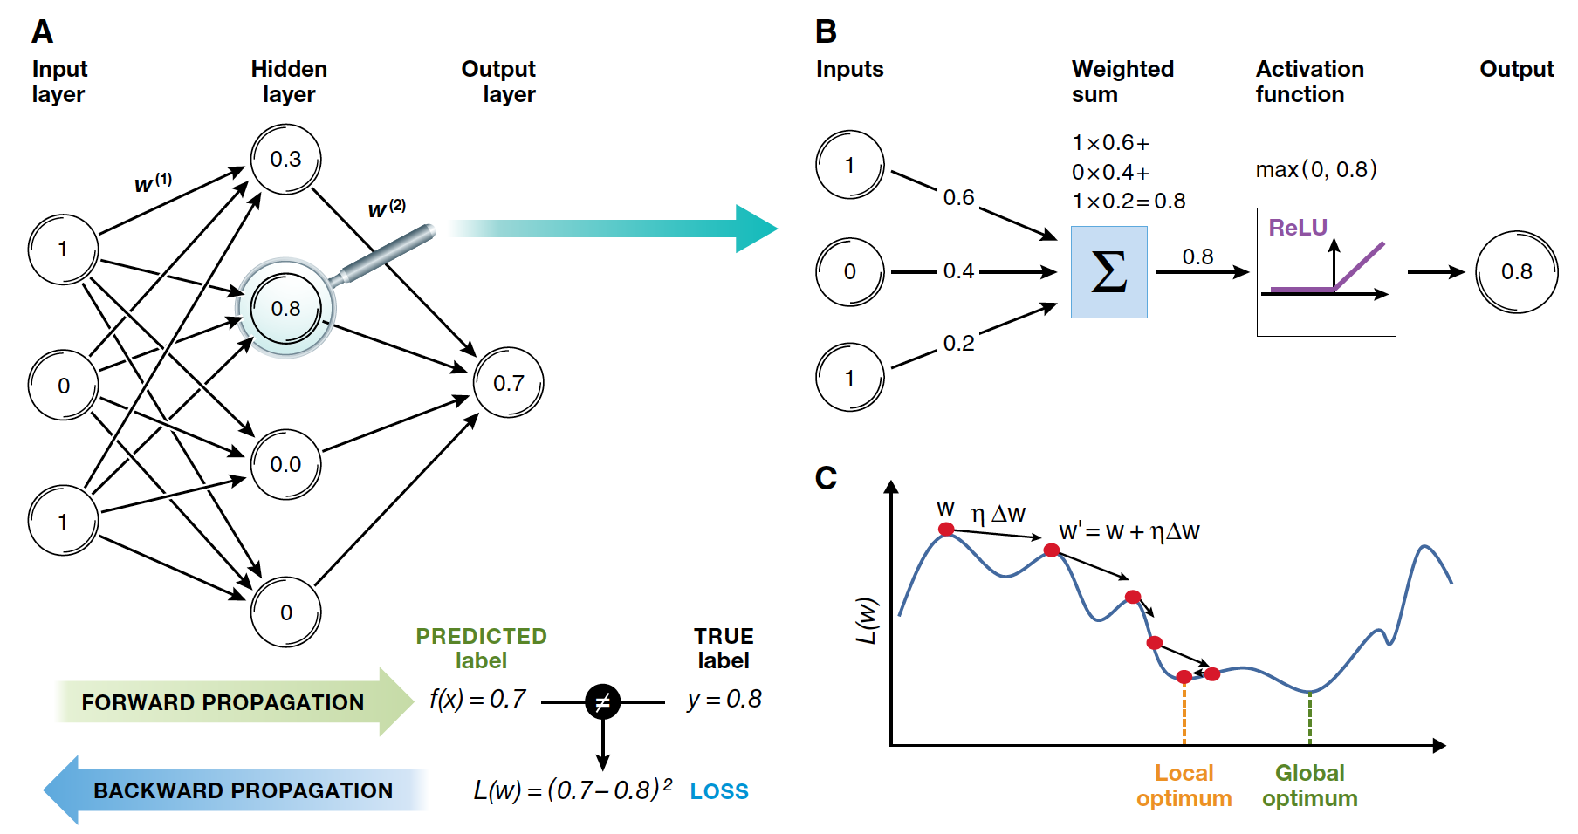
Artificial Neural Network
Christof Angermueller et al. Mol Syst Biol 2016;12:878

Slide 61
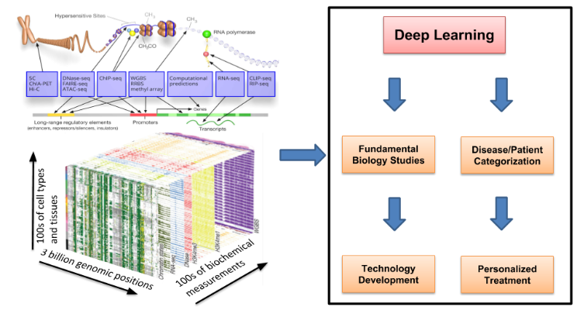
The Incredible Convergence Of Deep Learning And Genomics
Johnny Israeli

Slide 62
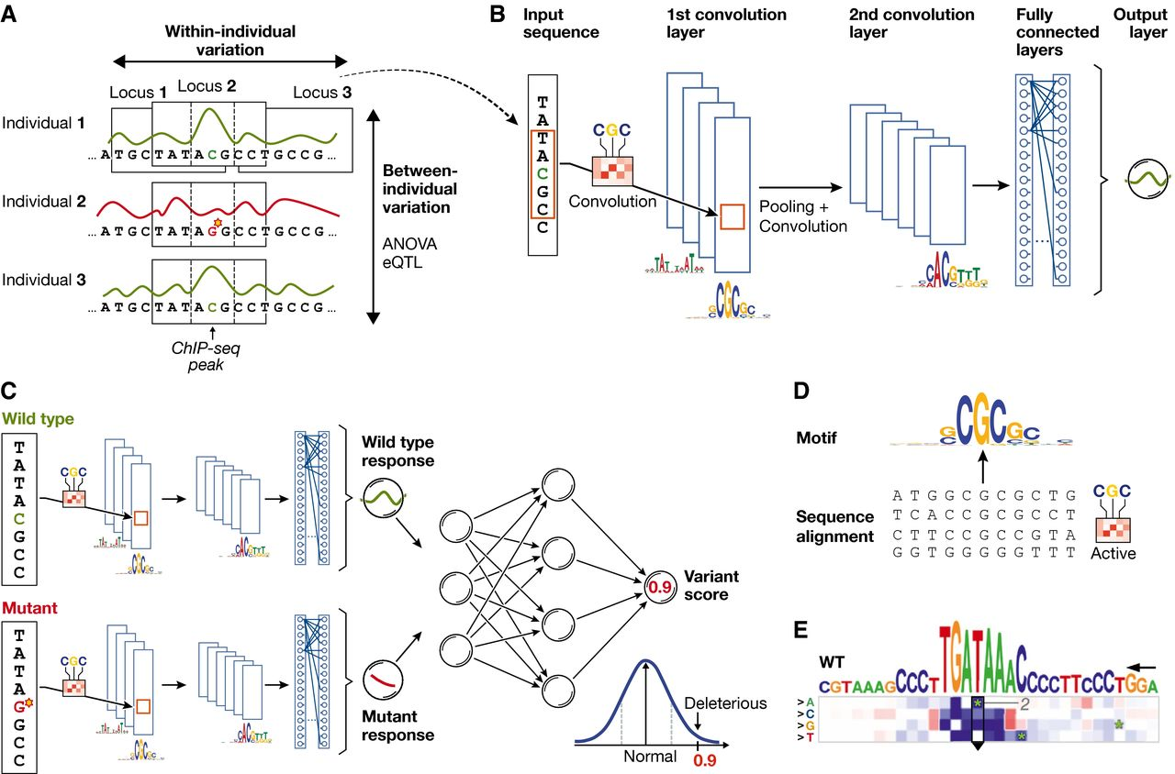
Principles of using neural networks for predicting molecular traits from DNA sequence
© as stated in the article, figure or figure legend
Christof Angermueller et al. Mol Syst Biol 2016;12:878
Notes:
Principles of using neural networks for predicting molecular traits from DNA sequence (A) DNA sequence and the molecular response variable along the genome for three individuals. Conventional approaches in regulatory genomics consider variations between individuals, whereas deep learning allows exploiting intra‐individual variations by tiling the genome into sequence DNA windows centred on individual traits, resulting in large training data sets from a single sample. (B) One‐dimensional convolutional neural network for predicting a molecular trait from the raw DNA sequence in a window. Filters of the first convolutional layer (example shown on the edge) scan for motifs in the input sequence. Subsequent pooling reduces the input dimension, and additional convolutional layers can model interactions between motifs in the previous layer. (C) Response variable predicted by the neural network shown in (B) for a wild‐type and mutant sequence is used as input to an additional neural network that predicts a variant score and allows to discriminate normal from deleterious variants. (D) Visualization of a convolutional filter by aligning genetic sequences that maximally activate the filter and creating a sequence motif. (E) Mutation map of a sequence window. Rows correspond to the four possible base pair substitutions, columns to sequence positions. The predicted impact of any sequence change is colour‐coded. Letters on top denote the wild‐type sequence with the height of each nucleotide denoting the maximum effect across mutations (figure panel adapted from Alipanahi et al, 2015).

Slide 63
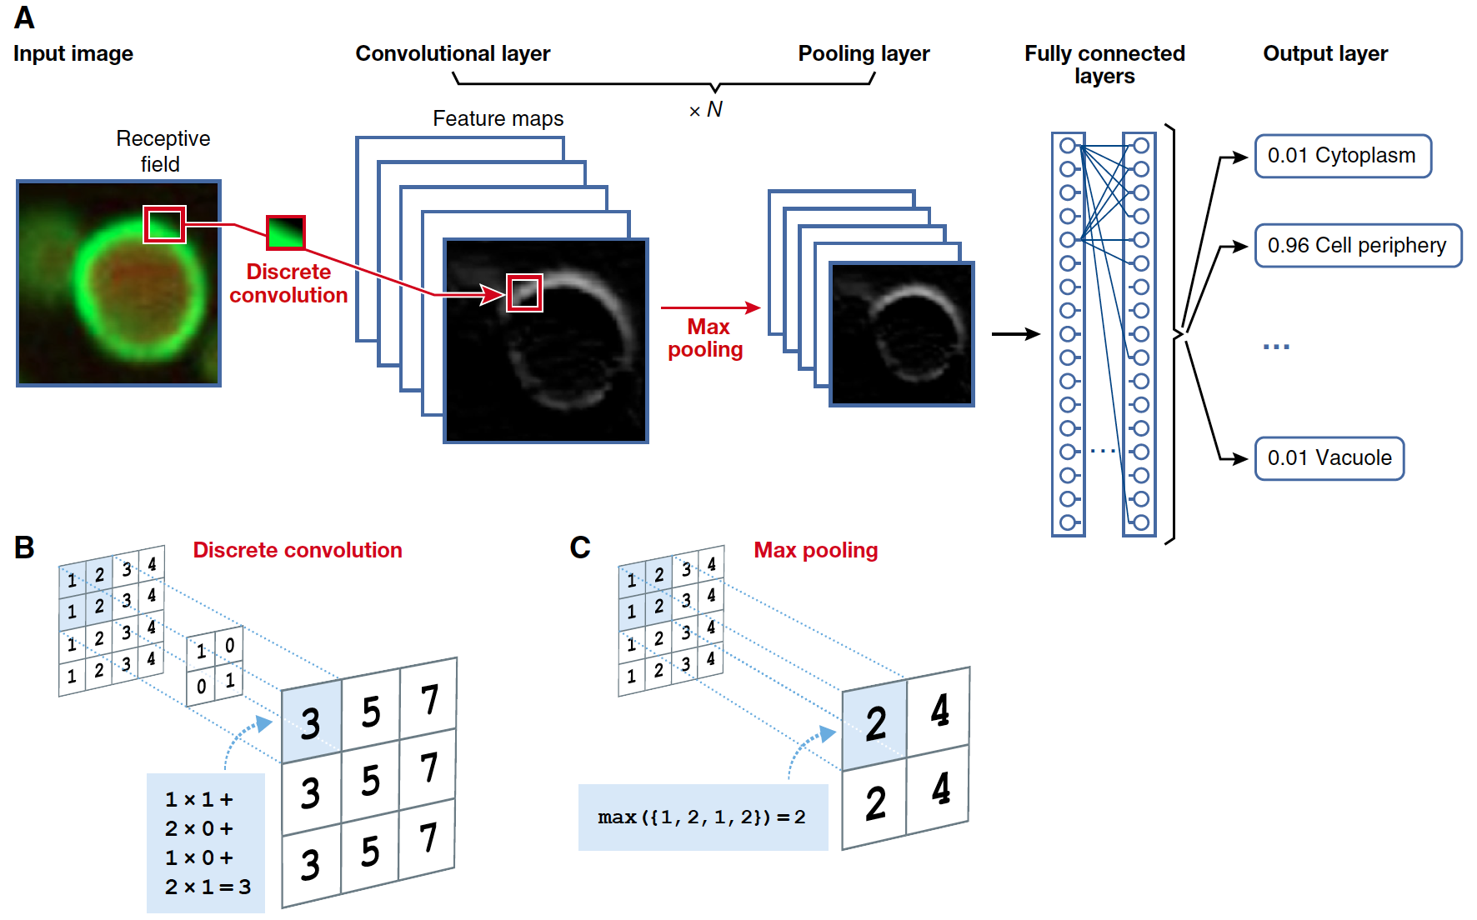
Convolutional Neural Network
Christof Angermueller et al. Mol Syst Biol 2016;12:878

Slide 64
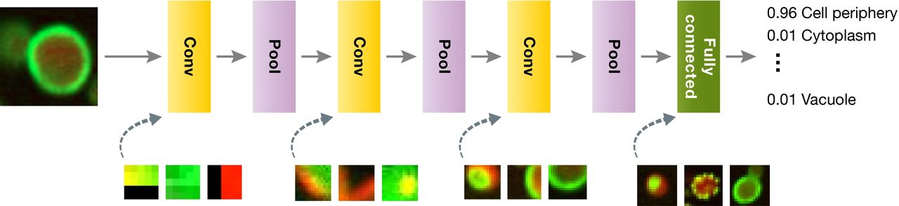
Convolution and pooling operators are stacked,
thereby creating a deep network for image analysis
Christof Angermueller et al. Mol Syst Biol 2016;12:878
© as stated in the article, figure or figure legend
Notes:
Convolution and pooling operators are stacked, thereby creating a deep network for image analysis In standard applications, convolution layers are followed by a pooling layer (Box 2). In this example, the lowest level convolutional units operate on 3 × 3 patches, but deeper ones use and capture information from larger regions. These convolutional pattern‐matching layers are followed by one or multiple fully connected layers to learn which features are most informative for classification. For each layer with learnable weights, three example images that maximize some neuron output are shown.

Slide 65
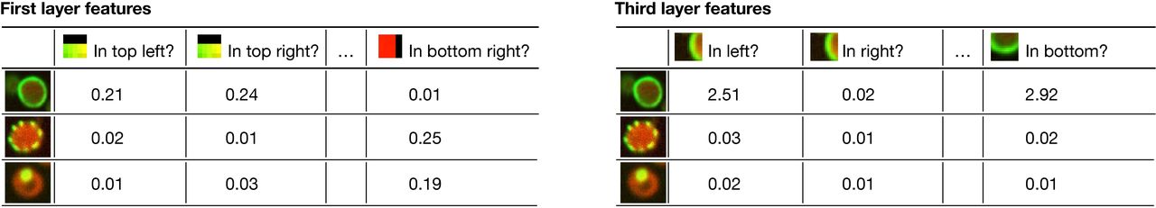
A pre‐trained network can be used as a
generic feature extractor
Christof Angermueller et al. Mol Syst Biol 2016;12:878
© as stated in the article, figure or figure legend
Notes:
A pre‐trained network can be used as a generic feature extractor Feeding input into the first layer (left) gives a low‐level feature representation in terms of patterns (left to right) present in smaller patches in every cell (top to bottom). Neuron activations extracted from deeper layers (right) give rise to more abstract features that capture information from a larger segment of the image.

Slide 66
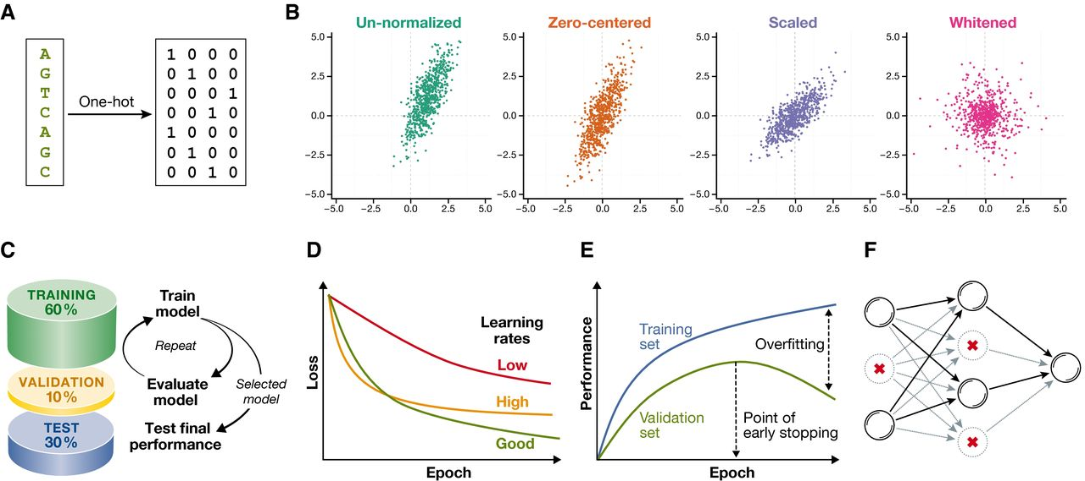
Data normalization for and
pre‐processing for deep neural networks
Christof Angermueller et al. Mol Syst Biol 2016;12:878
© as stated in the article, figure or figure legend
Notes:
Data normalization for and pre‐processing for deep neural networks (A) DNA sequence one‐hot encoded as binary vectors using codes A = 1 0 0 0, G = 0 1 0 0, C = 0 0 1 0 and T = 0 0 0 1. (B) Continuous data (green) after zero‐centring (orange), scaling to unit variance (blue) and whiting (purple). (C) Holdout validation partitions the full data set randomly into training (~60%), validation (~10%) and test set (~30%). Models are trained with different hyper‐parameters on the training set, from which the model with the highest performance on the validation set is selected. The generalization performance of the model is assessed and compared with other machine learning methods on the test set. (D) The shape of the learning curve indicates if the learning rate is too low (red, shallow decay), too high (orange, steep decay followed by saturation) or appropriate for a particular learning task (green, gradual decay). (E) Large differences in the model performance on the training set (blue) and validation set (green) indicate overfitting. Stopping the training as soon as the validation set performance starts to drop (early stopping) can prevent overfitting. (F) Illustration of the dropout regularization. Shown is a feedforward neural network after randomly dropping out neurons (crossed out), which reduces the sensitivity of neurons to neurons in the previous layer due to non‐existent inputs (greyed edges).

Slide 67
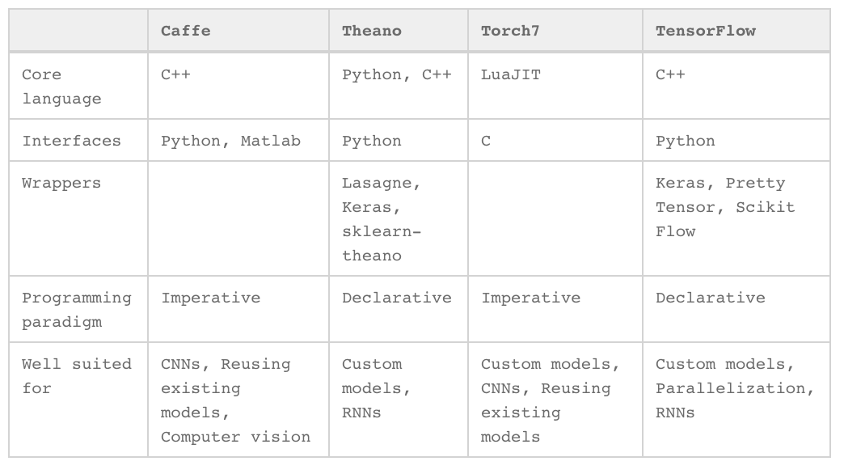
Overview of existing deep learning frameworks, comparing four widely used software solutions
Christof Angermueller et al. Mol Syst Biol 2016;12:878

Slide 68
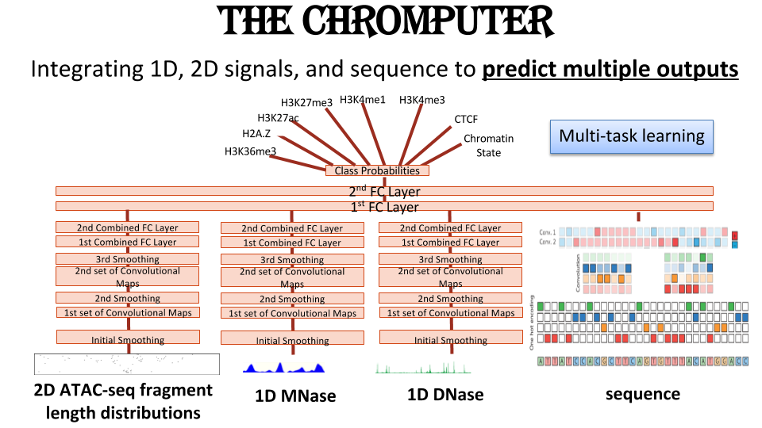
Johnny Israeli

Slide 69
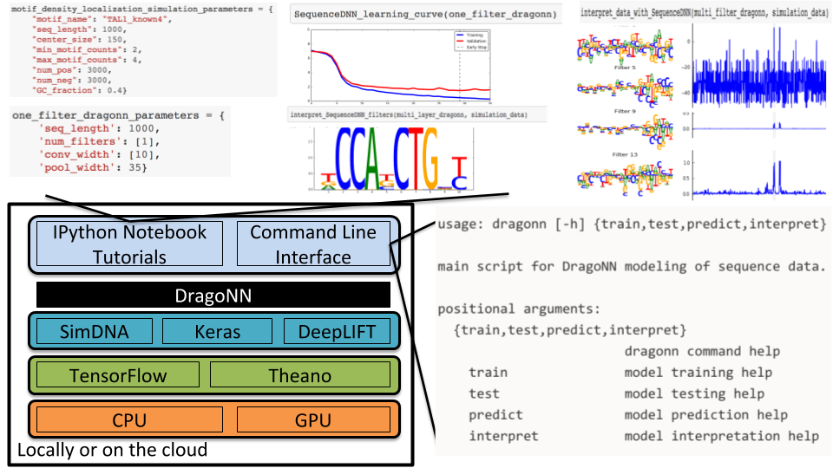
How to train your DragoNN
https://drive.google.com/file/d/0B4Yo77Kh_QeeaXZKQUtZWjNrWkE/view
Johnny Israeli

