Slide 1
Applied Machine Learning Part I
BMI/CS 776
www.biostat.wisc.edu/bmi776/
Spring 2021
Daifeng Wang
daifeng.wang@wisc.edu
These slides, excluding third-party material, are licensed under CC BY-NC 4.0 by Anthony Gitter, Mark Craven, Colin Dewey and Daifeng Wang

Slide 2
Goals for lecture
Basic machine learning ideas
Feature selection
Unsupervised learning
  Partitioning vs. hierarchical clustering
Supervised learning
  Classification
Applications in bioinformatics

Slide 3
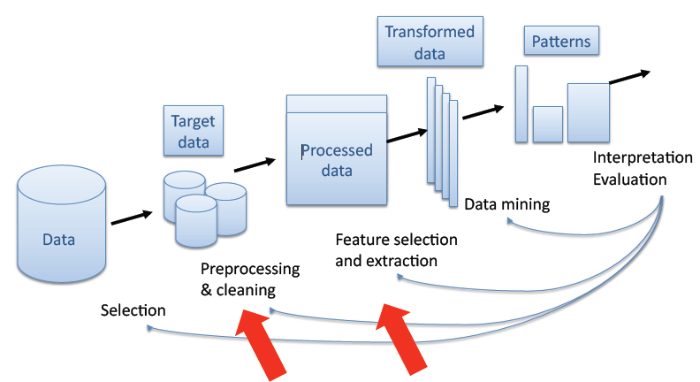
Knowledge Discovery in Databases (KDD)
U.M.Fayyad, G.Patetsky-Shapiro and P.Smyth (1995)

Slide 4
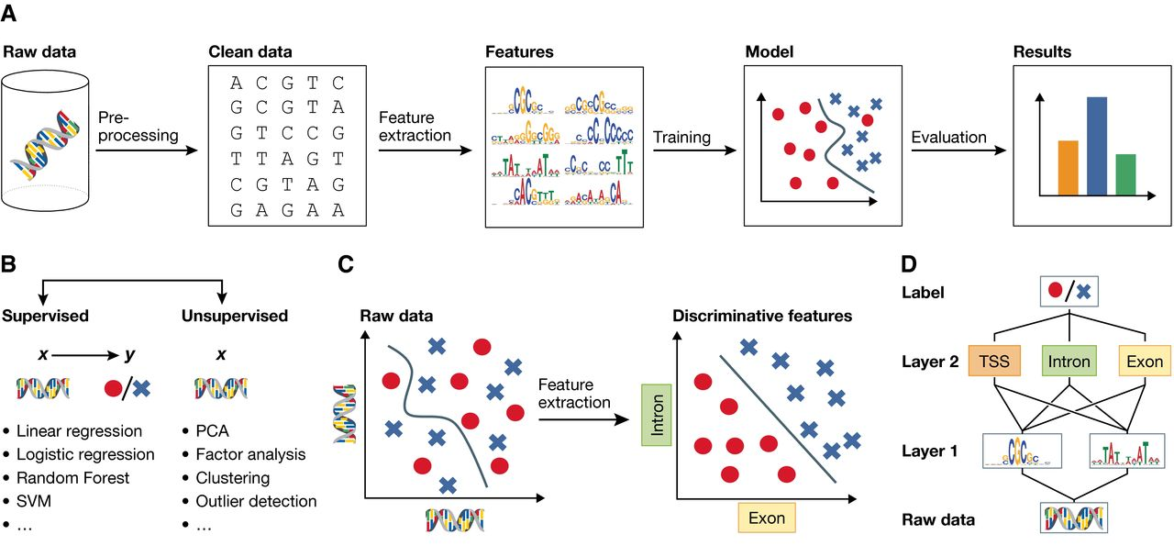

Example: Machine learning in genomics
Christof Angermueller et al. Mol Syst Biol 2016;12:878
© as stated in the article, figure or figure legend
Notes:
Machine learning and representation learning (A) The classical machine learning workflow can be broken down into four steps: data pre‐processing, feature extraction, model learning and model evaluation. (B) Supervised machine learning methods relate input features x to an output label y, whereas unsupervised method learns factors about x without observed labels. (C) Raw input data are often high‐dimensional and related to the corresponding label in a complicated way, which is challenging for many classical machine learning algorithms (left plot). Alternatively, higher‐level features extracted using a deep model may be able to better discriminate between classes (right plot). (D) Deep networks use a hierarchical structure to learn increasingly abstract feature representations from the raw data.

Slide 5
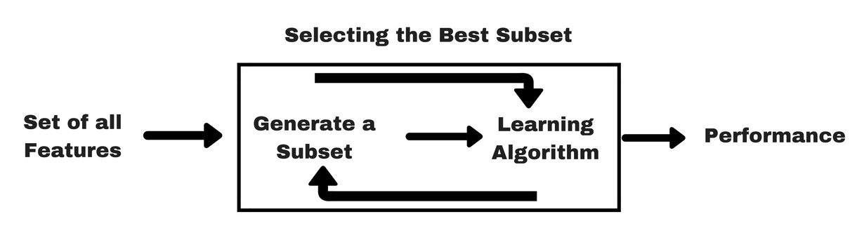
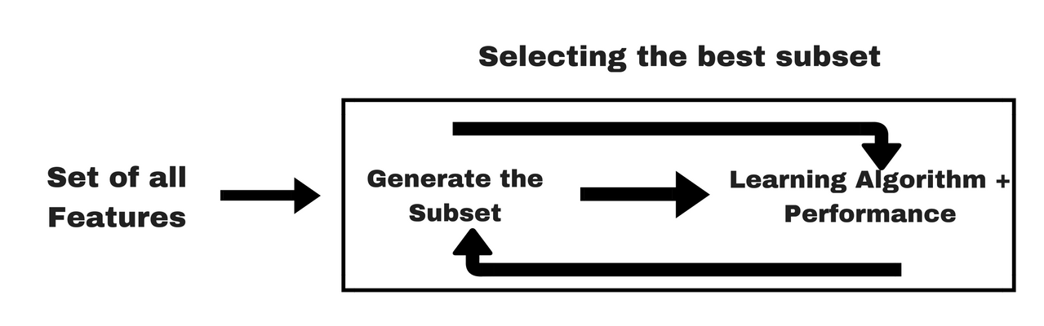
Feature selection
Filter approach scores and ranks features independently of the predictor (classifier).
  For example, t-test, correlation coefficient
Wrapper approach uses a classifier/predictive model to
search (many) best features or feature subsets.
  Recursive feature elimination
Embedded approach uses a classifier/predictive model
to build a (single) model with a subset of features
that are internally selected.
  LASSO regression
https://www.analyticsvidhya.com/blog/2016/12/introduction-to-feature-selection-methods-with-an-example-or-how-to-select-the-right-variables/

Slide 6
Differentially expressed genes
Identify genes with different levels in two conditions
Examples
  Highly expressed genes in cancer cells vs. health cells
Filter method for selecting “feature” genes

Slide 7
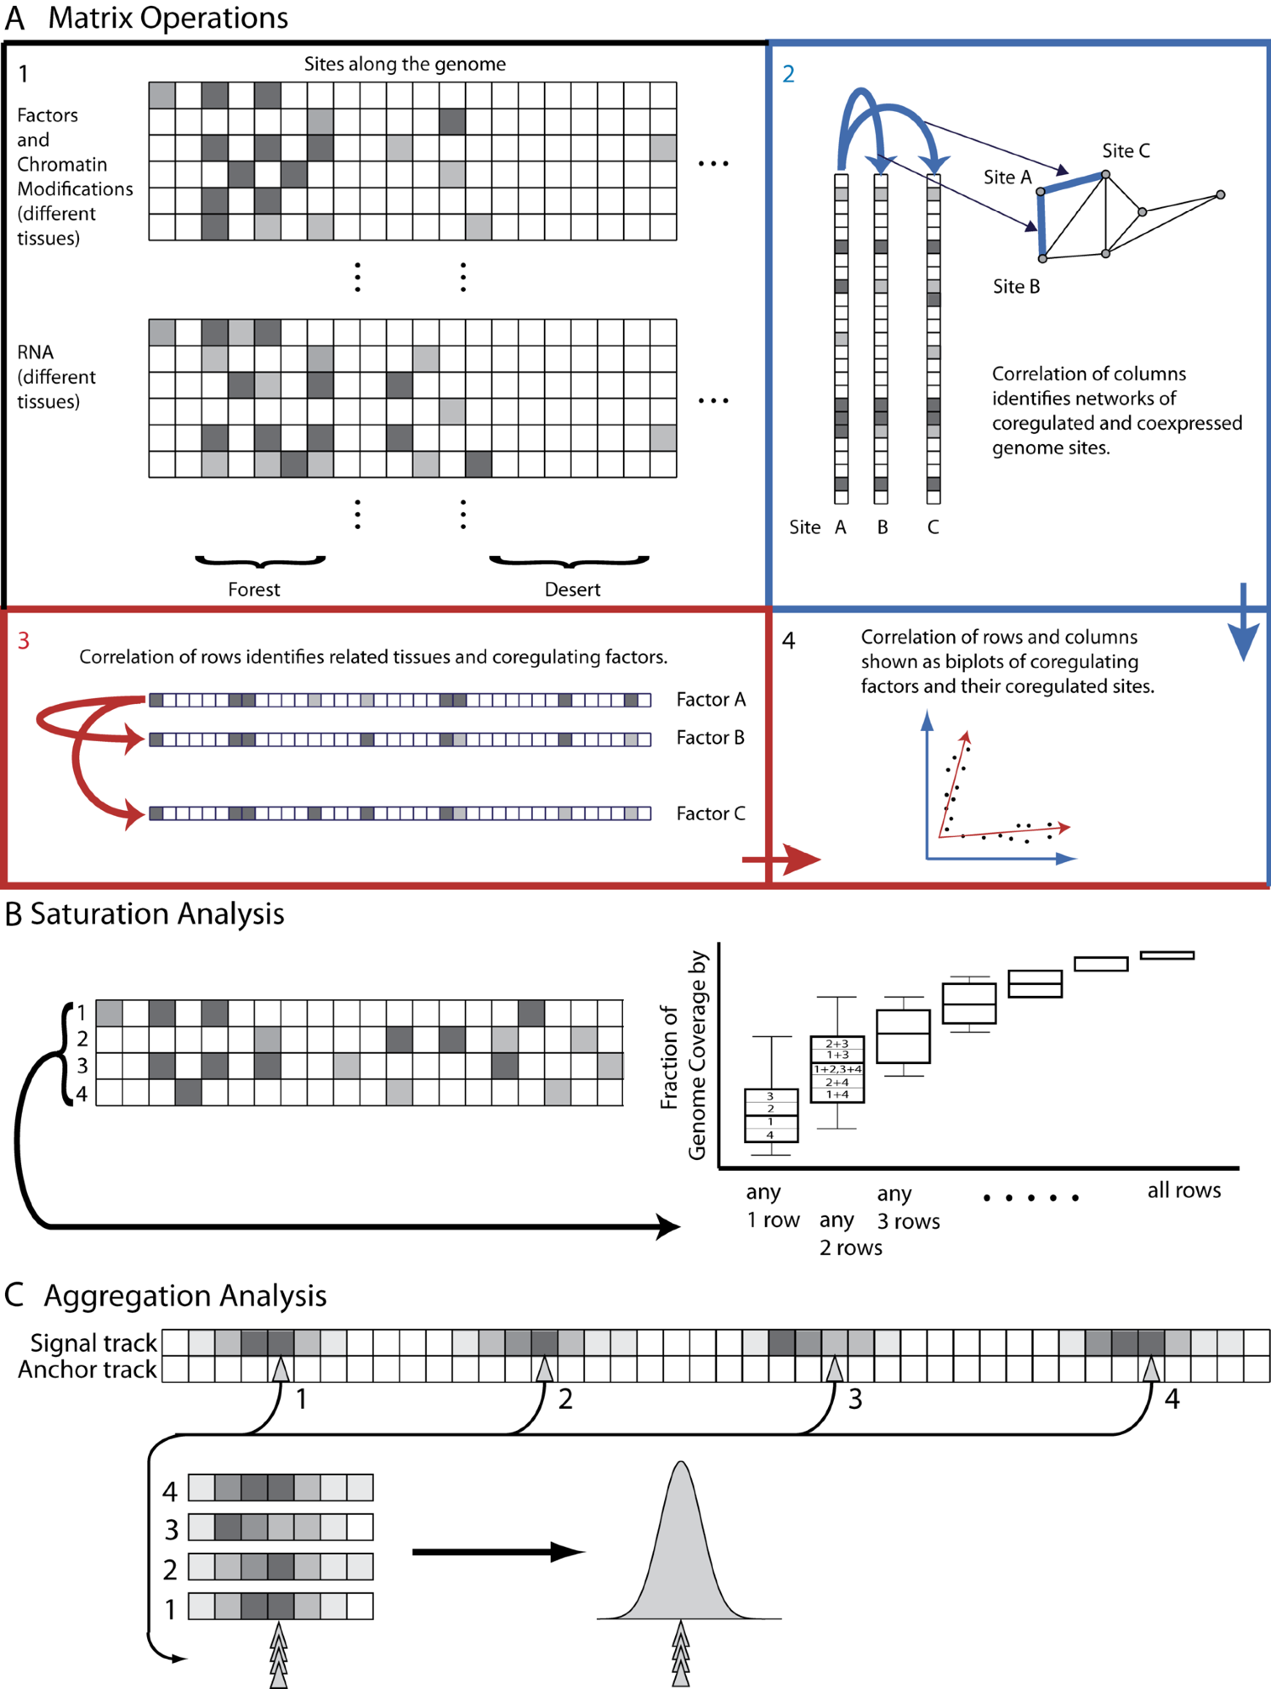
What can we learn from a data matrix?
Sample
Gene

Slide 8
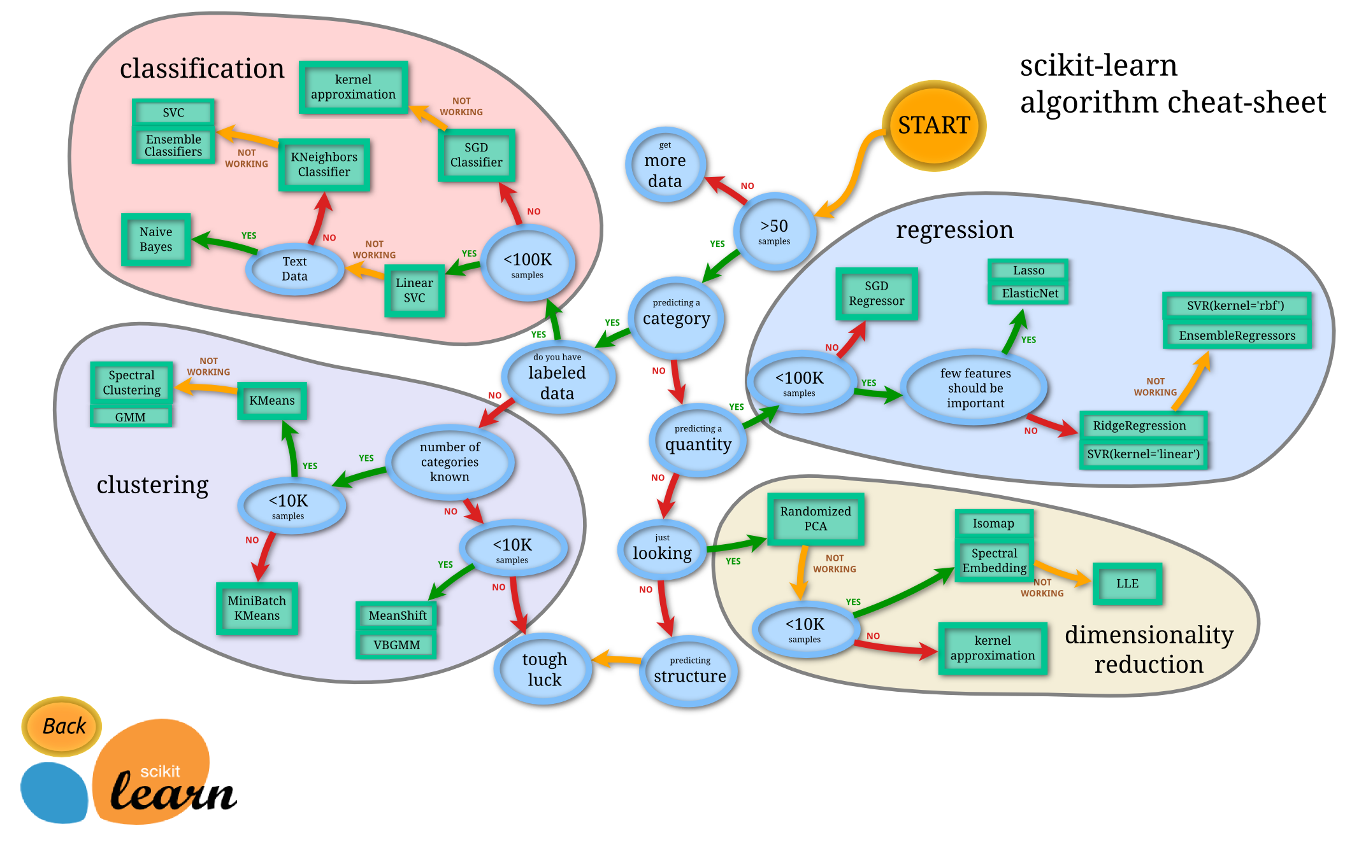
The World of Machine Learning
SciKit learn: http://scikit-learn.org/stable/tutorial/machine_learning_map/

Slide 9
Unsupervised learning
K-means
Hierarchical clustering
Network
  Weighted Gene Co-Expression Network

Slide 10
Structure of Genomic Features Matrix

Slide 11
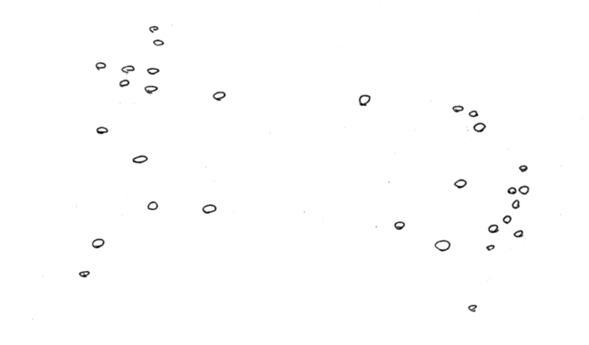
Represent predictors in abstract high dimensional space

Slide 12
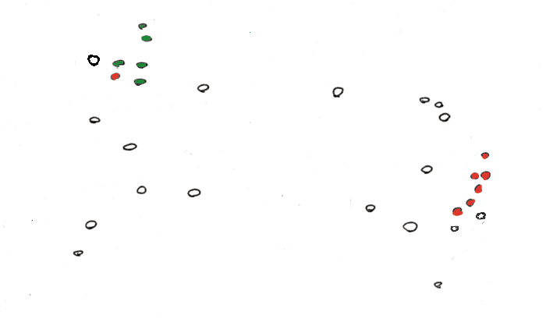
“Label” Certain Points

Slide 13
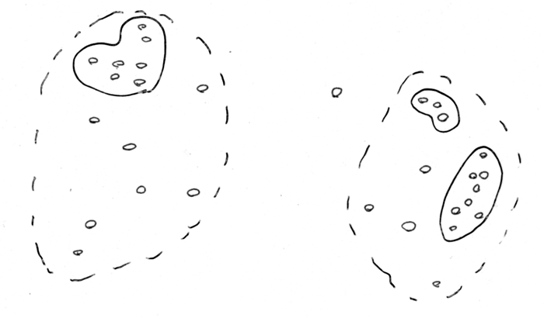
“Cluster” predictors (Unsupervised)

Slide 14
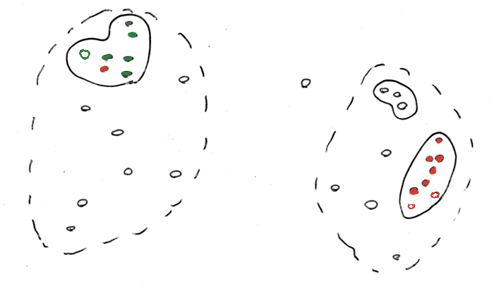
Use Clusters to predict Response (Unsupervised, guilt-by-association)

Slide 15
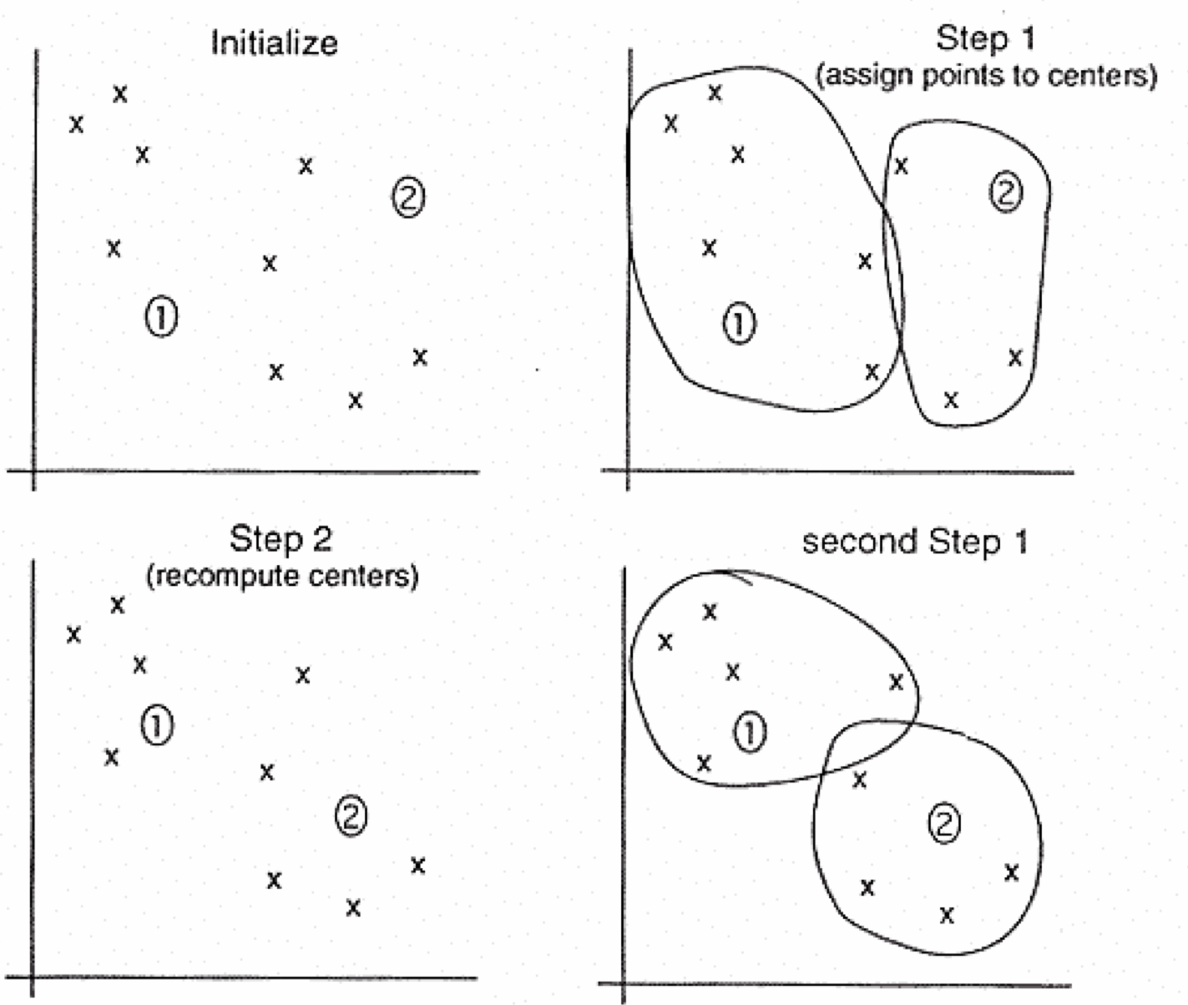
K-means
For example, PCA coefficients over PC1 and PC2
1) Pick K random points as putative cluster centers.
2) Group the points to be clustered by the center to which they are
closest.
3) Then take the mean of each group and repeat, with the means now at
the cluster center.
4)Stop when the centers stop moving.

Slide 16
K-means: Setup
x₁,…, x_{N} are data points or vectors of observations
Each observation (vector x_{i}) will be assigned to one and only one cluster
C(i) denotes cluster number for the i^{th} observation
Dissimilarity measure: Euclidean distance metric
K-means minimizes within-cluster point scatter:
where
m_{k} is the mean vector of the k^{th} cluster
N_{k} is the number of observations in k^{th} cluster

Slide 17
Within and Between Cluster Criteria
Let’s consider total point scatter for a set of N data points:
Distance between two points
T can be re-written as:
If d is square Euclidean distance, then
Where,
Within cluster
scatter
and
Between cluster
scatter
Grand mean
Minimizing W(C) is equivalent to maximizing B(C)

Slide 18
K-means Algorithm
For a given cluster assignment C of the data points, compute the cluster means m_{k}:
For a current set of cluster means, assign each observation as:
Iterate above two steps until convergence

Slide 19
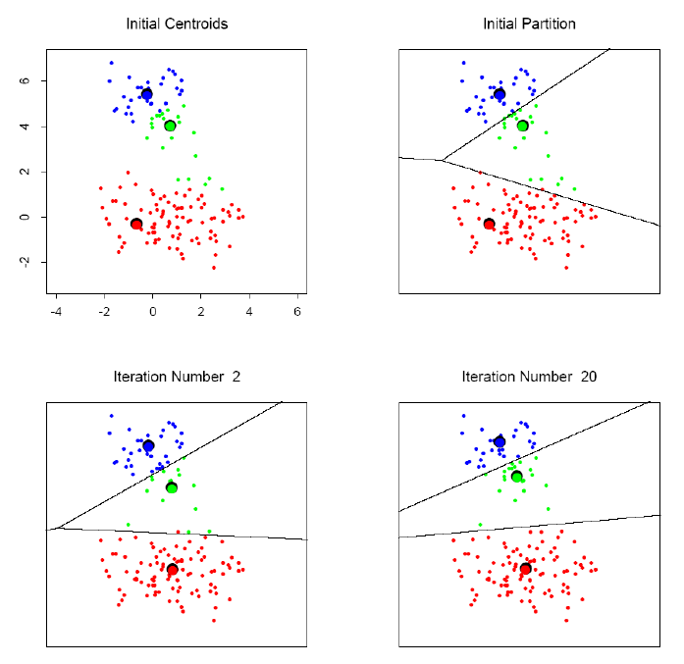
K-means clustering example

Slide 20
K-means: summary
Algorithmically, very simple to implement
K-means converges, but it finds a local minimum of the cost function
Works only for numerical observations
K is a user input; alternatively BIC (Bayesian information criterion) or MDL (minimum description length) can be used to estimate K
Outliers can considerable trouble to K-means

Slide 21
K-medoids Clustering
K-means is appropriate when we can work with Euclidean distances
Thus, K-means can work only with numerical, quantitative variable types
Euclidean distances do not work well in at least two situations
  Some variables are categorical
  Outliers can be potential threats
A general version of K-means algorithm called K-medoids can work with any distance measure
K-medoids clustering is computationally more intensive

Slide 22
K-medoids Algorithm
Step 1: For a given cluster assignment C, find the observation in the cluster minimizing the total distance to other points in that cluster:
Step 2: Assign
Step 3: Given a set of cluster centers {m₁, …, m_{K}}, minimize the total error by assigning each observation to the closest (current) cluster center:
Iterate steps 1 to 3

Slide 23
K-medoids Summary
Generalized K-means
Computationally much costlier that K-means
Apply when dealing with categorical data
Apply when data points are not available, but only pair-wise distances are available
  Kernel functions
Converges to local minimum

Slide 24
Choice of K?
Can W_{K}(C), i.e., the within cluster distance as a function of K serve as any indicator?
Note that W_{K}(C) decreases monotonically with increasing K. That is the within cluster scatter decreases with increasing centroids.
Instead look for gap statistics (successive difference between W_{K}(C)):

Slide 25
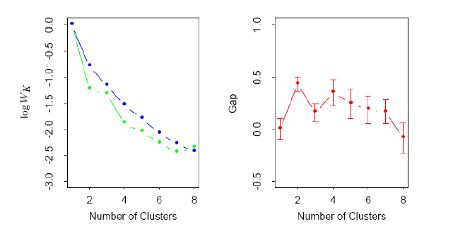
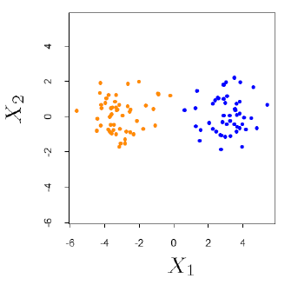
Choice of K…
Data points simulated
from two pdfs
Log(W_{K}) curve
Gap curve
This is essentially a visual heuristic

Slide 26
Hierarchical Clustering
Build a tree-based hierarchical taxonomy (dendrogram) from a set of documents.
animal
vertebrate
invertebrate
fish reptile amphib. mammal worm insect crustacean
How could you do this with K-means?

Slide 27
Hierarchical Clustering
Agglomerative (bottom-up):
  Start with each gene being a single cluster.
  Eventually all genes belong to the same cluster.
Divisive (top-down):
  Start with all genes belong to the same cluster.
  Eventually each gene forms a cluster on its own.
  Could be a recursive application of K-means like algorithms
Does not require the number of clusters K in advance
Needs a termination/readout condition

Slide 28
Hierarchical Agglomerative Clustering (HAC)
Start with each gene in a separate cluster
  then repeatedly joins the closest pair of clusters, until there is only one cluster.
The history of merging forms a tree or hierarchy.
How to measure distance of clusters??

Slide 29
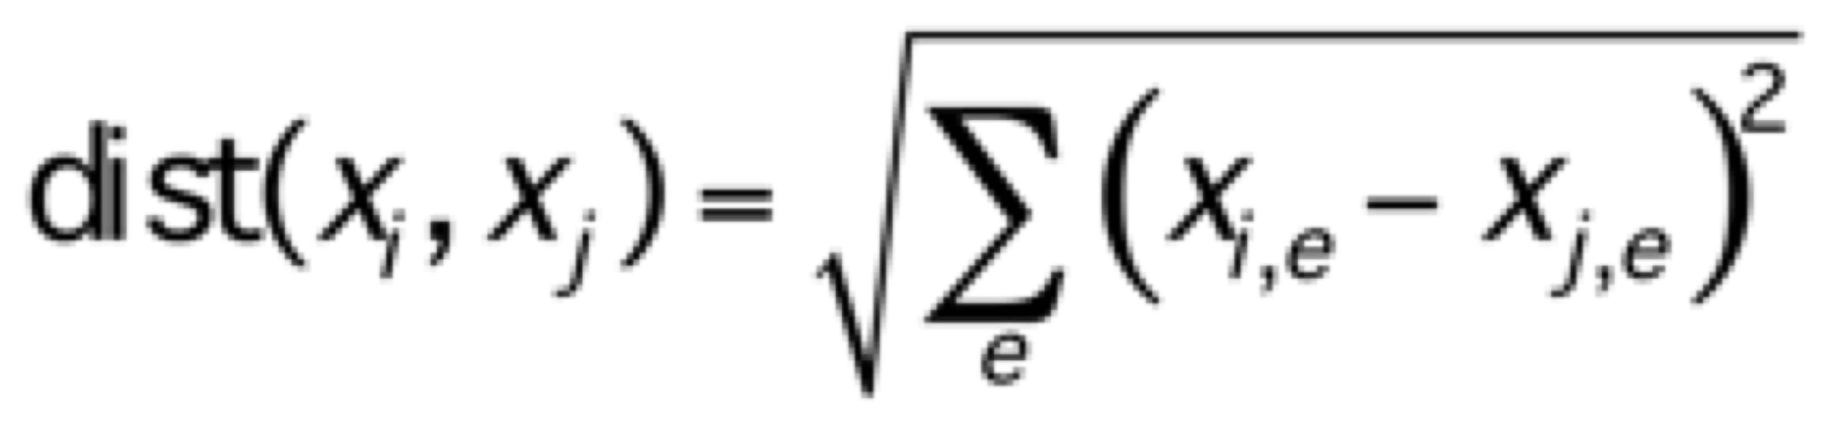
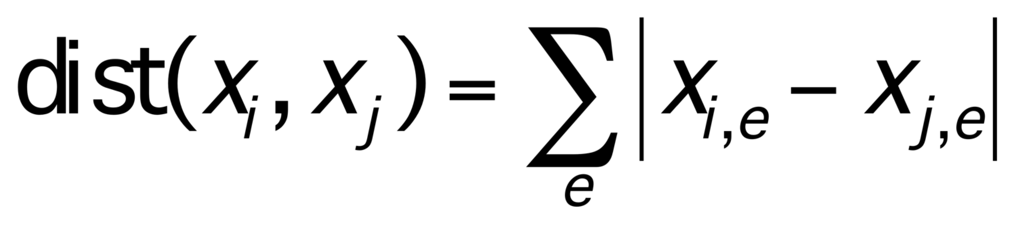
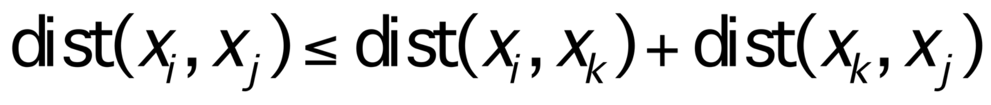
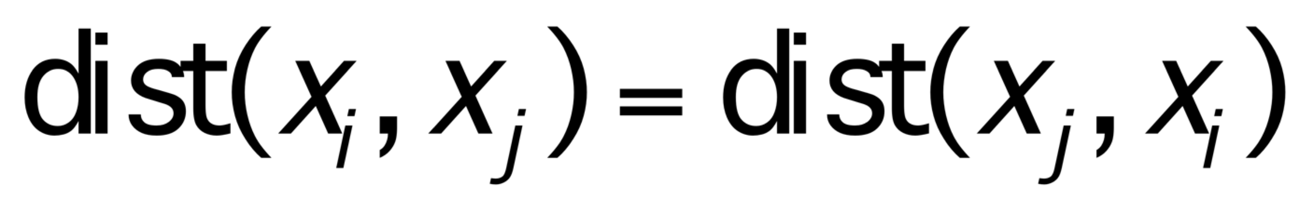
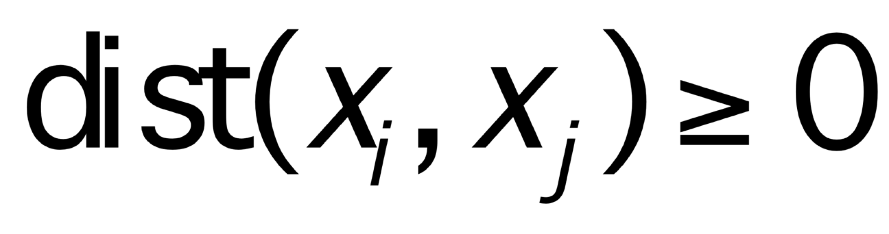
Distance Metrics
properties of metrics
some distance metrics
(non-negativity)
(identity)
(symmetry)
(triangle inequality)
Manhattan
Euclidean
e ranges over the individual measurements for x_{i} and x_{j}

Slide 30
Correlation distance
Correlation distance
  Cov(X,Y) stands for covariance of X and Y
    degree to which two different variables are related
  Var(X) stands for variance of X
    measurement of a sample differ from their mean

Slide 31
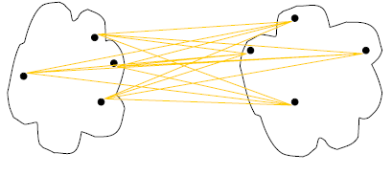
Cluster Distance Measures
Single link: smallest distance between an element in one cluster and an element in the other, i.e., d(C_{i}, C_{j}) = min{d(x_{ip}, x_{jq})}
Complete link: largest distance between an element in one cluster and an element in the other, i.e., d(C_{i}, C_{j}) = max{d(x_{ip}, x_{jq})}
Average: avg distance between elements in one cluster and elements in the other, i.e.,
d(C_{i}, C_{j}) = avg{d(x_{ip}, x_{jq})}
single link
(min)
complete link
(max)
average
d(C, C)=0
Machine learning : a probabilistic perspective, Kevin P. Murphy
COMP24111 Machine Learning, Univ. of Manchester
Notes:
Define D(C, C)=0, the distance between two exactly same clusters is ZERO!

Slide 32
Cluster Distance Measures
  Example: Given a data set of five objects characterized by a single continuous feature, assume that there are two clusters: C1: {a, b} and C2: {c, d, e}.
  1. Calculate the distance matrix. 2. Calculate three cluster distances between C1 and C2.
 | a | b | c | d | e
Feature | 1 | 2 | 4 | 5 | 6
Single link
Complete link
Average
 | a | b | c | d | e
a | 0 | 1 | 3 | 4 | 5
b | 1 | 0 | 2 | 3 | 4
c | 3 | 2 | 0 | 1 | 2
d | 4 | 3 | 1 | 0 | 1
e | 5 | 4 | 2 | 1 | 0
COMP24111 Machine Learning, Univ. of Manchester

Slide 33
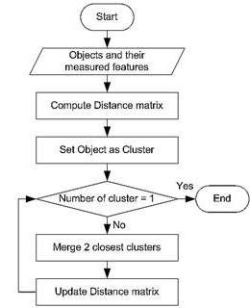
Agglomerative Algorithm
Convert all features (e.g., genes) into a distance matrix
Set each gene as a cluster (N genes -> N clusters at the beginning)
Repeat until number of cluster is one (or known # of clusters)
  Merge two closest clusters
  Update “distance matrix”

Slide 34
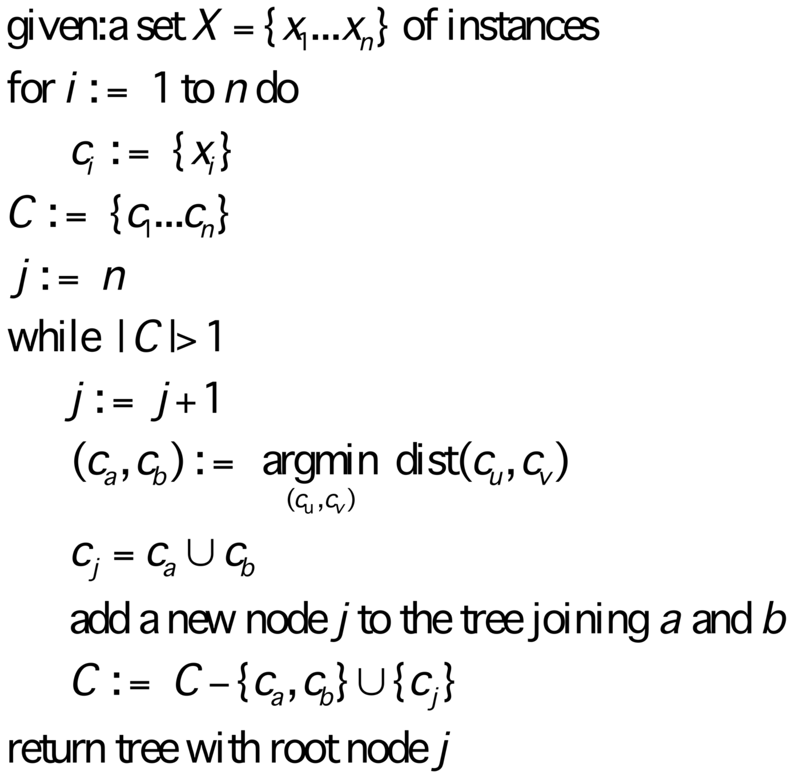
Bottom-Up Hierarchical Clustering
// each object is initially its own cluster, and a leaf in tree
// find least distant pair in C
// create a new cluster for pair

Slide 35
Single Link Example

Slide 36
Dendogram: Hierarchical Clustering
  Clustering obtained by cutting the dendrogram at a desired level: each connected component forms a cluster.
height of bar indicates
degree of distance within cluster
e.g., Gene

Slide 37
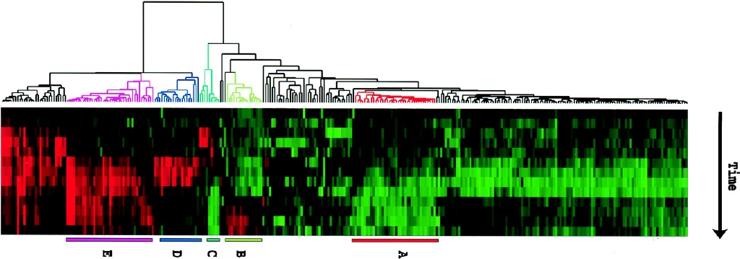
Hierarchical Clustering of Expression Data
http://www.pnas.org/content/95/25/14863.full

Slide 38
Partitioning or Hierarchical?
Partitioning:
– Advantages
  • Optimal for certain criteria.
  • Genes automatically assigned to clusters
– Disadvantages
  • Need initial k;
  • Often slow computation.
  • All genes are forced into a cluster.
Hierarchical
– Advantages
  • Faster computation.
  • Visual.
– Disadvantages
  • Unrelated genes are eventually joined
  • Rigid, cannot correct later for erroneous decisions made earlier.
  • Hard to define clusters.

Slide 39
Reading list
A. K. Jain and M. N. Murty and P. J. Flynn, Data clustering: a review, ACM Computing Surveys, 31:3, pp. 264 - 323, 1999.
T. R. Golub et. al, Molecular Classification of Cancer: Class Discovery and Class Prediction by Gene Expression Monitoring, Science, 286:5439, pp. 531 – 537, 1999.
Gasch,A.P. and Eisen,M.B. (2002) Exploring the conditional coregulation of yeast gene expression through fuzzy k-means clustering. Genome Biol., 3, 1–22.
M. Eisen et. al, Cluster Analysis and Display of Genome-Wide Expression Patterns. Proc Natl Acad Sci U S A 95, 14863-8, 1998.

Slide 40
Support Vector Machines
A very powerful tool for classifications
Example Applications:
  Text categorization
  Image classification
  Spam email recognition, etc
It has also been successfully applied in many biological problems:
  Disease diagnosis
  Automatic genome functional annotation
  Prediction of protein-protein interactions
  and more…

Slide 41
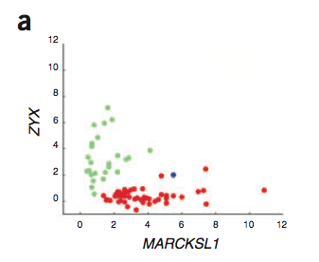
Example: Leukemia patient classification
ALL: acute lymphoblastic leukemia
AML: acute myeloid leukemia
William S Nobel. What is a support vector machine? Nature Biotechnology. 2006

Slide 42
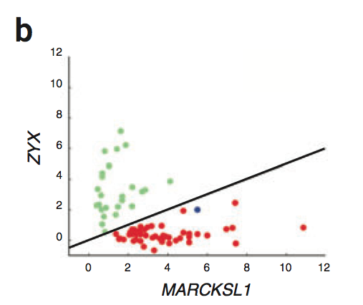
A simple line suffices to separate the expression profiles of ALL and AML
William S Nobel. What is a support vector machine? Nature Biotechnology. 2006

Slide 43
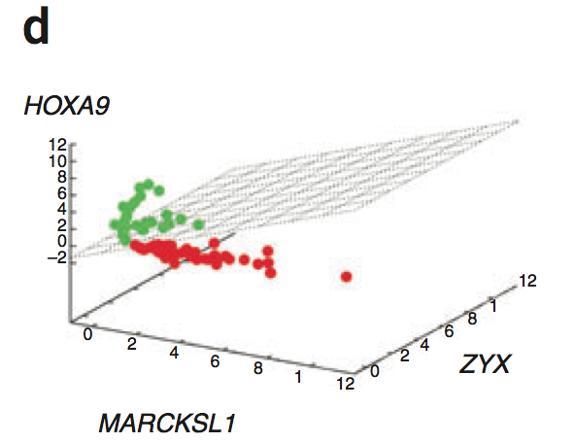
In the case of more than two genes, a line generalizes to a plane or “hyperplane”.
For generality, we refer to them all as “hyperplane”
William S Nobel. What is a support vector machine? Nature Biotechnology. 2006

Slide 44
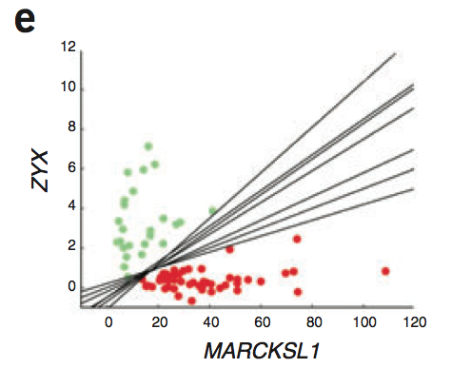
Is there a “best” line?
William S Nobel. What is a support vector machine? Nature Biotechnology. 2006

Slide 45
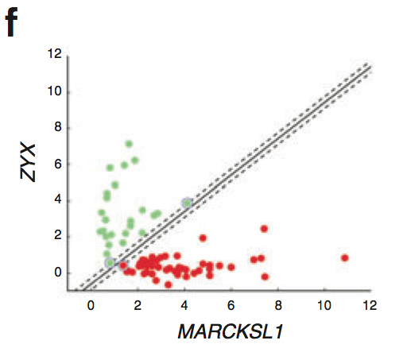
The maximum margin hyperplane
William S Nobel. What is a support vector machine? Nature Biotechnology. 2006

Slide 46
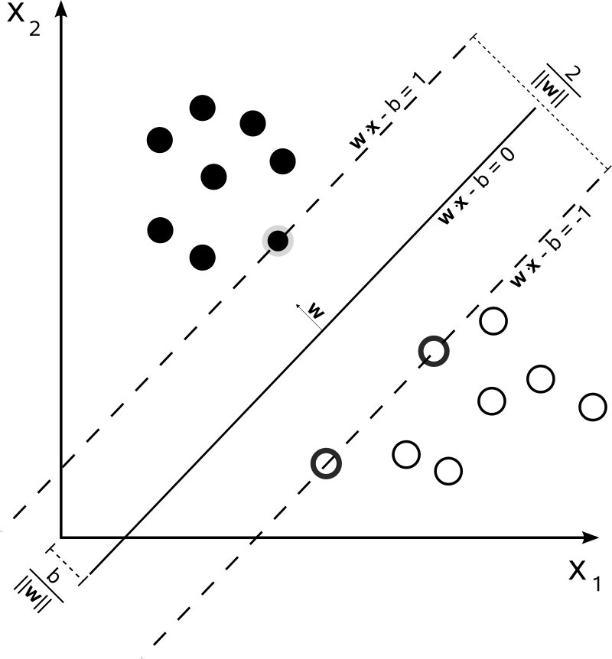
Denote each data point as (x_{i}, y_{i})
x_{i} is a vector of the expression profiles
y_{i} = -1 or 1, which labels the class
A hyperplane can be represented as: w*x + b = 0
The margin-width equals to:
http://en.wikipedia.org/wiki/Support_vector_machine

Slide 47
Find a hyperplane such that:
  No data points fall between the lines and
  The margin 2/||w|| is maximized
Mathematically,
  Minimize_{w,b} ½*||w||², subject to:
  for y_{i} = 1,
  for y_{i} = -1,
  Combining them, for any i,
The solution expresses w as a linear combination of the x_{i}
Assuming that the data points from two classes are always easily linearly separable. But that’s not always the case
http://en.wikipedia.org/wiki/Support_vector_machine

Slide 48
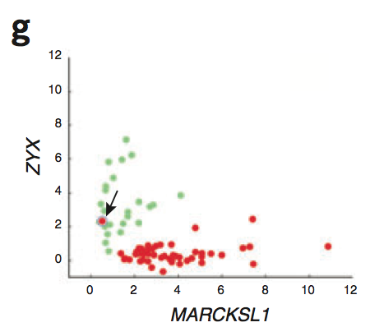
What if…
William S Nobel. What is a support vector machine? Nature Biotechnology. 2006

Slide 49
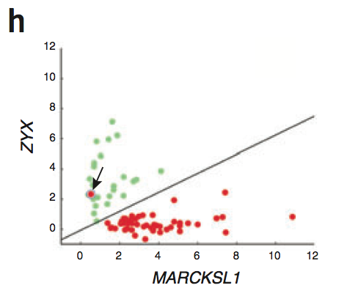
Allow a few anomalous data points
William S Nobel. What is a support vector machine? Nature Biotechnology. 2006

Slide 50
The soft-margin SVM
  subject to, for any i,
  S_{i} are the slack variables
  C controls the number of tolerated misclassifications
  (It's effectively a regularization parameter on model complexity)
  A small C would allow more misclassifications
  A large C would discourage misclassifications
  Note that even when the data points are linearly separable, one can still introduce the slack variables to pursue a larger separation margin
http://en.wikipedia.org/wiki/Support_vector_machine

Slide 51
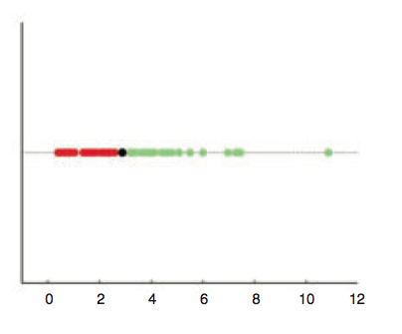
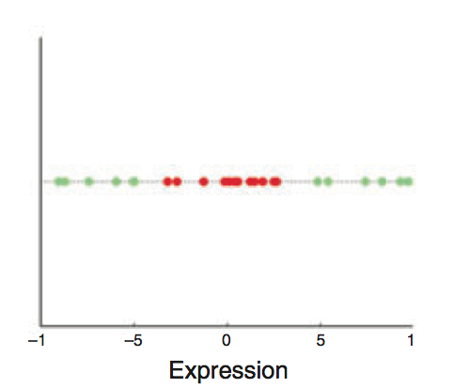
Are linear separating hyperplanes enough?
Yes
(by a 1D-hyperplane
= dot)
NO
William S Nobel. What is a support vector machine? Nature Biotechnology. 2006

Slide 52
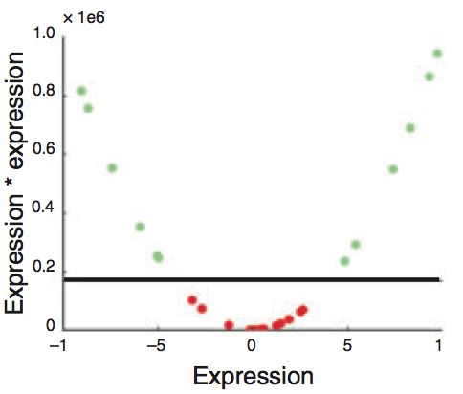
Transform (x_{i}) into (x_{i}, x_{i}²)
William S Nobel. What is a support vector machine? Nature Biotechnology. 2006

Slide 53
Non-linear SVM
  In some cases (e.g. the above example), even soft-margin cannot solve the non-separable problem
  Generally speaking, we can apply some function to the original data points so that different classes become linearly separable (maybe with the help of soft-margin)
    In the above example, the function is f(x) = (x, x²)
  The most import trick in SVM: to allow for the transformation, we only need to define the “kernel function”,
    e.g., a polynomial kernel used in above example

Slide 54
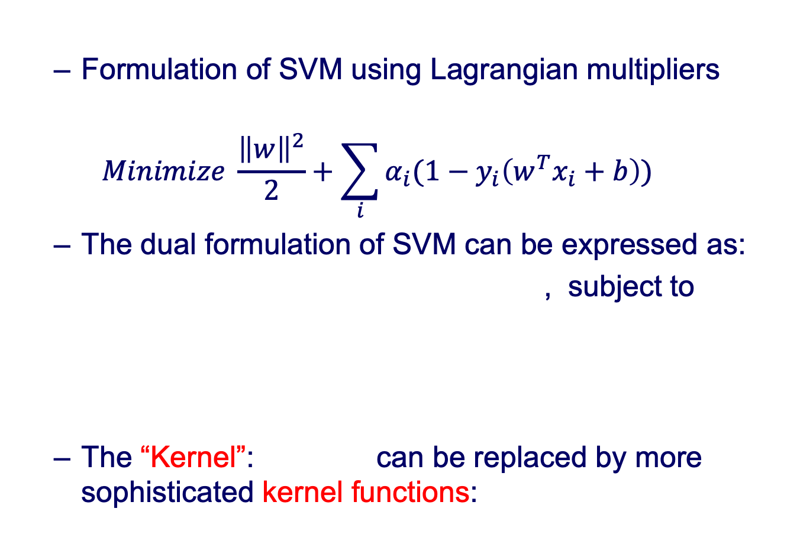
Solving SVM
  Formulation of SVM using Lagrangian multipliers
  $$Minimize \frac{{\left\|w\right\|}^{2}}{2}+\sum_{i}{α_{i}(1−y_{i}\left(w^{T}x_{i}+b\right))}$$
  The dual formulation of SVM can be expressed as:
  , subject to
  The “Kernel”: can be replaced by more sophisticated kernel functions:
no w and b now

Slide 55
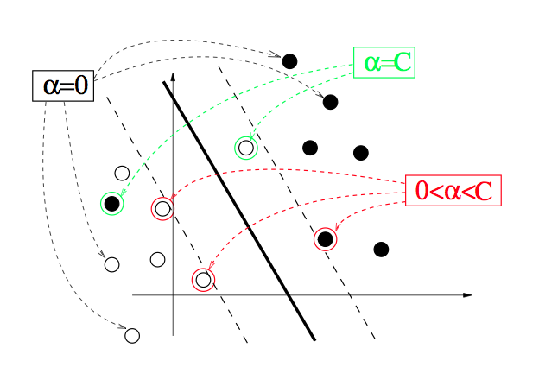
Support vectors
  The x_{i} for which α_{i} > 0 are called support vectors
  They fall between or right on the separating margins
from http://cbio.ensmp.fr/~jvert/talks/110401mines/mines.pdf

Slide 56
Tricks for solving SVM
Finding optimal w & b can be replaced by finding optimal "Lagrange multipliers" α_{i}
  One only optimizes using the product of x_{i}*x_{j}, now expressing the solution in terms of positive α_{i} for x_{i} that function as support vectors
Non-linear SVM x_{i}*x_{j} is replaced by f(x_{i})*f(x_{j}), so you don't need to know f(x_{i}) itself only the product
  Kernel trick: f(x_{i})*f(x_{j}) is just replaced by k(x_{i}, x_{j}). That is, one only has to know the “distance” between x_{i} & x_{j} in the high-dimensional space -- not their actual representation

Slide 57
Kernel functions
Polynomial kernel:
  a = 1 (inhomogeneous) or 0 (homogenous)
  d controls the degree of polynomial and henceforth the flexibility of the classifier
  degenerates to linear kernel when a = 0 and d = 1
Gaussian kernel:
  σ controls the width of the Gaussian and plays a similar role as d in the polynomial kernels

Slide 58
Kernel functions in computational biology
”Distance” even for non-vector biological data
  Protein-protein interactions
  DNA binding
  Ben-Hur et al., Support Vector Machines and Kernels for Computational Biology, PLoS Comp. Bio., 2008
For example, “Spectrum kernels” for sequences
  k-spectrum of a sequence x is all possible k-length subsequence
  Map the sequence to counts on k-spectrum c(x)
  Spectrum kernel K_{k}(x,y)=<c(x), c(y)>
  Leslie et al., PSB, 2002

Slide 59
kmer-SVM for predicting regulatory sequence features
Fletez-Brant et al., NAR, 2013
For example, ESRRB binding sites
kmer-SVM
PWM

Slide 60
Avoid over-fitting by kernel functions
High-degree kernels always fit the training data well, but at increased risks of over-fitting, i.e. the classifier will not generalize to new data points
One needs to find a balance between classification accuracy on the training data and regularity of the kernel (not allowing the kernel to be too flexible)

Slide 61
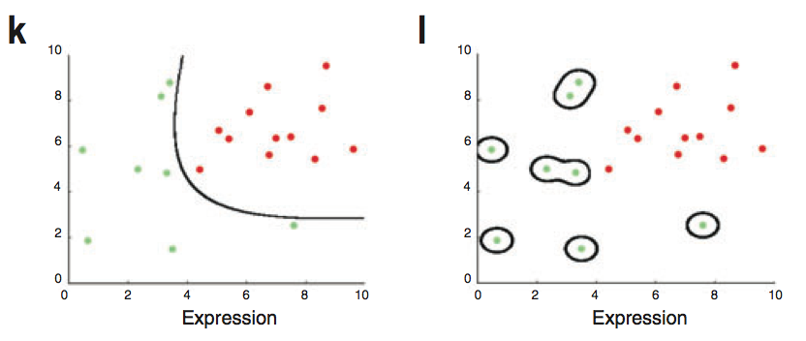
A low-degree kernel (left) and an over-fitting high-degree kernel (right)
William S Nobel. What is a support vector machine? Nature Biotechnology. 2006

Slide 62
The parameter C has a similar role
  Large C will make few classification errors on the training data
  But this may not generalize to the testing data
  Small C pursues a large separating margin at the expenses of some classification errors on the training data.
  The accuracy more likely to generalize to testing data

Slide 63
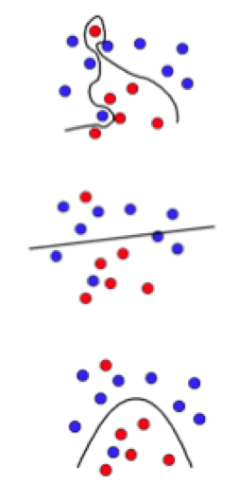
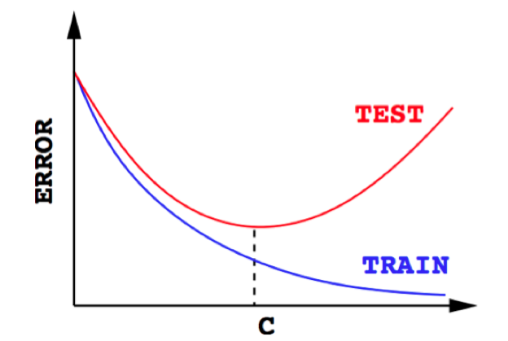
Large C
Small C
Intermediate C
http://cbio.ensmp.fr/~jvert/talks/110401mines/mines.pdf

Slide 64
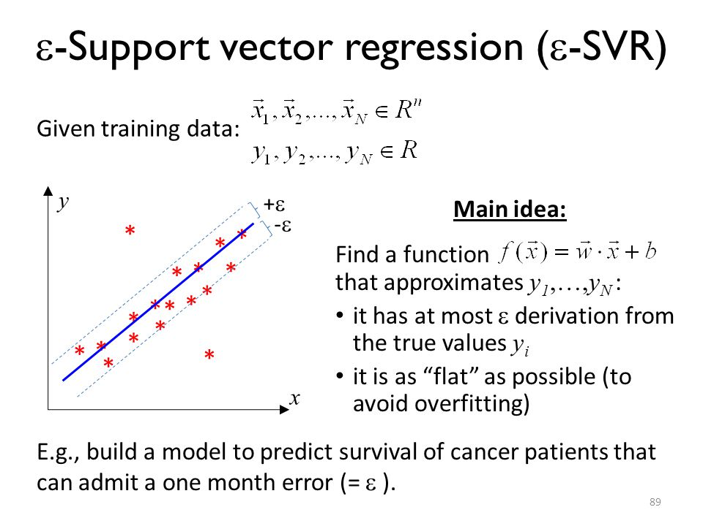

Slide 65
Workshop introducing machine learning to biologists
ML4BIO workshop from Gitter Lab
https://gitter-lab.github.io/ml-bio-workshop/

