Slide 1
Learning Sequence Motif Models Using Gibbs Sampling
BMI/CS 776
www.biostat.wisc.edu/bmi776/
Spring 2021
Daifeng Wang
daifeng.wang@wisc.edu
These slides, excluding third-party material, are licensed under CC BY-NC 4.0 by Mark Craven, Colin Dewey, Anthony Gitter and Daifeng Wang

Slide 2
Goals for Lecture
Key concepts:
Markov Chain Monte Carlo (MCMC) and Gibbs sampling
  CS 760 slides for background
Gibbs sampling applied to the motif-finding task
parameter tying
incorporating prior knowledge using Dirichlets and Dirichlet mixtures

Slide 3
Gibbs Sampling: An Alternative to EM
EM can get trapped in local maxima
One approach to alleviate this limitation: try different (perhaps random) initial parameters
Gibbs sampling exploits randomized search to a much greater degree
Can view it as a stochastic analog of EM for this task
In theory, Gibbs sampling is less susceptible to local maxima than EM
[Lawrence et al., Science 1993]

Slide 4
Gibbs Sampling Approach
In the EM approach we maintained a distribution over the possible motif starting points for each sequence at iteration t
In the Gibbs sampling approach, we’ll maintain a specific starting point for each sequence but we’ll keep randomly resampling these

Slide 5
Markov Chain Monte Carlo (MCMC)
Consider a Markov chain in which, on each time step, a grasshopper randomly chooses to stay in its current state, jump one state left or jump one state right.
Figure from Koller & Friedman, Probabilistic Graphical Models, MIT Press
Let P^{(t)}(u) represent the probability of being in state u at time t in the random walk

Slide 6
The Stationary Distribution
Let P(u) represent the probability of being in state u at any given time in a random walk on the chain
The stationary distribution is the set of such probabilities for all states
(for some sufficiently large t)
probability of
state v
probability of
transition v→u

Slide 7
Markov Chain Monte Carlo (MCMC)
We can view the motif finding approach in terms of a Markov chain
Each state represents a configuration of the starting positions (a_{i} values for a set of random variables A₁ … A_{n})
Transitions correspond to changing selected starting positions (and hence moving to a new state)
A₁=5
ACATCCG
CGACTAC
ATTGAGC
CGTTGAC
GAGTGAT
TCGTTGG
ACAGGAT
TAGCTAT
GCTACCG
GGCCTCA
ACATCCG
CGACTAC
ATTGAGC
CGTTGAC
GAGTGAT
TCGTTGG
ACAGGAT
TAGCTAT
GCTACCG
GGCCTCA
A₁=3
state u
state v

Slide 8
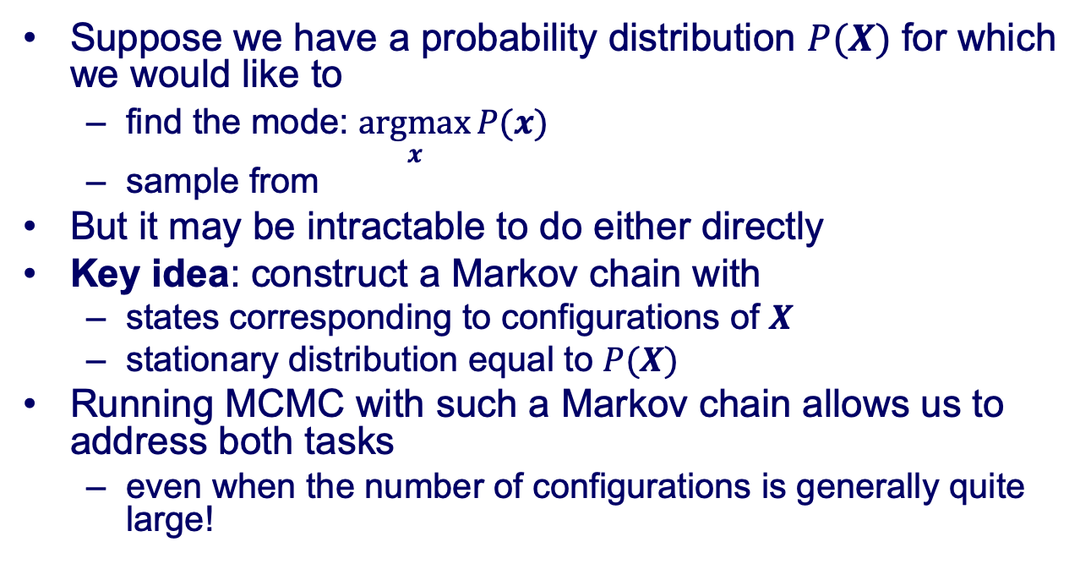
Sampling with MCMC
Suppose we have a probability distribution $P(X)$ for which we would like to
  find the mode: $\underset{x}{argmax}{P(x})$
  sample from
But it may be intractable to do either directly
Key idea: construct a Markov chain with
  states corresponding to configurations of $X$
  stationary distribution equal to $P(X)$
Running MCMC with such a Markov chain allows us to address both tasks
  even when the number of configurations is generally quite large!

Slide 9
Markov Chain Monte Carlo
How do we construct a Markov chain with a stationary distribution equal to our probability distribution, P, of interest?
Set the transition probabilities such that the condition of detailed balance holds for all pairs of states, u and v:
probability of
state u
probability of
transition u→v
When detailed balance holds, if we perform MCMC with N samples and count(u) is the number of times we are in state u, then:

Slide 10
MCMC with Gibbs Sampling
Gibbs sampling is a special case of MCMC in which
Markov chain transitions involve changing one variable at a time
Transition probability is conditional probability of the changed variable given all others
We sample the joint distribution of a set of random variables by iteratively sampling from

Slide 11
Gibbs Sampling for a toy example
Two binary random variables A₁, A₂ with joint probabilities P(A₁, A₂)
Calculate conditional probabilities P(A₁=1|A₂=0), P(A₁=0|A₂=0), P(A₂=1|A₁=0), P(A₂=0|A₁=0)
Start an initial value of A₁, e.g., A₁=0
At Step t, sample A₂^{(t)} from P(A₂|A₁=A₁^{(t-1)}), and then A₁^{(t)} from P(A₁|A₂=A₂^{(t)})
When t is large enough, the distribution of your samples approximates joint probabilities P(A₁, A₂)
P(A₁, A₂) |  | A₁
 |  | 0 | 1
A₂ | 0 | p1 | p2
 | 1 | p3 | p4

Slide 12
Gibbs Sampling Approach
Possible state transitions when first sequence is selected
ACATCCG
CGACTAC
ATTGAGC
CGTTGAC
GAGTGAT
TCGTTGG
ACAGGAT
TAGCTAT
GCTACCG
GGCCTCA
ACATCCG
CGACTAC
ATTGAGC
CGTTGAC
GAGTGAT
TCGTTGG
ACAGGAT
TAGCTAT
GCTACCG
GGCCTCA
ACATCCG
CGACTAC
ATTGAGC
CGTTGAC
GAGTGAT
TCGTTGG
ACAGGAT
TAGCTAT
GCTACCG
GGCCTCA
ACATCCG
CGACTAC
ATTGAGC
CGTTGAC
GAGTGAT
TCGTTGG
ACAGGAT
TAGCTAT
GCTACCG
GGCCTCA
ACATCCG
CGACTAC
ATTGAGC
CGTTGAC
GAGTGAT
TCGTTGG
ACAGGAT
TAGCTAT
GCTACCG
GGCCTCA

Slide 13
Gibbs Sampling Approach
The probability of a state is given by
count of
c in motif position j
background probability
for character c
probability of
c in motif position j
ACATCCG
CGACTAC
ATTGAGC
CGTTGAC
GAGTGAT
TCGTTGG
ACAGGAT
TAGCTAT
GCTACCG
GGCCTCA
1
2
3
A
1
3
1
C
5
2
1
G
2
2
6
See Liu et al., JASA, 1995 for the full derivation
T
2
3
2

Slide 14
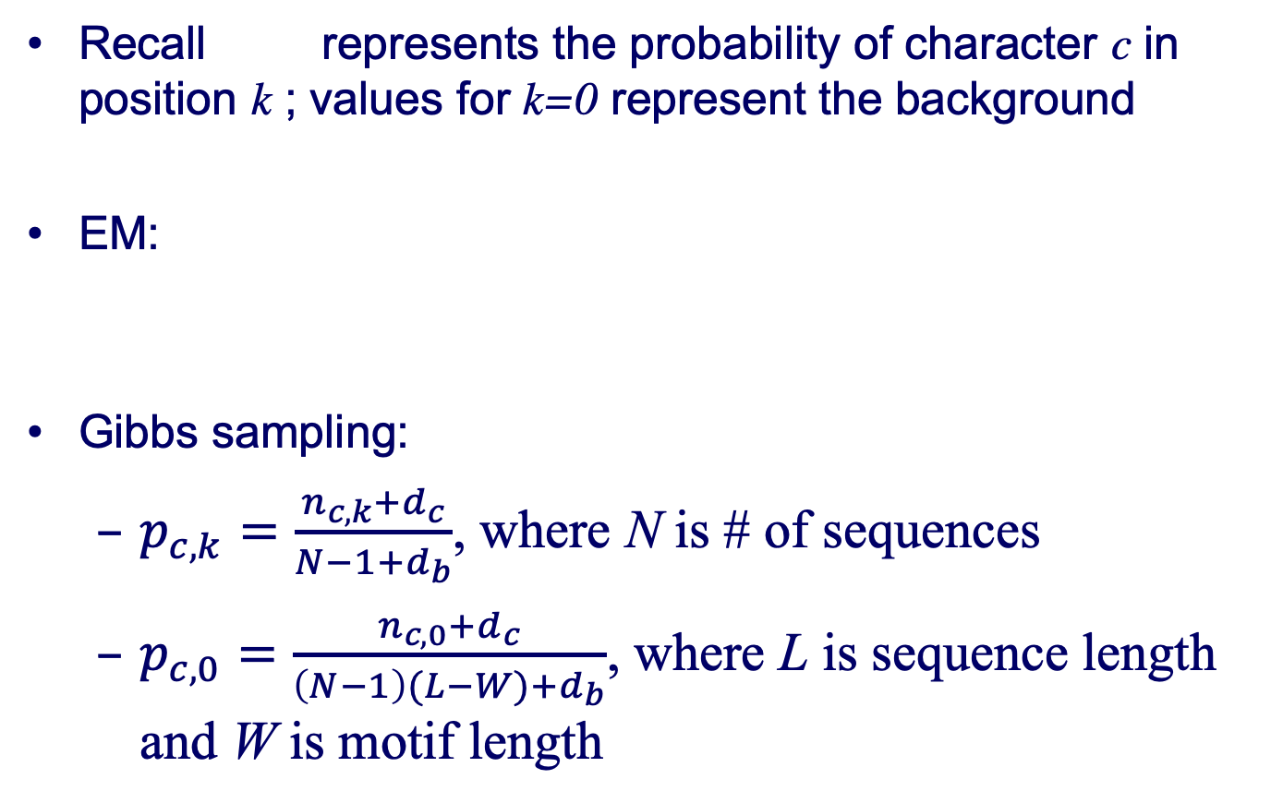
Estimating p
Recall represents the probability of character c in position k ; values for k=0 represent the background
EM:
Gibbs sampling:
  $p_{c,k}=\frac{n_{c,k}+d_{c}}{N−1+d_{b}}$, where N is # of sequences
  $p_{c,0}=\frac{n_{c,0}+d_{c}}{\left(N−1\right)(L−W)+d_{b}}$, where L is sequence length and W is motif length
pseudo-counts

Slide 15
Gibbs Sampling Approach
How do we get the transition probabilities when we don’t know what the motif looks like?

Slide 16
Sampling New Motif Positions
For sampling a new motif position in sequence i
Estimate p from all sequences except sequence i
For each possible starting position, , compute the likelihood ratio
Randomly select a new starting position with probability

Slide 17
Gibbs Sampling Algorithm for Motif Finding
given: length parameter W, training set of sequences
  choose random positions for a
  do
  pick a sequence
  estimate p given current motif positions a
  (using all sequences but ) (predictive update step)
  sample a new motif position for (sampling step)
  until convergence
return: p, a

Slide 18
The Phase Shift Problem
Gibbs sampler can get stuck in a local maximum that corresponds to the correct solution shifted by a few bases
Solution: add a special step to shift the a values by the same amount for all sequences
Try different shift amounts and pick one in proportion to its probability score

Slide 19
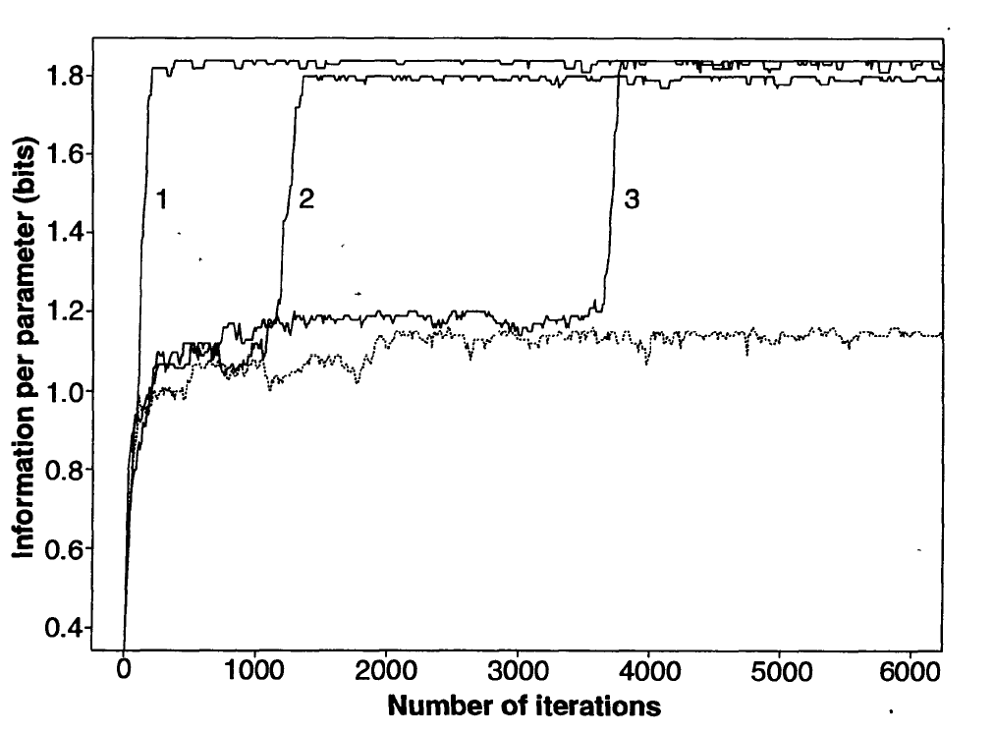
Convergence of Gibbs
true motif deleted from
input sequences

Slide 20
Using Background Knowledge to Bias the Parameters
Let’s consider two ways in which background
knowledge can be exploited in motif finding
Accounting for palindromes that are common in DNA binding sites
Using Dirichlet mixture priors to account for biochemical similarity of amino acids

Slide 21
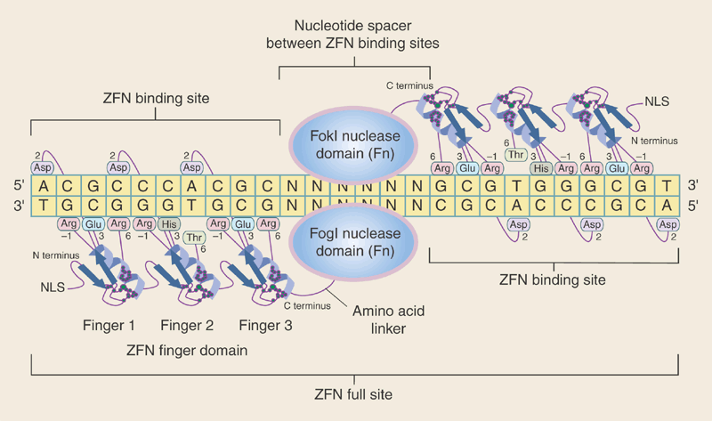
Using Background Knowledge to Bias the Parameters
Many DNA motifs have a palindromic pattern because they are bound by a protein homodimer: a complex consisting of two identical proteins
Reversed order is an identical sequence
Porteus & Carroll Nature Biotechnology 2005

Slide 22
Representing Palindromes
Parameters in probabilistic models can be “tied” or “shared”
During motif search, try tying parameters according to palindromic constraint; accept if it increases likelihood ratio test (half as many parameters)

Slide 23
Updating Tied Parameters

Slide 24
Including Prior Knowledge
Recall that MEME and Gibbs update parameters by:
Can we use background knowledge to guide our choice of pseudocounts ( d_{c,k} )?
  may not be uniformly distributed
Suppose we’re modeling protein sequences…

Slide 25
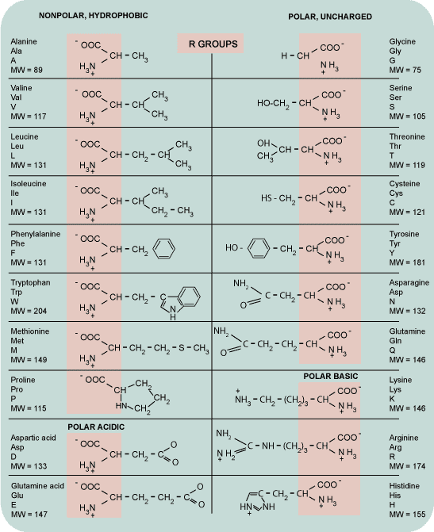
Amino Acids
Can we encode prior knowledge about amino acid properties into the motif finding process?
There are classes of amino acids that share similar properties

Slide 26
Using Dirichlet Mixture Priors
Prior for a single PWM column, not the entire motif
Because we’re estimating multinomial distributions (frequencies of amino acids at each motif position), a natural way to encode prior knowledge is using Dirichlet distributions
Let’s consider
  the Beta distribution
  the Dirichlet distribution
  mixtures of Dirichlets

Slide 27
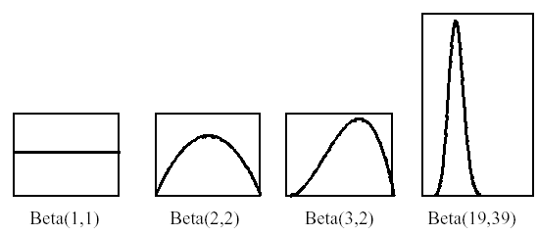
The Beta Distribution
Suppose we’re taking a Bayesian approach to estimating the parameter θ of a weighted coin
The Beta distribution provides an appropriate prior
  where
# of “imaginary” heads we have seen already
# of “imaginary” tails we have seen already
continuous generalization of
factorial function
0
1

Slide 28
The Beta Distribution
Suppose now we’re given a data set D in which we observe D_{h} heads and D_{t} tails
The posterior distribution is also Beta: we say that the set of Beta distributions is a conjugate family for binomial sampling

Slide 29
The Dirichlet Distribution
For discrete variables with more than two possible values, we can use Dirichlet priors
Dirichlet priors are a conjugate family for multinomial data
If P(θ) is Dirichlet(α₁, . . . , α_{K}), then P(θ|D) is Dirichlet(α₁+D₁, . . . , α_{K}+D_{K}), where D_{i} is the # occurrences of the i^{th} value

Slide 30
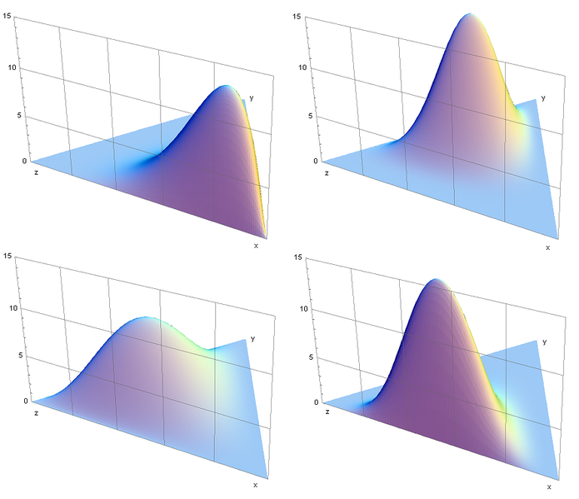
Dirichlet Distributions
Probability density (shown on a simplex) of Dirichlet distributions for K=3 and various parameter vectors α
Image from Wikipedia, Python code adapted from Thomas Boggs

Slide 31
Mixture of Dirichlets
We’d like to have Dirichlet distributions characterizing amino acids that tend to be used in certain “roles”
Brown et al. [ISMB ‘93] induced a set of Dirichlets from “trusted” protein alignments
  “large, charged and polar”
  “polar and mostly negatively charged”
  “hydrophobic, uncharged, nonpolar”
  etc.

Slide 32
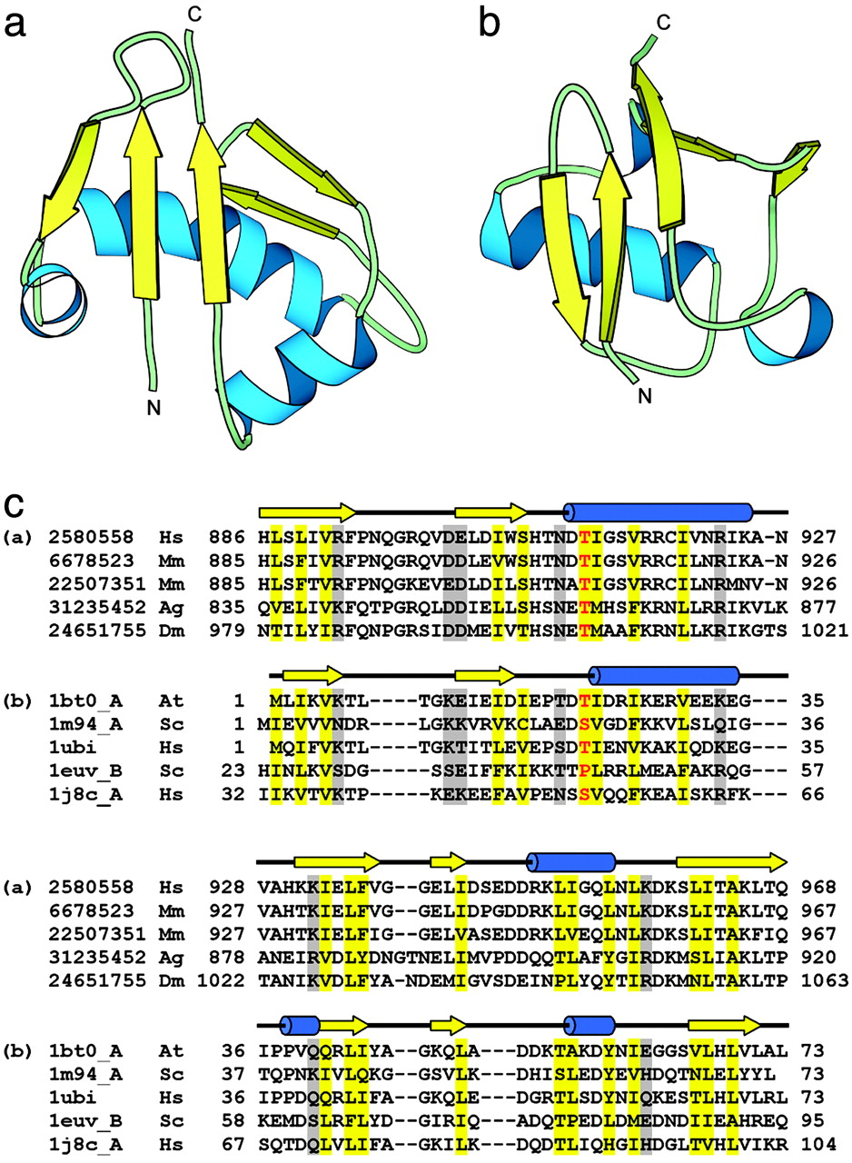
Trusted Protein Alignments
A trusted protein alignment is one in which known protein structures are used to determine which parts of the given set of sequences should be aligned

Slide 33
Using Dirichlet Mixture Priors
Recall that the EM/Gibbs update the parameters by:
We can set the pseudocounts using a mixture of Dirichlets:
where is the j^{th} Dirichlet component

Slide 34
Using Dirichlet Mixture Priors
probability of j^{th} Dirichlet
given observed counts
parameter for character c
in j^{th} Dirichlet
We don’t have to know which Dirichlet to pick
Instead, we’ll hedge our bets, using the observed counts to decide how much to weight each Dirichlet
See textbook section 11.5

Slide 35
Motif Finding: EM and Gibbs
These methods compute local, multiple alignments
Optimize the likelihood or likelihood ratio of the sequences
EM converges to a local maximum
Gibbs will “converge” to a global maximum, in the limit; in a reasonable amount of time, probably not
Can take advantage of background knowledge by
  tying parameters
  Dirichlet priors
There are many other methods for motif finding
In practice, motif finders often fail
  motif “signal” may be weak
  large search space, many local minima
  do not consider binding context

