Slide 1
Multiple Whole Genome Alignment
BMI/CS 776
www.biostat.wisc.edu/bmi776/
Spring 2019
Colin Dewey
colin.dewey@wisc.edu
These slides, excluding third-party material, are licensed under CC BY-NC 4.0 by Mark Craven, Colin Dewey, and Anthony Gitter

Slide 2
Goals for Lecture
Key concepts
the large-scale multiple-alignment task
progressive alignment
breakpoint identification
undirected graphical models
minimal spanning trees/forests

Slide 3
Multiple Whole Genome Alignment:
Task Definition
Given
  A set of n > 2 genomes (or other large-scale sequences)
Do
  Identify all corresponding positions between all genomes, allowing for substitutions, insertions/deletions, and rearrangements

Slide 4
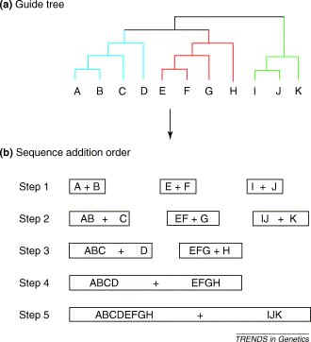
Progressive Alignment
Given a guide tree relating n genomes
Construct multiple alignment by performing n-1 pairwise alignments

Slide 5
Progressive Alignment:
MLAGAN Example
align pairs
of sequences
human
chimpanzee
mouse
rat
align multi-sequences
(alignments)
align multi-sequence
with sequence
chicken

Slide 6
The MLAGAN Method
[Brudno et al., Genome Research, 2003]
Given: k genomes X¹ , ... , X^{k}, guide tree T
  for each pair of genomes X^{i} , X^{j}
  anchors(i, j) = find_anchors(X^{i}, X^{j})
  align = progressive_alignment(T, anchors)
  for each genome X^{i} // iterative refinement
  anchors = segments of X^{i} with high scores in align
  align = LAGAN(align - X^{i}, X^{i}, anchors) // realign X^{i}
progressive_alignment(T, anchors)
if T is not a leaf node
align_left = progressive_alignment(T.left, anchors)
align_right = progressive_alignment(T.right, anchors)
align = LAGAN(align_left, align_right, anchors)
return align

Slide 7
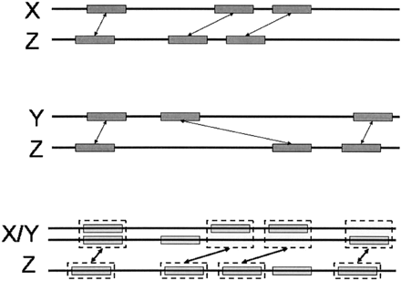
Progressive Alignment:
MLAGAN Example
Suppose we’re aligning the multi-sequence X/Y with Z
anchors from X-Z and Y-Z become anchors for X/Y-Z
overlapping anchors are reweighted
LIS algorithm is used to chain anchors
Figure from: Brudno et al. Genome Research, 2003

Slide 8
Reweighting Anchors in MLAGAN
X
s₁
Z
Y
s₂
Z
X / Y
Z
I
U

Slide 9
Genome Rearrangements
ancestor
ancestor
x y
a b c d e
a b c d e
extant species
a d c b e
extant species
inversion
d e
a b c x y
translocation
Can occur within a chromosome or across chromosomes
Can have combinations of these events

Slide 10
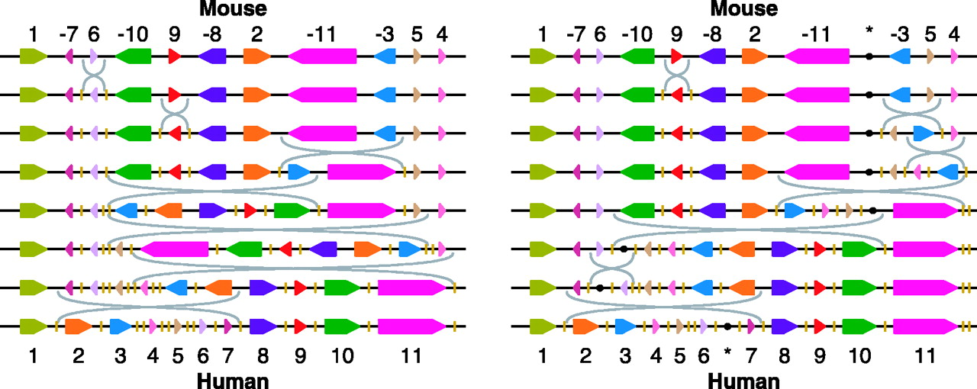
Genome Rearrangement Example:
Mouse vs. Human X Chromosome
Figure from: Pevzner and Tesler. PNAS, 2003
each colored block represents a syntenic region of the two chromosomes
the two panels show the two most parsimonious sets of rearrangements to map one chromosome to the other

Slide 11
The Mauve Method
[Darling et al., Genome Research, 2004]
Given: k genomes X¹ , ... , X^{k}
  find multi-MUMs (MUMs present in 2 or more genomes)
  calculate a guide tree based on multi-MUMs
  find LCBs (sequences of multi-MUMs) to use as anchors
  do recursive anchoring within and outside of LCBs
  calculate a progressive alignment of each LCB using guide tree
  note: no LIS step!

Slide 12
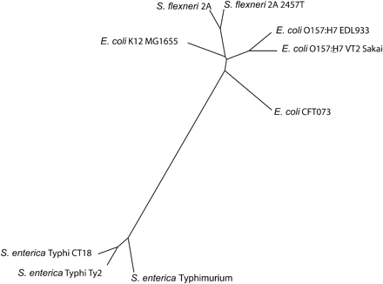
2. Calculating the Guide Tree in Mauve
unlike MLAGAN, Mauve calculates the guide tree instead of taking it as an input
find multi-MUMs in sequences
calculate pairwise distances
run neighbor-joining to get guide tree
distance between two sequences is based on fraction of sequences shared in multi-MUMs

Slide 13
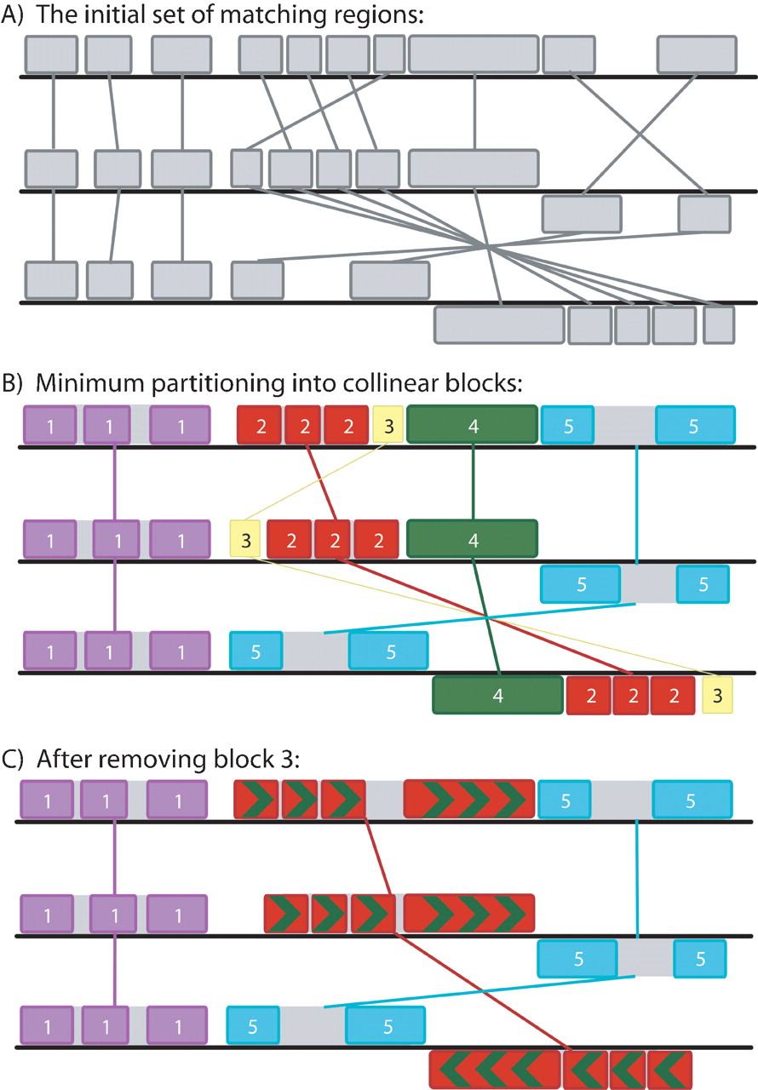
3. Selecting Anchors:
Finding Local Collinear Blocks
repeat
  partition set of multi-MUMs, M into collinear blocks
  find minimum-weight collinear block(s)
  remove minimum weight block(s) if they’re sufficiently small
until minimum-weight block is not small enough

Slide 14
4. and 5. Recursive Anchoring and Gapped Alignment
recursive anchoring (finding finer multi-MUMs and LCBs) and standard alignment (CLUSTALW) are used to extend LCBs
between LCBs
within LCBs

Slide 15
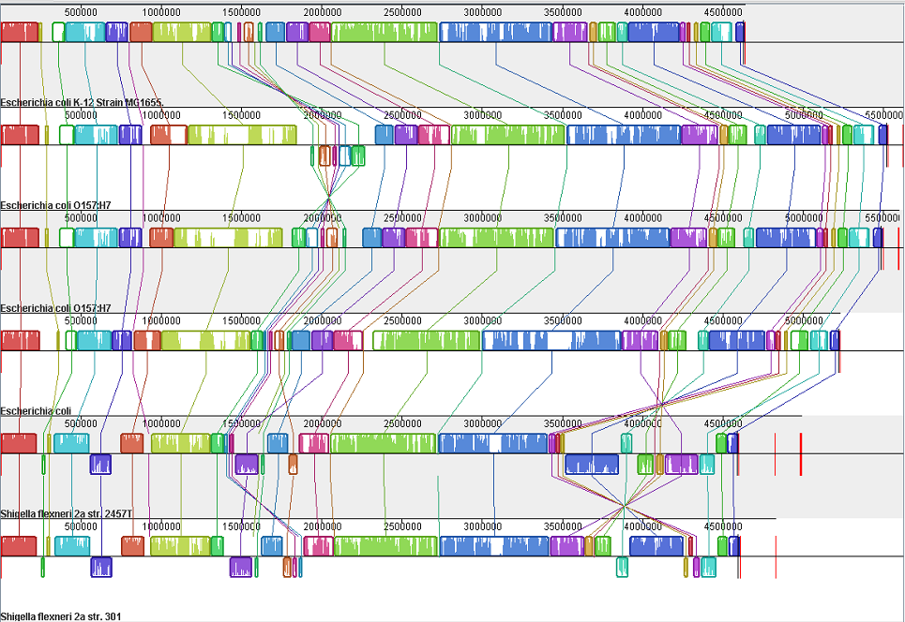
Mauve Alignment of 9 Enterobacteria (Shigella and E. coli)

Slide 16
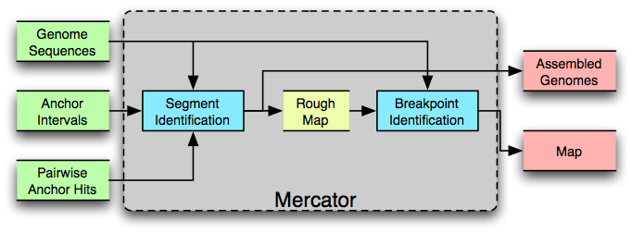
Mercator
Orthologous segment identification: graph-based method
Breakpoint identification: refine segment endpoints with a graphical model

Slide 17
Establishing Anchors Representing Orthologous Segments
Anchors can correspond to genes, exons or MUMS
E.g., may do all-vs-all pairwise comparison of genes
Construct graph with anchors as vertices and high-similarity hits as edges (weighted by alignment score)
edge
22
40
anchor
chromosome
10
60

Slide 18
Rough Orthology Map
k-partite graph with edge weights
vertices = anchors, edges = sequence similarity

Slide 19
Greedy Segment Identification
for i = k to 2 do
  identify repetitive anchors (depends on number of high-scoring edges incident to each anchor)
  find “best-hit” anchor cliques of size ≥ i
  join colinear cliques into segments
  filter edges not consistent with significant segments

Slide 20
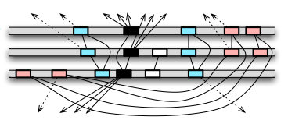
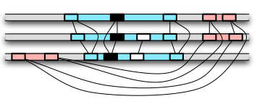
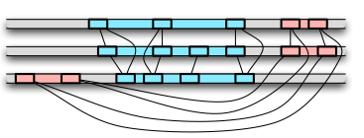
Mercator Example
Repetitive elements (black anchors) are identified; 3-cliques (red and blue anchors) are found
Segments are formed by red and blue anchors; inconsistent edges are filtered
2-cliques are found and incorporated into segments

Slide 21
Refining the Map:
Finding Breakpoints
Breakpoints: the positions at which genomic rearrangements disrupt colinearity of segments
Mercator finds breakpoints by using inference in an undirected graphical model

Slide 22
Undirected Graphical Models
An undirected graphical model represents a probability distribution over a set of variables using a factored representation
B₁
B₂
B₃
B₄
B₅
B₆
B₇
random variable
assignment of values to all variables (breakpoint positions)
assignment of values subset of variables in C
function (called a potential) representing the “compatibility”
of a given set of values
normalization term

Slide 23
Undirected Graphical Models
B₁
B₂
B₃
B₄
B₅
B₆
B₇
for the given graph:

Slide 24
The Breakpoint Graph
1
2
3
4
5
6
7
8
9
10
11
12
11
9
3
1
5
6
10
8
4
2
7
12
some prefix of region 2 and some prefix of region 11 should be aligned

Slide 25
Breakpoint Undirected Graphical Model
Mercator frames the task of finding breakpoints as an inference task in an undirected graphical model
configuration of breakpoints
potential function representing score of multiple alignment of sequences in clique C for breakpoints in b
11
9
3
1
5
6
10
8
4
2
7
12

Slide 26
Breakpoint Undirected Graphical Model
1
2
3
4
1
5
6
7
8
8
9
10
11
12
12
The possible values for a variable indicate the possible coordinates for a breakpoint
The potential for a clique is a function of the alignment score for the breakpoint regions split at the breakpoints b_{C}

Slide 27
Breakpoint Undirected Graphical Model
11
9
3
1
5
6
10
8
4
2
7
12
Inference task: find most probable configuration b of breakpoints
Not tractable in this case
  graph has a high degree of connectivity
  multiple alignment is difficult
So Mercator uses several heuristics

Slide 28
Making Inference Tractable in Breakpoint Undirected Graphical Model
11
9
3
1
5
6
10
8
4
2
7
12
Assign potentials, based on pairwise alignments, to edges only
Eliminate edges by finding a minimum spanning forest, where edges are weighted by phylogenetic distance

Slide 29
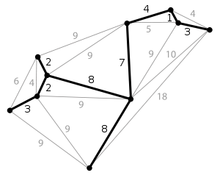
Minimal Spanning Forest
Minimal spanning tree (MST): a minimal-weight tree that connects all vertices in a graph
Minimal spanning forest: a set of MSTs, one for each connected component
11
9
3
1
5
6
10
8
4
2
7
12

Slide 30
Breakpoint Finding Algorithm
construct breakpoint segment graph
weight edges with phylogenetic distances
find minimum spanning forest (MSF)
perform pairwise alignment for each edge in MSF
use alignments to estimate
perform max-product inference (similar to Viterbi) to find maximizing b_{i}

Slide 31
Comments on Whole-Genome Alignment Methods
Employ common strategy
  find seed matches
  identify (sequences of) matches to anchor alignment
  fill in the rest with standard methods (e.g. DP)
Vary in what they (implicitly) assume about
  the distance of sequences being compared
  the prevalence of rearrangements
Involve a lot of heuristics
  for efficiency
  because we don’t know enough to specify a precise objective function (e.g. how should costs should be assigned to various rearrangements)

