Slide 1
Inferring Genetic Variation and Discovering Associations with Phenotypes
BMI/CS 776
www.biostat.wisc.edu/bmi776/
Spring 2018
Anthony Gitter
gitter@biostat.wisc.edu
These slides, excluding third-party material, are licensed under CC BY-NC 4.0 by Mark Craven, Colin Dewey, and Anthony Gitter

Slide 2
Outline
Variation detection
  Array technologies
  Whole-genome sequencing
Genome-wide association study (GWAS) basics
  Testing SNPs for association
  Correcting for multiple-testing

Slide 3
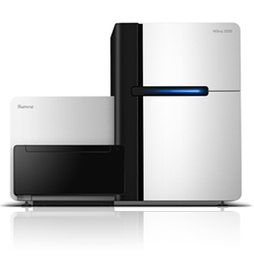
Variation detecting technologies
Array-based technologies
  Relies on hybridization of sample DNA to pre-specified probes
  Each probe is chosen to measure a single possible variant: SNP, CNV, etc.
Sequencing-based technologies
  Whole-genome shotgun sequence, usually at low coverage (e.g., 4-8x)
  Align reads to reference genome: mismatches, indels, etc. indicate variations
  Long read sequencing
Affymetrix SNP chip
Illumina HiSeq sequencer

Slide 4
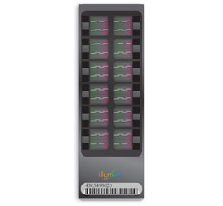
Array-based technologies
Currently two major players
Affymetrix Genome-Wide Human SNP Arrays
  Used for HapMap project, Navigenics service
Illumina BeadChips
  Used by 23andMe, deCODEme services

Slide 5
Affymetrix SNP arrays
Probes for ~900K SNPs
Another ~900K probes for CNV analysis
Differential hybridization – one probe for each possible SNP allele
Fluorescent tag on sample DNA
C
A
T
G
G
G
C
T
A
T
sample DNA
A
C
C
A
G
A
T
A
C
C
C
G
A
T
A
C
C
G
G
A
T
A
C
C
T
G
A
T
Probes for one SNP at a known locus

Slide 6
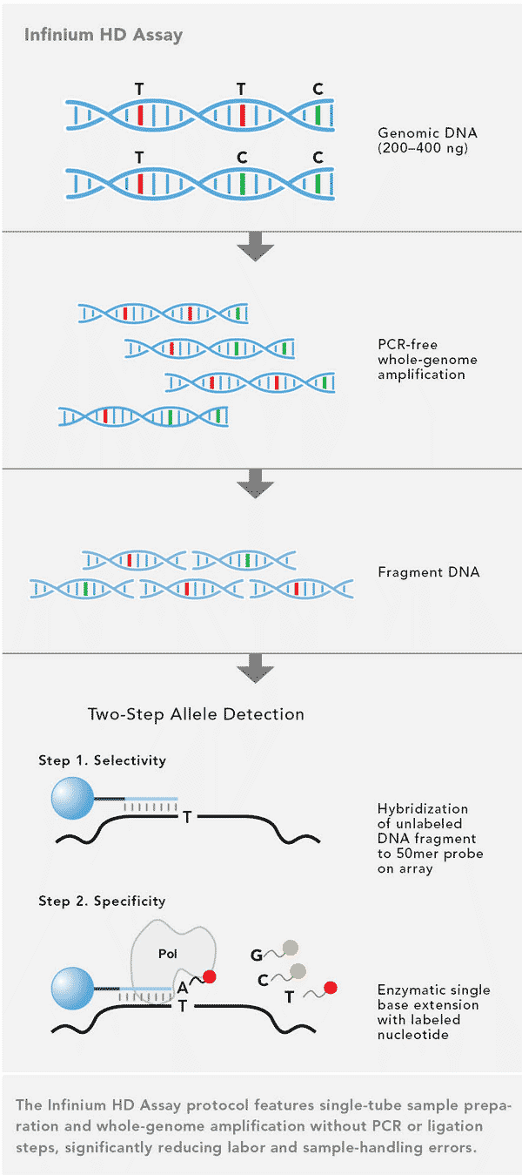
Illumina BeadChips
OmniExpress+
  ~900K SNPs (700K fixed, 200 custom)
Array with probes immediately adjacent to variant location
Single base extension (like sequencing) to determine base at variant location
Illumina

Slide 7
Sequencing-based genotyping
compute
for each genomic position
genotype = GA?
sequencing error?
GATCGTCGCTACGTGCTAG
CTCTACGTACGATCGTCGC
CGATCATCGCTACGTGCTA
reads
TACGATCGTCTCTACGTGC
CTACGTAAGATCATCGCTA
ACGATCATCGCTACGTGCT
CGTACGATCGTCGCTACGT
reference
ACTCTACGTACGATCGTCGCTACGTGCTAGCTAGTCGCAC

Slide 8
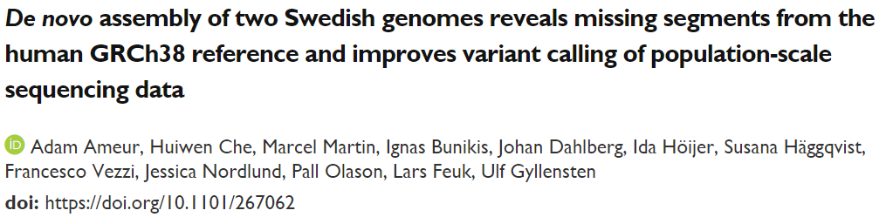
Long read sequencing
Pacific Biosciences SMRT
MinION nanopore
Illumina TruSeq Synthetic
  “over 10 Mb of sequences absent from the human GRCh38 reference in each individual”

Slide 9
GWAS jargon
Locus - genetic position on a chromosome, and a single base pair position in the context of SNPs
SNP - a locus (single base pair) that exhibits variation (polymorphism) in a population
Allele (in the context of SNPs) - the alternative forms of a nucleotide at a particular locus
Genotype - the pair of alleles at a locus, one paternal and one maternal
Heterozygous - the two alleles differ at a locus
Homozygous - the two alleles are identical at a locus
Genotyped SNP - we have observed the genotype at a particular SNP, e.g. because the SNP is among the 1 million on the SNP array we used
Ungenotyped SNP - we have not observed the genotype at a particular locus
Causal SNP - a SNP that directly affects the phenotype, e.g. a mutation changes the amino acid sequence of a protein and changes the protein's function in a way that directly affects a biological process
Haplotype - a group of SNPs that are inherited jointly from a parent
Linkage disequilibrium - alleles at multiple loci that exhibit a dependence (nonrandom association)
Compiled from http://www.nature.com/scitable/definition/allele-48 http://www.nature.com/scitable/definition/genotype-234
http://www.nature.com/scitable/definition/haplotype-142 http://www.nature.com/scitable/definition/snp-295 https://en.wikipedia.org/wiki/Allele
http://www.nature.com/nrg/journal/v9/n6/full/nrg2361.html https://www.snpedia.com/index.php/Glossary

Slide 10
GWAS data
Individual | Genotype at Position 1 | Genotype at Position 2 | Genotype at Position 3 | … | Genotype at Position M | Disease?
1 | CC | AG | GG |  | AA | N
2 | AC | AA | TG |  | AA | Y
3 | AA | AA | GG |  | AT | Y
…
N | AC | AA | TT |  | AT | N
N individuals genotyped at M positions
Disease status (or other phenotype) is measured for each individual

Slide 11
GWAS task
Given: genotypes and phenotypes of individuals in a population
Do: identify which genomic positions are associated with a given phenotype

Slide 12
Can we identify causal SNPs?
Typically only genotype at 1 million sites
Humans vary at ~100 million sites
Unlikely that an associated SNP is causal
Tag SNPs: associated SNPs “tag” blocks of the genome that contain the causal variant
Genotyped SNP
Ungenotyped causal SNP
Ungenotyped SNP
Haplotype block: interval in which little recombination has been observed

Slide 13
Direct and indirect associations
Phenotype
direct association
indirect association
direct association (haplotype block)

Slide 14
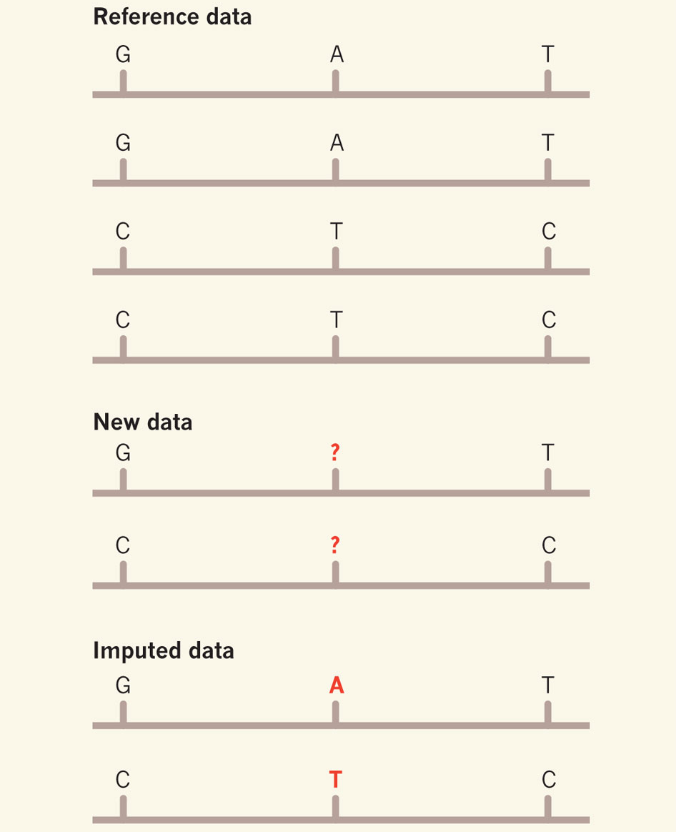
SNP imputation
Estimate the ungenotyped SNPs using reference haplotypes
1000 Genomes
SNP array
Nielsen Nature 2010

Slide 15
Basics of association testing
Test each site individually for association with a statistical test
  each site is assigned a p-value for the null hypothesis that the site is not associated with the phenotype
Correct for the fact that we are testing multiple hypotheses

Slide 16
Basic genotype test
Assuming binary phenotype (e.g., disease status)
Test for significant association with Pearson’s Chi-squared test or Fisher’s Exact Test
genotype
 | AA | AT | TT
Disease | 40 | 30 | 30
No disease | 70 | 20 | 10
phenotype
Chi-squared test p-value = 4.1e-5 (2 degrees of freedom)
Fisher’s Exact Test p-value = 3.4e-5

Slide 17
Armitage (trend) test
Can gain more statistical power if we can assume that probability of trait is linear in the number of one of the alleles
Balding Nature Reviews
Genetics 2006
TT
AT
AA

Slide 18
Trend test example
genotype
 | AA | AT | TT
Disease | 40 | 30 | 30
No disease | 70 | 20 | 10
phenotype
Disease proportion | 0.36 | 0.60 | 0.75
Trend in Proportions test p-value = 8.1e-6
(note that this is a smaller p-value than from the basic genotype test)

Slide 19
GWAS challenges
Population structure
Interacting variants
Multiple testing
Interpreting hits

Slide 20
Population structure issues
If certain populations disproportionally represent cases or controls, then spurious associations may be identified
One SNP for N = 40 individuals
AA
ACTCTACGTAC
ACTCTACGTAC
Individual with genotype 1
TT
ACTCTTCGTAC
ACTCTTCGTAC
Individual with genotype 2
Balding Nature Reviews Genetics 2006

Slide 21
Interacting variants
Most traits are complex: not the result of a single gene or genomic position
Ideally, we’d like to test subsets of variants for associations with traits
  But there are a huge number of subsets!
  Multiple testing correction will likely result in zero association calls
Area of research
  Only test carefully selected subsets
  Bayesian version: put prior on subsets

Slide 22
Multiple testing
In the genome-age, we have the ability to perform large numbers of statistical tests simultaneously
  SNP associations (~1 million)
  Gene differential expression tests (~ 20 thousand)
Do traditional p-value thresholds apply in these cases?

Slide 23
Multiple testing
Bennett et al. “Neural correlates of interspecies perspective taking in the post-mortem Atlantic Salmon:
An argument for multiple comparisons correction”
“One mature Atlantic Salmon (Salmo salar) participated in the fMRI study. The salmon was… not alive at the time of scanning.”
“The salmon was shown a series of photographs depicting human individuals… [and] asked to determine what emotion the individual in the photo must have been experiencing.”
fMRI to assess changes in brain activity
From Simply Statistics post on messed up data analyses

Slide 24
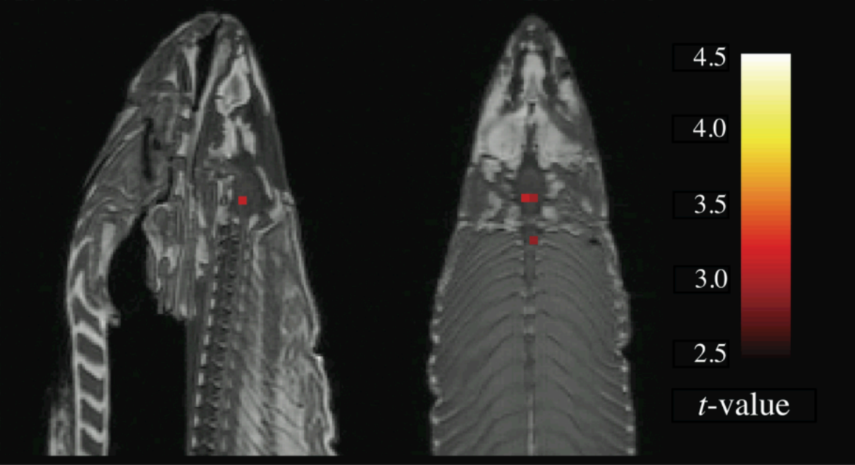
Multiple testing
Bennett et al. “Neural correlates of interspecies perspective taking in the post-mortem Atlantic Salmon:
An argument for multiple comparisons correction”
t-test finds 16 significant voxels (p < 0.001)

Slide 25
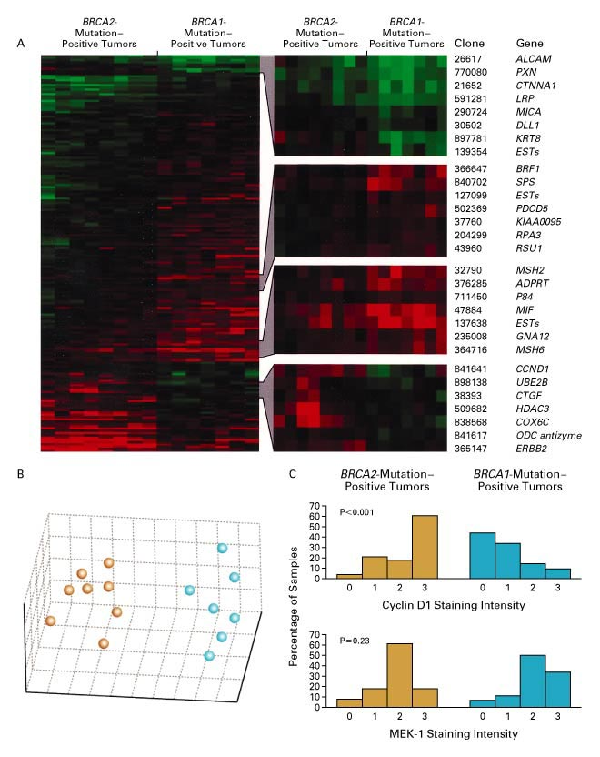
Expression in BRCA1 and BRCA2 Mutation-Positive Tumors
Hedenfalk et al., New England Journal
of Medicine 344:539-548, 2001.
7 patients with BRCA1 mutation-positive tumors vs. 7 patients with BRCA2 mutation-positive tumors
5631 genes assayed

Slide 26
Expression in BRCA1 and BRCA2 Mutation-Positive Tumors
Key question: which genes are differentially expressed in these two sets of tumors?
Methodology: for each gene, use a statistical test to assess the hypothesis that the expression levels differ in the two sets

Slide 27
Hypothesis testing
Consider two competing hypotheses for a given gene
  null hypothesis: the expression levels in the first set come from the same distribution as the levels in the second set
  alternative hypothesis: they come from different distributions
First calculate a test statistic for these measurements, and then determine its p-value
p-value: the probability of observing a test statistic that is as extreme or more extreme than the one we have, assuming the null hypothesis is true

Slide 28
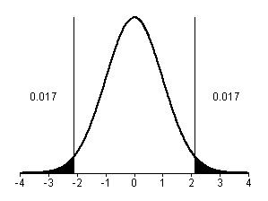
Calculating a p-value
Calculate test statistic (e.g. T statistic)
See how much mass in null distribution with value this extreme or more
BRAC2
BRAC1
where
If test statistic is here, p = 0.034

Slide 29
Multiple testing problem
If we’re testing one gene, the p-value is a useful measure of whether the variation of the gene’s expression across two groups is significant
Suppose that most genes are not differentially expressed
If we’re testing 5000 genes that don’t have a significant change in their expression (i.e. the null hypothesis holds), we’d still expect about 250 of them to have p-values ≤ 0.05
Can think of p-value as the false positive rate over null genes

Slide 30
Family-wise error rate
One way to deal with the multiple testing problem is to control the probability of rejecting at least one null hypothesis when all genes are null
This is the family-wise error rate (FWER)
Suppose you tested 5000 null genes and predicted that all genes with p-values ≤ 0.05 were differentially expressed
  you are guaranteed to be wrong at least once!
  above assumes tests are independent

Slide 31
Bonferroni correction
Simplest approach
Choose a p-value threshold β such that the FWER is ≤ α
where g is the number of genes (tests)
For g=5000 and α=0.05 we set a p-value threshold of β=1e-5

Slide 32
Loss of power with FWER
FWER, and Bonferroni in particular, reduce our power to reject null hypotheses
  As g gets large, p-value threshold gets very small
For expression analysis, FWER and false positive rate are not really the primary concern
  We can live with false positives
  We just don’t want too many of them relative to the total number of genes called significant

Slide 33
The False Discovery Rate
[Benjamini & Hochberg‘95; Storey & Tibshirani ‘02]
gene p-value rank
C 0.0001 1
F 0.001 2
G 0.016 3
J 0.019 4
I 0.030 5
B 0.052 6
A 0.10 7
D 0.35 8
H 0.51 9
E 0.70 10
Suppose we pick a threshold, and call genes above this threshold “significant”
The false discovery rate is the expected fraction of these that are mistakenly called significant (i.e. are truly null)

Slide 34
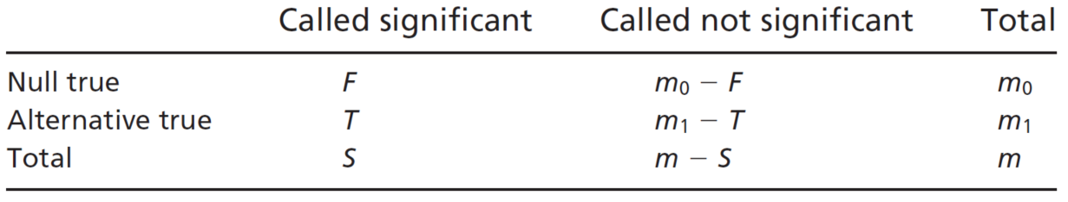
The False Discovery Rate
false positives (false discoveries)
Storey & Tibshirani PNAS 100(16), 2002
total significant at threshold
features (genes)
true positives

Slide 35
The False Discovery Rate
gene p-value rank
C 0.0001 1
F 0.001 2
G 0.016 3
J 0.019 4
I 0.030 5
B 0.052 6
A 0.10 7
D 0.35 8
H 0.51 9
E 0.70 10
# genes
t
p-value threshold

Slide 36
The False Discovery Rate
To compute the FDR for a threshold t, we need to estimate E[F(t)] and E[S(t)]
estimate by the observed S(t)
So how can we estimate E[F(t)]?

Slide 37
Estimating E[F(t)]
Two approaches we’ll consider
  Benjamini-Hochberg
  Storey-Tibshirani (q-value)
Different assumptions about null features (m₀)

Slide 38
Benjamini-Hochberg
Suppose the fraction of genes that are truly null is very close to 1 so
Then
Because p-values are uniformly distributed over [0,1] under the null model
Suppose we choose a threshold t and observe that S(t) = k

Slide 39
Benjamini-Hochberg
Suppose we want FDR ≤ α
Observation:

Slide 40
Benjamini-Hochberg
Algorithm to obtain FDR ≤ α
Sort the p-values of the genes so that they are in increasing order
Select the largest k such that
where we use P_{(k)} as the p-value threshold t

Slide 41
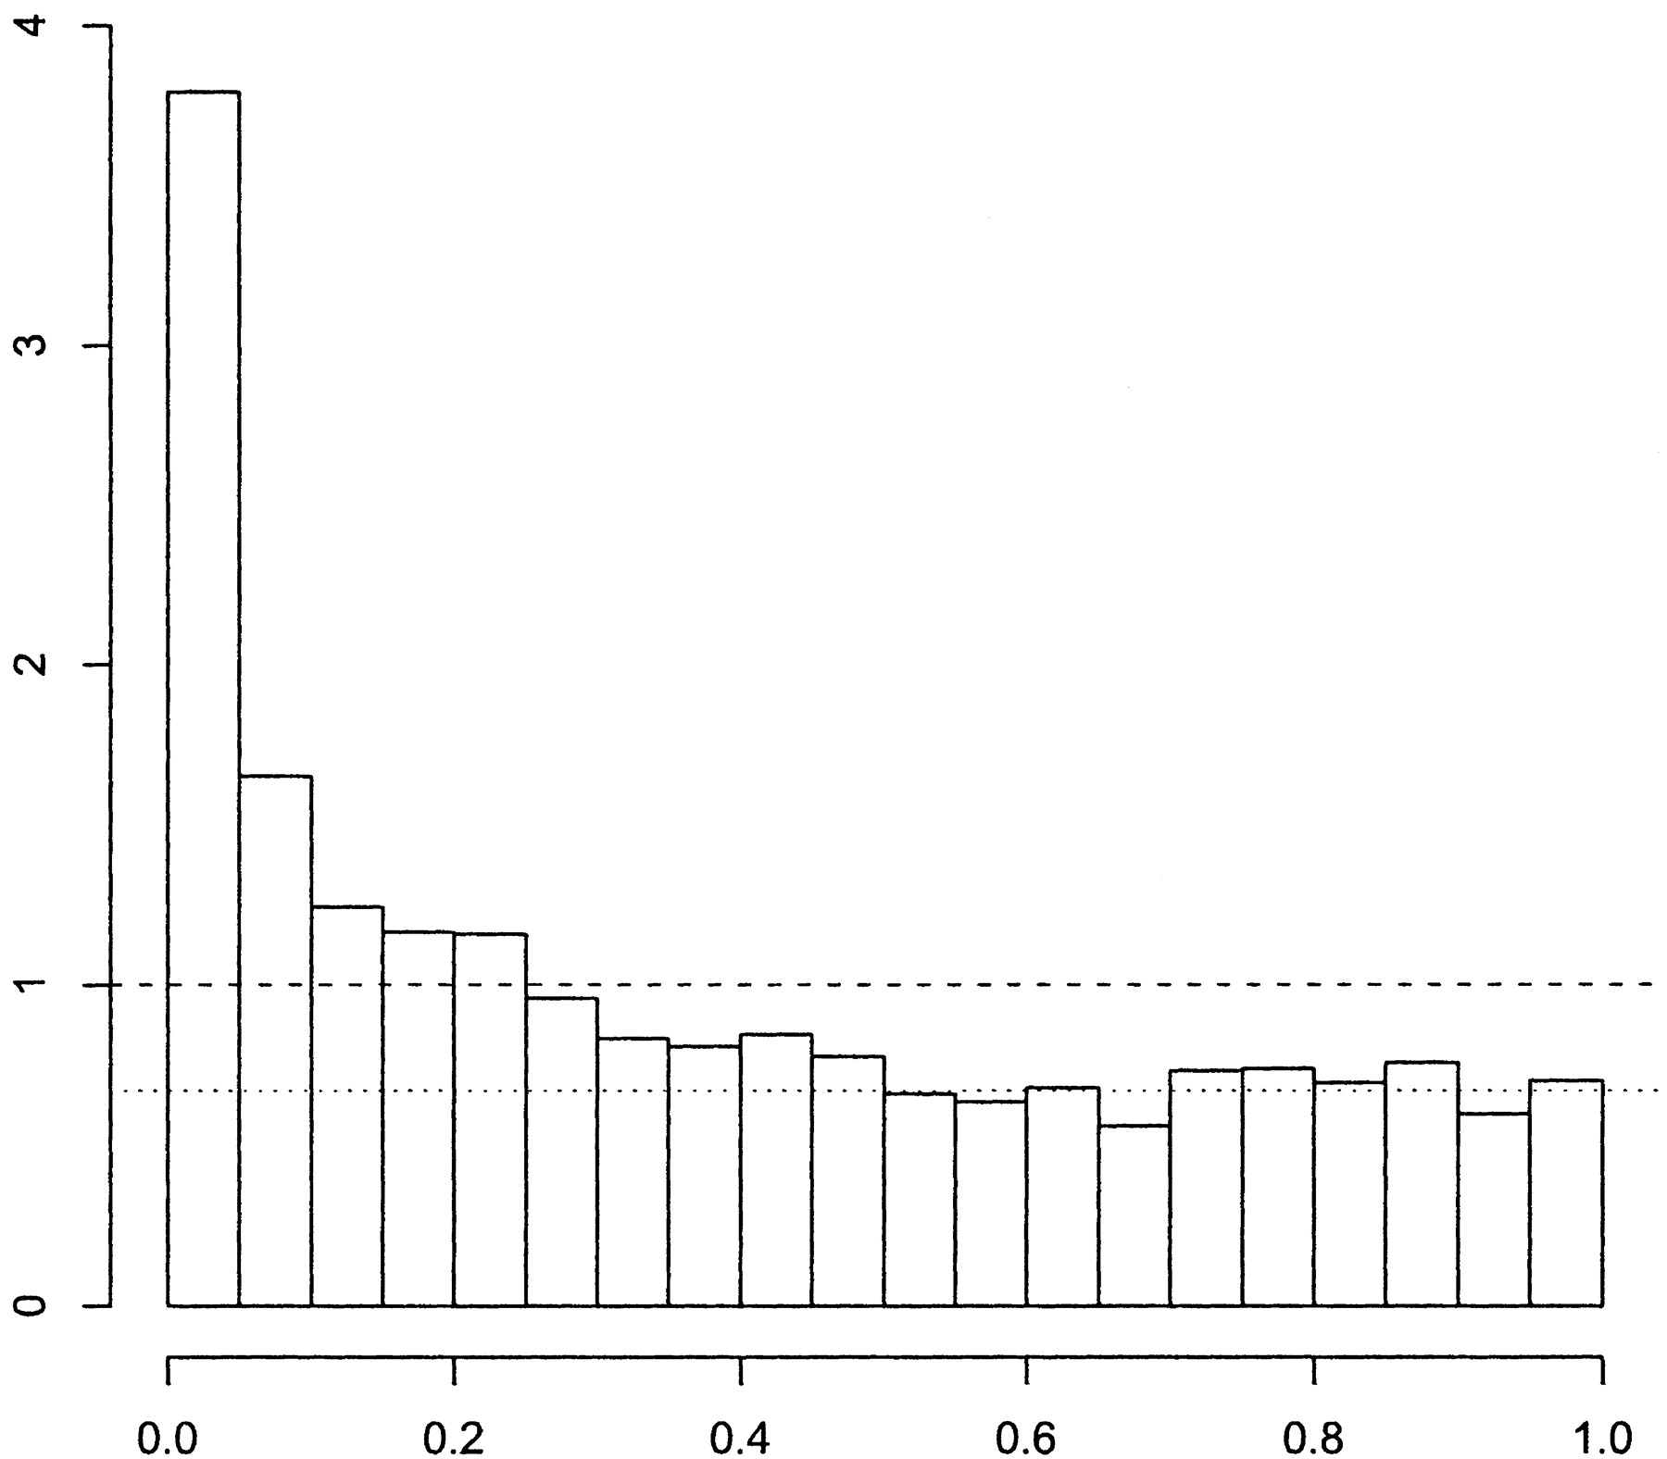
What fraction of the genes are truly null?
Consider the p-value histogram from Hedenfalk et al.
  includes both null and alternative genes
  but we expect null p-values to be uniformly distributed
estimated proportion of null p-values
expected histogram if all genes were null
actual proportion of null p-values
Storey & Tibshirani PNAS 100(16), 2002

Slide 42
Storey & Tibshirani approach
estimated proportion of
null p-values
# genes
p-value threshold
gene p-value rank
C 0.0001 1
F 0.001 2
G 0.016 3
J 0.019 4
I 0.030 5
B 0.052 6
A 0.10 7
D 0.35 8
H 0.51 9
E 0.70 10
q-value
0.0010
0.0050
0.0475
0.0475
0.0600
0.0867
0.1430
0.4380
0.5670
0.7000
t
pick minimum FDR for all greater thresholds

Slide 43
q-value example for gene J
gene p-value rank
C 0.0001 1
F 0.001 2
G 0.016 3
J 0.019 4
I 0.030 5
B 0.052 6
A 0.10 7
D 0.35 8
H 0.51 9
E 0.70 10
q-value
0.0010
0.0050
0.0475
0.0475
0.0600
0.0867
0.1430
0.4380
0.5670
0.7000
t
In this case, already have minimum FDR for all greater thresholds

Slide 44
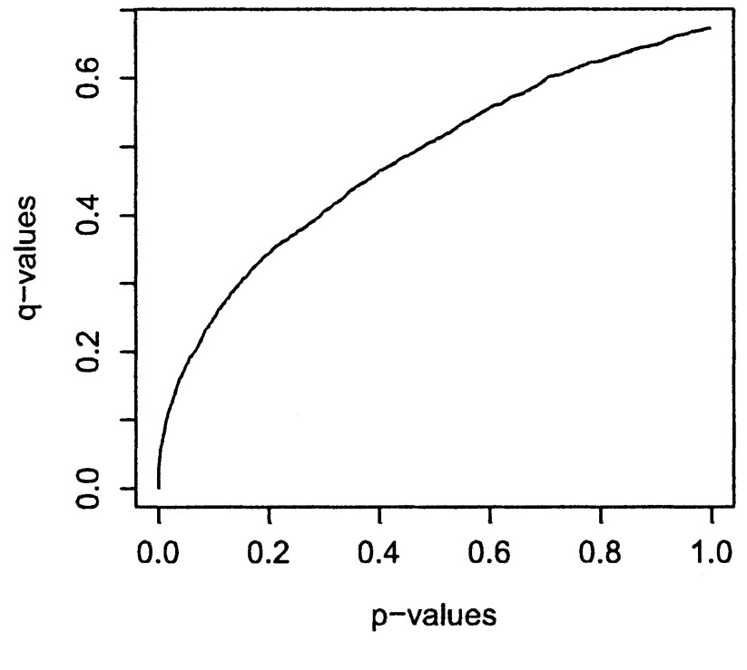
q-values vs. p-values for Hedenfalk et al.
Storey & Tibshirani PNAS 100(16), 2002

Slide 45
FDR summary
In many high-throughput experiments, we want to know what is different across two sets of conditions/individuals (e.g. which genes are differentially expressed)
Because of the multiple testing problem, p-values may not be so informative in such cases
FDR, however, tells us which fraction of significant features are likely to be null
q-values based on the FDR can be readily computed from p-values (see Storey’s R package qvalue)

