Slide 1
Alignment of Long Sequences
BMI/CS 776
www.biostat.wisc.edu/bmi776/
Spring 2018
Anthony Gitter
gitter@biostat.wisc.edu
These slides, excluding third-party material, are licensed under CC BY-NC 4.0 by Mark Craven, Colin Dewey, and Anthony Gitter

Slide 2
Goals for Lecture
Key concepts
how large-scale alignment differs from the simple case
the canonical three step approach of large-scale aligners
using suffix trees to find maximal unique matching subsequences (MUMs)
If time permits
using tries and threaded tries to find alignment seeds
constrained dynamic programming to align between/around anchors
using sparse dynamic programming (DP) to find a chain of local alignments

Slide 3
Pairwise Large-Scale Alignment:
Task Definition
Given
  a pair of large-scale sequences (e.g. chromosomes)
  a method for scoring the alignment (e.g. substitution matrices, insertion/deletion parameters)
Do
  construct global alignment: identify all matching positions between the two sequences

Slide 4

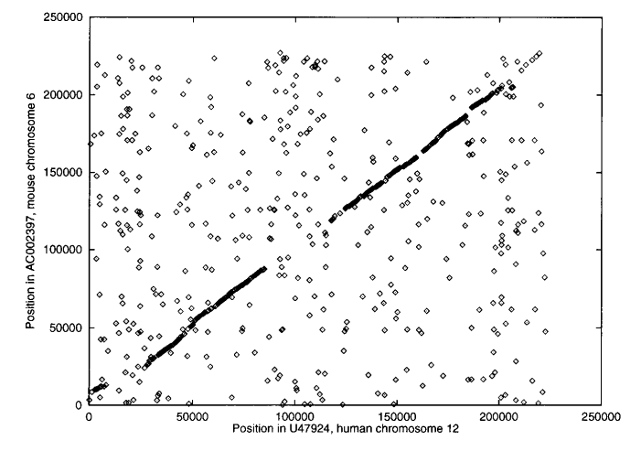

Large Scale Alignment Example
Mouse Chr6 vs. Human Chr12
Figure from: Delcher et al., Nucleic Acids Research 27, 1999

Slide 5
Why the Problem is Challenging
Sequences too big to make O(n²) dynamic-programming methods practical
Long sequences are less likely to be colinear because of rearrangements
  initially we’ll assume colinearity
  we’ll consider rearrangements in next lecture (or never)

Slide 6
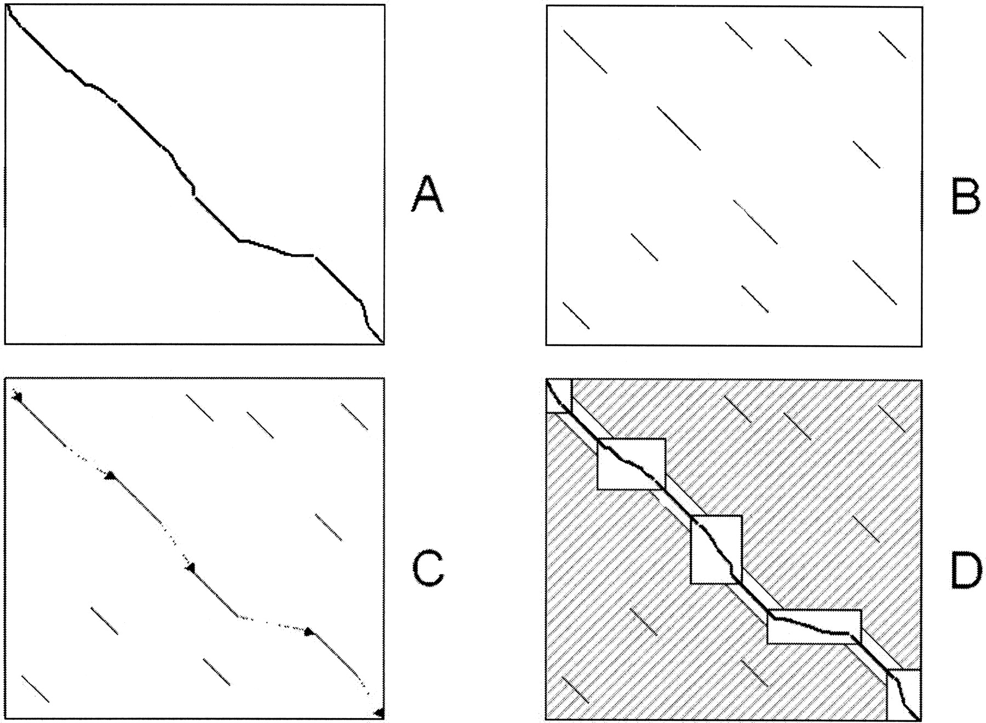
General Strategy
Figure from: Brudno et al. Genome Research, 2003
perform pattern matching to find seeds for global alignment
find a good chain of anchors
fill in remainder with standard but constrained alignment method

Slide 7
The MUMmer System
Delcher et al., Nucleic Acids Research, 1999
Given: genomes A and B
  find all maximal unique matching subsequences (MUMs)
  extract the longest possible set of matches that occur in the same order in both genomes
  close the gaps

Slide 8
Step 1: Finding Seeds in MUMmer
Maximal unique match:
  occurs exactly once in both genomes A and B
  not contained in any longer MUM
mismatches
Key insight: a significantly long MUM is certain to be part of the global alignment

Slide 9
Suffix Trees
Substring problem:
  given text S of length m
  preprocess S in O(m) time
  such that, given query string Q of length n, find occurrence (if any) of Q in S in O(n) time
Suffix trees solve this problem and others

Slide 10

Suffix Tree Definition
A suffix tree T for a string S of length m is a tree with the following properties:
  rooted and directed
  m leaves, labeled 1 to m
  each edge labeled by a substring of S
  concatenation of edge labels on path from root to leaf i is suffix i of S (we will denote this by Si...m)
  each internal non-root node has at least two children
  edges out of a node must begin with different characters
key property

Slide 11
Suffixes
S = “banana$”
suffixes of S
    $ (special character)
    a$
    na$
    ana$
    nana$
    anana$
    banana$

Slide 12
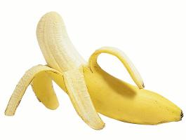
Suffix Tree Example
S = “banana$”
Add ‘$’ to end so that suffix tree exists (no suffix is a prefix of another suffix)
a
b
n
n
a
a
a
n
$
$
a
n
n
n
a
a
$
$
a
$
7
$
$
2
4
6
1
3
5

Slide 13
Solving the Substring Problem
Assume we have suffix tree T and query string Q
FindMatch(Q, T):
  follow (unique) path down from root of T according to characters in Q
  if all of Q is found to be a prefix of such a path
    return label of some leaf below this path
  else, return no match found

Slide 14

Solving the Substring Problem
Q = nan
Q = anab
a
a
n
b
n
b
n
a
n
a
a
$
a
a
a
n
n
$
$
a
STOP
a
n
n
n
n
$
a
a
n
n
$
$
a
a
$
a
a
$
7
$
$
7
$
$
$
$
2
4
6
1
3
5
2
4
6
1
3
5
return 3
return no match found

Slide 15
MUMs and Generalized Suffix Trees
Build one suffix tree for both genomes A and B
Label each leaf node with genome it represents
Genome A: ccacg#
each internal node represents
a repeated sequence
Genome B: cct$
acg#
c
g#
t$
A, 3
A, 5
B, 3
acg#
c
g#
t$
A, 2
A, 4
B, 2
acg#
t$
A, 1
B, 1
each leaf represents a suffix
and its position in sequence

Slide 16
MUMs and Suffix Trees
Unique match: internal node with 2 children, leaf nodes from different genomes
But these matches are not necessarily maximal
Genome A: ccacg#
Genome B: cct$
acg#
c
g#
t$
A, 3
A, 5
B, 3
acg#
c
g#
t$
A, 2
A, 4
B, 2
acg#
t$
represents unique match
A, 1
B, 1

Slide 17
MUMs and Suffix Trees
To identify maximal matches, can compare suffixes following unique match nodes
Genome A: acat#
Genome B: acaa$
a
t#
ca
A, 4
$
a$
ca
t#
t#
a$
B, 4
B, 3
A, 3
A, 2
B, 2
t#
a$
the suffixes following
these two match nodes
are the same; the left one represents a longer match (aca)
A, 1
B, 1

Slide 18
Using Suffix Trees to Find MUMs
O(n) time to construct suffix tree for both sequences (of lengths ≤ n)
O(n) time to find MUMs - one scan of the tree (which is O(n) in size)
O(n) possible MUMs in contrast to O(n²) possible exact matches
Main parameter of approach: length of shortest MUM that should be identified (20 – 50 bases)

Slide 19
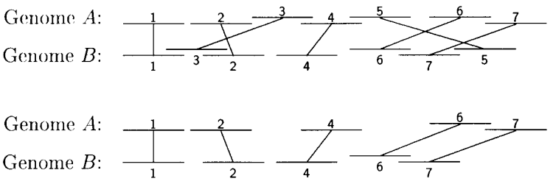
Step 2: Chaining in MUMmer
Sort MUMs according to position in genome A
Solve variation of Longest Increasing Subsequence (LIS) problem to find sequences in ascending order in both genomes
Figure from: Delcher et al., Nucleic Acids Research 27, 1999

Slide 20
Finding Longest Subsequence
Unlike ordinary LIS problems, MUMmer takes into account
  lengths of sequences represented by MUMs
  overlaps
Requires time where k is number of MUMs

Slide 21
Recall: Three Main Steps of Large-Scale Alignment
Brudno et al. Genome Research, 2003
General
Pattern matching to find seeds for global alignment
Find a good chain of anchors
Fill in with standard but constrained alignment
MUMmer
Suffix trees to obtain MUMs
LIS to find colinear MUMs
Smith-Waterman and recursive MUMmer for gap filling

Slide 22
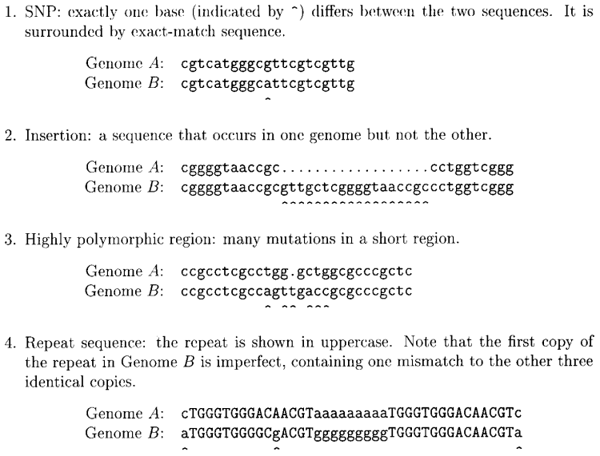
Types of Gaps in a MUMmer Alignment
Figure from: Delcher et al., Nucleic Acids Research 27, 1999

Slide 23
Step 3: Close the Gaps
SNPs:
  between MUMs: trivial to detect
  otherwise: handle like repeats
Insertions
  simple insertions: trivial to detect
  transpositions (subsequences that were deleted from one location and inserted elsewhere): look for out-of-sequence MUMs

Slide 24
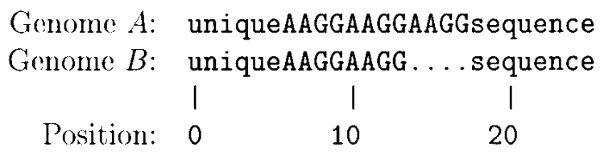
Step 3: Close the Gaps
Polymorphic regions
  short ones: align them with dynamic programming method
  long ones: call MUMmer recursively with reduced minimum MUM length
Repeats
  detected by overlapping MUMs
Figure from: Delcher et al. Nucleic Acids Research 27, 1999

Slide 25
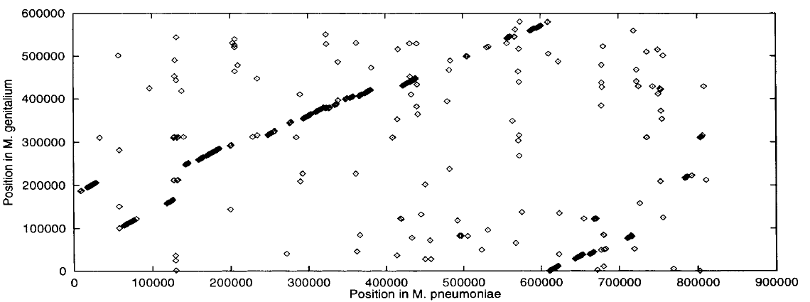
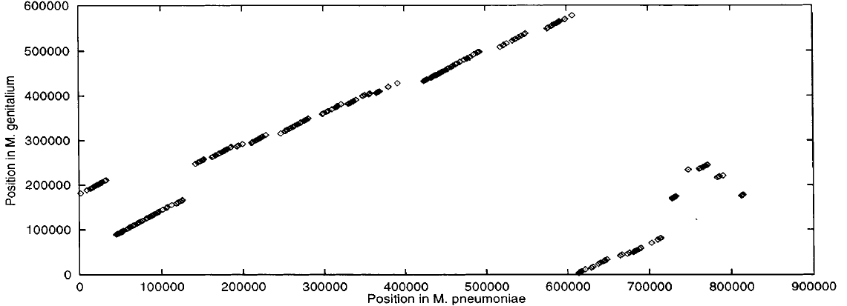
MUMmer Performance
FASTA on 1000 base pair segments
MUMmer
Figure from: Delcher et al. Nucleic Acids Research 27, 1999

Slide 26
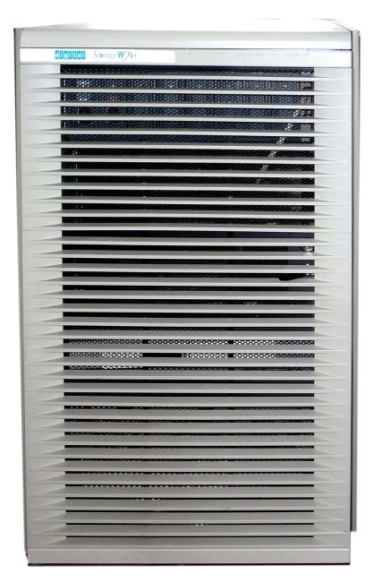
MUMmer Performance
DEC Alpha 4100
Mycoplasma test case
Suffix tree: 6.5s
LIS: 0.02s
Smith-Waterman: 116s
FASTA baseline: many hours
Centre for Computing History

Slide 27
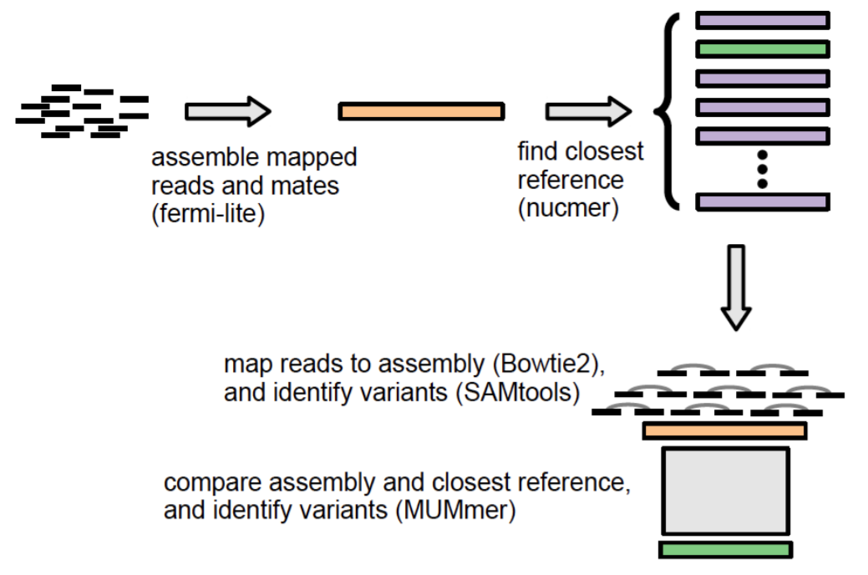
Longevity of MUMmer
Antimicrobial Resistance Identification By Assembly (ARIBA)
Identify antimicrobial resistance genes from Illumina reads
Figure from: Hunt et al. bioRxiv 2017

Slide 28
Longevity of MUMmer
Whole genome alignment still an active area of research
  Jain et al. 2018 (Mashmap2): “we were able to map an error-corrected whole-genome NA12878 human assembly to the hg38 human reference genome in about one minute total execution time and < 4 GB memory using 8 CPU threads”
  Uses MUMmer as ground truth in evaluation

Slide 29
Limitations of MUMmer
MUMs are perfect matches, typically ≥ 20-50 base pairs
Evolutionarily distant may not have sufficient MUMs to anchor global alignment
How can we tolerate minor variation in the seeds?

Slide 30
LAGAN: Three Main Steps
Brudno et al. Genome Research, 2003
General
Pattern matching to find seeds for global alignment
Find a good chain of anchors
Fill in with standard but constrained alignment
LAGAN
Threaded tries to obtain seeds
Sparse dynamic programming for chaining
Dynamic programming for gap filling

Slide 31
Step 1: Finding Seeds in LAGAN
Degenerate k-mers: matching k-long sequences with a small number of mismatches allowed
By default, LAGAN uses 10-mers and allows 1 mismatch
cacg cgcgctacat acct
acta cgcggtacat cgta

Slide 32
Finding Seeds in LAGAN
Example: a trie to represent all 3-mers of the sequence gaaccgacct
a
c
g
a
c
c
g
a
c
c
g
t
a
a
c
2
3, 7
4
8
5
1
6
One sequence is used to build the trie
The other sequence (the query) is “walked” through to find matching k-mers

Slide 33
Allowing Degenerate Matches
Suppose we’re allowing 1 base to mismatch in looking for matches to the 3-mer acc; need to explore green nodes
a
c
g
a
c
c
g
a
c
c
g
t
a
a
c
2
3, 7
4
8
5
1
6

Slide 34
LAGAN Uses Threaded Tries
In a threaded trie, each leaf for word w₁...w_{k} has a back pointer to the node for w₂...w_{k}
a
c
g
a
c
c
g
a
c
c
g
t
a
a
c
2
3, 7
4
8
5
1
6

Slide 35
Traversing a Threaded Trie
Consider traversing the trie to find 3-mer matches for the query sequence: accgt
a
c
g
a
c
c
g
a
c
c
g
t
a
a
c
2
3, 7
4
8
5
1
6
Usually requires following only two pointers to match against the next k-mer, instead of traversing tree from root for each

Slide 36
Comparing MUMmer and LAGAN
 | Baboon | Chimpanzee | Mouse | Rat | Cow | Pig | Cat | Dog | Chicken | Zebrafish | Fugu | Overall
Exons | 232 | 176 | 230 | 230 | 224 | 174 | 176 | 182 | 68 | 48 | 150 | 1914
MUMmer (% human exons covered by ≥ 90% alignment) | 100 | 100 | 8 | 9 | 40 | 44 | 47 | 37 | 0 | 0 | 0 | 41
LAGAN (% human exons covered by ≥ 90% alignment) | 100 | 100 | 100 | 100 | 99 | 100 | 100 | 99 | 99 | 88 | 77 | 98

Slide 37
Comparing MUMmer and LAGAN
Brudno et al. Genome Research, 2003
Pattern matching to find seeds for global alignment
Find a good chain of anchors
Fill in with standard but constrained alignment
MUMmer
Suffix trees to obtain MUMs
Longest Increasing Subsequence
Smith-Waterman, recursive MUMmer
LAGAN
k-mer trie to obtain seeds
Spare dynamic programming
Dynamic programming

Slide 38
Multiple Whole Genome Alignment:
Task Definition
Given
  A set of n > 2 genomes (or other large-scale sequences)
Do
  Identify all corresponding positions between all genomes, allowing for substitutions, insertions/deletions, and rearrangements

Slide 39
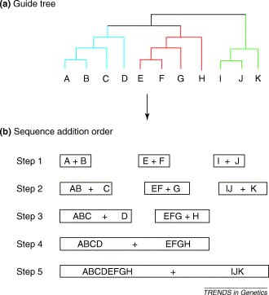
Progressive Alignment
Given a guide tree relating n genomes
Construct multiple alignment by performing n-1 pairwise alignments

Slide 40
Progressive Alignment:
MLAGAN Example
align pairs
of sequences
human
chimpanzee
mouse
rat
align multi-sequences
(alignments)
align multi-sequence
with sequence
chicken

Slide 41
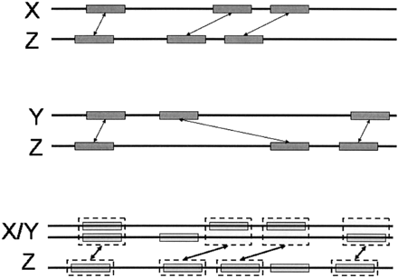
Progressive Alignment:
MLAGAN Example
Suppose we’re aligning the multi-sequence X/Y with Z
anchors from X-Z and Y-Z become anchors for X/Y-Z
overlapping anchors are reweighted
LIS algorithm is used to chain anchors
Figure from: Brudno et al. Genome Research, 2003

Slide 42
Genome Rearrangements
ancestor
ancestor
x y
a b c d e
a b c d e
extant species
a d c b e
extant species
inversion
d e
a b c x y
translocation
Can occur within a chromosome or across chromosomes
Can have combinations of these events

Slide 43
Mercator: Rough Orthology Map
k-partite graph with edge weights
vertices = anchors, edges = sequence similarity

Slide 44
Refining the Map:
Finding Breakpoints
Breakpoints: the positions at which genomic rearrangements disrupt colinearity of segments
Mercator finds breakpoints by using inference in an undirected graphical model

Slide 45
The Breakpoint Graph
1
2
3
4
5
6
7
8
9
10
11
12
11
9
3
1
5
6
10
8
4
2
7
12
some prefix of region 2 and some prefix of region 11 should be aligned

Slide 46
Comparing MLAGAN and Mercator
MLAGAN
  Requires phylogenetic tree
  Greedy solution with local refinement
Mercator
  Define probabilistic model to solve globally
  Inference is intractable, resort to approximations

