Slide 1
Eukaryotic Gene Finding
BMI/CS 776
www.biostat.wisc.edu/bmi776/
Spring 2018
Anthony Gitter
gitter@biostat.wisc.edu
These slides, excluding third-party material, are licensed under CC BY-NC 4.0 by Mark Craven, Colin Dewey, and Anthony Gitter

Slide 2
Goals for Lecture
Key concepts
Incorporating sequence signals into gene finding with HMMs
Modeling durations with generalized HMMs
Modeling conversation with pair HMMs
Modern gene finding and genome annotation

Slide 3
Sources of Evidence for Gene Finding
Signals: the sequence signals (e.g. splice junctions) involved in gene expression
Content: statistical properties that distinguish protein-coding DNA from non-coding DNA
Conservation: signal and content properties that are conserved across related sequences (e.g. orthologous regions of the mouse and human genome)

Slide 4
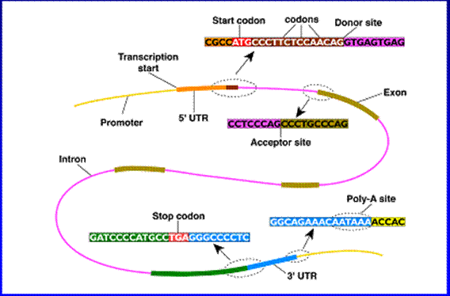
Eukaryotic Gene Structure

Slide 5
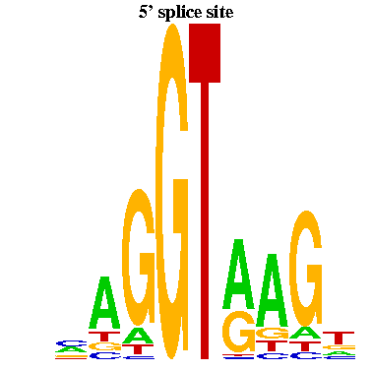
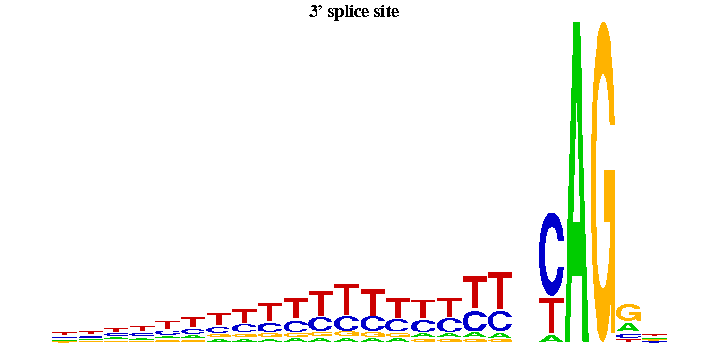
Splice Signals Example
donor sites
acceptor sites
-3
-2
-1
1
2
3
4
5
6
exon
Figures from Yi Xing
exon
There are significant dependencies among non-adjacent positions in donor splice signals
Informative for inferring hidden state of HMM

Slide 6
Parsing a DNA Sequence
The HMM Viterbi path represents a parse of a given sequence, predicts exons, acceptor sites, introns, etc.
Hidden state
Intergenic
5’UTR
Exon
Intron
Observed sequence
ACCGTTACGTGTCATTCTACGTGATCATCGGATCCTAGAATCATCGATCCGTGCGATCGATCGGATTAGCTAGCTTAGCTAGGA
ACCGTTA
CGTGTCATTCTACGTGATCAT
CGGATCCTAGAATCATCGATC
CGTGCGATCGATCGGATTAGCTAGCTTAGCTAGGA
How can we properly model the transitions from one state to another?

Slide 7
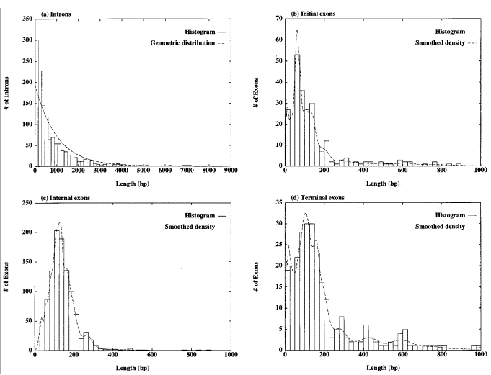
Length Distributions of Introns/Exons
Introns
Initial exons
geometric dist.
provides good fit
Figure from Burge & Karlin, Journal of Molecular Biology, 1997
Internal exons
Terminal exons
geometric dist.
provides poor fit

Slide 8
Duration Modeling in HMMs
Semi-Markov models are well-motivated for some sequence elements (e.g. exons)
  Semi-Markov: explicitly model length duration of hidden states
  Also called generalized hidden Markov model

Slide 9
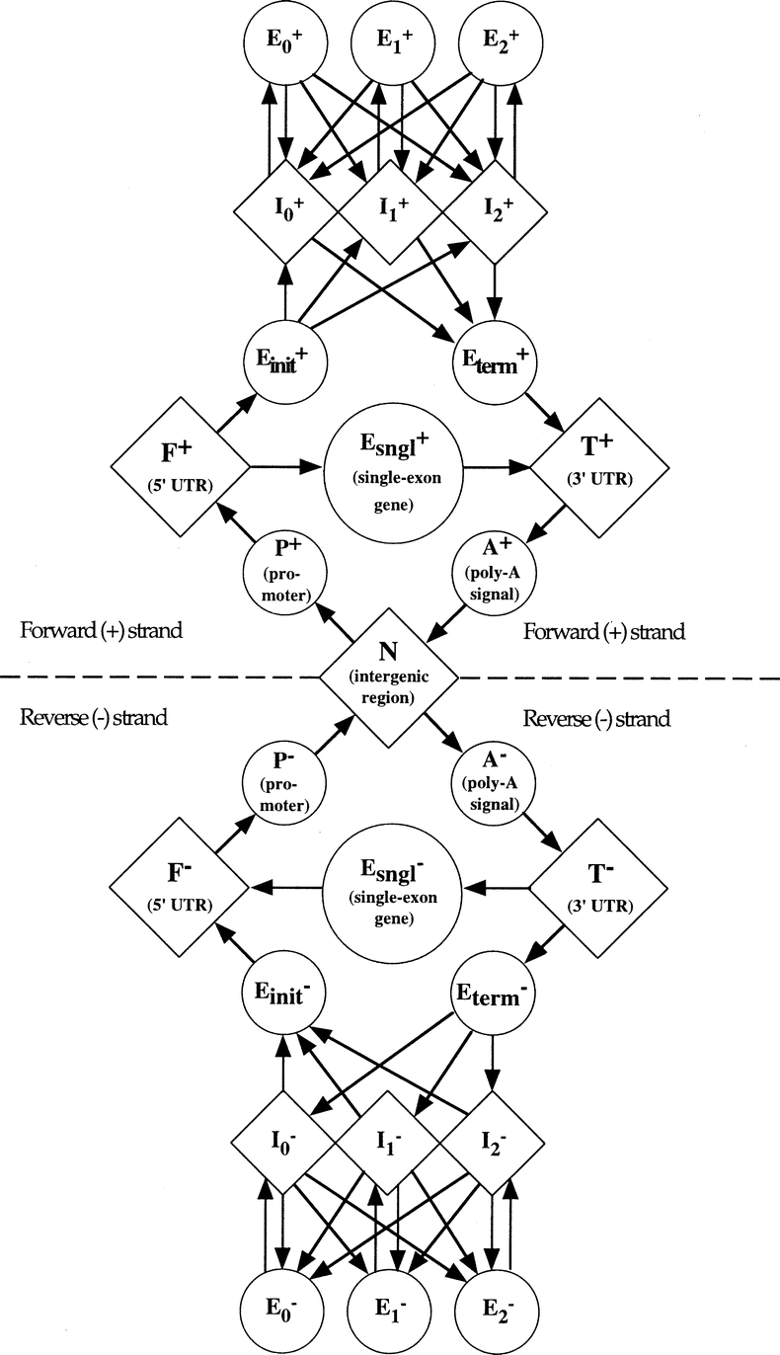
The GENSCAN HMM for Eukaryotic Gene Finding [Burge & Karlin ‘97]
Each shape represents a functional unit
of a gene or genomic region
Pairs of intron/exon units represent
the different ways an intron can interrupt
a coding sequence (after 1st base in codon,
after 2nd base or after 3rd base)
Figure from Burge & Karlin, Journal of Molecular Biology, 1997
Complementary submodel
(not shown) detects genes on
opposite DNA strand

Slide 10
Parsing a DNA Sequence
The Viterbi path represents
a parse of a given sequence,
predicting exons, introns, etc.
ACCGTTACGTGTCATTCTACGTGATCATCGGATCCTAGAATCATCGATCCGTGCGATCGATCGGATTAGCTAGCTTAGCTAGGAGAGCATCGATCGGATCGAGGAGGAGCCTATATAAATCAA
ACCGTTA
CGTGTCATTCTACGTGATCAT
CGGATCCTAGAATCATCGATC
CGTGCGATCGATCGGATTAGCTAGCTTAGCTAGGA
GAGCATCGATCGGATCGAGGAGGAGCCTATATAAATCAA

Slide 11
Comparative Algorithms
Genes are among the most conserved elements in the genome
  use conservation to help infer locations of genes
Some signals associated with genes are short and occur frequently in the genome
  use conservation to eliminate false candidate sites from consideration

Slide 12
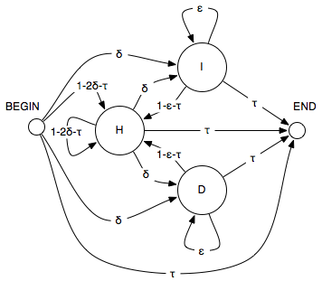
Pair Hidden Markov Models
Each non-silent state emits one or a pair of characters
Transition probabilities
H: homology (match) state
I: insert state
D: delete state

Slide 13
Pair HMM Paths are Alignments
sequence 1: AAGCGC
sequence 2: ATGTC
hidden:
B
H
A
A
H
A
T
I
G
I
C
H
G
G
D
T
H
C
C
E
observed:

Slide 14
Generalized Pair HMMs
Represent a parse π, as a sequence of states and a sequence of associated lengths for each input sequence
sequence of hidden states
N
P⁺
F⁺
E_{init}⁺
pair of sequences generated by hidden state
may be gaps
in the sequences
pair of duration times generated by hidden state
SLAM: Pachter et al. RECOMB 2001

Slide 15
Modern Genome Annotation
RNA-Seq, mass spectrometry, and other technologies provide powerful information for genome annotation

Slide 16
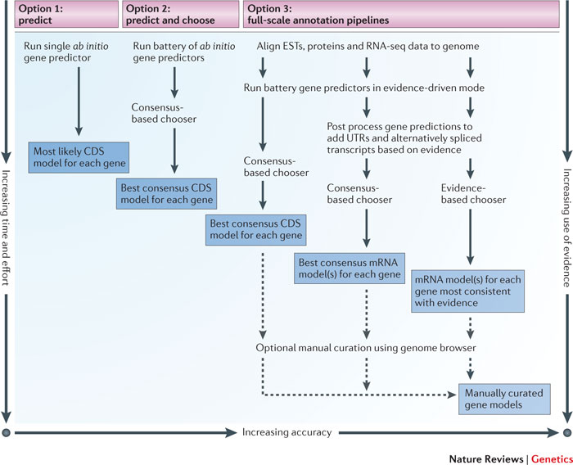
Modern Genome Annotation
Yandell et al. Nature Reviews Genetics 2012

Slide 17
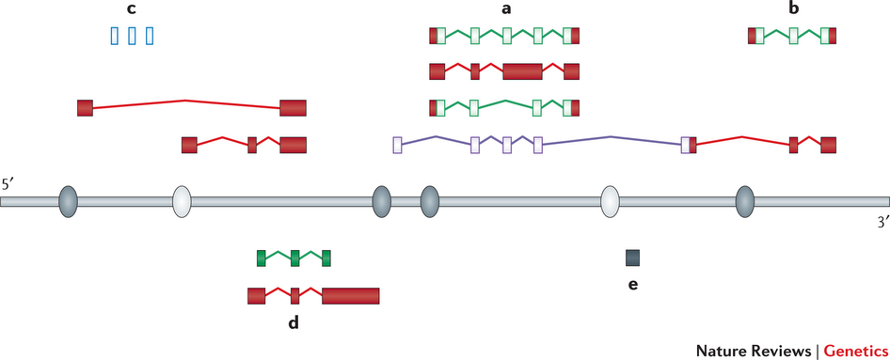
Modern Genome Annotation
protein-coding genes, isoforms, translated regions
small RNAs
long non-coding RNAs
promoters and enhancers
pseudogenes
Mudge and Harrow Nature Reviews Genetics 2016

