Slide 1
Advanced Bioinformatics
Biostatistics & Medical Informatics 776
Computer Sciences 776
Spring 2018
Anthony Gitter
gitter@biostat.wisc.edu
www.biostat.wisc.edu/bmi776/
These slides, excluding third-party material, are licensed under CC BY-NC 4.0 by Mark Craven, Colin Dewey, and Anthony Gitter

Slide 2
Agenda Today
Introductions
Course information
Overview of topics

Slide 3
Course Web Site
www.biostat.wisc.edu/bmi776/
Syllabus and policies
Readings
Tentative schedule
Lecture slides (draft posted before lecture)
Announcements
Homework
Project information
Link to Piazza discussion board

Slide 4
Your Instructor: Anthony Gitter
Email: gitter@biostat.wisc.edu
Office: room 3268, Discovery Building
Assistant professor, Biostatistics & Medical Informatics
Affiliate faculty, Computer Sciences
Investigator, Morgridge Institute for Research
Research interests: biological networks, time series analysis, applied machine learning

Slide 5
Your TA: Fangzhou Mu
Email: fmu2@wisc.edu
Office: WID 3365C
Graduate student, Pharmacy

Slide 6
Office Hours
Instructor: Tuesday and Thursday, 2:30-3:30 PM
  Immediately after class
TA: Monday, 1:00-2:00 PM

Slide 7
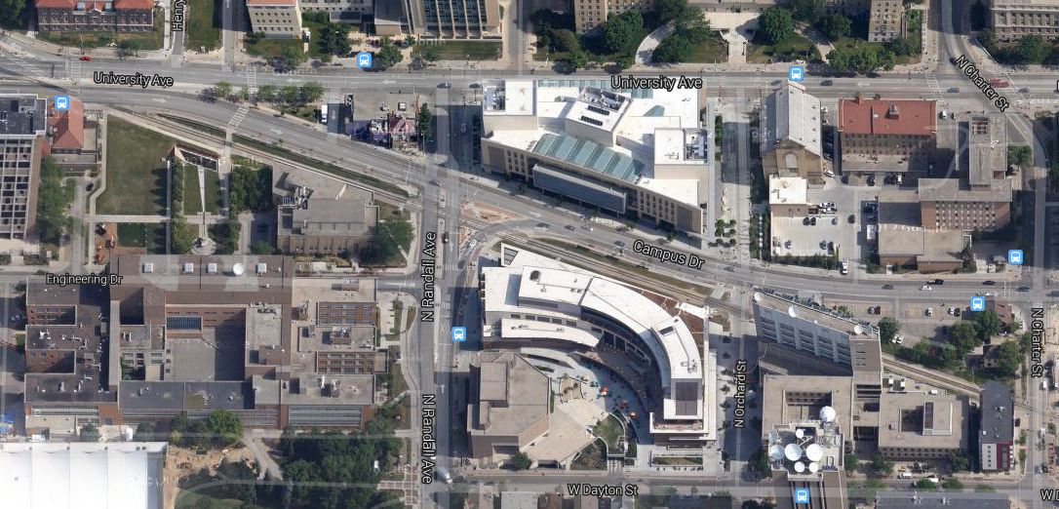
Finding Our Offices: Discovery Building
our offices
Discovery Building
Engineering Hall
Union South
Computer Sciences
3rd floor has restricted access
See Piazza before 1/28 if you need building access
Stop at visitor desk to call my office if card does not work

Slide 8
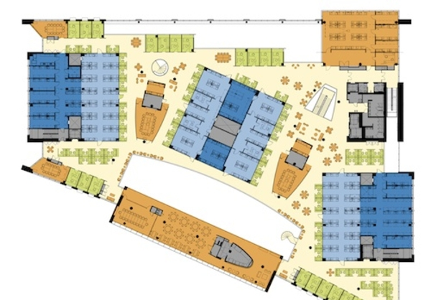
Finding Our Offices: Discovery Building
my office
TA office

Slide 9
You
So that we can all get to know each other better, please tell us your
  name
  major or graduate program
  research interests and/or topics you’re especially interested in learning about
  favorite programming language

Slide 10
Course Requirements
4 or 5 homework assignments: ~40%
  Written exercises
  Programming (Python)
  Computational experiments (e.g. measure the effect of varying parameter x in algorithm y)
  Five late days permitted
Project: ~25%
Midterm: ~15%
Final exam: ~15%
Class participation: ~5%

Slide 11
Exams
Midterm: March 13, in class
Final: Wednesday May 9, 12:25-2:25 PM
Let me know immediately if you have a conflict with either of these exam times

Slide 12
Computing Resources for the Class
Linux servers in Dept. of Biostatistics & Medical Informatics
  No “lab”, must log in remotely (use WiscVPN)
  Will create accounts for everyone on course roster
  Two machines
    mi1.biostat.wisc.edu
    mi2.biostat.wisc.edu
  HW0 tests your access to these machines
  Homework must be able to run on these machines
CS department usually offers Unix orientation sessions at beginning of semester

Slide 13
Programming Assignments
All programming assignments require Python
  Project can be in any language
Have a Python 3 environment on biostat servers
  Permitted packages on course website
  Can request others
HW0 will be Python introduction
Use Piazza for Python discussion
  If you know Python, please help answer questions

Slide 14
Project
Design and implement a new computational method for a task in molecular biology
Improve an existing method
Perform an evaluation of several existing methods
Run on real biological data
Suggestions will be provided
Not directly related to your existing research
Can email me now to discuss ideas

Slide 15
Participation
Do the assigned readings before class
Show up to class
No one will have the perfect background
  Ask questions about computational or biological concepts
Correct me when I am wrong
  Seriously, it will happen
Piazza discussion board
  Questions and answers

Slide 16
Piazza Discussion Board
Instead of a mailing list
http://piazza.com/wisc/spring2018/bmics776/home
Post your questions to Piazza instead of emailing the instructor or TA
  Unless it is a private issue or project-related
Answer your classmates’ questions
Announcements will also be posted to Piazza
Supplementary material for lecture topics

Slide 17

Course Readings
Mostly articles from the primary literature
Must be using a campus IP address to download some of the articles (can use WiscVPN from off campus)
Biological Sequence Analysis: Probabilistic Models of Proteins and Nucleic Acids. R. Durbin, S. Eddy, A. Krogh, and G. Mitchison. Cambridge University Press, 1998.

Slide 18
Prerequisites
BMI/CS 576 or equivalent
Knowledge of basic biology and methods from that course will be assumed
May want to go over the material on the 576 website to refresh
http://www.biostat.wisc.edu/bmi576/

Slide 19
What you should get out of this course
An understanding of some of the major problems in computational molecular biology
Familiarity with the algorithms and statistical techniques for addressing these problems
How to think about different data types
At the end you should be able to
  Read the bioinformatics literature
  Apply the methods you have learned to other problems both within and outside of bioinformatics
  Write a short bioinformatics research paper

Slide 20
Major Topics to be Covered
(the algorithms perspective)
Expectation Maximization
Gibbs sampling
Mutual information
Multiple hypothesis testing correction
Convolutional neural networks
Linear programming
Interpolated Markov models
Duration modeling and semi-Markov models
Tries and suffix trees
Markov random fields
Stochastic context free grammars

Slide 21
Major Topics to be Covered
(the task perspective)
Modeling of motifs and cis-regulatory modules
Identification of transcription factor binding sites
Genotype analysis and association studies
Regulatory information in epigenomic data
Transcriptome quantification
Mass spectrometry peptide and protein identification
Pathways in cellular networks
Gene finding
Large-scale sequence alignment
RNA sequence and structure modeling

Slide 22
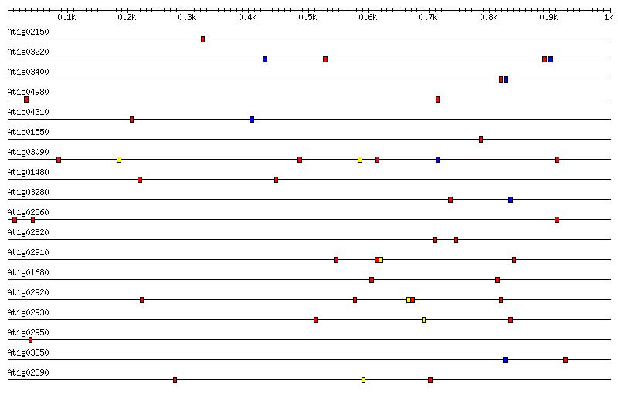
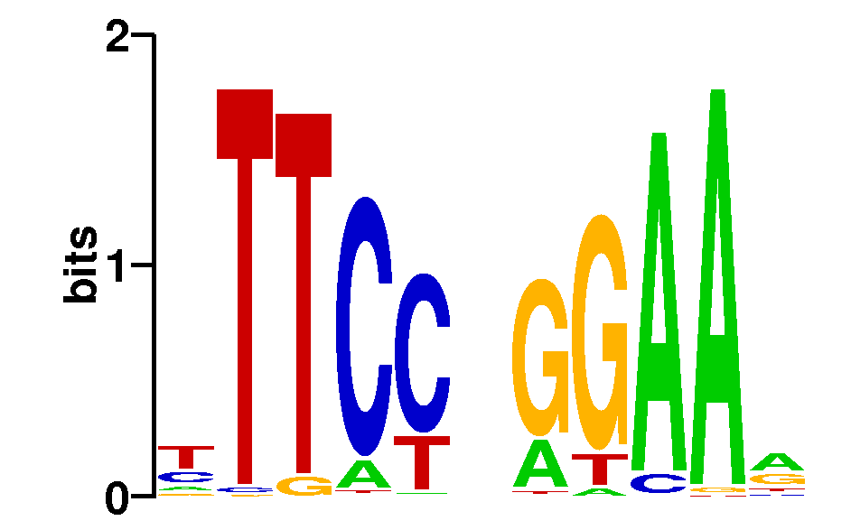
Motif Modeling
What sequence motif do these promoter regions have in common?

Slide 23
cis-Regulatory Modules
What configuration of sequence motifs do these promoter regions have in common?
RNAP
…accgcgctgaaaaaattttccgatgagtttagaagagtcaccaaaaaattttcatacagcctactggtgttctctgtgtgtgctaccactggctgtcatcatggttgta…
…caaaattattcaagaaaaaaagaaatgttacaatgaatgcaaaagatgggcgatgagataaaagcgagagataaaaatttttgagcttaaatgatctggcatgagcagt…
…gagctggaaaaaaaaaaaatttcaaaagaaaacgcgatgagcatactaatgctaaaaatttttgaggtataaagtaacgaattggggaaaggccatcaatatgaagtcg…
RNAP
RNAP

Slide 24
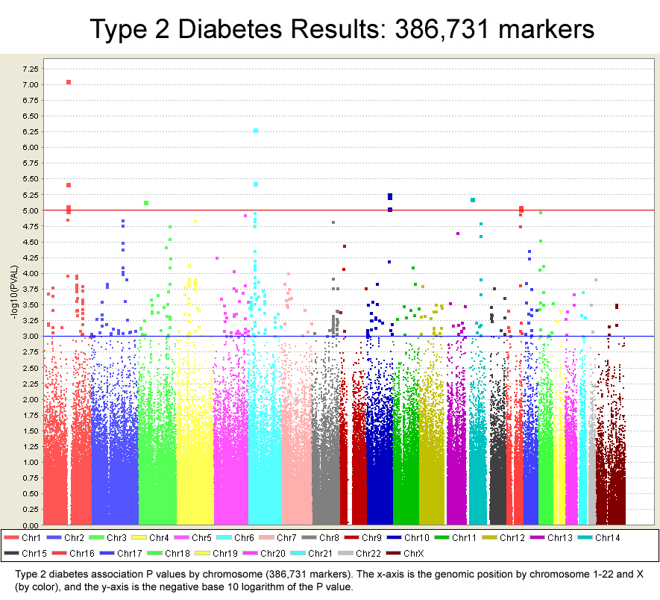
Genome-wide Association Studies
Which genes are involved in diabetes?

Slide 25
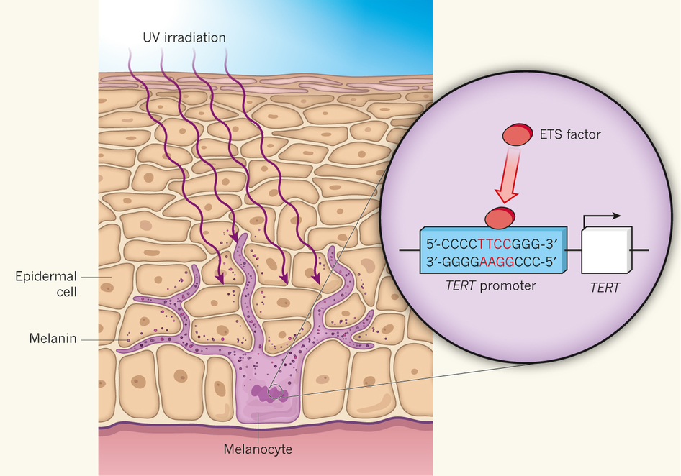
Noncoding Genetic Variants
How do genetic variants outside protein coding regions impact phenotypes?
Patton and Harrington, Nature, 2013

Slide 26
Transcriptome Analysis with RNA-Seq
What genes are expressed and at what levels?

Slide 27
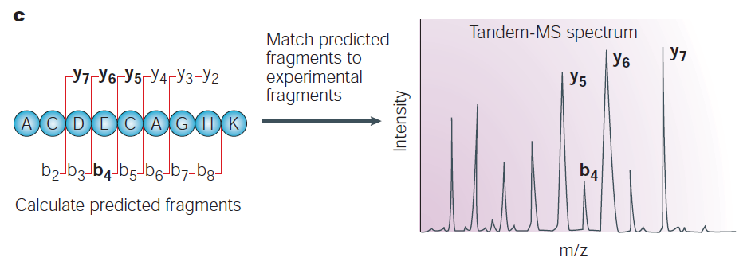
Proteomic Analysis with Mass Spectrometry
What proteins are expressed and at what levels?
Steen and Mann, Nature Reviews Molecular Cell Biology, 2004

Slide 28
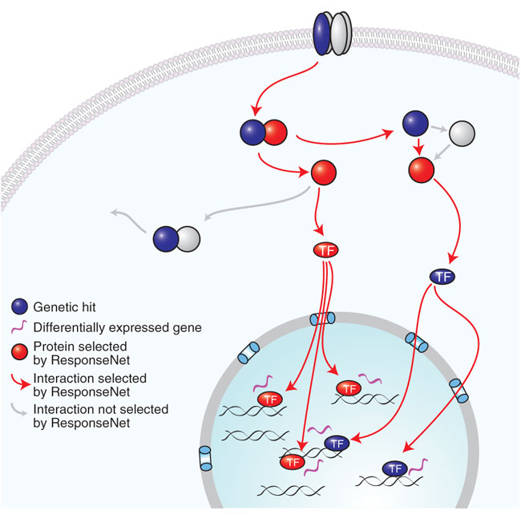
Identifying Signaling Pathways
How do proteins coordinate to transmit information?
Yeger-Lotem et al., Nature Genetics, 2009

Slide 29
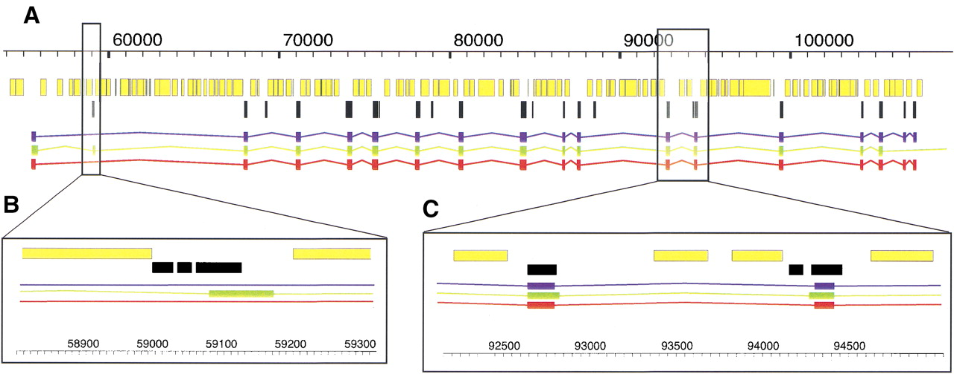
Gene Finding
Where are the genes and functional elements in a genome?

Slide 30
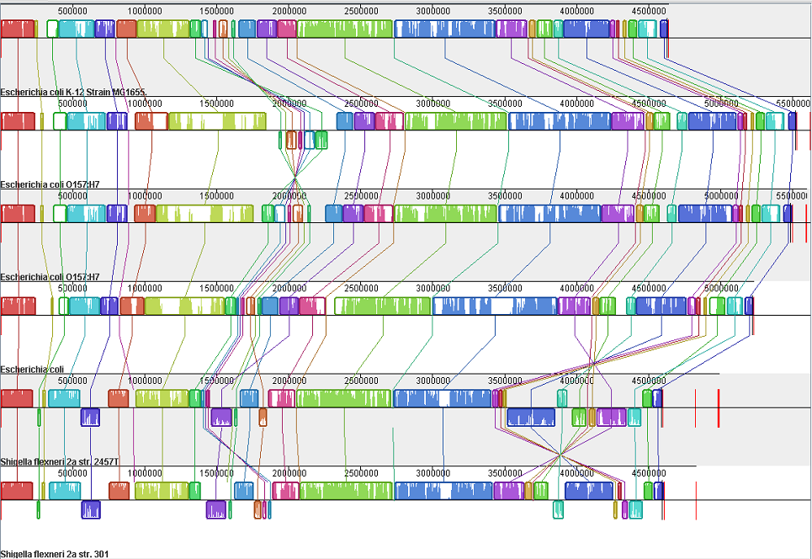
Large Scale Sequence Alignment
What is the best alignment of these 6 genomes?

Slide 31
RNA Sequence and Structure Modeling
How can we identify sequences that encode this RNA structure?

Slide 32
Other Topics
Many topics we aren’t covering
  Protein structure prediction
  Protein function annotation
  Modeling long reads
  Metagenomics
  Metabolomics
  Sequence compression
  Graph genomes
  Single-cell sequencing
  Pseudo- and quasi-alignment
  Text mining
  Others?

Slide 33
Reading Groups
Computational Systems Biology Reading Group
  http://lists.discovery.wisc.edu/mailman/listinfo/compsysbiojc
AI Reading Group
  http://lists.cs.wisc.edu/mailman/listinfo/airg
ComBEE Python Study Group
  https://combee-uw-madison.github.io/studyGroup/
Many relevant seminars on campus

