Slide 1
RNA Secondary Structure Prediction
BMI/CS 776
www.biostat.wisc.edu/bmi776/
Spring 2018
Anthony Gitter
gitter@biostat.wisc.edu
These slides, excluding third-party material, are licensed under CC BY-NC 4.0 by Mark Craven, Colin Dewey, and Anthony Gitter

Slide 2
Goals for Lecture
Key concepts
RNA secondary structure
Secondary structure features: stems, loops, bulges
Pseudoknots
Nussinov algorithm
Adapting Nussinov to take free energy into account

Slide 3
Why RNA is Interesting
Messenger RNA (mRNA) isn’t the only important class of RNA
  ribosomal RNA (rRNA)
    ribosomes are complexes that incorporate several RNA subunits in addition to numerous protein units
  transfer RNA (tRNA)
    transport amino acids to the ribosome during translation
  the spliceosome, which performs intron splicing, is a complex with several RNA units
  microRNAs and others that play regulatory roles
  many viruses (e.g. HIV) have RNA genomes
  guide RNA
    sequence complementary determines whether to cleave DNA
Folding of an mRNA can be involved in regulating the gene’s expression

Slide 4
RNA Secondary Structure
RNA is typically single stranded
Folding, in large part is determined by base-pairing
  A-U and C-G are the canonical base pairs
  other bases will sometimes pair, especially G-U
Base-paired structure is referred to as the secondary structure of RNA
Related RNAs often have homologous secondary structure without significant sequence similarity

Slide 5

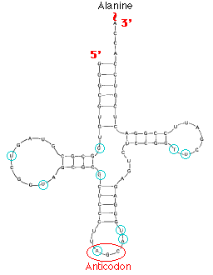
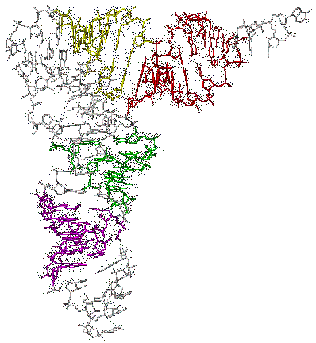
tRNA Secondary Structure
Scitable
tertiary structure

Slide 6
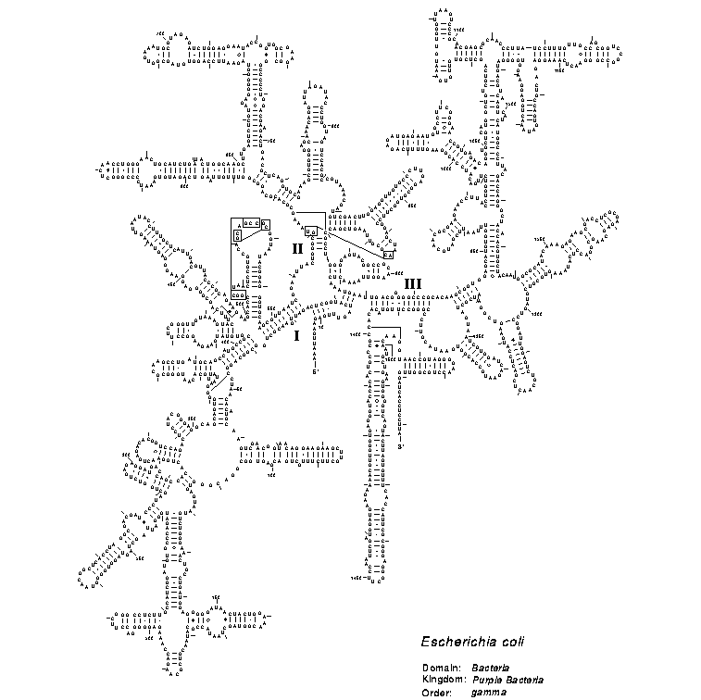
Small Subunit Ribosomal RNA Secondary Structure

Slide 7
6S RNA Secondary Structure

Slide 8
Secondary Structure Features
bulge
stem
hairpin loop
internal loop

Slide 9
Four Key Problems
Focus for today
Predicting RNA secondary structure
  Given: RNA sequence
  Do: predict secondary structure that sequence will fold into
Searching for instances of a given structure
  Given: an RNA sequence or its secondary structure
  Do: find sequences that will fold into a similar structure
Modeling a family of RNAs
  Given: a set of RNA sequences with similar secondary structure
  Do: construct a model that captures the secondary structure regularities of the set
Identifying novel RNA genes
  Given: a pair of homologous DNA sequences
  Do: identify subsequences that appear to have highly conserved RNA secondary structure (putative RNA genes)

Slide 10
RNA Folding Assumption
Algorithms we’ll consider assume that base pairings do not cross
For base-paired positions i, i’ and j, j’, with i < i’ and j < j’, we must have either
  i < i’ < j < j’ or j < j’ < i < i’ (not nested)
  i < j < j’ < i’ or j < i < i’ < j’ (nested)
Can’t have i < j < i’ < j’ or j < i < j’ < i’
i
i’
j
j’
i
j
j’
i’

Slide 11
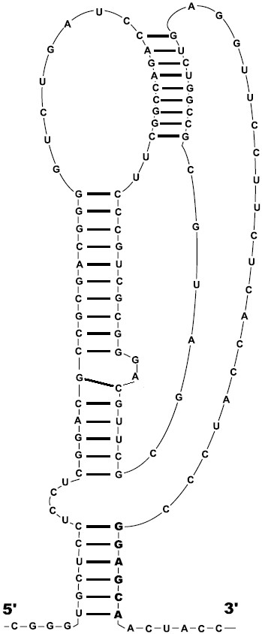
Pseudoknots
pseudoknot
These crossings are called pseudoknots
Dynamic programming breaks down if pseudoknots are allowed
Fortunately, they are not very frequent
Modern software does support them
  Akiyama et al. 2018
Figure from Seliverstov et al. BMC Microbiology, 2005

Slide 12
Simplest RNA Secondary Structure Task
Given:
  An RNA sequence
  The constraint that pseudoknots are not allowed
Do:
  Find a secondary structure for the RNA that maximizes the number of base pairing positions

Slide 13
Predicting RNA Secondary Structure: the Nussinov Algorithm
[Nussinov et al., SIAM Journal of Applied Mathematics 1978]
Key idea:
  Do this using dynamic programming
    start with small subsequences
    progressively work to larger ones

Slide 14
DP in the Nussinov Algorithm
j
 | G | G | G | A | A | A | U | C | C
G
G
G
A
A
A
U
C
C
i
max # of
paired bases in
subsequence [i, j]
Figure 10.8 from textbook

Slide 15
DP in the Nussinov Algorithm
Let
Initialization:
Recursion
max # of
paired bases in
subsequence [i, j]

Slide 16
Nussinov Algorithm Traceback

Slide 17
Predicting RNA Secondary Structure by Energy Minimization
It’s naïve to predict folding just by maximizing the number of base pairs
However, we can generalize the key recurrence relation so that we’re minimizing free energy instead
case that i and j
are base paired

Slide 18
Predicting RNA Secondary Structure by Energy Minimization
A sophisticated program, such as Mfold [Zuker et al.], can take into account free energy of the “local environment” of [i, j]

Slide 19
Predicting RNA Secondary Structure by Energy Minimization
c
a
u
c
u
i+k+1
g
c
j-l-1
u
u
i
c
g
j
c
c
a
u
c
c
a
u
j
i
g
c
a
u
i+k+1
g
c
j-1
u
g
c
c
c
i+1
g
c
j-1
a
u
j
i
i
c
g
j
g
c
a
u

Slide 20
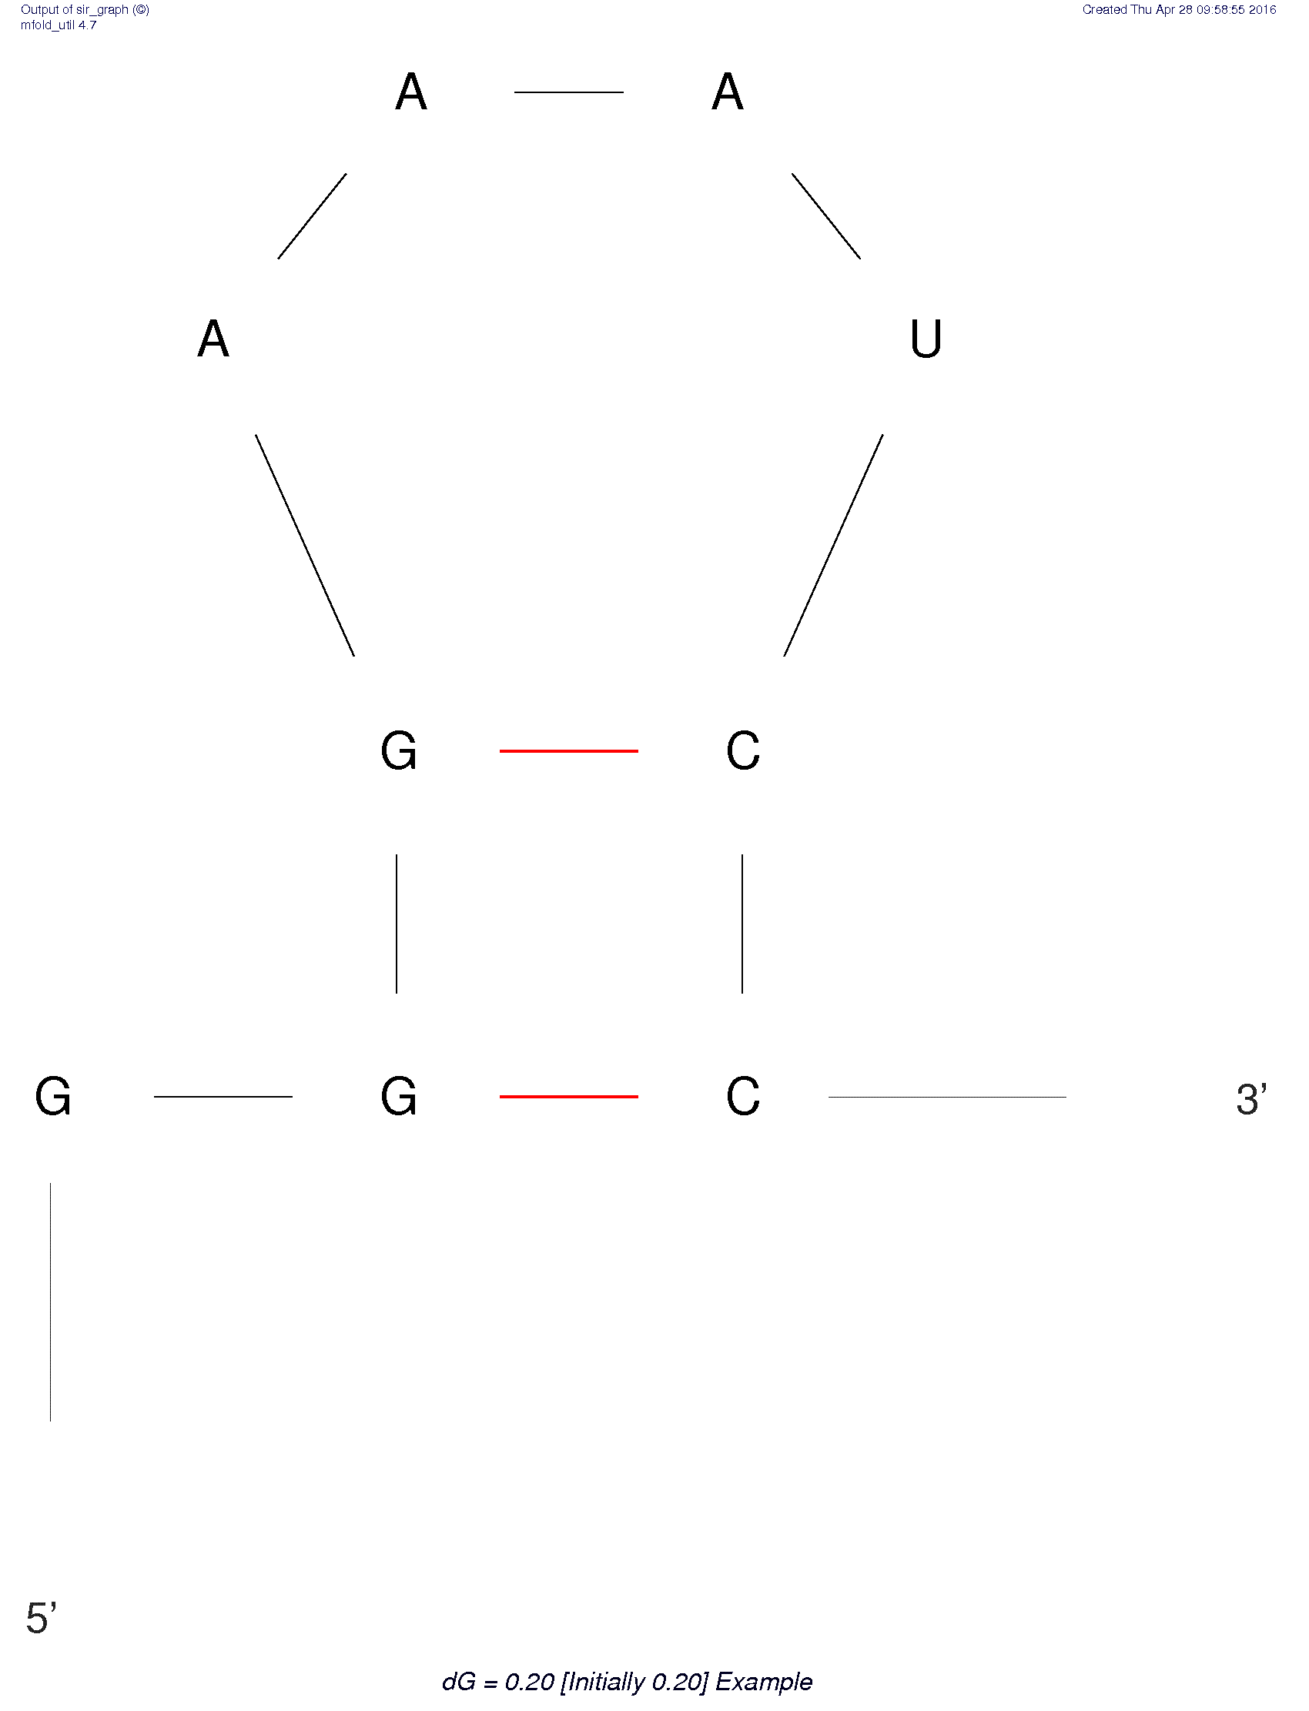
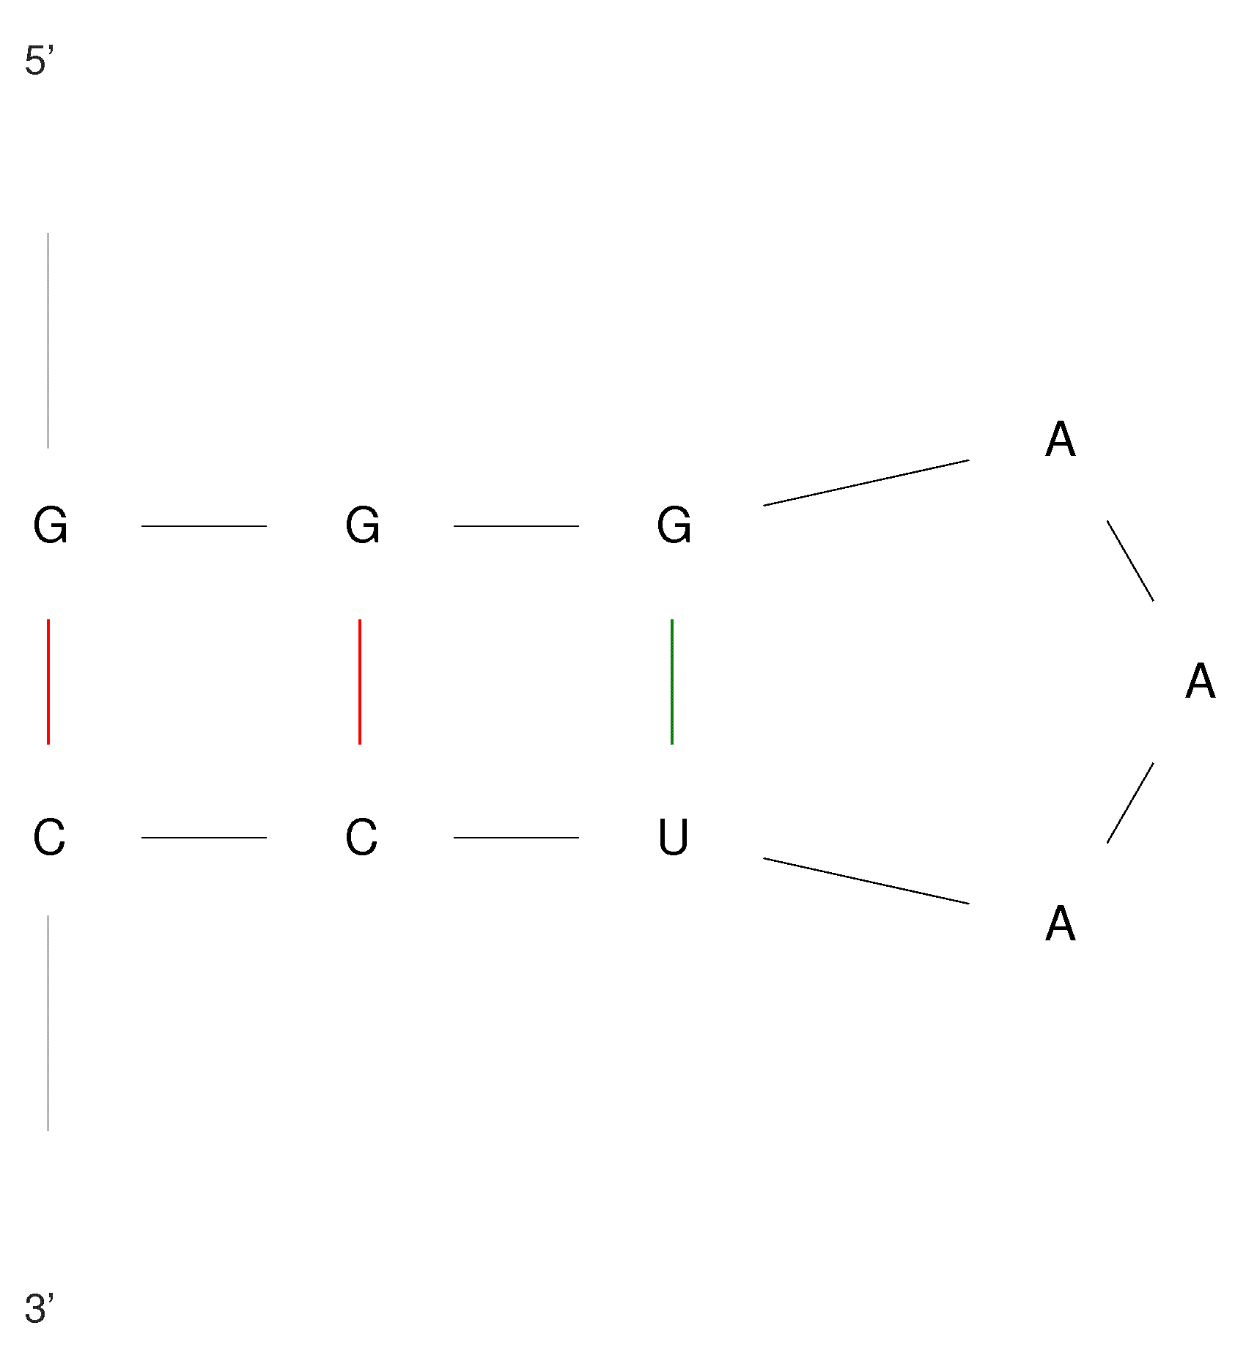
Mfold example
GGGAAAUCC
ΔG = -0.80 kcal/mol
ΔG = 0.20 kcal/mol
http://unafold.rna.albany.edu/

