Slide 1
Identifying Signaling Pathways
BMI/CS 776
www.biostat.wisc.edu/bmi776/
Spring 2018
Anthony Gitter
gitter@biostat.wisc.edu
These slides, excluding third-party material, are licensed under CC BY-NC 4.0 by Anthony Gitter, Mark Craven, Colin Dewey

Slide 2
Goals for lecture
Challenges of integrating high-throughput assays
Connecting relevant genes/proteins with interaction networks
ResponseNet algorithm
Evaluating pathway predictions
Classes of signaling pathway prediction methods

Slide 3
High-throughput screening
Which genes are involved in which cellular processes?
Hit: gene that affects the phenotype
Phenotypes include:
  Growth rate
  Cell death
  Cell size
  Intensity of some reporter
  Many others

Slide 4
Types of screens
Genetic screening
  Test genes individually or in parallel
  Knockout, knockdown (RNA interference), overexpression, CRISPR/Cas genome editing
Chemical screening
  Which genes are affected by a stimulus?

Slide 5
Differentially expressed genes
Compare mRNA transcript levels between control and treatment conditions
Genes whose expression changes significantly are also involved in the cellular process
Alternatively, differential protein abundance or phosphorylation

Slide 6
Interpreting screens
Differentially expressed genes
Screen hits
Very few genes detected in both

Slide 7
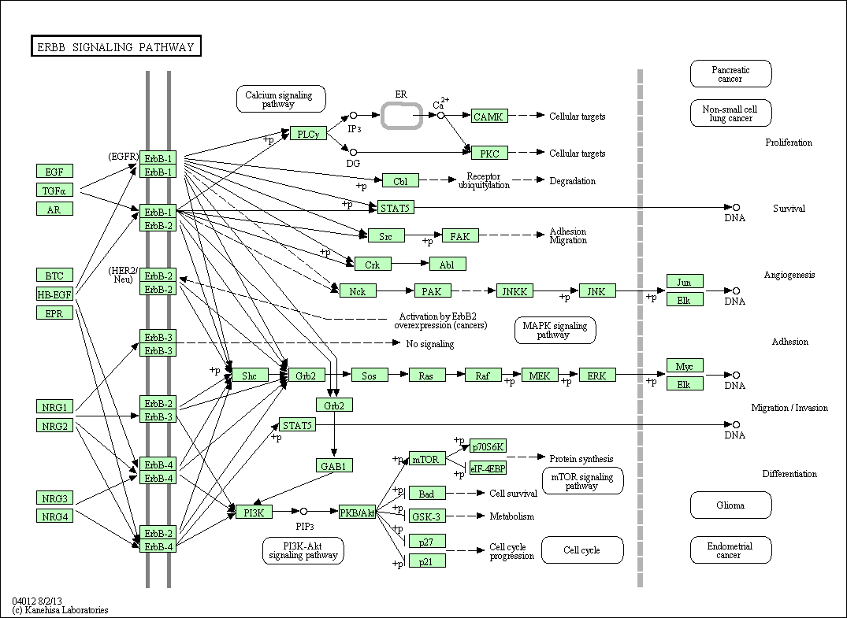
Assays reveal different parts of a cellular process
Database representation of a “pathway”
KEGG

Slide 8
Assays reveal different parts of a cellular process
Differentially expressed genes
Genetic screen hits

Slide 9
Pathways connect the disjoint gene lists
Can’t rely on pathway databases
High-quality, low coverage
Instead learn condition-specific pathways computationally
Combine data with generic physical interaction networks

Slide 10
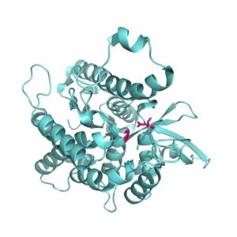
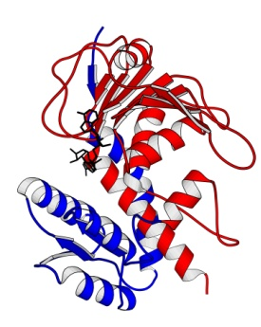

Physical interactions
Protein-protein interactions (PPI)
Metabolic
Protein-DNA (transcription factor-gene)
Genes and proteins are different node types
Prot A
Prot B
Appling
Graz
TF
Gene
Yeger-Lotem2009

Slide 11
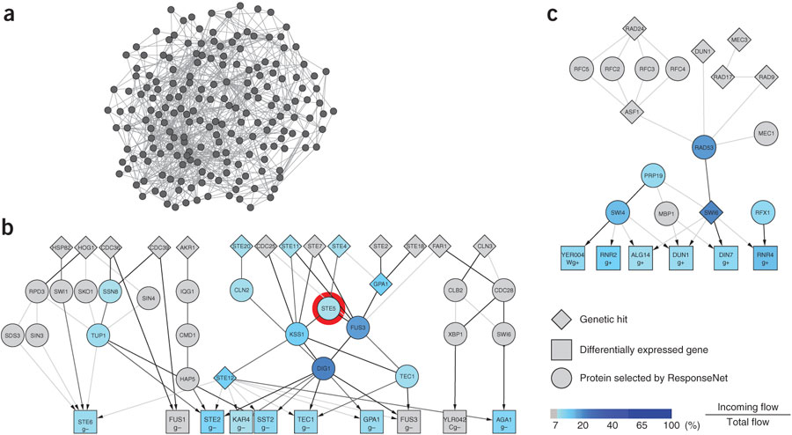
Hairball networks
Networks are highly connected
Can’t use naïve strategy to connect screen hits and differentially expressed genes
Yeger-Lotem2009

Slide 12
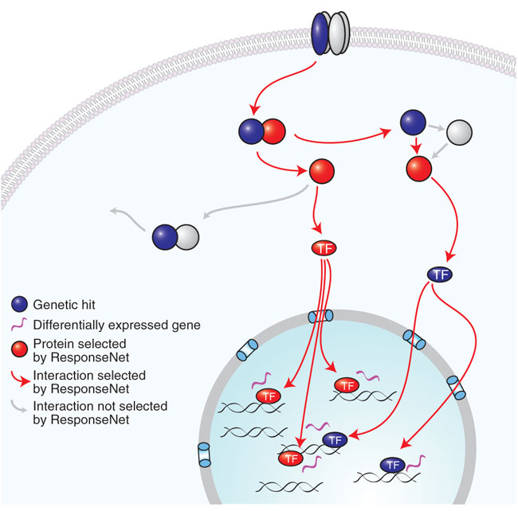
Identify connections within an interaction network
Yeger-Lotem2009

Slide 13
How to define a computational “pathway”
Given:
  Partially directed network of known physical interactions (e.g. PPI, kinase-substrate, TF-gene)
  Scores on source nodes
  Scores on target nodes
Do:
  Return directed paths in the network connecting sources to targets

Slide 14
ResponseNet optimization goals
Connect screen hits and differentially expressed genes
Recover sparse connections
Identify intermediate proteins missed by the screens
Prefer high-confidence interactions
Minimum cost flow formulation can meet these objectives

Slide 15
Construct the interaction network
Protein
Gene

Slide 16
Transform to a flow problem
S
T

Slide 17
Max flow on graphs
Each edge can tolerate different level of flow or have different preference of sending flow along that edge
S
Pump flow from source
Incoming and outgoing flow conserved at each node
T
Flow conserved to target

Slide 18
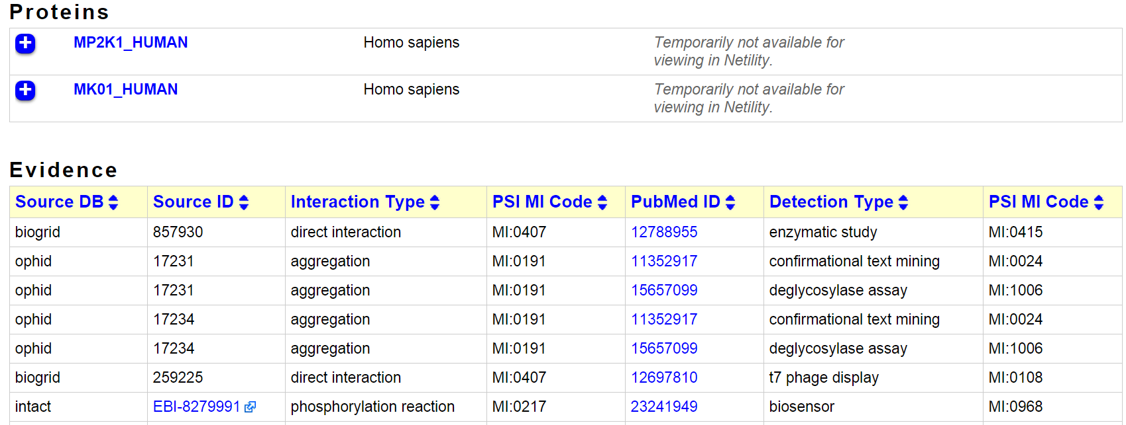
Weighting interactions
Probability-like confidence of the interaction
Example evidence: edge score of 1.0
16 distinct publications supporting the edge
iRefWeb

Slide 19
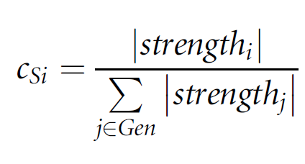
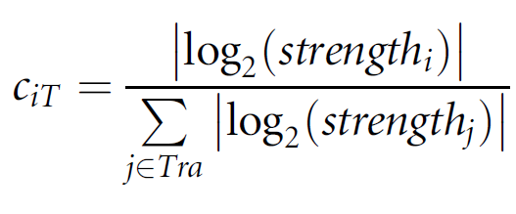
Weights and capacities on edges
S
c_{ij}= 1
Flow capacity
(w_{ij}, c_{ij})
w_{ij} from interaction network confidence
T

Slide 20
Find the minimum cost flow
S
Prefer no flow on the low-weight edges if alternative paths exist
Return the edges with non-zero flow
T

Slide 21
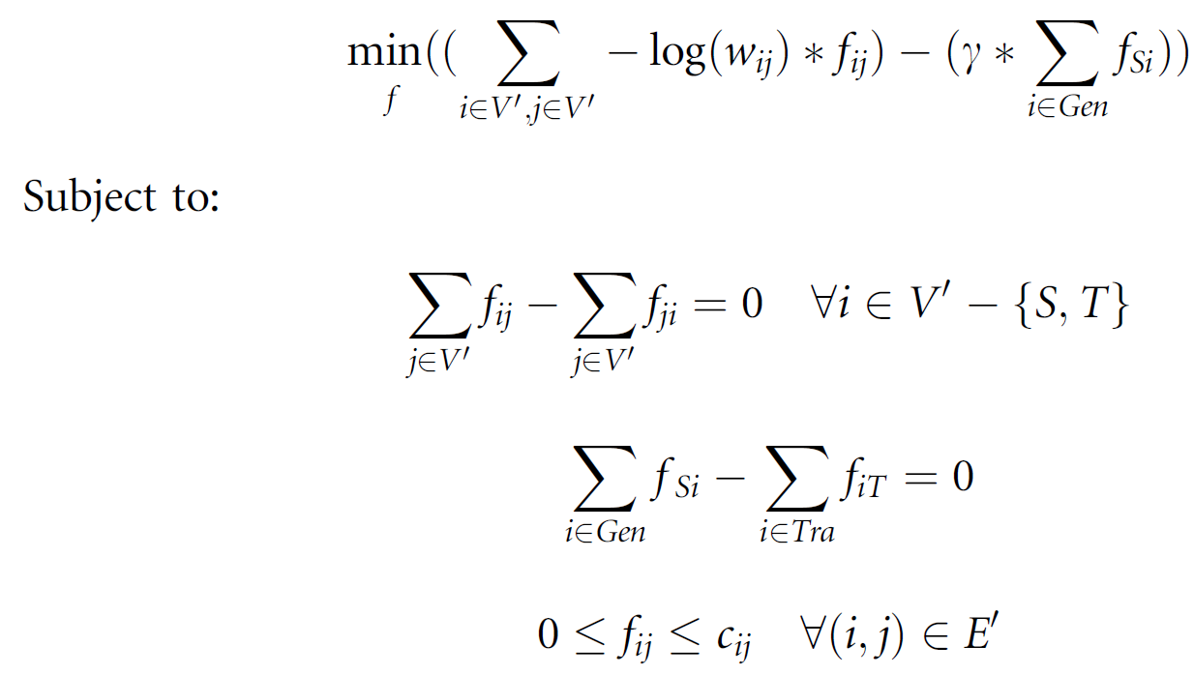
Formal minimum cost flow
Positive flow on an edge incurs a cost
Cost is greater for low-weight edges
Flow on an edge
Parameter controlling the amount of flow from the source

Slide 22
Formal minimum cost flow
Flow coming in to a node equals flow leaving the node

Slide 23
Formal minimum cost flow
Flow leaving the source equals flow entering the target

Slide 24
Formal minimum cost flow
Flow is non-negative and does not exceed edge capacity

Slide 25
Formal minimum cost flow

Slide 26

Linear programming
Optimization problem is a linear program
Canonical form
Polynomial time complexity
Many off-the-shelf solvers
Practical Optimization: A Gentle Introduction
  Introduction to linear programming
  Simplex method
  Network flow
Wikipedia

Slide 27
ResponseNet pathways
Identifies pathway members that are neither hits nor differentially expressed
Ste5 recovered when STE5 deletion is the perturbation

Slide 28
ResponseNet summary
Advantages
  Computationally efficient
  Integrates multiple types of data
  Incorporates interaction confidence
  Identifies biologically plausible networks
Disadvantages
  Direction of flow is not biologically meaningful
  Path length not considered
  Requires sources and targets
  Dependent on completeness and quality of input network

Slide 29
Evaluating pathway predictions
Unlike PIQ, we don’t have a complete gold standard available for evaluation
Can simulate “gold standard” pathways from a network
Compare relative performance of multiple methods on independent data

Slide 30
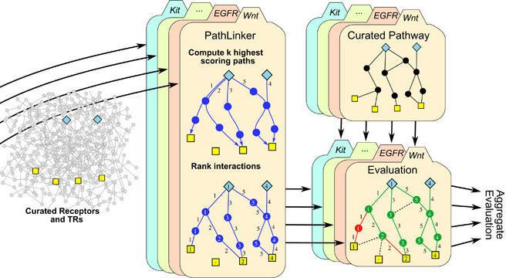
Evaluating pathway predictions
Ritz2016

Slide 31
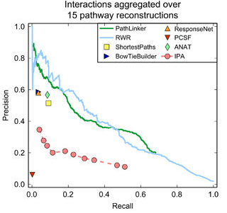
Evaluating pathway predictions
Ritz2016

Slide 32
Evaluating pathway predictions
MacGilvray2018
PR curves can evaluate node or edge recovery but not the global pathway structure

Slide 33
Evaluation beyond pathway databases
Natural language processing can also help semi-automated evaluation
  Literome
  Chilibot
  iHOP

Slide 34
Classes of pathway prediction algorithms
Are edges important?
No
Network diffusion
Yes
Sources and targets?
No
Yes
Steiner tree
Spanning tree
Next slide…

Slide 35
Classes of pathway prediction algorithms
Have sources and targets
What path properties are important?
Total path length or score
Shortest paths
Total source-target connectivity
Network flow
Connectivity in minimum cost network
Steiner tree
Complex properties
Integer program
Symbolic solver
Graphical model

Slide 36
Alternative pathway identification algorithms
k-shortest paths
  Ruths2007
  Shih2012
Random walks / network diffusion / circuits
  Tu2006
  eQTL electrical diagrams (eQED)
  HotNet
Integer programs
  Signaling-regulatory Pathway INferencE (SPINE)
  Chasman2014

Slide 37
Alternative pathway identification algorithms
Path-based objectives
  Physical Network Models (PNM)
  Maximum Edge Orientation (MEO)
  Signaling and Dynamic Regulatory Events Miner (SDREM)
Steiner tree
  Prize-collecting Steiner forest (PCSF)
  Belief propagation approximation (msgsteiner)
  Omics Integrator implementation
Hybrid approaches
  PathLinker: random walk + shortest paths
  ANAT: shortest paths + Steiner tree

Slide 38
Recent developments in pathway discovery
Multi-task learning: jointly model several related biological conditions
  ResponseNet extension: SAMNet
  Steiner forest extension: Multi-PCSF
  SDREM extension: MT-SDREM
Temporal data
  ResponseNet extension: TimeXNet
  Steiner forest extension and ST-Steiner
  Temporal Pathway Synthesizer

Slide 39
Condition-specific genes/proteins used as input
Genetic screen hits (as causes or effects)
Differentially expressed genes
Transcription factors inferred from gene expression
Proteomic changes (protein abundance or post-translational modifications)
Kinases inferred from phosphorylation
Genetic variants or DNA mutations
Enzymes regulating metabolites
Receptors or sensory proteins
Protein interaction partners
Pathway databases or other prior knowledge

