Slide 1
Interpolated Markov Models for Gene Finding
BMI/CS 776
www.biostat.wisc.edu/bmi776/
Spring 2018
Anthony Gitter
gitter@biostat.wisc.edu
These slides, excluding third-party material, are licensed under CC BY-NC 4.0 by Mark Craven, Colin Dewey, and Anthony Gitter

Slide 2
Goals for Lecture
Key concepts
the gene-finding task
the trade-off between potential predictive value and parameter uncertainty in choosing the order of a Markov model
interpolated Markov models

Slide 3
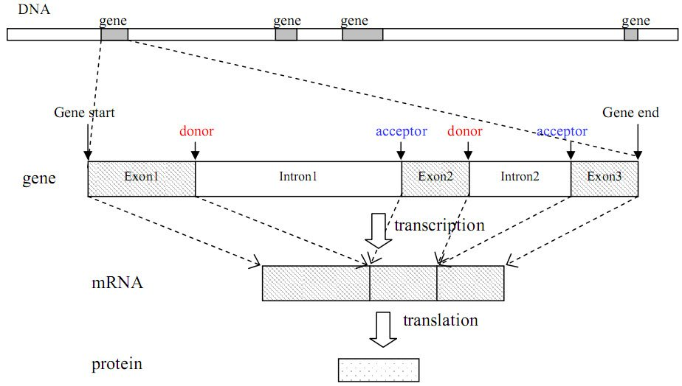
The Gene Finding Task
Given: an uncharacterized DNA sequence
Do: locate the genes in the sequence, including the coordinates of individual exons and introns

Slide 4
Sources of Evidence for Gene Finding
Signals: the sequence signals (e.g. splice junctions) involved in gene expression
Content: statistical properties that distinguish protein-coding DNA from non-coding DNA
Conservation: signal and content properties that are conserved across related sequences (e.g. orthologous regions of the mouse and human genome)

Slide 5
Gene Finding: Search by Content
Encoding a protein affects the statistical properties of a DNA sequence
  some amino acids are used more frequently than others (Leu more prevalent than Trp)
  different numbers of codons for different amino acids (Leu has 6, Trp has 1)
  for a given amino acid, usually one codon is used more frequently than others
    this is termed codon preference
    these preferences vary by species

Slide 6
Codon Preference in E. Coli
AA codon /1000
----------------------
Gly GGG 1.89
Gly GGA 0.44
Gly GGU 52.99
Gly GGC 34.55
Glu GAG 15.68
Glu GAA 57.20
Asp GAU 21.63
Asp GAC 43.26

Slide 7
Reading Frames
A given sequence may encode a protein in any of the six reading frames
G C T A C G G A G C T T C G G A G C
C G A T G C C T C G A A G C C T C G

Slide 8
Open Reading Frames (ORFs)
An ORF is a sequence that
  starts with a potential start codon
  ends with a potential stop codon, in the same reading frame
  doesn’t contain another stop codon in-frame
  and is sufficiently long (say > 100 bases)
An ORF meets the minimal requirements to be a protein-coding gene in an organism without introns
G T T A T G G C T • • • T C G T G A T T

Slide 9
Markov Models & Reading Frames
Consider modeling a given coding sequence
For each “word” we evaluate, we’ll want to consider its position with respect to the reading frame we’re assuming
reading frame
G C T A C G G A G C T T C G G A G C
G C T A C G
G is in 3rd codon position
C T A C G G
G is in 1st position
T A C G G A
A is in 2nd position
Can do this using an inhomogeneous model

Slide 10
Inhomogeneous Markov Model
Homogenous Markov model: transition probability matrix does not change over time or position
Inhomogenous Markov model: transition probability matrix depends on the time or position

Slide 11

Higher Order Markov Models
Higher order models remember more “history”
Additional history can have predictive value
Example:
  predict the next word in this sentence fragment “…you__” (are, give, passed, say, see, too, …?)
  now predict it given more history
“…can you___”
“…say can you___”
“…oh say can you___”
YouTube

Slide 12
A Fifth Order Inhomogeneous Markov Model
AAAAA
CTACA
CTACC
start
CTACG
CTACT
GCTAC
TTTTT
position 2

Slide 13
A Fifth Order Inhomogeneous Markov Model
AAAAA
AAAAA
AAAAA
CTACA
CTACA
CTACA
CTACC
CTACC
start
CTACG
CTACG
TACAA
CTACT
CTACT
Trans.
to states
in pos. 2
TACAC
TACAG
GCTAC
GCTAC
TACAT
TTTTT
TTTTT
TTTTT
position 2
position 3
position 1

Slide 14
Selecting the Order of a
Markov Model
But the number of parameters we need to estimate grows exponentially with the order
  for modeling DNA we need parameters for an nth order model
The higher the order, the less reliable we can expect our parameter estimates to be
Suppose we have 100k bases of sequence to estimate parameters of a model
  for a 2nd order homogeneous Markov chain, we’d see each history 6250 times on average
  for an 8th order chain, we’d see each history ~ 1.5 times on average

Slide 15
Interpolated Markov Models
The IMM idea: manage this trade-off by interpolating among models of various orders
Simple linear interpolation:
where

Slide 16
Interpolated Markov Models
We can make the weights depend on the history
  for a given order, we may have significantly more data to estimate some words than others
General linear interpolation
λ is a function of
the given history

Slide 17
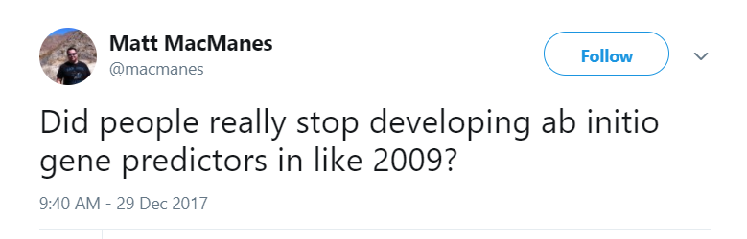
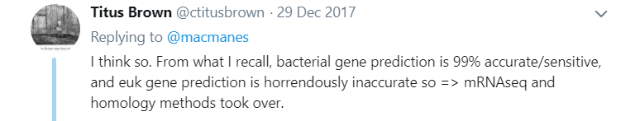
The GLIMMER System
[Salzberg et al., Nucleic Acids Research, 1998]
System for identifying genes in bacterial genomes
Uses 8th order, inhomogeneous, interpolated Markov models

Slide 18
IMMs in GLIMMER
How does GLIMMER determine the values?
First, let’s express the IMM probability calculation recursively
Let be the number of times we see the history in our training set

Slide 19
IMMs in GLIMMER
If we haven’t seen more than 400 times, then compare the counts for the following:
nth order history + base
(n-1)th order history + base
Use a statistical test to assess whether the distributions of depend on the order

Slide 20
IMMs in GLIMMER
nth order history + base
(n-1)th order history + base
Null hypothesis in test: distribution is independent of order
Define
If is small we don’t need the higher order history

Slide 21
IMMs in GLIMMER
Putting it all together
where

Slide 22
IMM Example
Suppose we have the following counts from our training set
ACGA 25
ACGC 40
ACGG 15
ACGT 20
___
100
CGA 100
CGC 90
CGG 35
CGT 75
___
300
GA 175
GC 140
GG 65
GT 120
___
500
χ² test: d = 0.857
χ² test: d = 0.140
λ₃(ACG) = 0.857 × 100/400 = 0.214
λ₂(CG) = 0 (d < 0.5, c(CG) < 400)
λ₁(G) = 1 (c(G) > 400)

Slide 23
IMM Example (Continued)
Now suppose we want to calculate

Slide 24
Gene Recognition in GLIMMER
Essentially ORF classification
For each ORF
  calculate the probability of the ORF sequence in each of the 6 possible reading frames
  if the highest scoring frame corresponds to the reading frame of the ORF, mark the ORF as a gene
For overlapping ORFs that look like genes
  score overlapping region separately
  predict only one of the ORFs as a gene

Slide 25
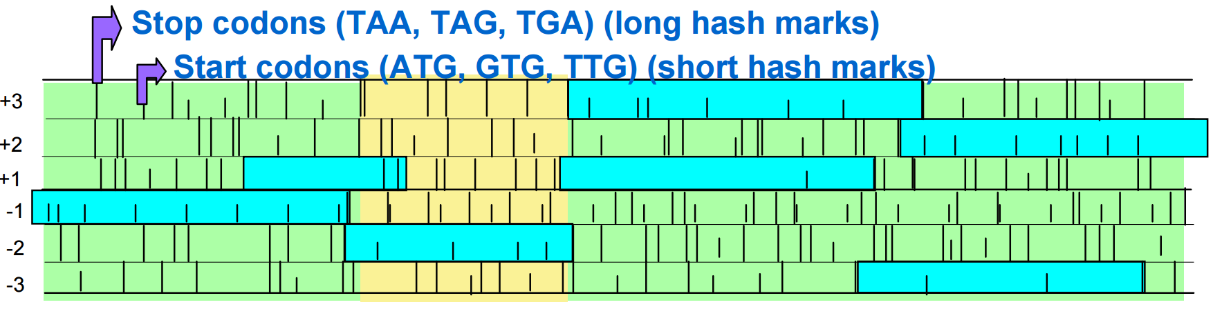
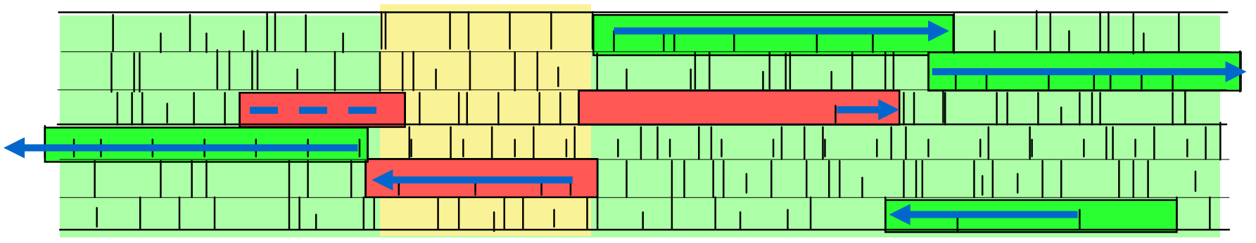
Gene Recognition in GLIMMER
ORF meeting length requirement
JCVI
Low scoring ORF
High scoring ORF

Slide 26
GLIMMER Experiment
8th order IMM vs. 5th order Markov model
Trained on 1168 genes (ORFs really)
Tested on 1717 annotated (more or less known) genes

Slide 27
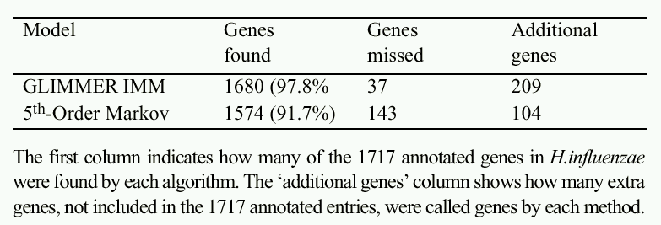
GLIMMER Results
TP
FN
FP & TP?
GLIMMER has greater sensitivity than the baseline
It’s not clear whether its precision/specificity is better

